Slide 1
AI as a Course content assistant
Rachael Hutchings
PIR, Woodbury school of business

Slide 2
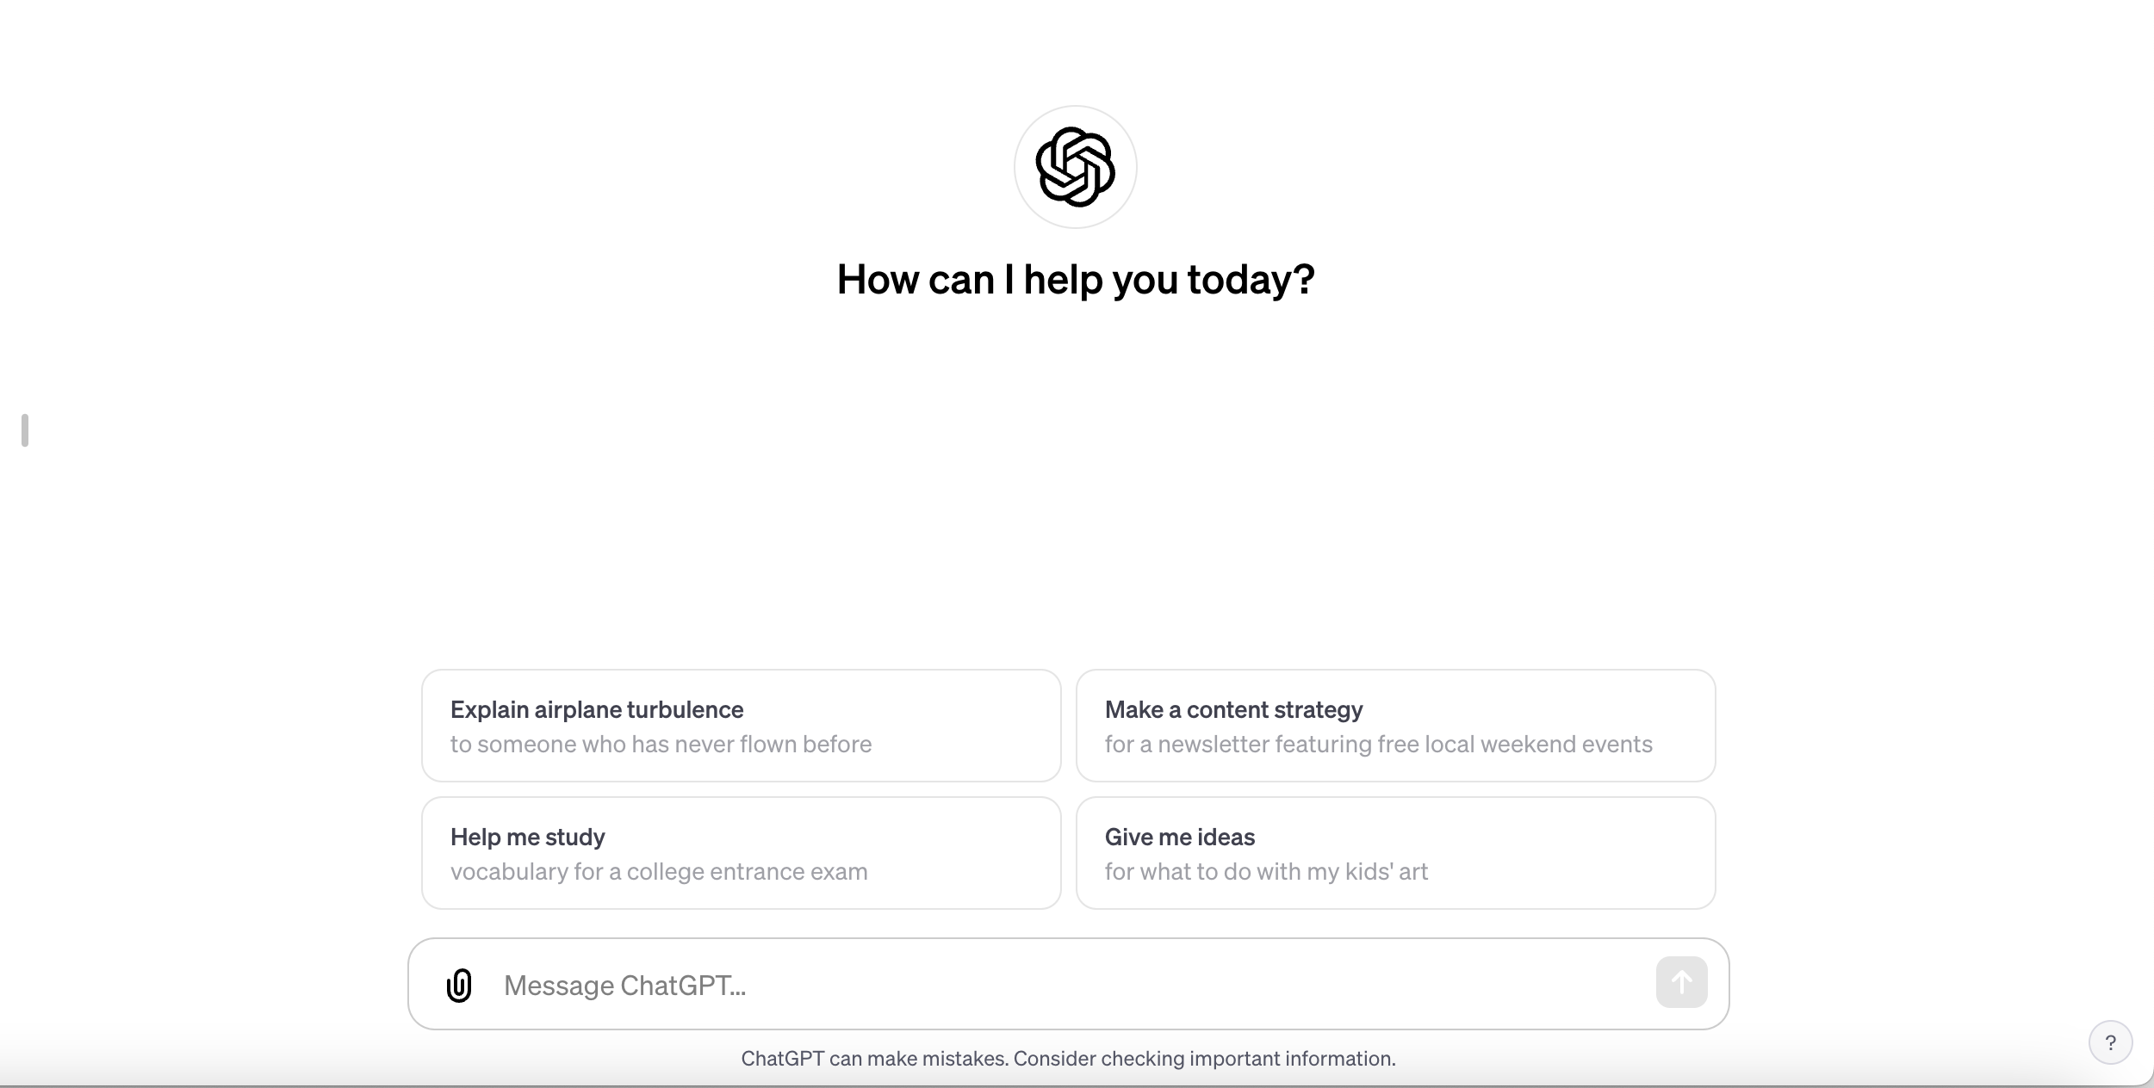
NEW COURSE OUTLINE
Use generative AI as a creative assistant to help you brainstorm an outline of topics for a new course, or help you reimagine or redo a course you have previously taught.

Slide 3
NEW COURSE OUTLINE
Make sure to include a detailed prompt that outlines exactly what you want your AI assistant to do. The more specific you are, the better the output will be.
A basic template could look like this:
Act as [persona you want ChatGPT to simulate].
I am [persona who's giving instructions].
I want you to [task].
Constraints: (What difficulty level do you want the content to be? Are there keywords or topics that you want included? Etc.)
• [constraint 1]
• [constraint 2]
• [constraint 3]
Output format:
• [format instruction 1]
• [format instruction 2]

Slide 4
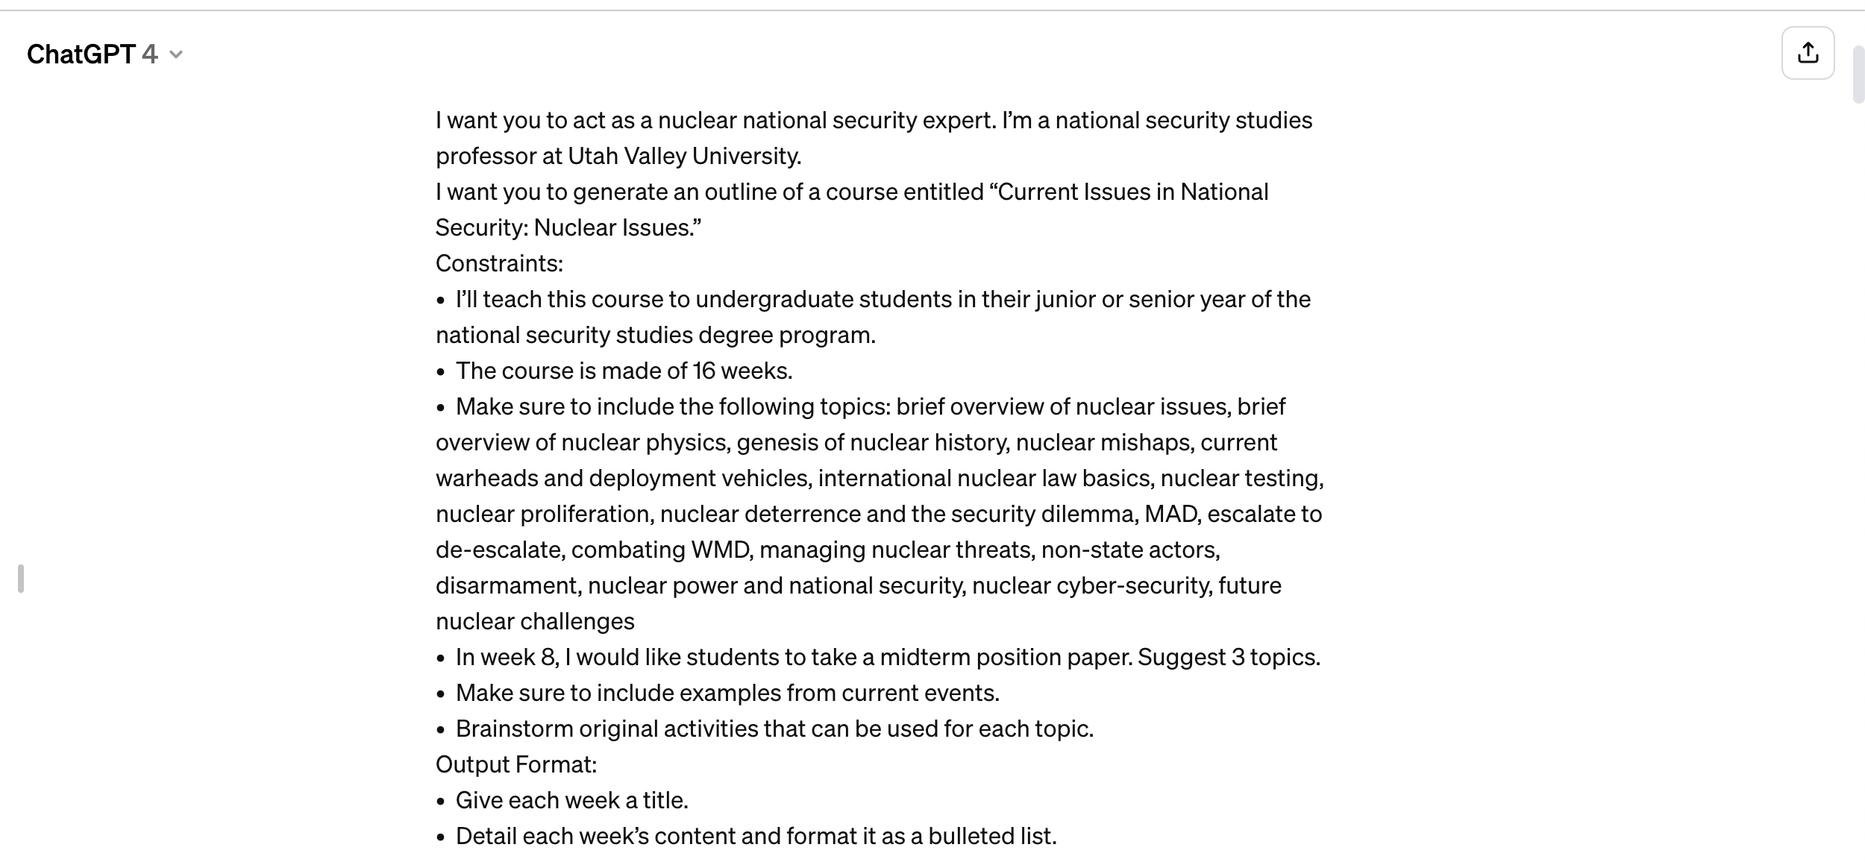
NEW COURSE OUTLINE
Ex: National Security Studies current topics course about nuclear issues.

Slide 5
NEW COURSE OUTLINE
Video clip: Results of the output for the Nuclear Issues course.

Slide 6
NEW COURSE OUTLINE
After receiving the initial output, you can ask it to generate a new result, or several, so you get multiple ideas, or you can ask your AI assistant to change something, or you can ask for more detail.

Slide 7
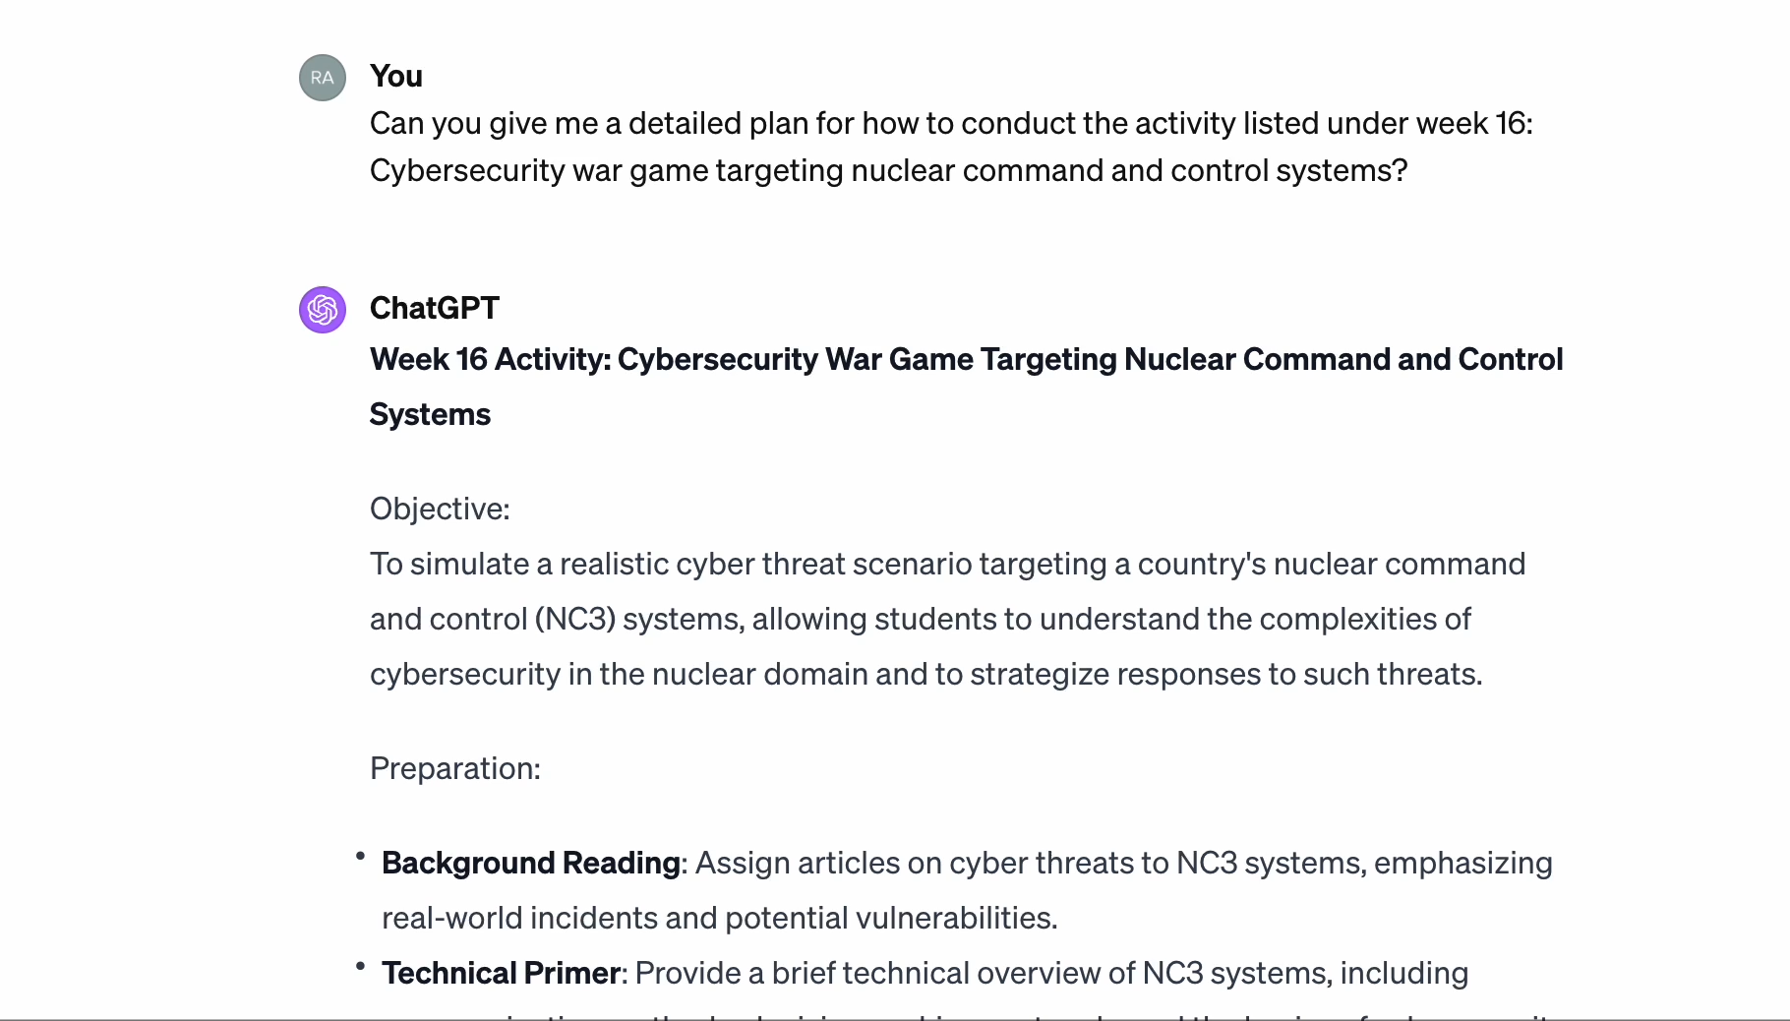
NEW COURSE content
*Advice: Use the same prompt on different platforms. You will receive different information and oftentimes one platform will be better than others. For example, I wanted ideas on how to conduct one of the activity ideas given for my Nuclear Issues course. The information generated by ChatGPT was much more detailed than the information generated by Copilot.

Slide 8
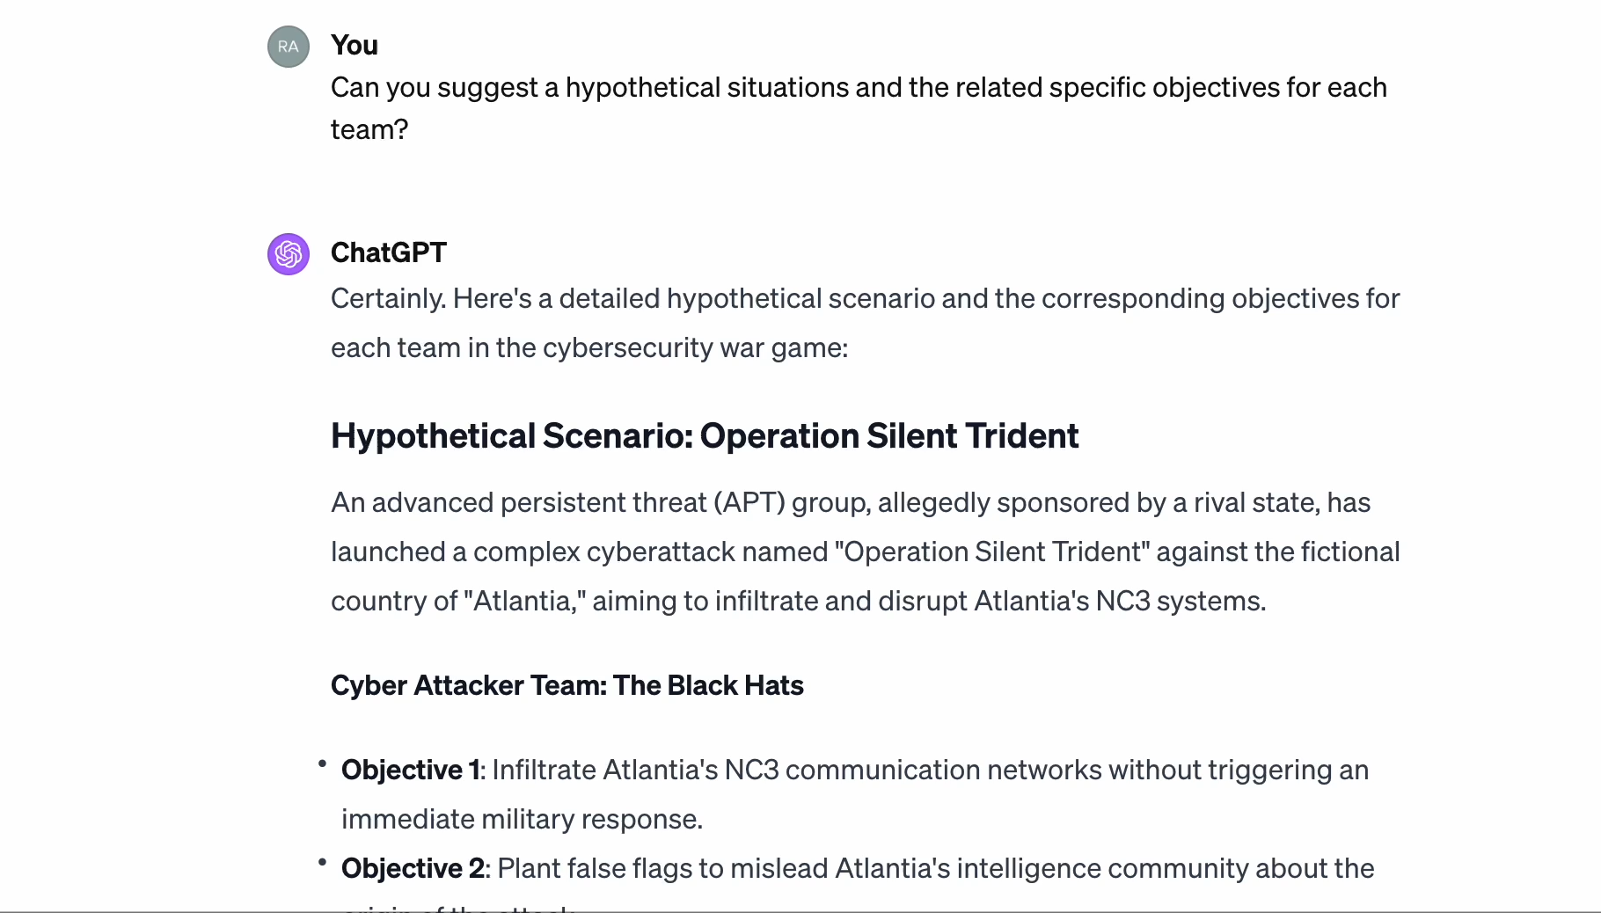
NEW COURSE CONTENT
*ChatGPT generated activity instructions, cont’d.

Slide 9
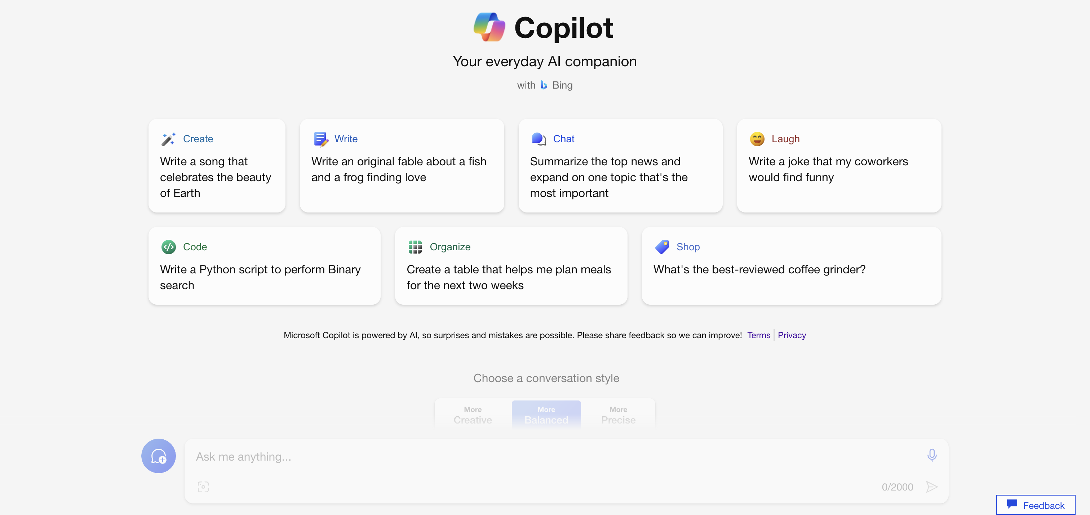
NEW COURSE CONTENT
*Use your AI assistant to help you search for YouTube videos about different topics to augment different lectures. I like Copilot for this purpose. The links won’t always be accurate, but hey, you will need to look at them anyways to see if the suggested videos are event helpful for what you need.

Slide 10
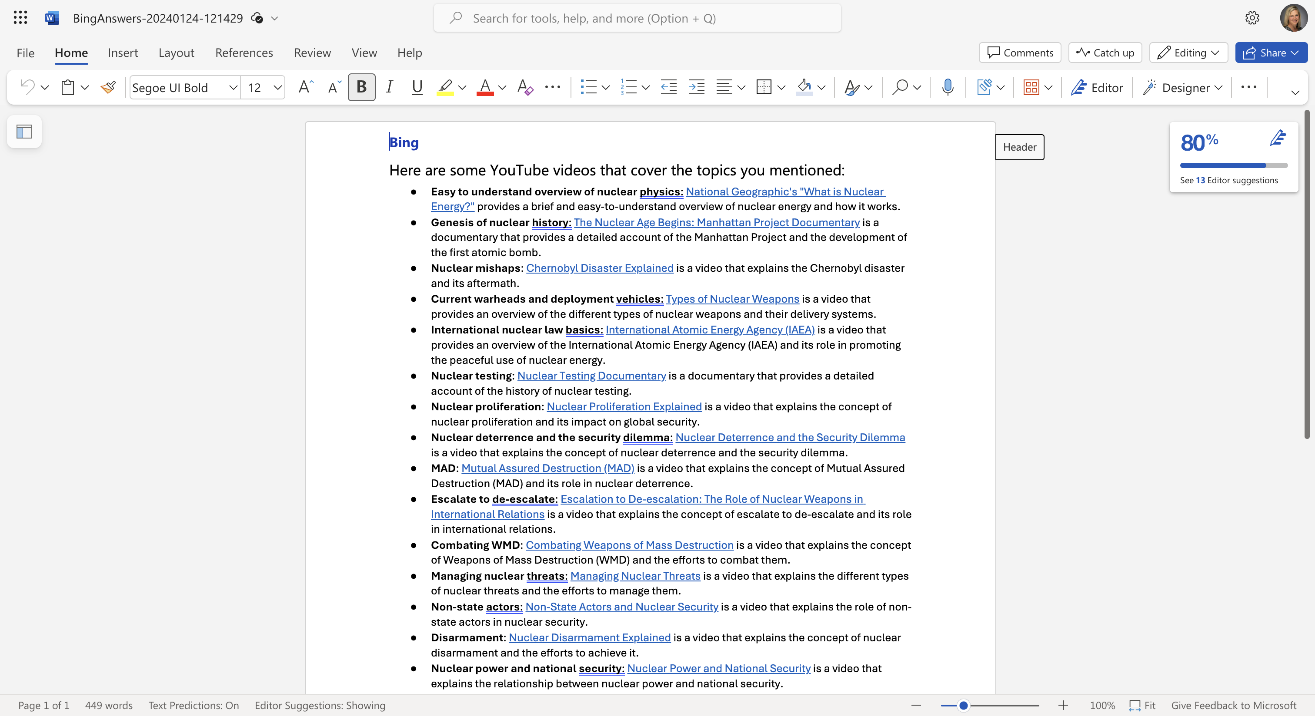
NEW COURSE CONTENT
*Example of a Copilot generated YouTube video list.

Slide 11
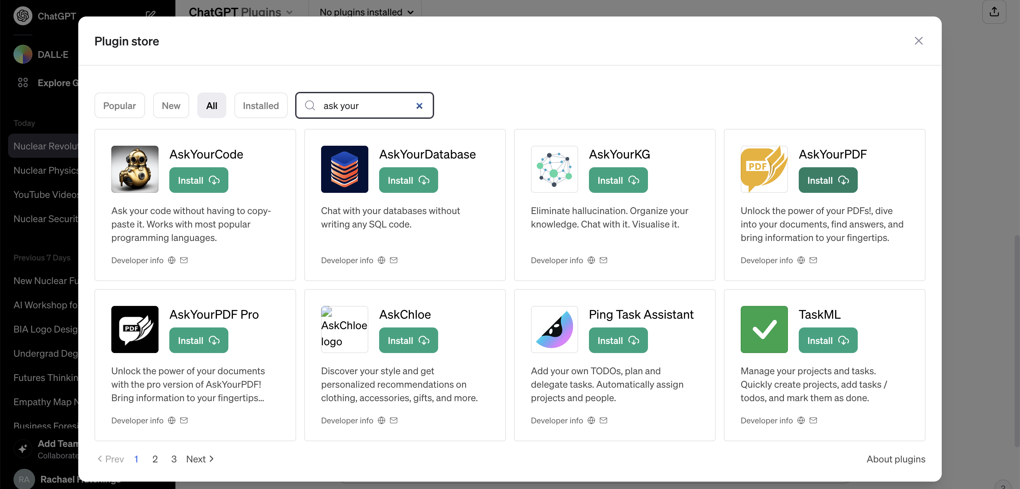
POWERPOINT SLIDES
*Use your AI assistant to help you generate PowerPoint slides. There are multiple ways you could do this. You could prompt your assistant to generate the text for PowerPoint slides from the material provided, then copy and paste your lecture notes. You could use a ChatGPT plugikn, such as “AskYourPDF” and upload a PDF copy of your lecture notes, to avoid copying and pasting.

Slide 12
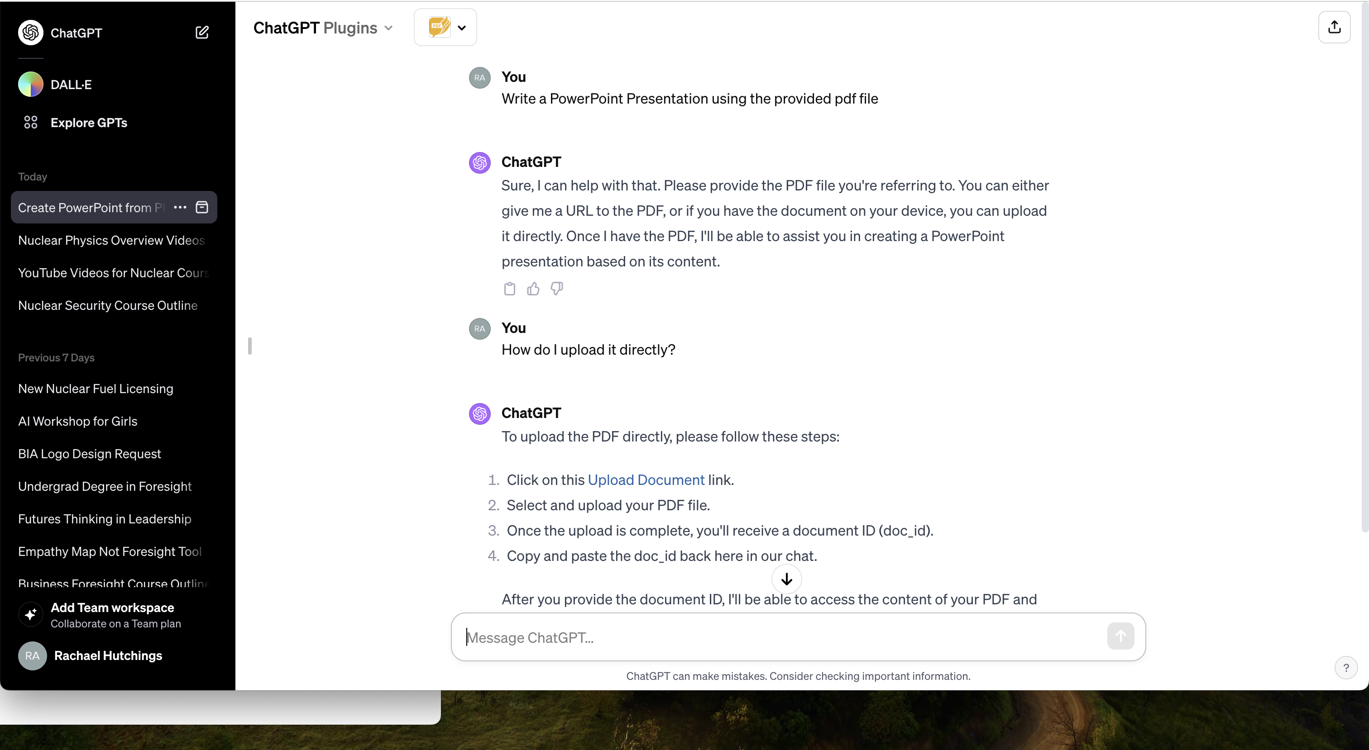
POWERPOINT SLIDES

Slide 13
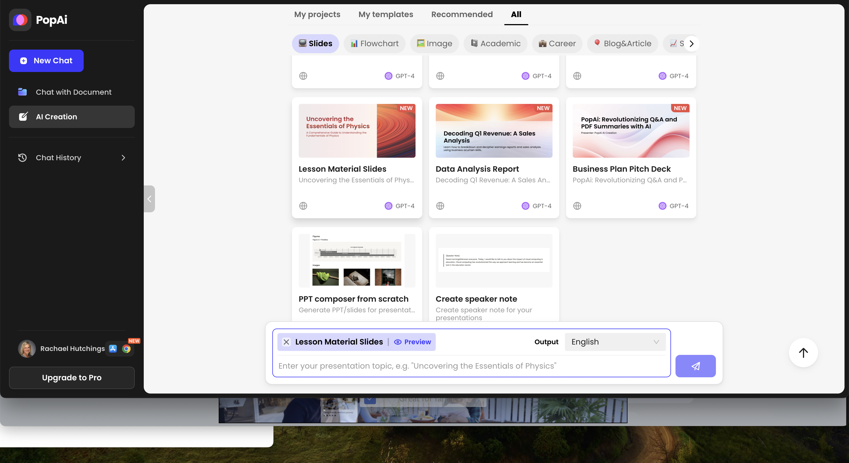
POWERPOINT SLIDES
*Or you could use a platform, such as PopAi (currently my favorite), to generate slides that include not only the text, but the actual slides with suggested layouts, pictures, and backgrounds.

Slide 14
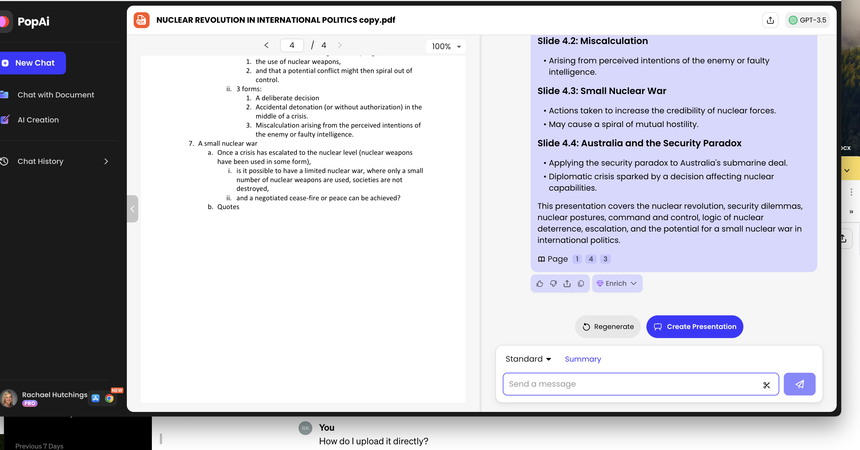
PowerPoint slides

Slide 15
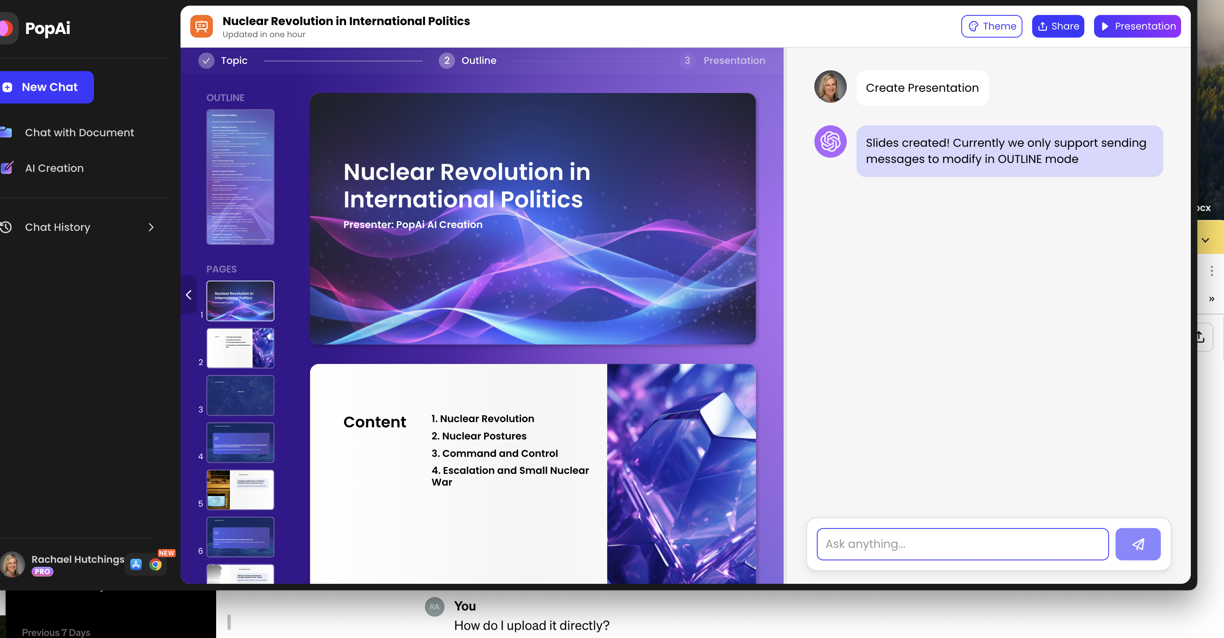
PowerPoint slides
*Once your slides have been generated, you can try different looks, then export them as a .pptx filed.

Slide 16
PowerPoint slides
*After you export your slides, you can then edit them in PowerPoint, like any a normal PowerPoint file.

