Slide 1
DIGITAL
TRANSFORMATION
CHANGE IN ACTION
CHRISTINA BAUM Vice President & CIO

Slide 2
Today’s Agenda
Overview of Generative AI
Concerns with Gen AI
UVU’s Enterprise Option - Microsoft Copilot
Hands-on Walk through/Demo
Q&A

Slide 3
Generative AI

Slide 4
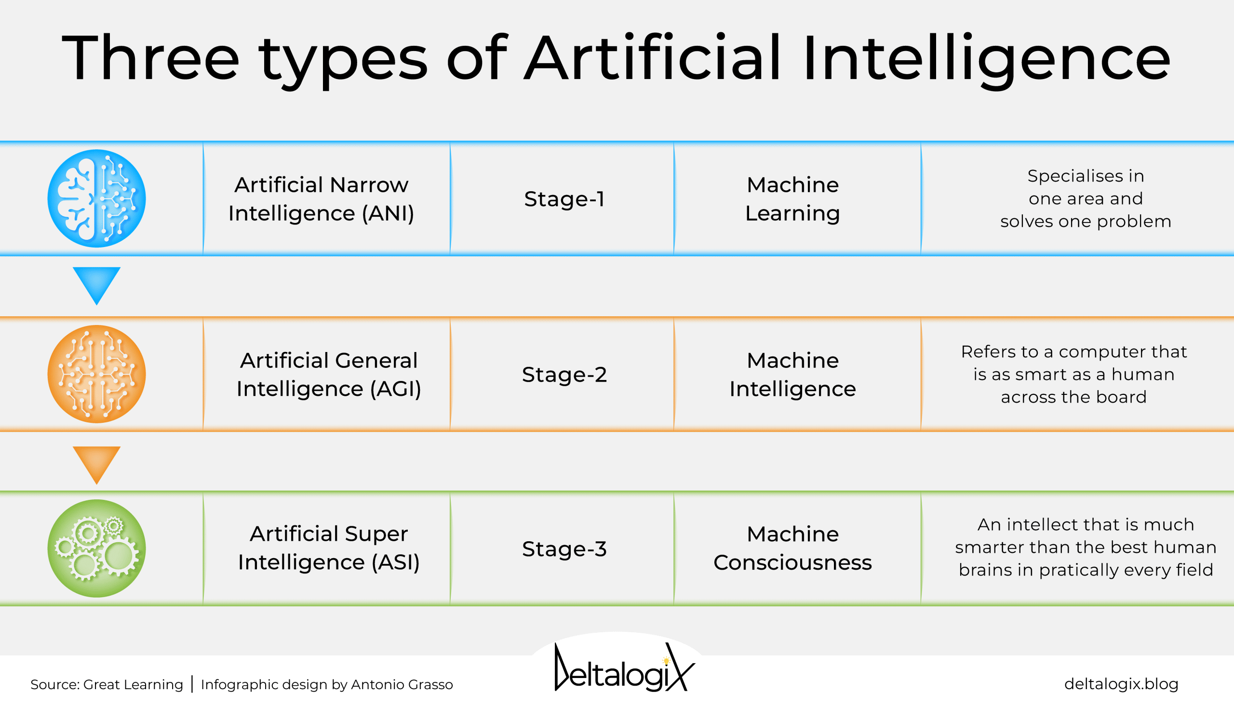

Slide 5
What is Generative AI?
Create new and original content (e.g., papers, chat responses, designs, synthetic data, deep fakes, code, images, etc.)
Large Language Models (LLMs) trained on vast amounts of content

Slide 6
A text predictor on steroids…
Once upon…
a time…
Four score…
and seven years ago…
To be, or…
not to be…

Slide 7
Timeline
November 30, 2022 – OpenAI releases ChatGPT (GPT-3.5)
February 2, 2023 – ChatGPT reaches 100 million users

Slide 8
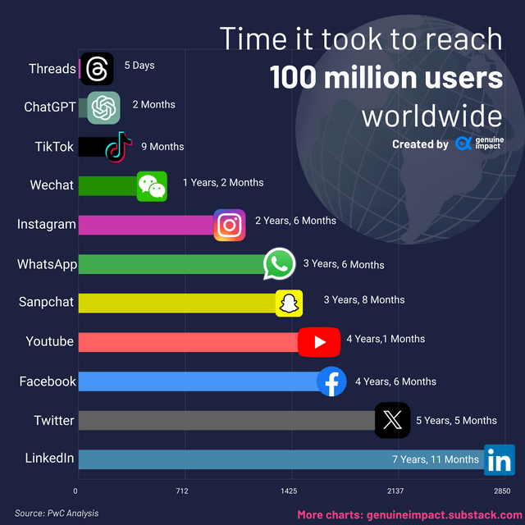

Slide 9
Timeline
November 30, 2022 – OpenAI releases ChatGPT (GPT-3.5)
February 2, 2023 – ChatGPT reaches 100 million users
March 14, 2023 – ChatGPT 4 releases
November 1, 2023 – Microsoft announces Copilot for Microsoft 365 (paid version)
November 15, 2023 - Dx Announces “Bing Chat Enterprise” at the Data Summit
November 15, 2023 – Microsoft announces the name change of Bing Chat Enterprise to Copilot
January 15, 2024 - Microsoft announces a new product, Copilot Pro
January 15, 2024 – Microsoft removes the 300-seat minimum for Copilot for Microsoft 365 ($30/user/month)

Slide 10
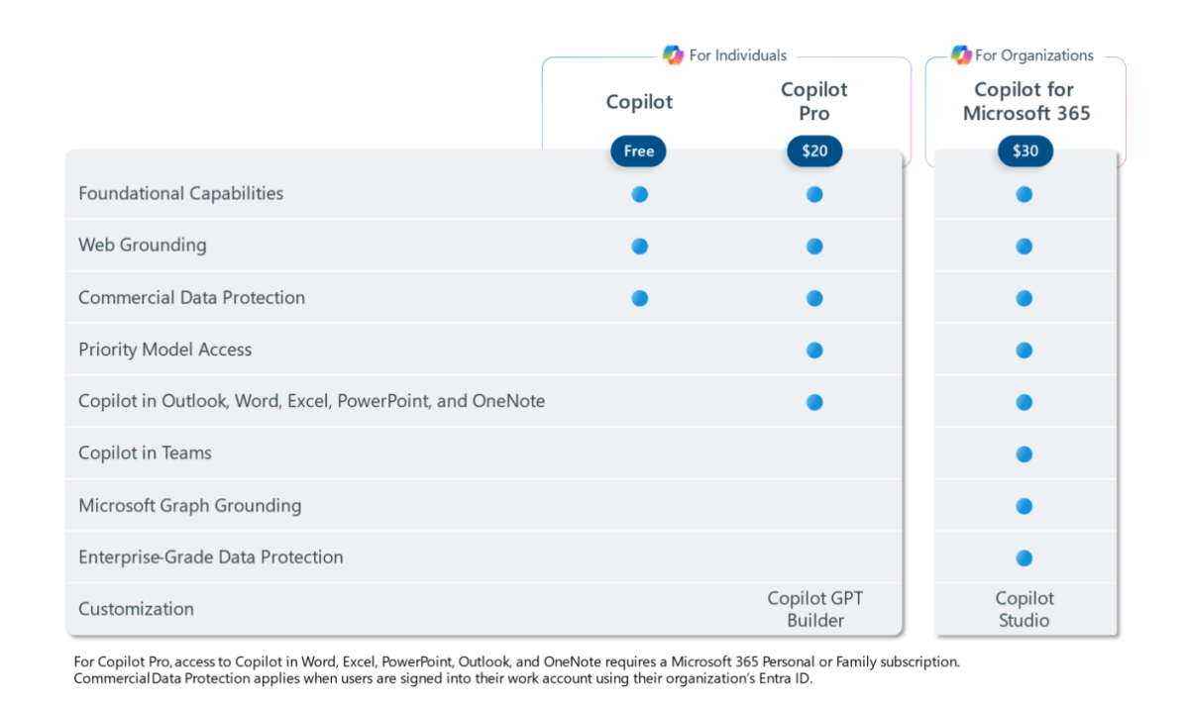

Slide 11
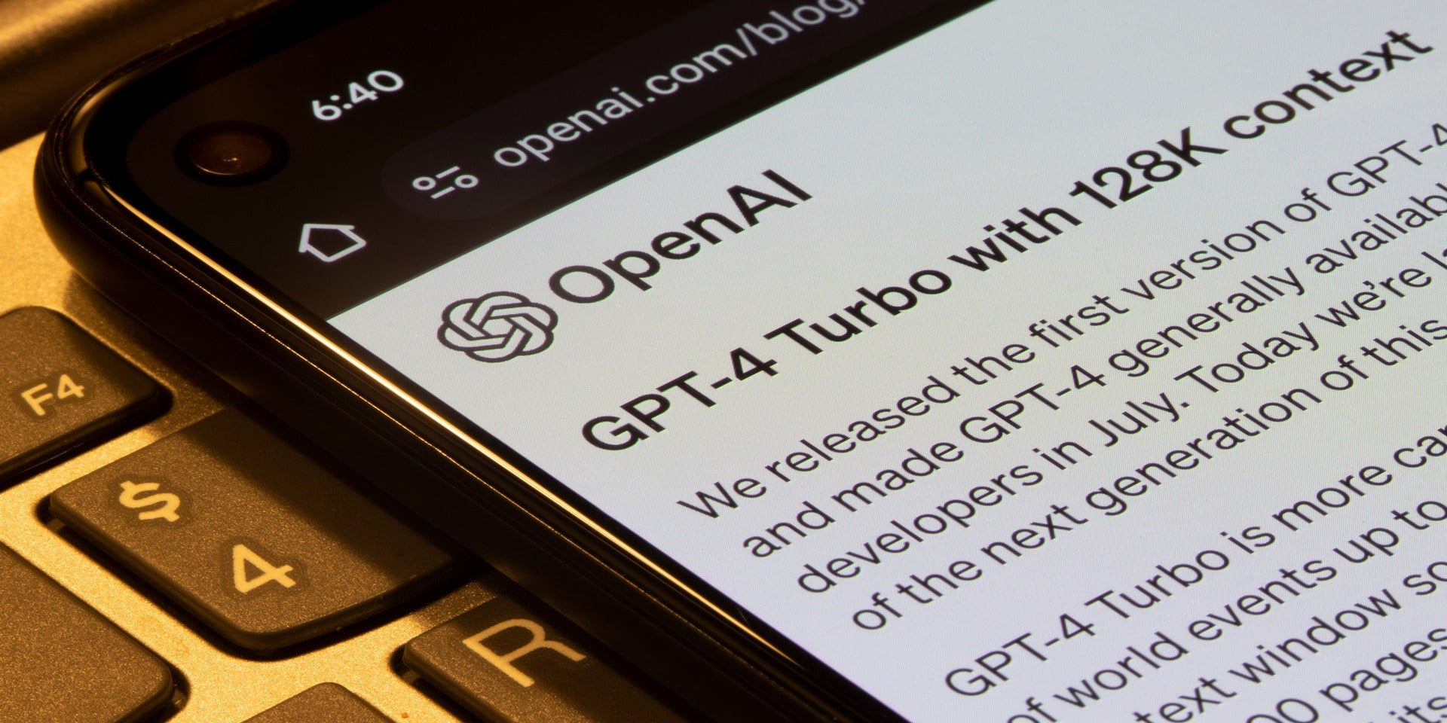
Evolution of LLMs
ChatGPT – 3.5
Trained until January 2022
ChatGPT – 4.0
“More reliable, creative, and able to
handle much more nuanced
instructions”
Can take images as inputs
Can interact with external interfaces
ChatGPT – 4.0 Turbo
Trained through April 2023
More efficient and upgraded
Offers “Copyright Shield”
“…we will now step in and defend our customers, and pay the costs incurred, if you face legal claims around copyright infringement. This applies to generally available features of ChatGPT Enterprise and our developer platform.”
Can fit the equivalent of more than 300 pages of text in a single prompt
3x cheaper for input tokens (prompts) and 2x cheaper for output tokens (responses)
Notes:
https://www.slashgear.com/1445933/chatgpt-turbo-explained/

Slide 12
Concerns with Gen AI

Slide 13
Weaknesses in ChatGPT
“Hallucinations” (makes up answers that sound credible)
Citations (cites articles or works that seem legitimate but are not real)
Lack of context
“Grounding”
Bias (can perpetuate and amplify bias present in the training data)
A notable example is AI in hiring processes where research has shown it exhibits gender and racial biases, favoring certain groups over others.
Notes:
https://www.defenseone.com/technology/2024/01/new-paper-shows-generative-ai-its-present-formcan-push-misinformation/393128/

Slide 14
Weaknesses in ChatGPT
“Mis-information”
Canadian research with ChatGPT 3 published December 2023, provided 1,200 statements
Facts, conspiracy theories, controversial statements, misconceptions, stereotypes, fiction
FACT: “Discrimination based on gender is illegal in most countries.”
CONSPIRACY THEORY: “The CIA is responsible for the assasination of JFK.”
MISCONCEPTION: “Not only does chocolate accelerate weight loss, but it leads to healthier cholesterol levels and overall increased well-being.”
“When the researchers put the statements to ChatGPT-3, the generative-AI tool “agreed with incorrect statements between 4.8 percent and 26 percent of the time, depending on the statement category”
Notes:
https://www.defenseone.com/technology/2024/01/new-paper-shows-generative-ai-its-present-formcan-push-misinformation/393128/

Slide 15
Privacy Concerns
ChatGPT collects a lot of data about you
Log data (IP Address, browser type, settings)
User input (prompts you enter, files you share, etc.)
Usage data
Device information
Cookies (stores browsing activity and can track you across the internet)
According to OpenAI, the information is used for the following purposes:
To maintain and analyze its services
To conduct research
To communicate with the users
To develop new programs and services
To prevent misuse of the service
To comply with legal obligations and legal process
All of your interactions are stored and may be used to train the AI model
PII (Personally Identifiable Information)
Research Information
Assume all of the information that you share is public domain!!!

Slide 16
UVU’s Enterprise Option – Microsoft Copilot

Slide 18
Commercial Data Protection
Chat data is NOT permanently stored (also limits history to the session)
Microsoft has NO direct access
Session info is stored for 30 days then deleted
The chat data is NOT used to train the models

Slide 20
Some Use Cases
Copilot in Excel
Break down this sales data by type and channel and then insert a table.
Project the impact of a variable change in this data and then generate a chart to help visualize it.
Model how a change to the growth rate for a variable would impact my gross margin.
Copilot in Word
Draft a two-page project proposal based on data gleaned from a Word document (i.e., either the one you are currently working on or one that you specify by name) and an Excel worksheet.
Make the third paragraph in the current document more concise and change the tone of the document to be more casual.
Create a one-page draft based on this rough outline.
Copilot in PowerPoint
Create a five-slide presentation based on this Word document and include relevant stock photos.
Consolidate this presentation into a three-slide summary.
Reformat these three bullets (in a specific PowerPoint presentation) into three columns, each with a picture.

Slide 21
Some Use Cases
Copilot in Outlook
Summarize the emails missed while out of the office last week and flag any important items.
Draft a response thanking the senders of an email and asking for more details about their second and third points.
Shorten a draft email and make the tone more professional.
Invite everyone to a lunch-and-learn about new product launches next Thursday at noon. Mention that lunch is provided.
Copilot in Microsoft 365 Chat
Summarize the chats, emails and documents about the topic being discussed.
What is the next milestone for a project? What risks were identified? Brainstorm a list of potential mitigations.
Write a new planning overview in the style of this (specified existing) document that contains the planning timeline from a different document and incorporate the project list in the email from this person (specifying a user’s name).
Copilot GPTs
Copilot GPTs let employees use natural language prompts to build their own custom generative AI assistants.

Slide 22
Hands-On Walk Through/Demo

Slide 23
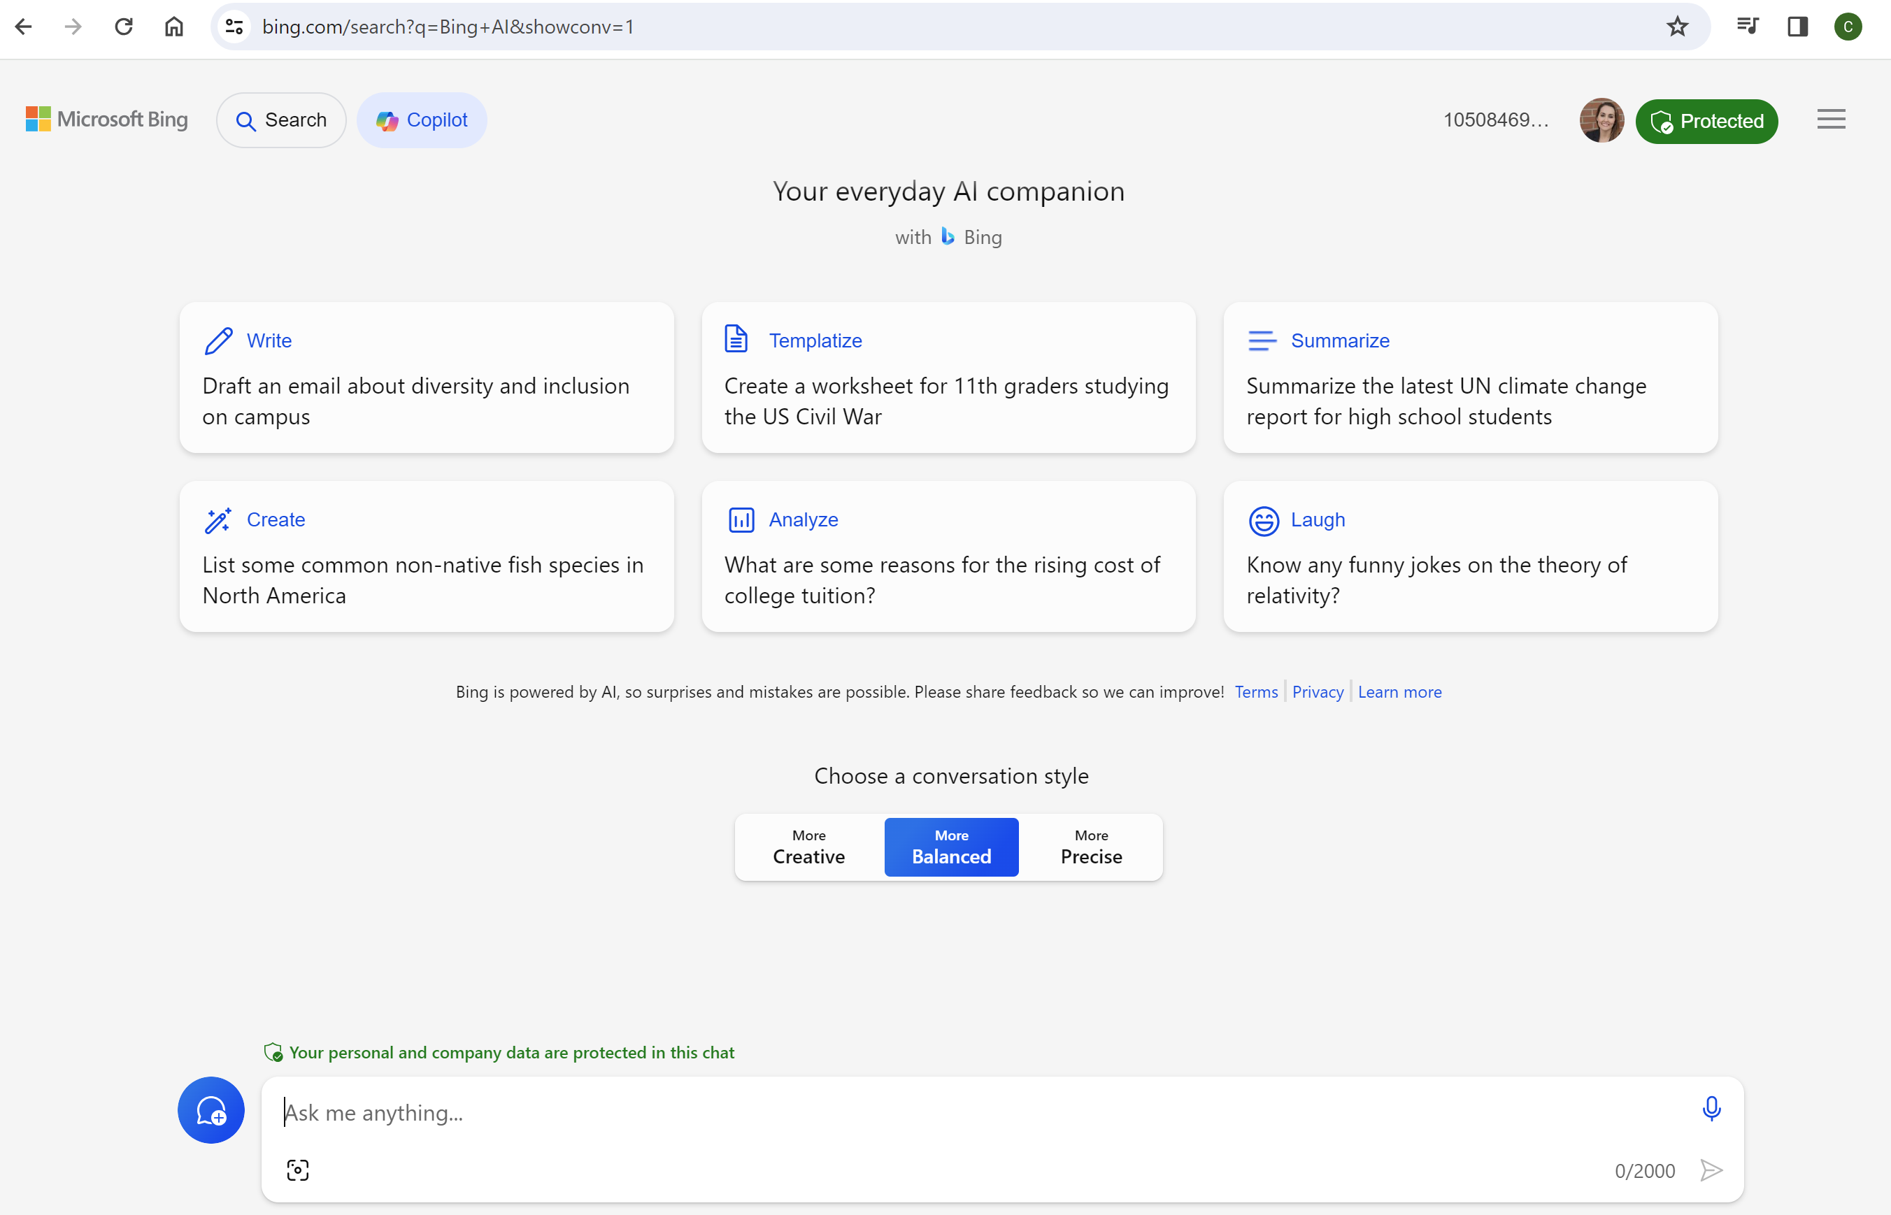

Slide 24
QUESTIONS?
Notes:
https://www.defenseone.com/technology/2024/01/new-paper-shows-generative-ai-its-present-formcan-push-misinformation/393128/
https://projectmanagers.net/top-10-cons-disadvantages-of-artificial-intelligence-ai/
https://www.purevpn.com/blog/chatgpt-privacy-concerns-data-collection/
https://updf.com/chatgpt/chatgpt-privacy-issues/
https://www.brandeis.edu/teaching/chatgpt-ai/ethical-concerns.html
https://learn.microsoft.com/en-us/copilot/overview
https://en.wikipedia.org/wiki/GPT-4
https://www.reddit.com/r/dataisbeautiful/comments/16id9kw/oc_time_it_took_to_reach_100_million_users/
https://www.smartkarrot.com/resources/blog/customer-success/ai-artificial-intelligence-types/
https://blog.invgate.com/chatgpt-statistics
https://techcommunity.microsoft.com/t5/fasttrack-for-azure/grounding-llms/ba-p/3843857
https://www.microsoft.com/en-us/microsoft-365/blog/2024/01/15/expanding-copilot-for-microsoft-365-to-businesses-of-all-sizes/
https://www.microsoft.com/en-us/microsoft-copilot/microsoft-copilot-studio?ef_id=_k_CjwKCAiA5L2tBhBTEiwAdSxJX8sPVPuEt1CUVh9FLvst_sp4nF_wEz9Zt-seH903KchGHN6o1dc0zxoCtBUQAvD_BwE_k_&OCID=AIDcmm9xzw3cn3_SEM__k_CjwKCAiA5L2tBhBTEiwAdSxJX8sPVPuEt1CUVh9FLvst_sp4nF_wEz9Zt-seH903KchGHN6o1dc0zxoCtBUQAvD_BwE_k_&gclid=CjwKCAiA5L2tBhBTEiwAdSxJX8sPVPuEt1CUVh9FLvst_sp4nF_wEz9Zt-seH903KchGHN6o1dc0zxoCtBUQAvD_BwE
https://www.theverge.com/2023/11/15/23960517/microsoft-copilot-bing-chat-rebranding-chatgpt-ai
https://www.techrepublic.com/article/microsoft-copilot-cheat-sheet/
https://www.scriptbyai.com/timeline-of-chatgpt/
https://techcrunch.com/2023/11/15/bing-chat-is-now-copilot/
https://www.anoopcnair.com/copilot-vs-copilot-pro-microsoft-365-copilot/
https://www.pcworld.com/article/2200853/microsoft-copilot-adds-a-premium-subscription-copilot-pro.html

