Slide 1
Beat the Bot
Using AI to Practice Source Usage
Brendan McCarthy

Slide 2
Try Perusall
Go to app.perusall.com
Register an account
Use MCCARTHY-DAB24 to join class

Slide 3
Outcomes
Digital Literacy
Introduces students to AI work
Identify habits and issues typical of AI-generated text
Information Literacy
Evaluate the work of LLMs based on standards established in class
Identify claims that require evidence
Provide evidence for claims through research
Go to app.perusall.com
Register an account
Use MCCARTHY-DAB24 to join class

Slide 4
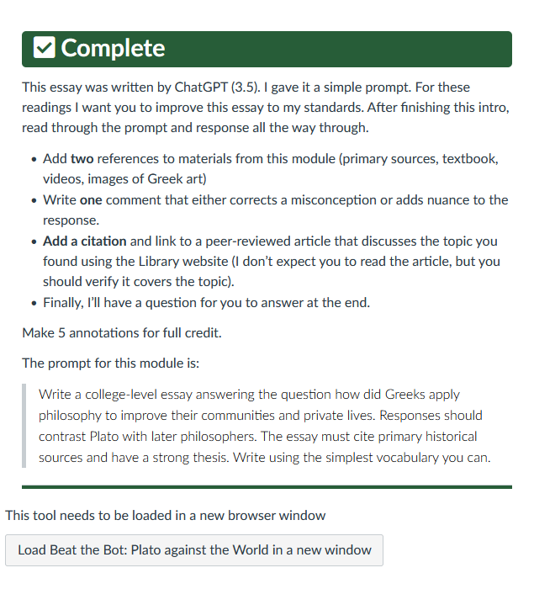
Go to app.perusall.com
Register an account
Use MCCARTHY-DAB24 to join class

Slide 5
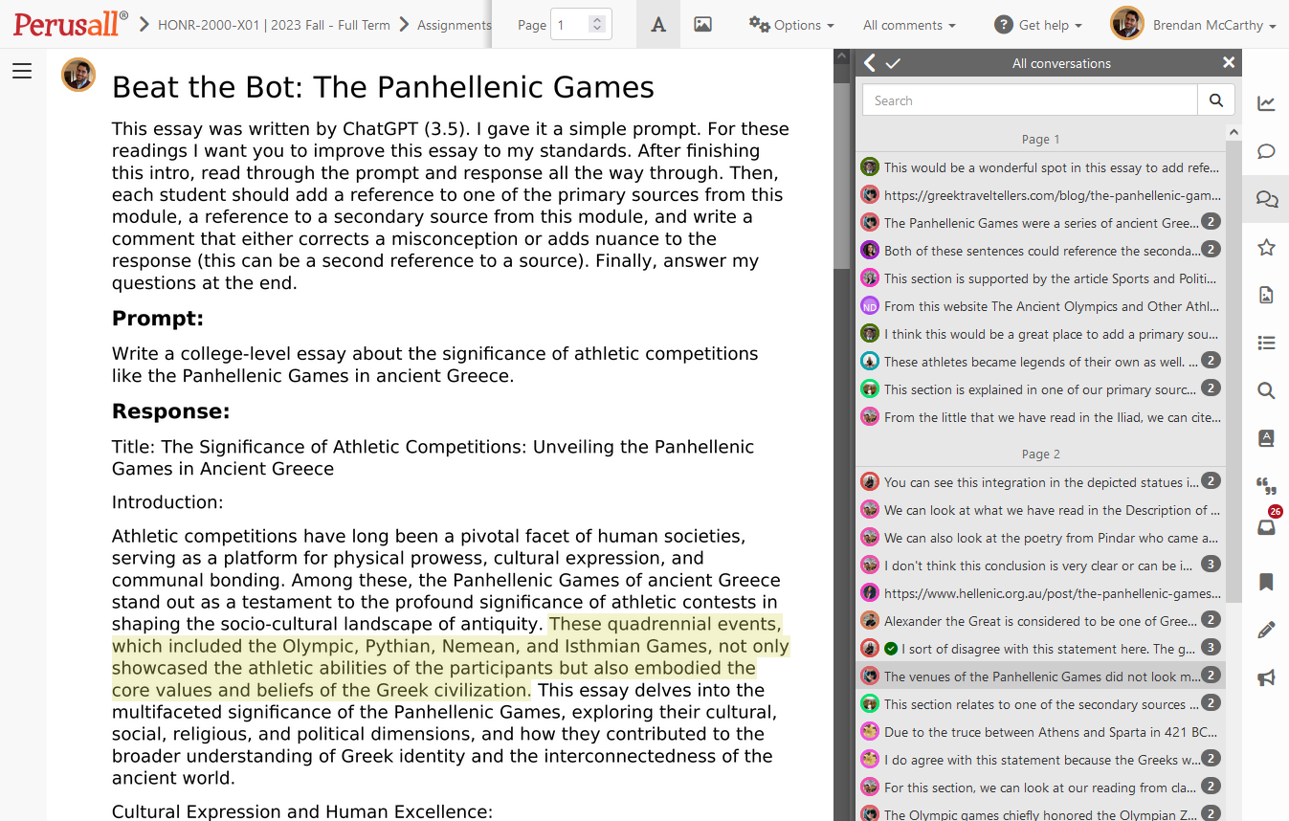

Slide 6
