Slide 1
AI at UVU
A Writing Center Perspective
Dr. Lisa Bell
Dr. Joni Hayward Marcum

Slide 2
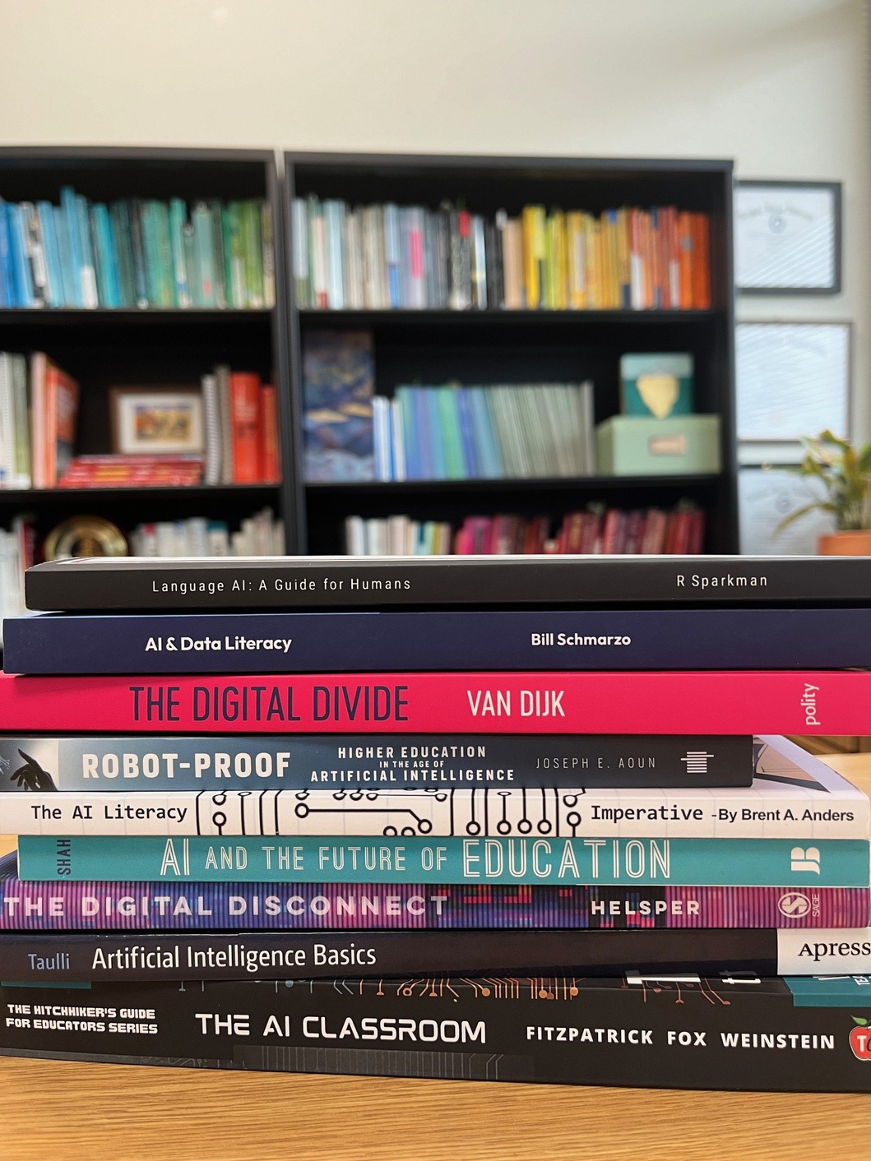
Writing Center Work as an Interdisciplinary Perspective

Slide 3
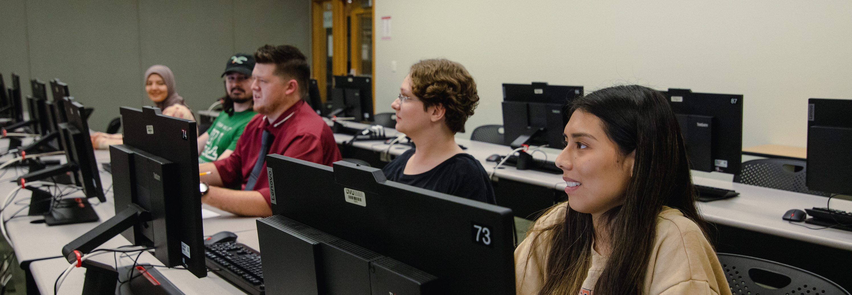
Writing Center Staff and AI Policy

Slide 4
Learning & Critical Thinking
Campus & Course Policy
Digital & Info Literacies
Access to Tools
Access to Education
Privacy Concerns
Linguistic Diversity
Diversity of Thought & Methodology
Digital Footprints
Relationships (Students & Educators)
What are the Writing Center’s AI concerns, and what can be done?

Slide 5
How are students using AI?

Slide 6
Students Not Disclosing AI Use
They are unaware of their use
They are still trying to gauge outcomes
They are not early adopters
They are not disclosing their use

Slide 7
Students Disclosing AI Use
They are focused on efficiency
They are in STEM or business
They are using it for work or to apply for jobs
They are early adopters or experiential learners
They are using it in common ways

Slide 8
What are we seeing in the Writing Center?

Slide 9
What the Writing Center is Seeing
An expansion of ideas and possibilities
Affective and relational concerns
Mixed messaging (disciplines and class standings)
Increased platform integration
Unintended consequences of not adapting assignments
Changing conversations about literacies

Slide 10
What the Writing Center is Not Seeing
Requests for prompt engineering or instruction
A large number of assignments using AI

Slide 11
What questions do students and faculty have?

Slide 12
AI Pedagogy Project
(metaLAB (at) Harvard, 2024)

Slide 13
Assignments
(metaLAB (at) Harvard, 2024)

Slide 14
Assignments
(metaLAB (at) Harvard, 2024)

Slide 15
AI Pedagogy Project Recommendations
Learn the AI basics.
Know the affordances of AI tools.
Create a classroom AI policy.
Use a critical approach.
Lead with trust.
Recognize the opportunity.
Approach with humility and openness.
(metaLAB (at) Harvard, 2024)

Slide 16
The Writing Center as a Learning Space
Figure 1.3: AI and data literacy radar chart (Schmarzo, 2023, pp. 14).

Slide 17
"The 'help' writing centers provide is not simply fixing a comma splice like using spit to pat down an unseemly cowlick. Rather, the work of a writing center is a matter of being available mentally and emotionally to engage in the mutual construction of meaning with another.”
(Grimm, 2008. p. 9)

Slide 18
References
Grimm, N. M. (2008). Attending to the conceptual change potential of writing center narratives. The Writing Center Journal, 28(1), 3-21.
metaLAB (at) Harvard. (2023, January 22). AI Pedagogy Project. https://aipedagogy.org
Schmarzo, B. (2023). AI & Data Literacy: Empowering Citizens of Data Science. Packat Publishing.

