Slide 1
Positive Predictors of Postschool Success for Students with Disabilities
Presented by Crystal Emery, PhD

Slide 2
Learning Intentions
You will be able to articulate the postsecondary transition process
You will be able to identify activities that predict positive post school outcomes for students with disabilities
You will be able to access postsecondary transition resources available in Utah
Notes:
Presentation Description: Students with disabilities, including autism, face many challenges in transitioning to adulthood after they exit the school system. Much research has been done to identify services and experiences that will support a successful postsecondary transition for students with disabilities. In this session, we will discuss the top predictors of postschool success as well as postsecondary transition resources available in Utah. This session will offer information and insight relevant to professionals and families alike.

Slide 3
What do you know about postsecondary transition?
Get with a neighbor or few
Introduce yourself (if needed)
Come up with a definition of postsecondary transition.
  If you don’t know, guess
  If you do know, define it in a way that anyone can understand it

Slide 4
What is Postsecondary Transition?
Postsecondary transition planning is a process beginning at age 14 (or earlier if appropriate) designed to help students reach their potential as they transition into adulthood.
The postsecondary transition process includes ongoing assessment, services, instruction, experiences, opportunities, and supports designed to elevate students’ in-school and post school outcomes.

Slide 5
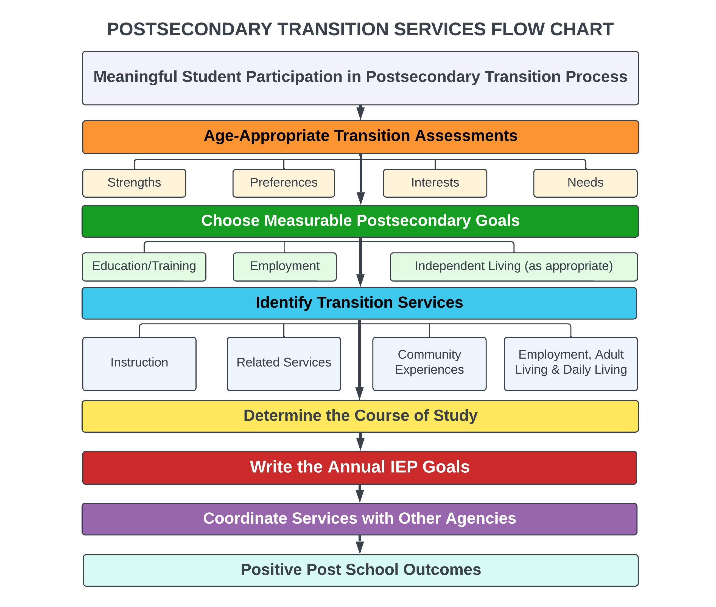
Postsecondary Transition Services Flow Chart

Slide 6
What does the research say?
Contemporary transition policies and practices are grounded in the belief that students with disabilities are far more likely to achieve their aspirations for life after high school if provided the right combination of opportunities, instruction, services, and supports [in high school]. (Trainor et. al., 2019)

Slide 7
What do we need to know?
Research suggests youth with disabilities are less likely to experience positive outcomes compared to peers without disabilities. Identifying in-school predictors of postschool success can provide [educators, other service providers, and families] with information to design, evaluate, and improve transition programs. (Mazzotti et. al., 2020)
Notes:
“Research has produced a consistent set of predictors of in-school activities that positively correlate with postschool success in education, employment, and independent living

Slide 8
Predictors of Post School Success
23 Predictors of postschool success in education, employment, and/or independent living
1 Evidence-based practice (EBP) that is a predictor for employment
18 Research-based practices (RBP): 8 for employment, 8 for education, and 2 for independent living
27 Promising practices (PP): 12 for employment, 9 for education, and 6 for independent living

Slide 9
Secondary Transition Predictors of Postschool Success (Mazzotti et. al., 2020)
Career Awareness
Career and Technical Education**
Community Experiences
Exit exam requirements / High School Diploma Status
Goal Setting*
Inclusion in General Education*
Interagency Collaboration
Occupational Courses
Paid Employment / Work Experiences
Parent Expectations
Parental Involvement
Program of Study
Psychological Empowerment
Self-Advocacy / Self-Determination
Self-Care / Independent Living Skills
Self-Realization
Social Skills
Student Support
Technology Skills
Transition Program
Travel Skills
Work Study
Youth Autonomy / Decision-Making
** EBP for employment and RBP for education
*RBP in all three areas
Notes:
Predictors highlighted in yellow are at least research-based in both education and employment
Predictors bold and italicized are also positive factors identified in the National Longitudinal Transition Study

Slide 10
Utah Postsecondary Transition Resources
The USBE Postsecondary Transition team has developed multiple padlets to support educators, other agencies and families
The Utah Postsecondary Transition Padlet is a centralized resource linking to padlets in many relevant categories

Slide 11
Need Help?
Please contact any of the USBE Postsecondary Transition Specialists for help or questions:
Crystal Emery
crystal.emery@schools.utah.gov
Lavinia Gripentrog
lavinia.gripentrog@schools.utah.gov
Deanna Taylor
deanna.taylor@schools.utah.gov

Slide 12
Thank you for coming!!
Questions?

