Slide 1
Living and Loving with Autism
Location
Presented by:
James & Chrissy Williams

Slide 2
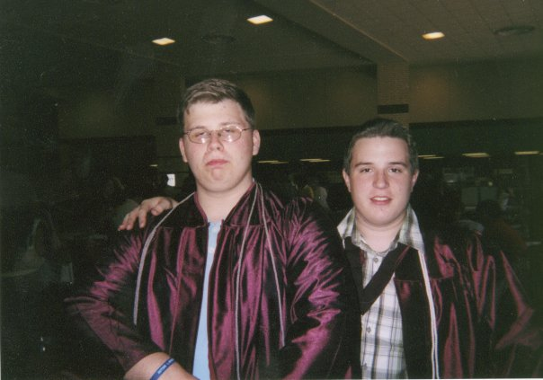
In the beginning
My Best Friend Brenton!
(Didn’t start that way)

Slide 3
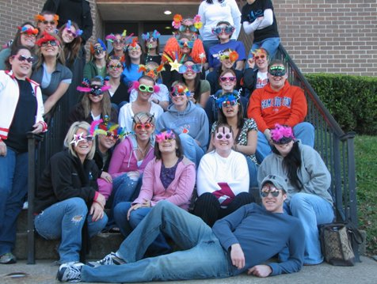
College to Career

Slide 4
“When James Met Chrissy”
Paid Dating Sites vs. Free Dating and Chat Sites
Smart Safety Tips
The Beginning…
Is the 2nd date to early to say I love you?
Should you call her 30 seconds after you say goodbye on the first date?
Should you bring a HUGE bouquet of flowers for her to a school program?

Slide 5
College-Graduate

Slide 6
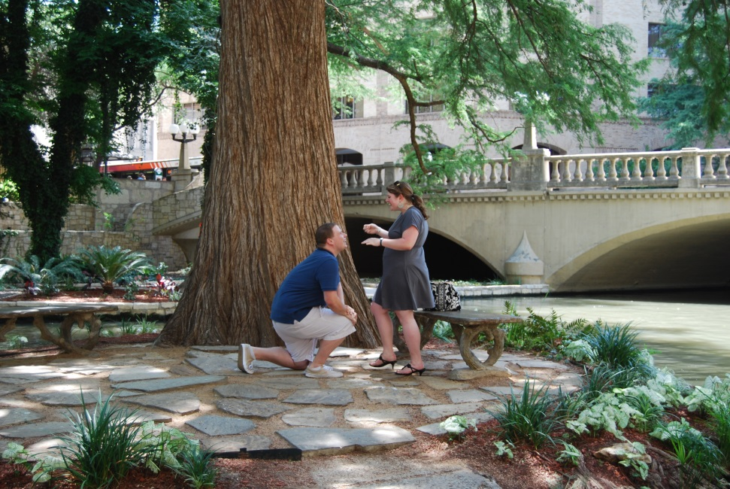
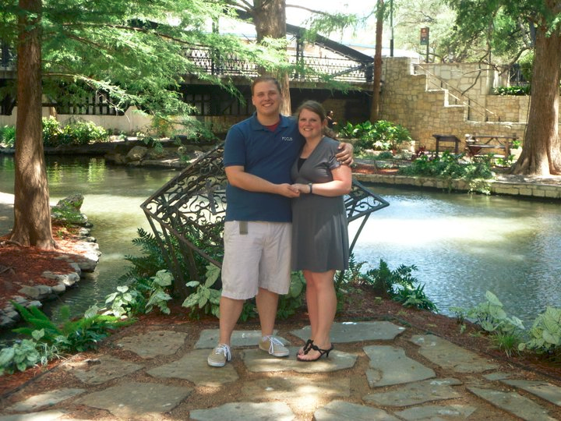
Engagement!!!

Slide 7
Relationships
They are all different!
We read the books.
We had to make some
changes….
“Save a tree!”
“Why are you upset?”
Is that what you intended?

Slide 8
Wedding Planning!!!!!
Our Mothers!

Slide 9
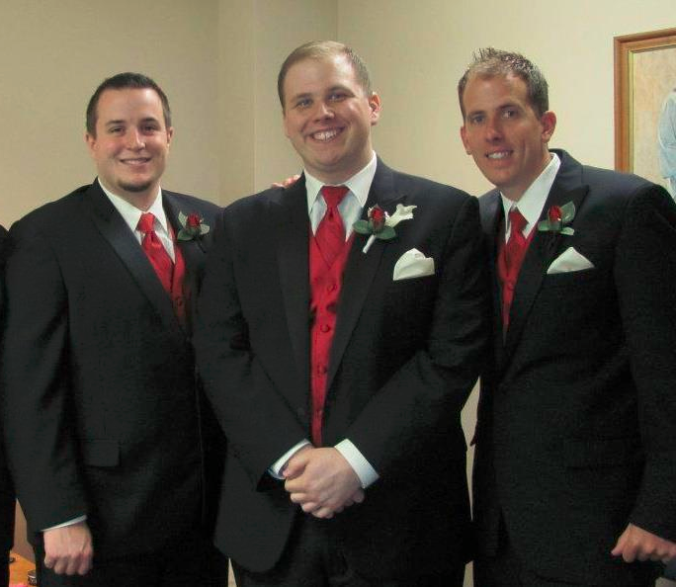
Marriage!!

Slide 10
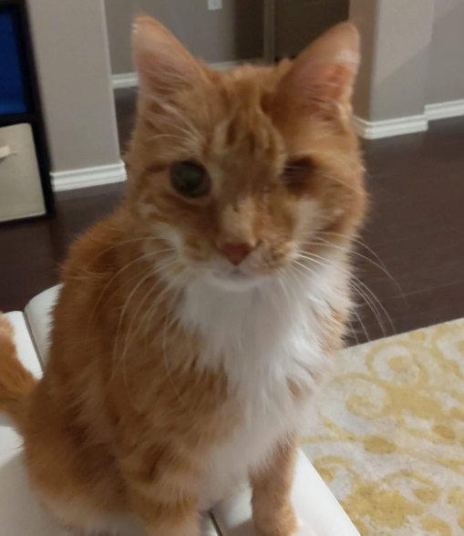
Our Family!!!!

Slide 11
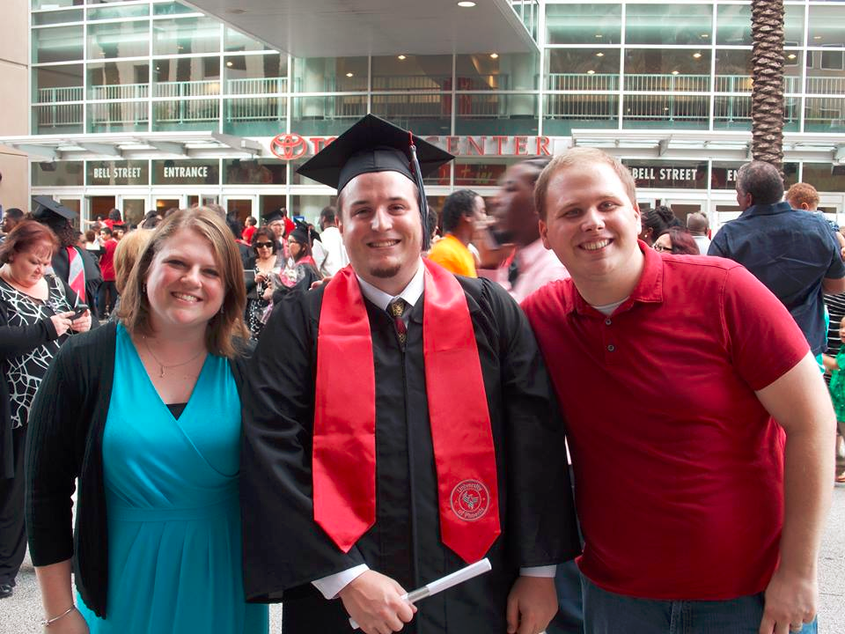
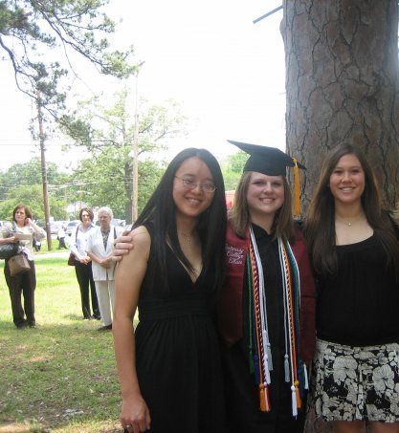
Our Friends!!!!

Slide 12
Our Move to Austin!!!!

Slide 13
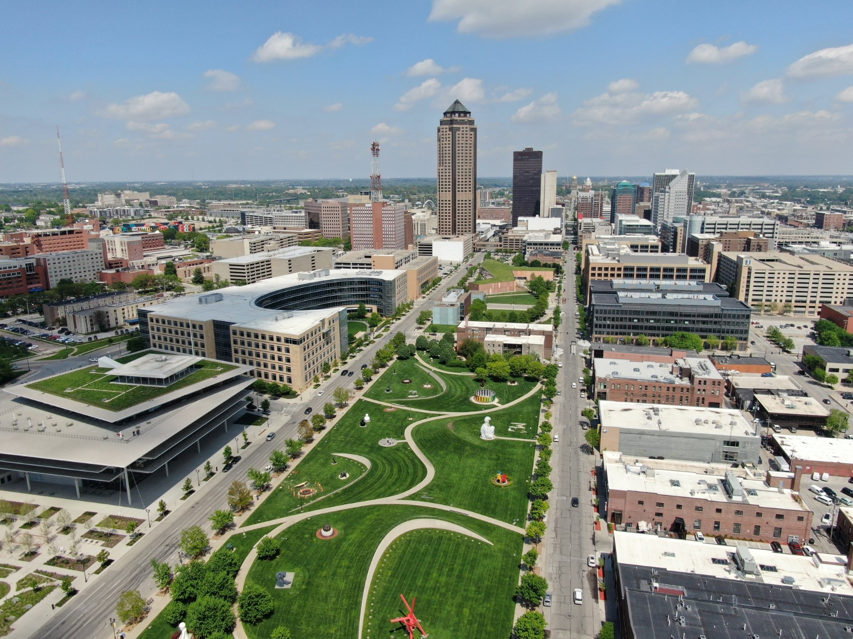
Our Move to Des Moines!!

Slide 14
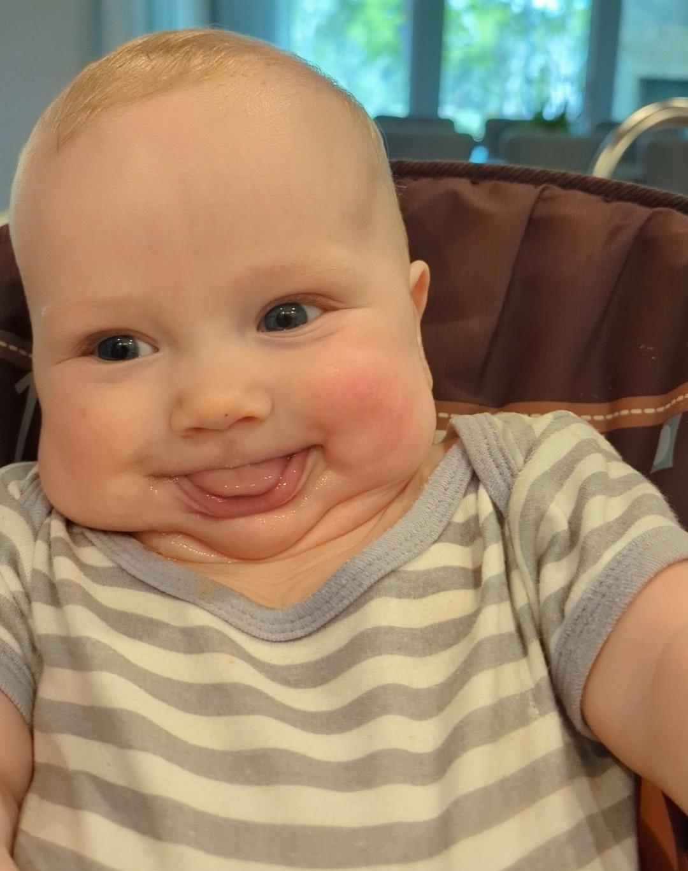
Our Future!

Slide 15
Resources on Love and Autism
What Men with Asperger Syndrome Want to Know about Women, Dating and Relationships by Maxine Aston
22 Things a Woman Must Know: If She Loves a Man With Asperger's Syndrome by Rudy Simone
Asperger’s in Love: Couple Relationships and Family Affairs by Maxine Aston
The 5 Love Languages: The Secret to Love That Lasts by Gary Chapman
Read: http://www.wikihow.com/Get-a-Girlfriend-When-You-Have-Asperger-Syndrome
Read: http://www.aspergerexperts.com/social/the-3-keys-to-dating/
Read: Look at http://www.npr.org/sections/health-shots/2014/08/08/338910290/advice-for-dating-with-aspergers-dont-call-100-times-a-week

Slide 16
What Can Professionals and Parents Do?
Expect that, like everyone else, people with disabilities can and do have successful, healthy relationships that can include marriage, kids, & intimacy.
Teach and model appropriate social skills and boundaries to encourage healthy relationships/dating. (Age and Time Period Appropriate)
As is appropriate and comfortable, teach dating secrets
Parents should focus on transitioning from the role of an advocate to more of an advisor.

Slide 17
What Can Professionals and Parents Do? Continued…
Like their typical peers, individuals with disabilities, especially Autism, must have a basic understanding of sexuality and it’s challenges, including diseases, reproduction, and legal and moral rules. (Will Vary Based on Culture and Age)
Consider the safest and most comfortable settings for dating/relationships based on the interests and preferences of the individual. (Online Dating vs. Dating Co-workers)
Be patient and know that it may take longer for them to develop relationships, but they are capable and deserve the same respect and privacy as anyone else.

Slide 18
Overall, my best advice as a person with ASD and a professional...
Never accept a disability as an excuse for their behavior, poor social skills, lack of performance, or inability to work.
While ASD will often be a contributing factor, as adults, we all make choices, whether intentional or not, and they're still ultimately responsible for their actions.
Why should we ignore or excuse it, when they're future employers, peers, friends, college professors, and/or law enforcement will not.
Avoid being "nice", "polite", "sugarcoating", or "beating around the bush", we do best when someone sets clear expectations, communicates honestly and openly, and draws boundaries of acceptable and not acceptable behavior.
It can be counter intuitive, but it may be very helpful adults with ASD.
All of us are very different, avoid making assumptions or stereotypes about us based on other individuals or past experiences.
Finally, as a parent or professional, never be afraid to push a person with ASD to achieve reasonable goals.
If you yield to their initial anxiety or resistance to change, than you are letting it stop you, just like it stops us.
As a very knowledgeable expert and mother of an adult with AS has told me, "We need to push them, as long as it's not over the cliff.“
All people have to be pushed, encouraged, and motivated to achieve their potential, people with Autism are no different.

Slide 19
Questions/Comments
Dr. James Williams, CRC, ACAS
Phone: 515-829-6035
Email: James.Williams@iwd.iowa.gov

