Slide 1
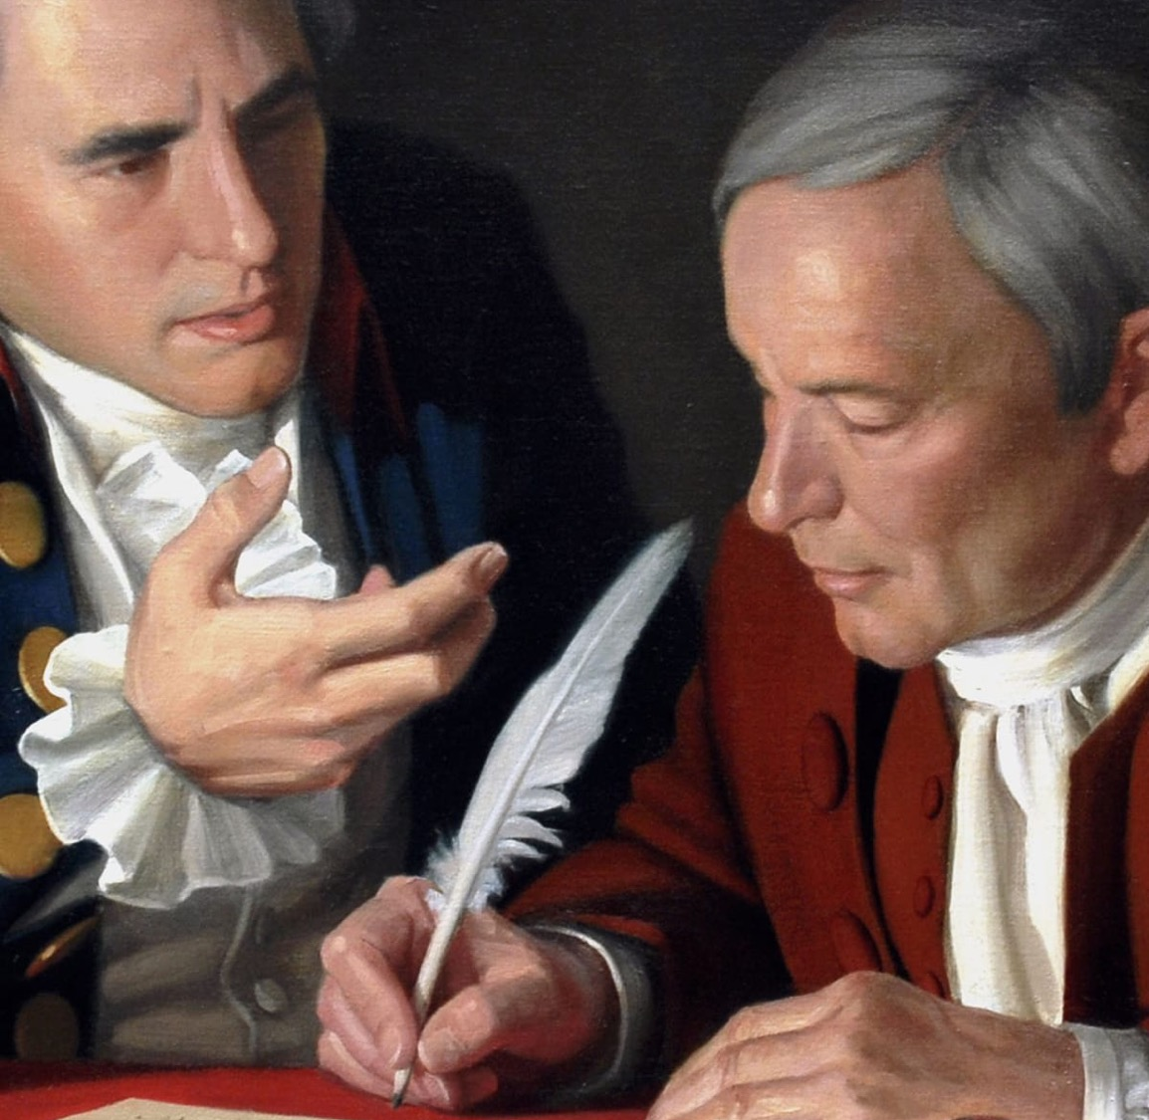
The Great Compromise: A Document-based Lesson
Jeffery D. Nokes
Brigham Young University
jeff_nokes@byu.edu
Constitutional Literacy Institute
June 23, 2025

Slide 2
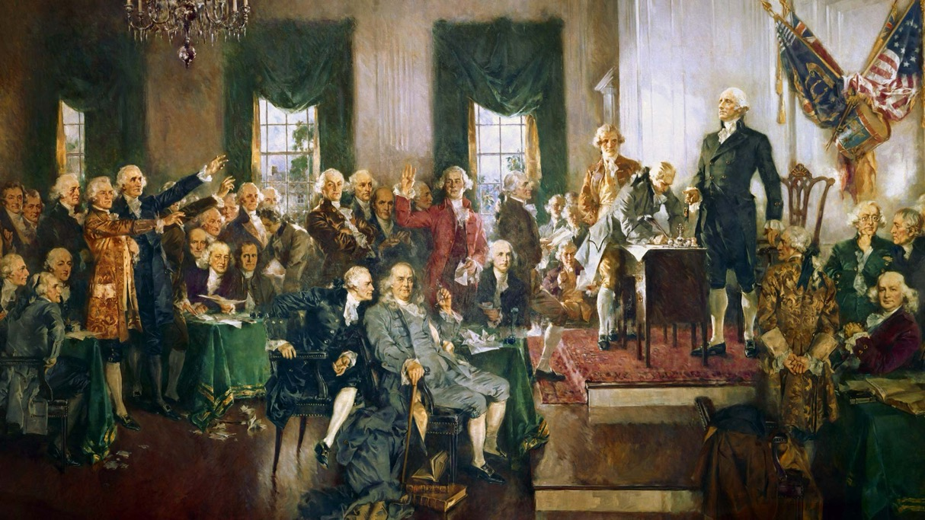
How do we make the Federal Convention of 1787 comprehensible, manageable, palatable, and practical for young people?
context
  Shays’ Rebellion
people
  Randolph, Morris, Washington
debate procedures
  Committee of the Whole
outcomes
  Article 1
applications
  separation of powers

Slide 3
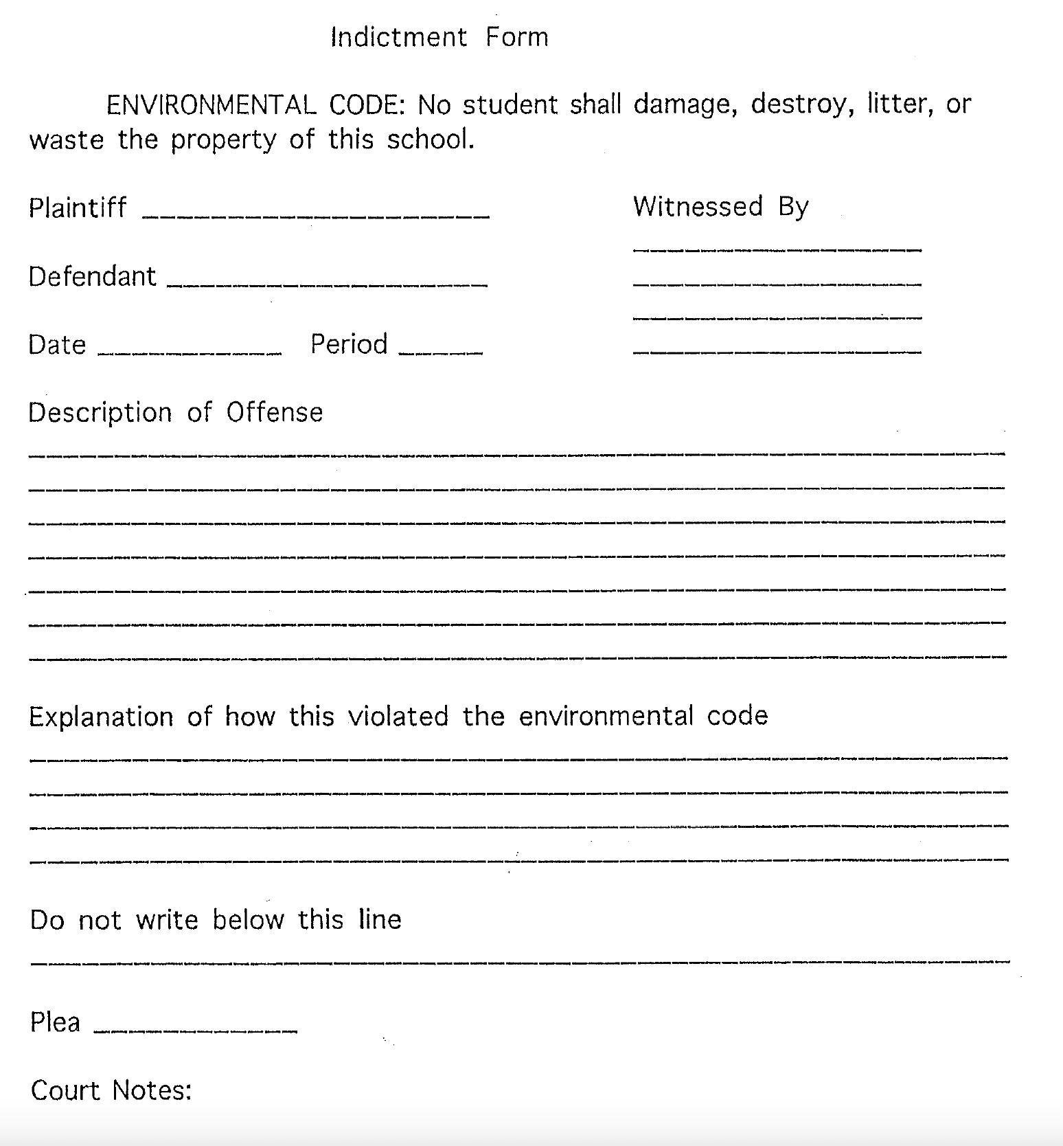
Judicial Branch: Interprets the law
plaintiff
defendant
witness
evidence
indictment
hearing
plea deal
elements of a trial
jury
mistrial
due process
precedent
rule of law

Slide 4
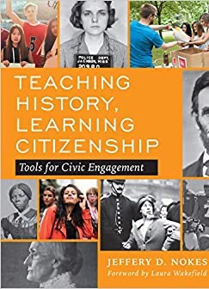
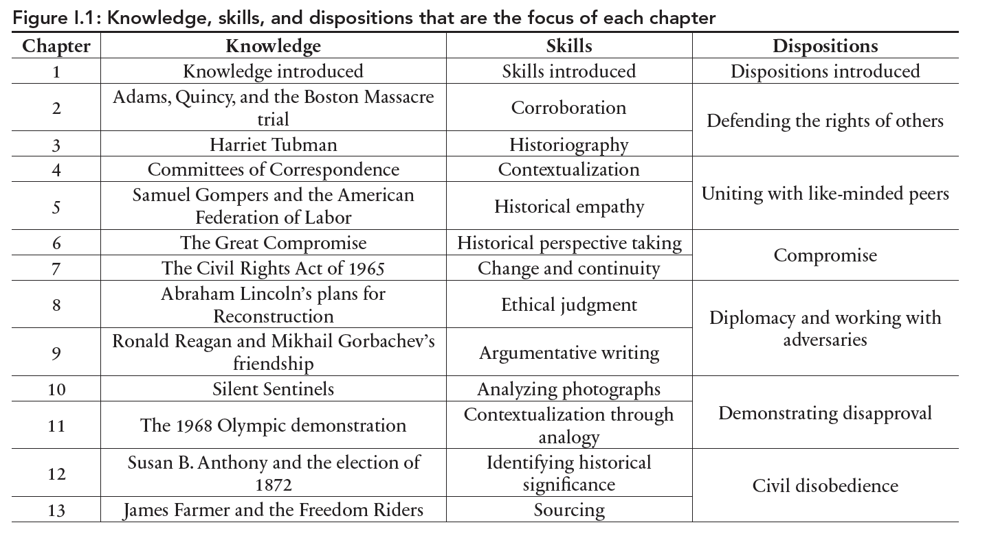
Teaching History,
Learning Citizenship
4

Slide 5
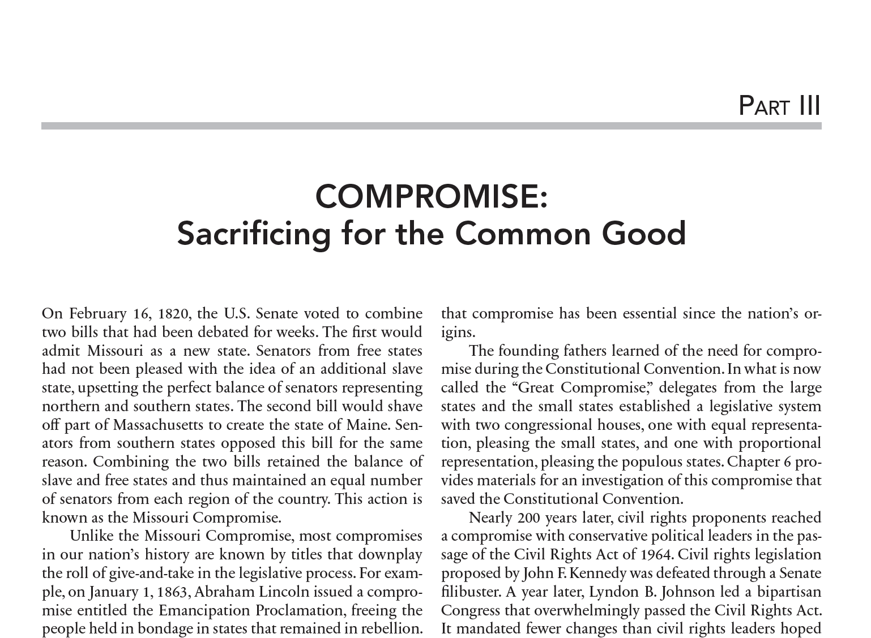

Slide 6
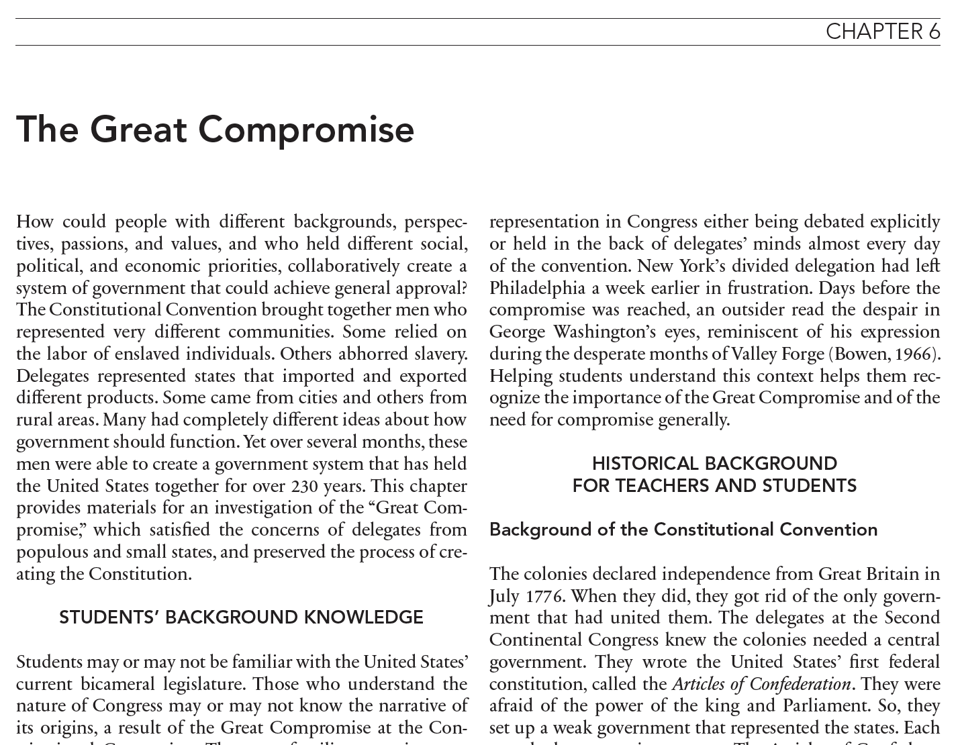

Slide 7
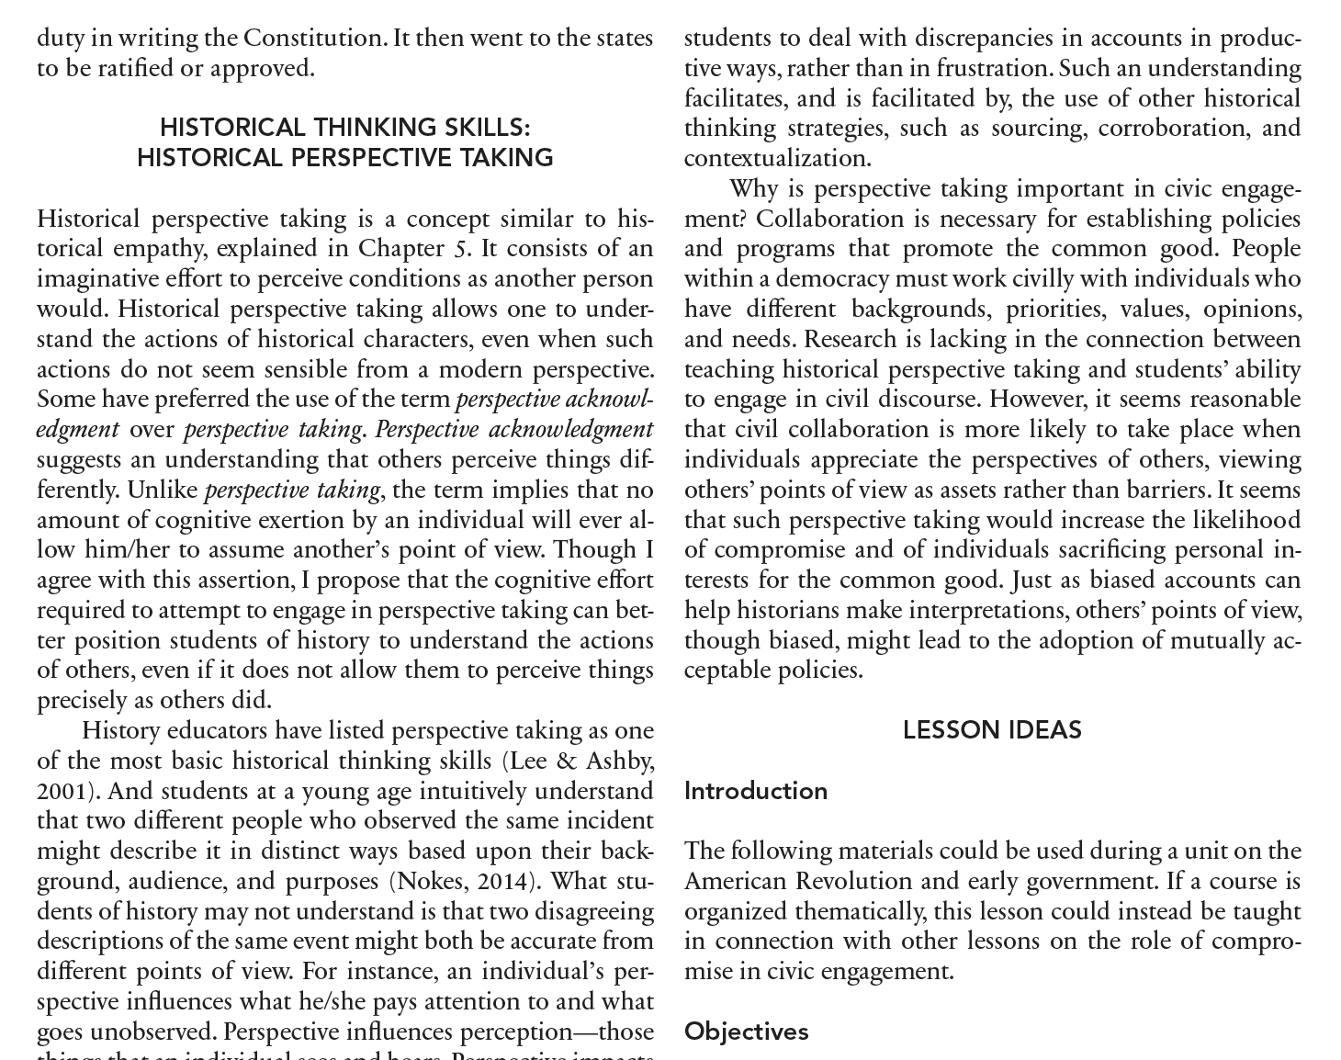

Slide 8
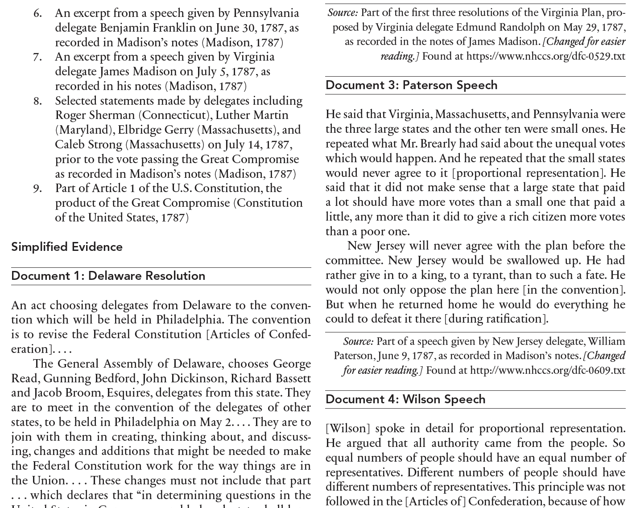

Slide 9

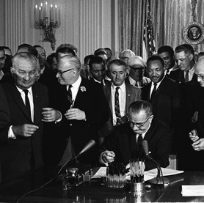
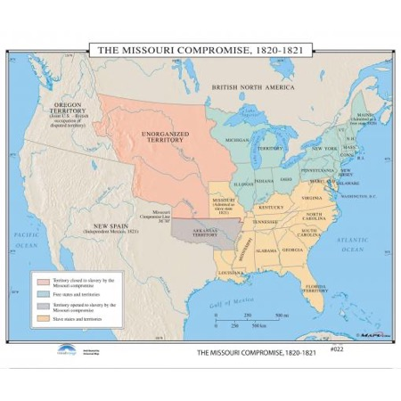
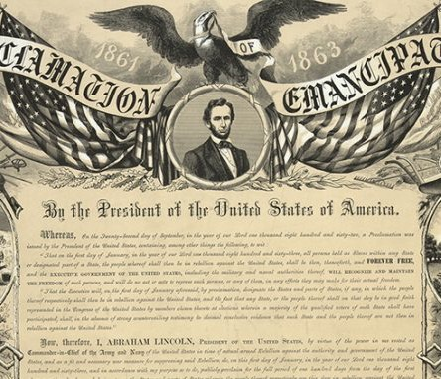
A legacy of compromise…
Notes:
Some compromises in history are called compromises (The Missouri Compromise). Most compromises are not (The Civil Rights Act of 1964). Almost all legislation and every policy requires some degree of compromise.

Slide 10
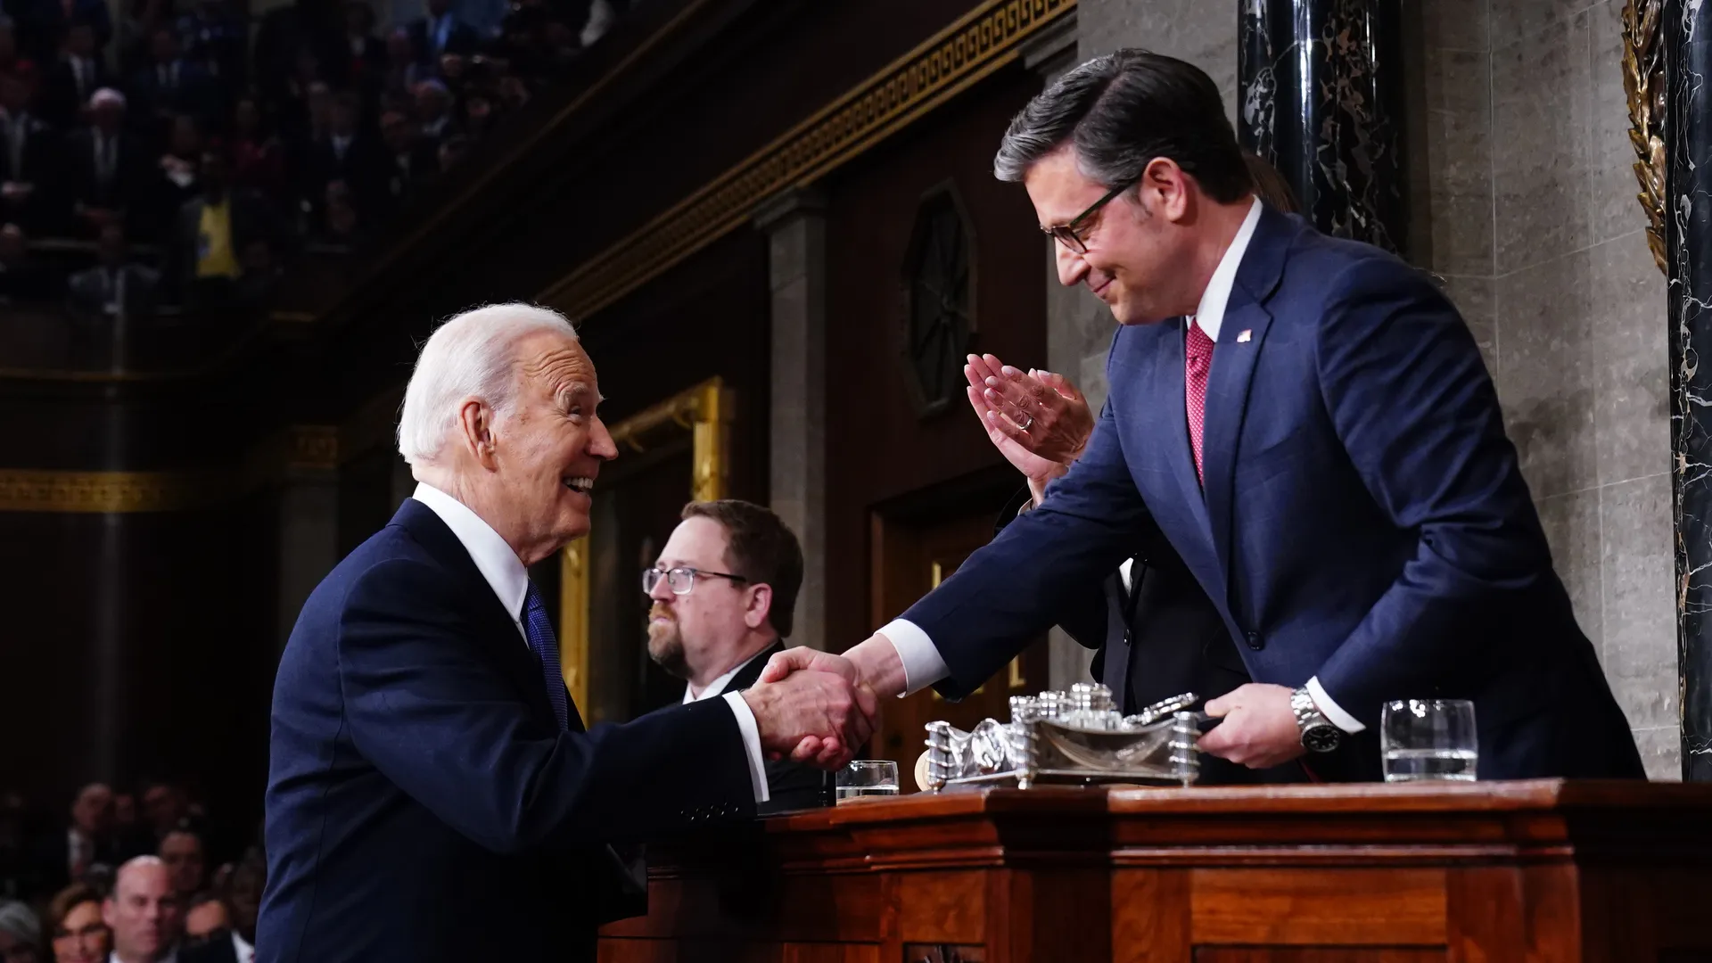
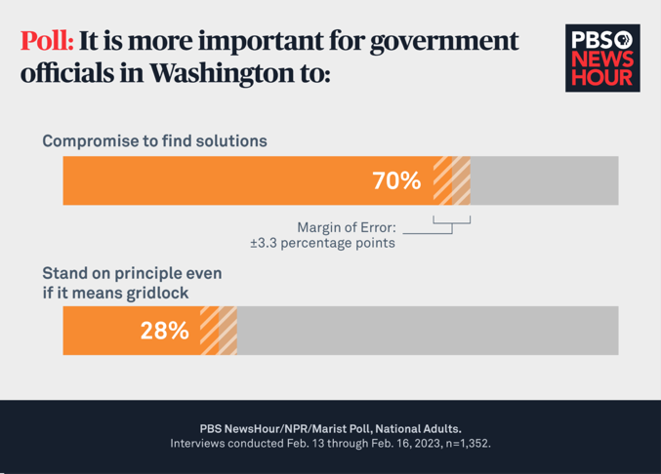
The latest call for compromise…
Notes:
Debt ceiling compromise with poll from February 16, 2023

Slide 11
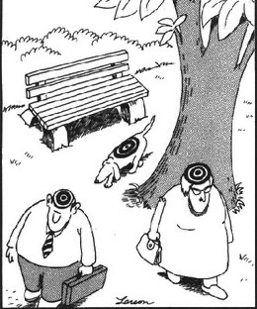
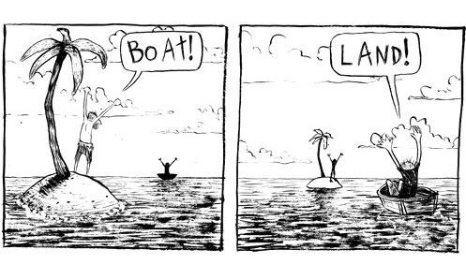
Perspective Taking

Slide 12
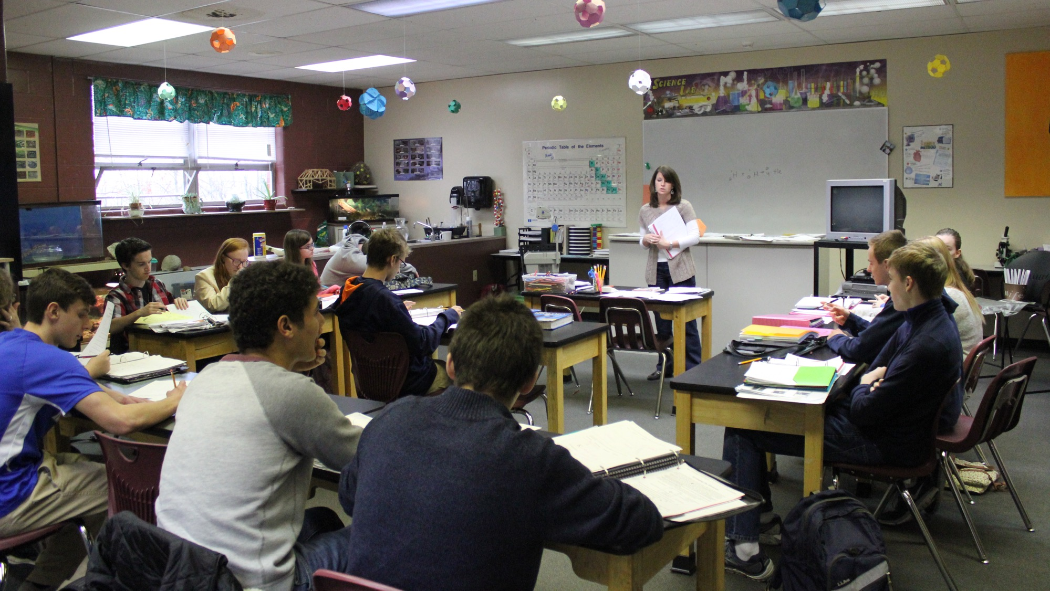
Write down the most important thing that happened at this school last week?

Slide 13
Now write what you think the person to your left wrote about.

Slide 14
What thought process did you go through to try to figure out what they wrote?

Slide 15
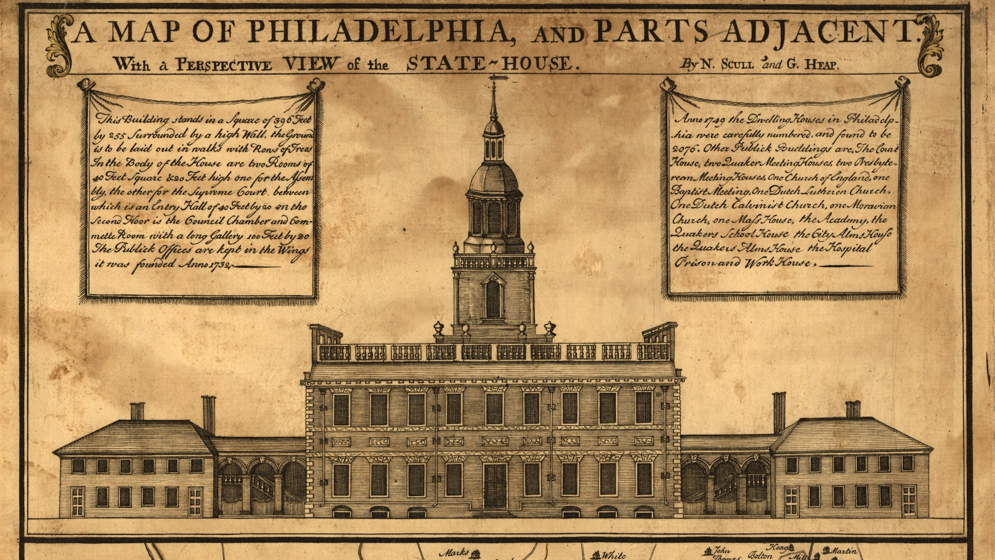
Constitutional Convention Background
Notes:
Hopefully they read the background information in the book (written at 7th grade level for students)

Slide 16
A FEDERAL government that represents states
State A
State B
State C
2 Representatives
2 Representatives
2 Representatives
2 representatives for every state.
Different representation of the people (1/30, 1/5, 1/10).
Notes:
Practice vocab: populous or large vs. small. Background knowledge: large states (>400,000 = Virginia 691,000, Pennsylvania, Massachusetts) Small states (<100,000 = Delaware 59,000, Georgia, Rhode Island)

Slide 17
A NATIONAL government that represents people
State A
State B
State C
6 Representatives
1 Representatives
2 Representatives
1 representative for every 10 people. Different representation of the states.

Slide 18
A national government that represents people
State A
State B
State C
6 Representatives
1 Representatives
2 Representatives
Who prefers this system?

Slide 19
A federal government that represents states
State A
State B
State C
2 Representatives
2 Representatives
2 Representatives
Who prefers this system?

Slide 20
How did the delegates at the Constitutional Convention work through their disagreements to reach a compromise?
How did the differing perspectives of delegates from the populous states and the small states lead to disagreements at the Constitutional Convention?
What type of dialogue was likely to lead to compromise?
What types of dialogue decreased the likelihood of compromise?

Slide 21
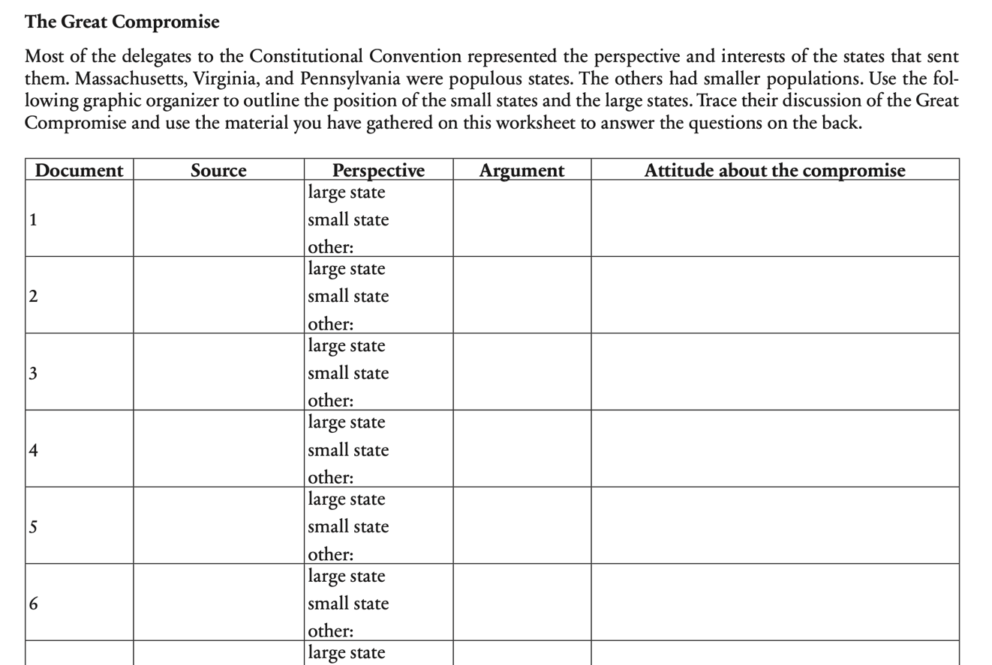

Slide 22
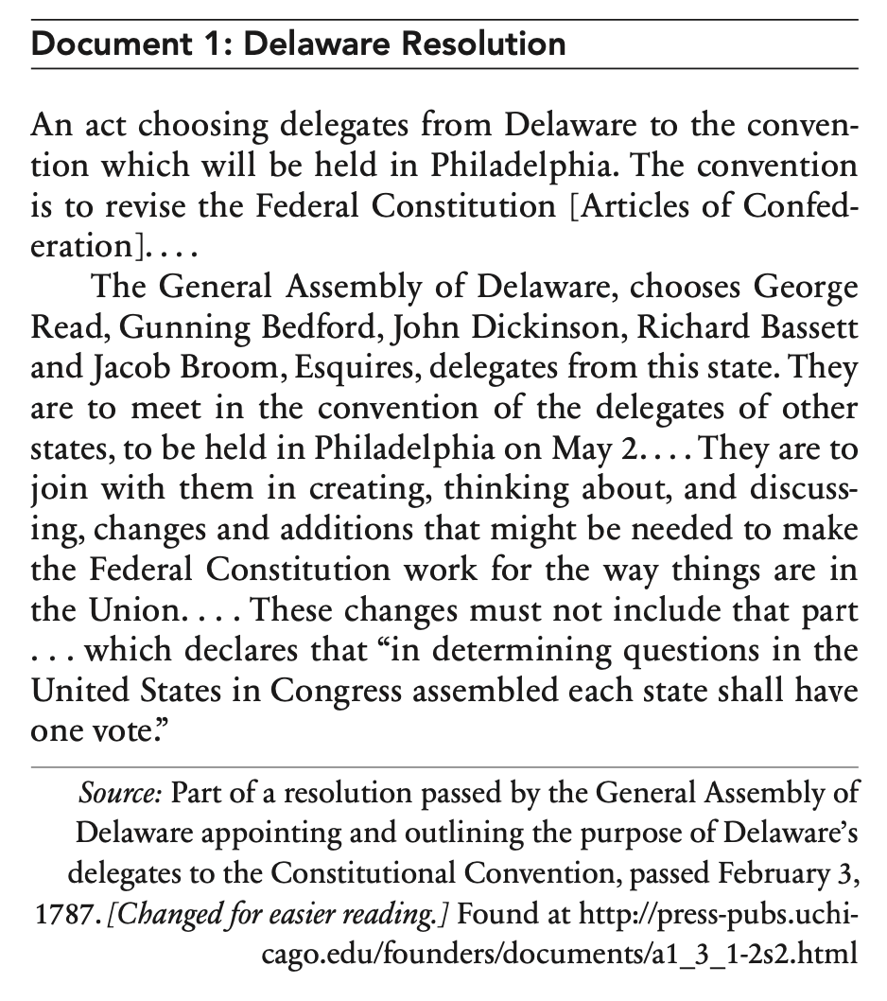
Sourcing
small state
formal, public
state legislature
3 months before convention
explains role of Del’s reps

Slide 23
Close Reading
minor changes
fed govt reps states
not natl. govt.
just change it, don’t replace it
it sounds like Del’s legislature may have suspected a change from fed to a natl system, with large states gaining more reps

Slide 24
Perspective Taking
Notes:
How would you react if you were a delegate from Delaware and you heard the Virginia Resolves that would create proportional representation?

Slide 25

Instructions for Delaware’s delegates
Delaware’s General Assembly (state legislators) Feb 1787
They are there only to revise.
Once they start talking about revising the single vote in the federal legislature they lose their authority to be there.

Slide 26
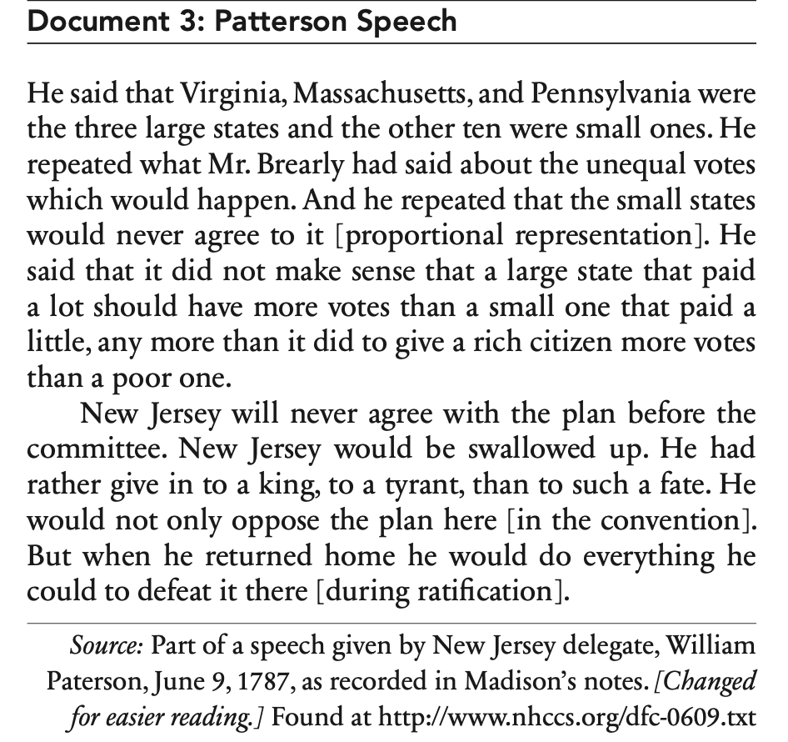
Sourcing
Close Reading
Perspective Taking

Slide 27
Sourcing

Slide 28
Close Reading

Slide 29
Perspective Taking

Slide 30
Instructions for Delaware’s delegates
Delaware’s General Assembly (state legislators)
They are there only to revise.
Once they start talking about revising the single vote in the federal legislature they lose their authority to be there.

Slide 31
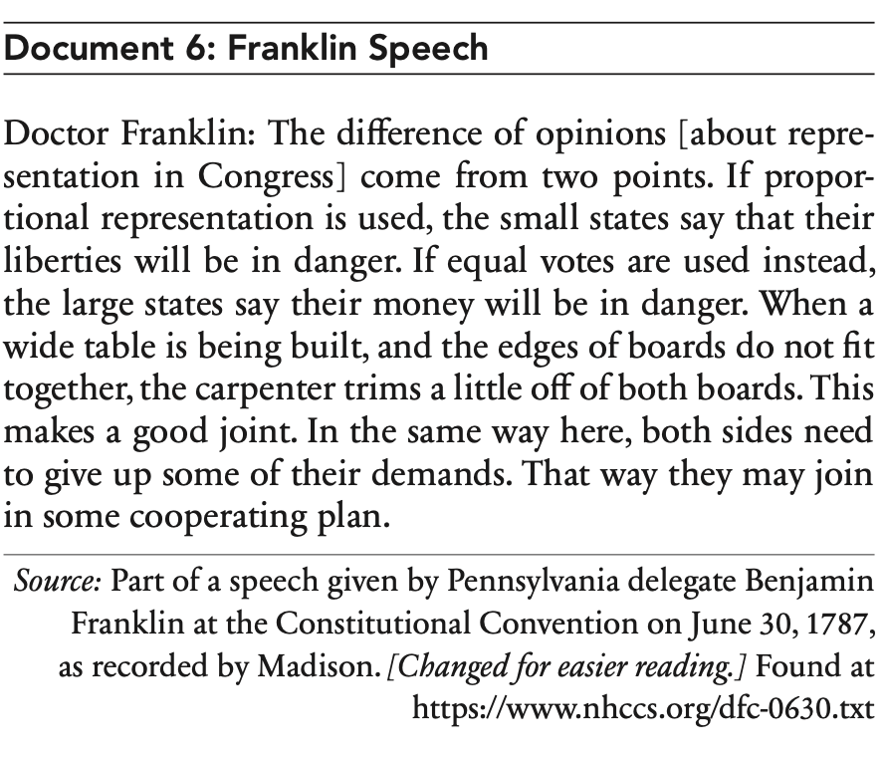
Sourcing
Close Reading
Perspective Taking

Slide 32
Sourcing

Slide 33
Close Reading

Slide 34
Perspective Taking

Slide 35
Instructions for Delaware’s delegates
Delaware’s General Assembly (state legislators)
They are there only to revise.
Once they start talking about revising the single vote in the federal legislature they lose their authority to be there.

Slide 36
Activity Debriefing
What were some of the main arguments for equal representation in Congress? For proportional representation?
How did the perspectives of the delegates change as the convention continued, allowing them to reach the Great Compromise?
What are some of the main barriers to compromise? How can these barriers be overcome?
Notes:
Debriefing questions deal with knowledge, skills, and dispositions.
Interestingly, Delaware was the first to ratify the Constitution

Slide 37

Connections to current events
What factors contributed to or hindered the recent compromise on the debt ceiling?
How did your Congressional representatives participate in the debate and vote on the debt ceiling?

Slide 38


Connections to civic engagement
How might perspective recognition help in civic engagement?

Slide 39
Teaching Debriefing
How would you adapt this for your classroom?
Notes:
Debriefing questions deal with knowledge, skills, and dispositions.
Interestingly, Delaware was the first to ratify the Constitution

