Slide 1
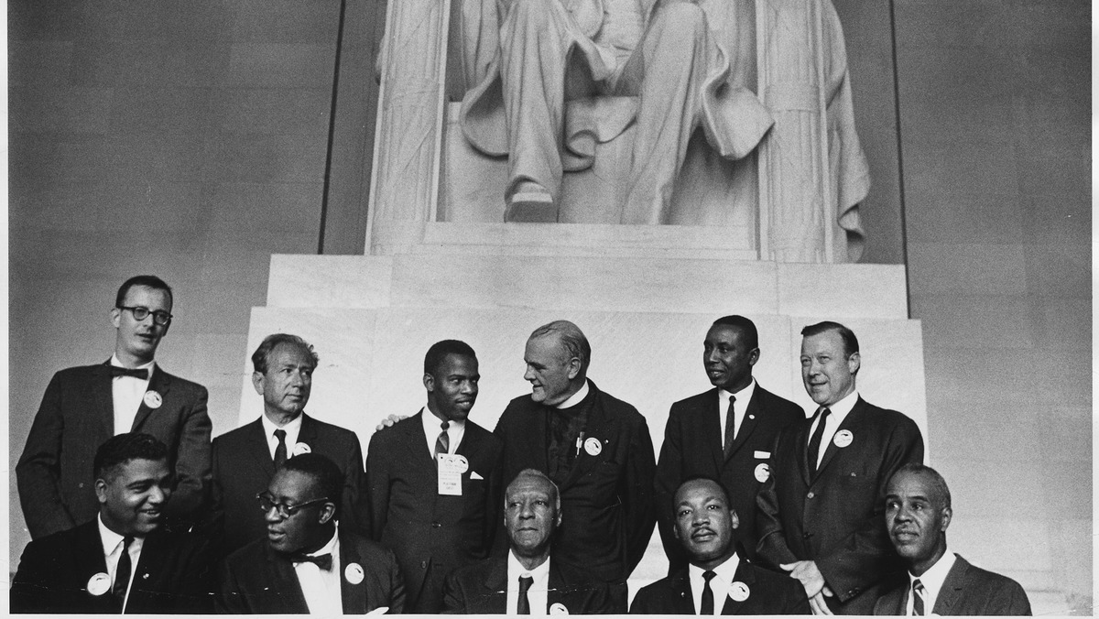
Landmark Civil Rights Cases
1856-1961
This Photo by Unknown Author is licensed under CC BY-SA

Slide 2
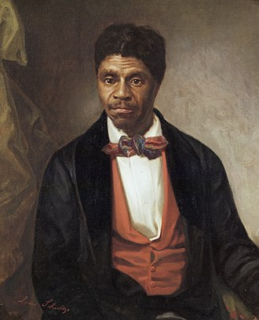
Dred Scott v. Sanford
This Photo by Unknown Author is licensed under CC BY-SA

Slide 3
Fourteenth Amendment
This Photo by Unknown Author is licensed under CC BY

Slide 4
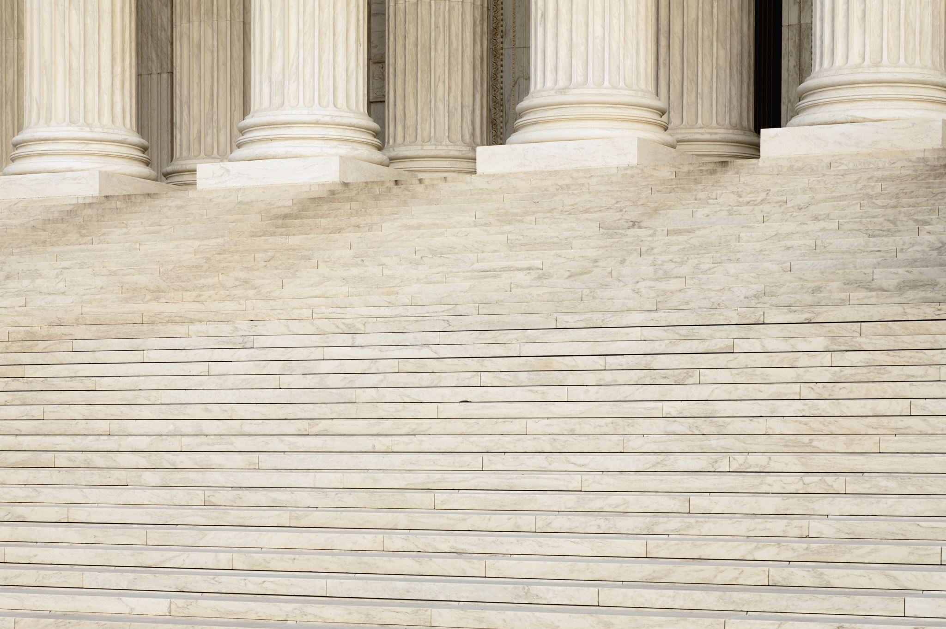
“All persons born or naturalized in the United States and subject to the jurisdiction thereof, are citizens of the United States and of the State wherein they reside. No State shall make or enforce any law which shall abridge the privileges or immunities of citizens of the United States; nor shall any State deprive any person of life, liberty, or property, without due process of law; nor deny to any person within its jurisdiction the equal protection of the laws.”

Slide 5
Sec. 5: The Congress shall have power to enforce, by appropriate legislation, the provisions of this article.

Slide 6
The Supreme Court Strikes Again

Slide 7
Slaughter-House Cases

Slide 8
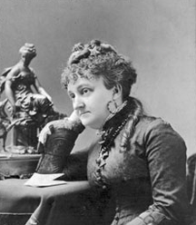
Bradwell v. Illinois
This Photo by Unknown Author is licensed under CC BY-SA

Slide 9
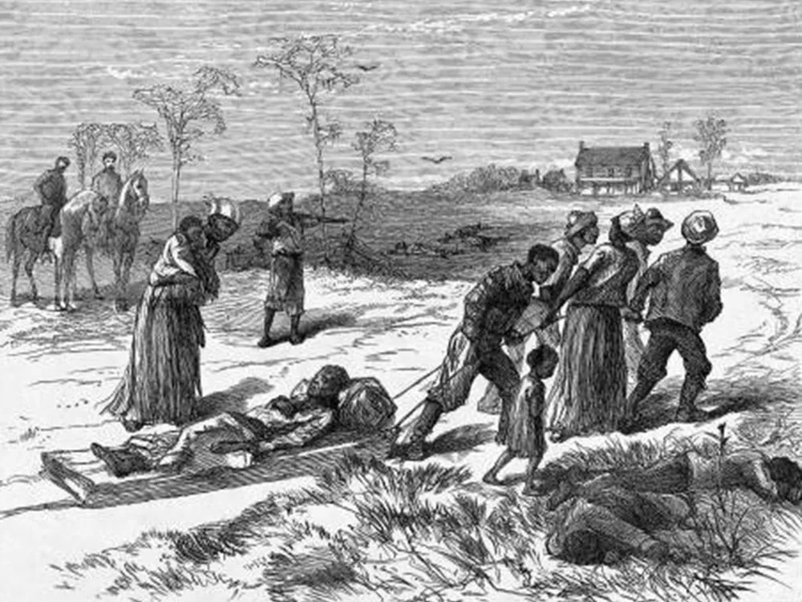
US v. Cruikshank

Slide 10
Strauder v. West Virginia

Slide 11
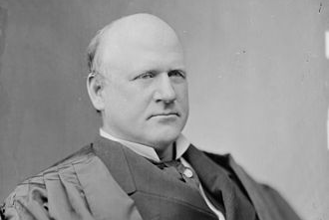
Civil Rights Cases
This Photo by Unknown Author is licensed under CC BY-SA

Slide 12
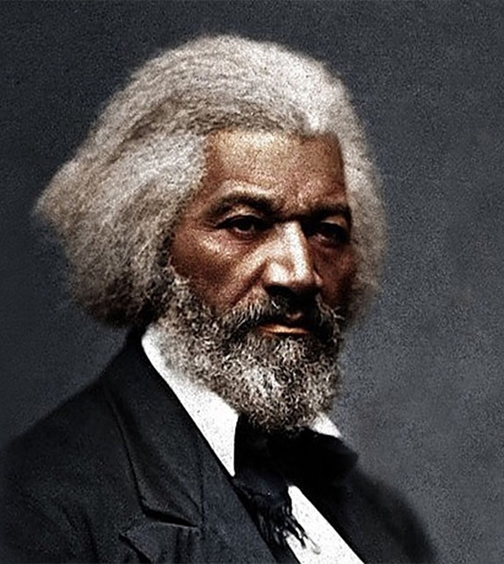
Responding to The Civil Rights Cases
“And yet of the nine only one is found worthy to hold up the liberal side of the American Constitution – only one who dares to respect the beneficent intentions of the loyal statesmen of the county, and to secure to colored citizens the rights plainly written down in the Constitution.”
This Photo by Unknown Author is licensed under CC BY-SA-NC

Slide 13
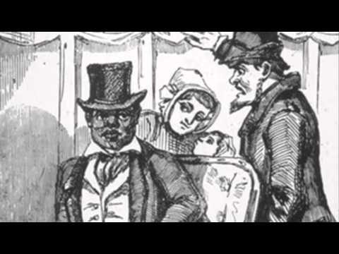
Plessy v. Ferguson
This Photo by Unknown Author is licensed under CC BY-SA-NC

Slide 14
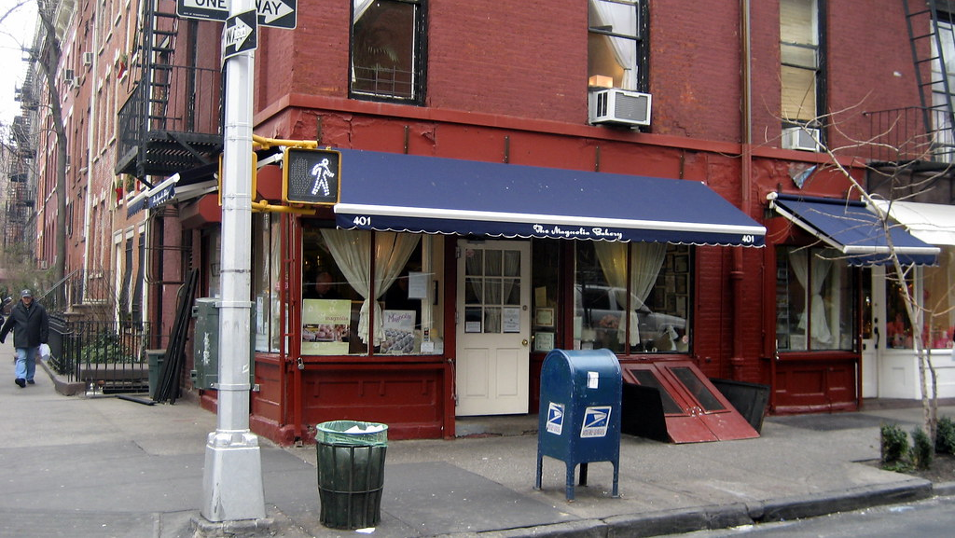
Lochner v. New York
This Photo by Unknown Author is licensed under CC BY-NC-ND

Slide 15
Sweatt v. Painter & McLaurin v. Oklahoma State Regents

Slide 16
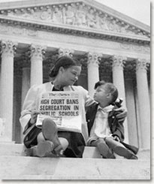
Brown v. Board of Education
This Photo by Unknown Author is licensed under CC BY-NC

Slide 17
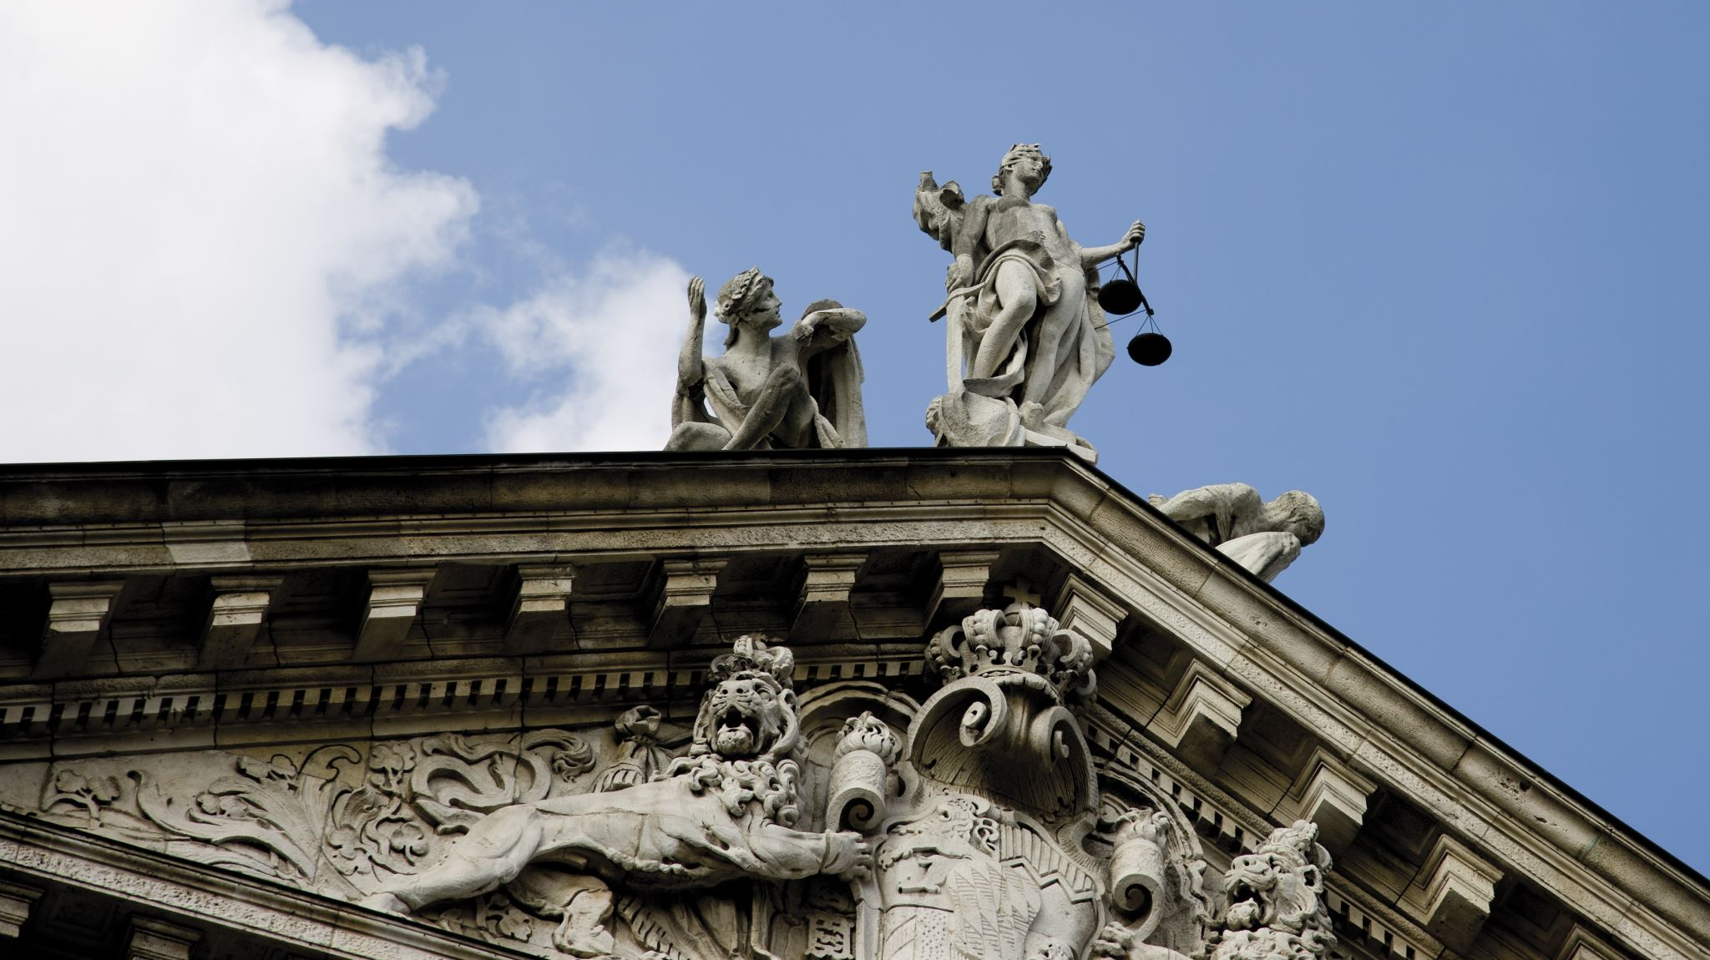
Busing (Gayle v. Browder), Affirmative Action (Regents of the University of California v. Bakke), Marriage (Loving v. Virginia, Obergefell v. Hodges)

Slide 18
Recent Cases
Religious Liberty
Fulton v. City of Philadelphia
Masterpiece Cakeshop v. Colorado Civil Rights Commission
Speech
303 Creative v. Elenis
Abortion
Dobbs v. Jackson's Whole Women's Health Organization
Voting
Allen v. Milligan
Affirmative Action
Students for Fair Admissions v. Harvard
FDA v. Alliance for Hippocratic Medicine
Moyle v. US
Transgender Care
United States v. Skrmetti

Slide 19
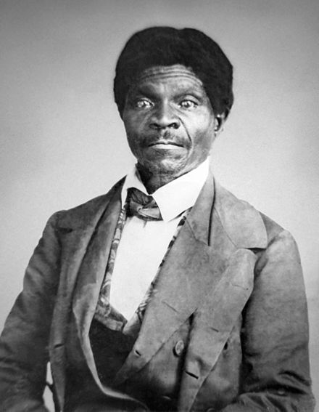
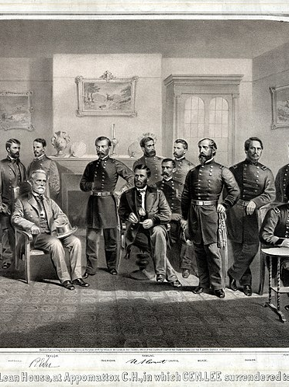
Conclusion
This Photo by Unknown Author is licensed under CC BY
This Photo by Unknown Author is licensed under CC BY-SA
This Photo by Unknown Author is licensed under CC BY-SA
This Photo by Unknown Author is licensed under CC BY-NC-ND

