Slide 1

LABORATORY SAFETY TRAINING
UVU College of Science and Health

Slide 2
Chemical Hygiene Coordinator
Craig Moore
Office: SB052b
801-863-5252
craig.moore@uvu.edu

Slide 3

Why are we doing this?
Because OSHA says we have to.
Occupational Exposures to Hazardous Chemicals in the Laboratory
(29 CFR 1910.1450), “Laboratory Standard".
https://www.osha.gov/pls/oshaweb/owadisp.show_document?p_table=STANDARDS&p_id=10106
A facility where:
Chemical manipulations are carried out on a “laboratory scale” (easily handled by one person)
Multiple chemical procedures or chemicals are used
The procedures involved are not part of a production process, nor do they in any way simulate a production process
“Protective laboratory practices and equipment” are available and in common use to minimize the potential for worker exposure to hazardous chemicals.

Slide 4


Elements of the Safety Program
The goal of the Laboratory Safety Program is to minimize the risk of injury or illness to laboratory workers by ensuring that they have the training, information, support and equipment needed to work safely in the laboratory.
Utah Valley University
College of Science & Health
Laboratory Safety Manual
Utah Valley University
College of Science & Health
Chemical Hygiene Plan

Slide 5
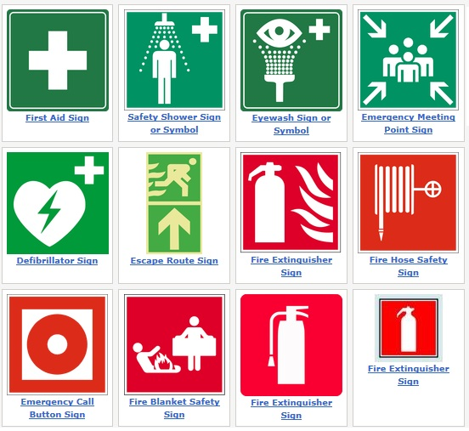
Laboratory Safety Manual
INTRODUCTION
  Safety Policy
II Roles and Responsibilities
  Deans and Department Chairs
  Chemical Hygiene Coordinator
  Faculty / Lab Managers
  All Employees and Students
III EVACUATIONS PROCEDURES
  Fire
  Electrical Outage
  Critical Operations
IV HEALTH HAZARDS OF CHEMICALS
  Toxic Effects of Chemical Exposure
  Routes of Entry
V CONTROLLING CHEMICAL EXPOSURE
  Engineering Controls
  Administrative Controls
  Safe Work Practices
  Personal Protective Equipment (PPE)
VI SAFE WORK PRACTICES
  Before you Begin
  Chemical Storage
  Segregation of Chemicals
  Personal Behavior
  Transporting Chemicals
  Working with Scaled-Up Reactions
  Unattended Experiments
  Working Alone
VII Personal Protective Equipment (PPE)
  Eye Protection
  Safety Glasses
  Chemical Splash Goggles
  Face Shields
  Contact Lenses
  Gloves
  Respiratory Protection
  Protective Clothing
  Footwear
VIII CHEMICAL SPILLS
  Spill Response and Clean-up Procedures
IX WASTE DISPOSAL

Slide 6

Chemical Hygiene Plan
To provide every aspect for prudent work practices and procedures for the procurement, storage, handling and disposal of chemicals in the laboratory, in order to protect all personnel from the potential health hazards of the chemicals they may encounter in the laboratory.

Slide 7
Chemical Hygiene Plan
INTRODUCTION
SCOPE AND APPLICATION
ROLES AND RESPONSIBILITIES
  Deans and Department Chairs
  Chemical Hygiene Coordinator
  Faculty / Lab Managers
  All Employees and Students
CHEMICAL AND HAZARD IDENTIFICATION
CHEMICAL STORAGE
  General Considerations
  Segregation of Chemicals
  Specific Considerations
    Flammable and Combustible Liquids
    Acids
    Compressed Gases
CONTROLLING CHEMICAL EXPOSURE
  Engineering Controls
  Fume Hoods
  Elephant Trunks
  Administrative Controls
  Safe Work Practices
  Personal Protective Equipment (PPE)
CHEMICAL HANDLING
  Before you Begin
  General Procedures
  Transporting Chemicals
  Laboratory Equipment and Glassware
  Specific Procedures
    Flammable Liquids
    Flammable Solids
    Peroxide Forming Compounds and Reactives
    Corrosive Liquids
    Corrosive Solids
    Compressed Gases
PERSONAL PROTECTIVE EQUIPMENT (PPE)
  Eye Protection
  Safety Glasses
  Chemical Splash Goggles
  Face Shields
  Contact Lenses
  Gloves
  Respiratory Protection
  Protective Clothing
  Footwear

Slide 8
Chemical Hygiene Plan (continued)
WASTE DISPOSAL
  Classification of Waste as Hazardous
  Storage of Chemical Hazardous Waste
  90-Day Storage Areas
CHEMICAL SPILLS, RELEASES AND ACCIDENTS
  Spill Response and Clean-up Procedures
  Spills resulting in release to the Orem City wastewater stream
SAFETY AND EMERGENCY EQUIPMENT
INFORMATION AND TRAINING
  Laboratory Safety Training
  Training Records
PRIOR APPROVAL OF LABORATORY ACTIVITIES
  Chemical Procurement
  Working in the Laboratory Unsupervised
  Working Alone in the Laboratory
  Unattended Operations
  Critical Operations
CHEMICAL EXPOSURE DETERMINATION
  Incident Reporting
  Exposure Monitoring
MEDICAL CONSULTATIONS AND EXAMINATIONS
  Medical Consultation Procedure
  Emergency Situations
  Non-Emergency Situations
PARTICULARLY HAZARDOUS SUBSTANCES
  Select Carcinogens
  Reproductive Toxin
  High acute toxicity
  Working Safely with Particularly Hazardous Substances
  Work Habits
  Personal Protective Equipment
  Ventilation/Isolation
  Storage and Transportation
  Vacuum Lines and Services
  Decontamination and Disposal
INSPECTIONS AND AUDITS
RECORDKEEPING
REFERENCES AND RECOMMENDED READING

Slide 9

All UVU Faculty/Staff and Students
Are to follow safe work practices, and if you are unsure of what is the correct/safe way to perform a task or a job, you are to ask your faculty mentor or lab manager
Must immediately report all unsafe equipment or tools to your faculty mentor or lab manager. This includes reporting unsafe behavior of others, if they are approached and remain unwilling to correct their unsafe actions or conditions.
Are to uphold the safe work practices the departments have established
If injured on the job, or become ill, immediately inform your faculty mentor or lab manager.

Slide 10



PEL – Permissible Exposure Limit
TWA – Time Weighted Average (8 hours)
STEL – Short-term Exposure Limit (~15 minutes)
TLV – Threshold Limit Value
  ACHIH – American Conference of Governmental Industrial Hygienist
LD₅₀ – Median Lethal Dose
LC₅₀ – Lethal Concentration and Time

Slide 11

CONTROLLING CHEMICAL EXPOSURE
Engineering Controls
Administrative Controls
Safe Work Practices
Personal Protective Equipment (PPE)

Slide 12
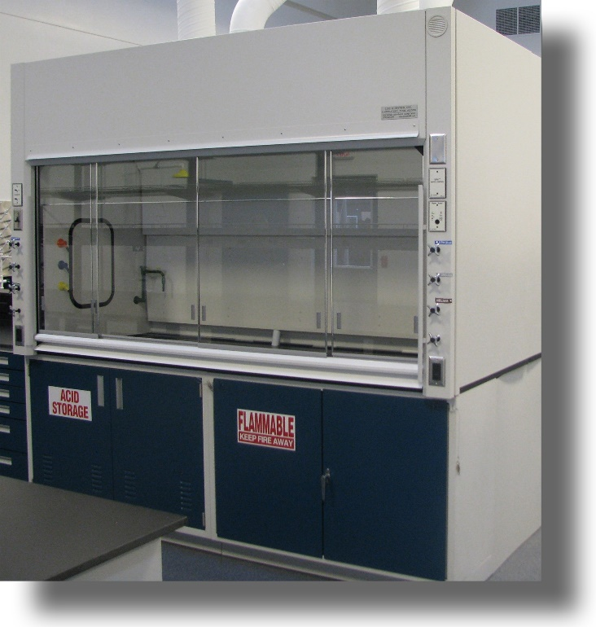
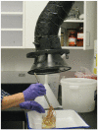
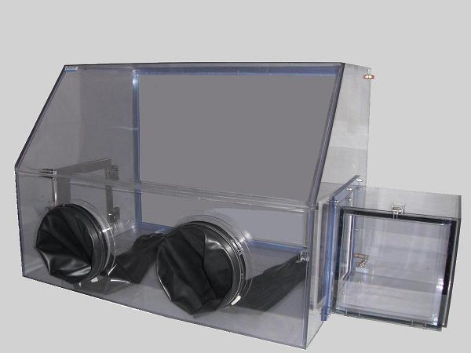

Engineered Controls
The primary method of controlling chemical exposure!

Slide 13
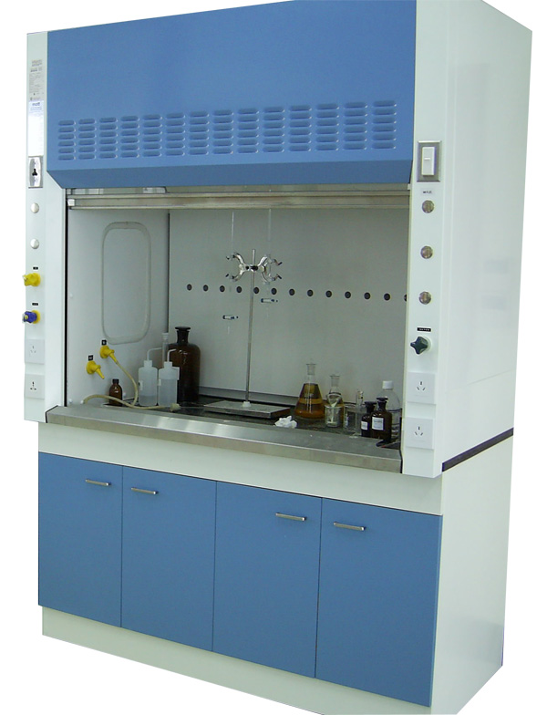
Fume Hoods
When to use
When the MSDS/SDS says to
When working with extremely volatile chemicals
High probability of chemical vapors

Slide 14
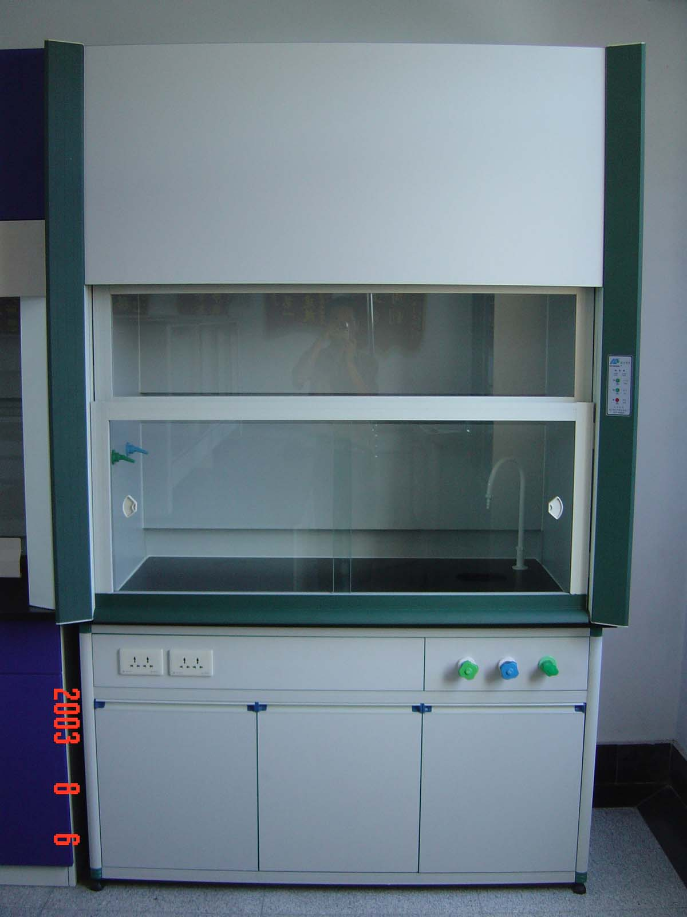
Fume Hood Work Practices
Know the toxic properties of the chemicals with which you work. (SDS)
Be able to identify signs and symptoms of overexposure. (SDS)
Keep all chemicals and equipment six inches from the sash
Keep the sash completely lowered anytime "hands-on" experiments are not in progress or whenever the hood is on and unattended.
Never utilize the hood unless there is some indication that the hood is operating.
The hood is not a substitute for personal protective equipment. Wear gloves, safety glasses, etc., as appropriate.
Visually inspect the baffles to be sure the slots are open and unobstructed.
Do not block baffles. If large equipment is in the hood, put it on blocks to raise it approximately two inches so that air may pass beneath it.
Do not use the hood as a storage cabinet.
Keep the sash clean and clear.
Clean all chemical residues from the hood chamber after each use.
All electrical devices should be connected outside the hood to avoid sparks which may ignite a flammable or explosive chemical.

Slide 15
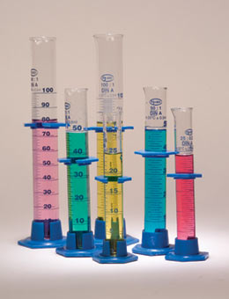

Administrative Controls
Changes in the method or process to reduce exposure. These include:
  Substituting a less toxic chemical
  Reducing the amount of the chemical being used
  Reducing the length of the exposure time
  Using plastic equipment instead of glass
  All Laboratory personnel are encouraged to look for and suggest changes in procedures to reduce exposure!

Slide 16
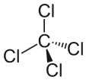

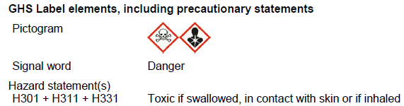
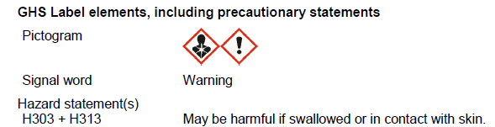
Tetrachloromethane (Carbon Tetrachloride)
Dichloromethane (Methylene Chloride)
TWA 5 ppm
STEL 10 ppm
TWA 50 ppm
STEL 125 ppm
TWA – Time Weighted Average (8 hours)
STEL – Short-term Exposure Limit (~15 minutes)

Slide 17

SAFE WORK PRACTICES

Slide 18




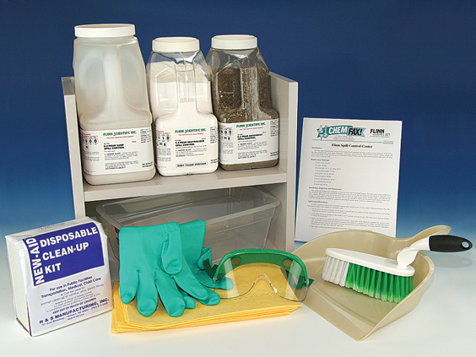


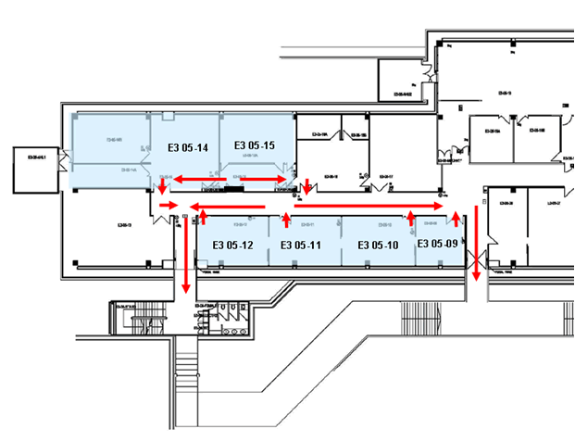

Be Aware of Your Surroundings

Slide 19


















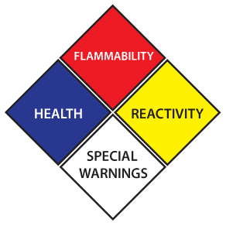





Know the potential hazards and appropriate safety precautions before beginning work. Ask and be able to answer the following questions:
  What are the hazards?
  What are the worst things that could happen?
  What do I need to do to be prepared?
  What work practices, facilities or personal protective equipment are needed to minimize the risk?

Slide 20
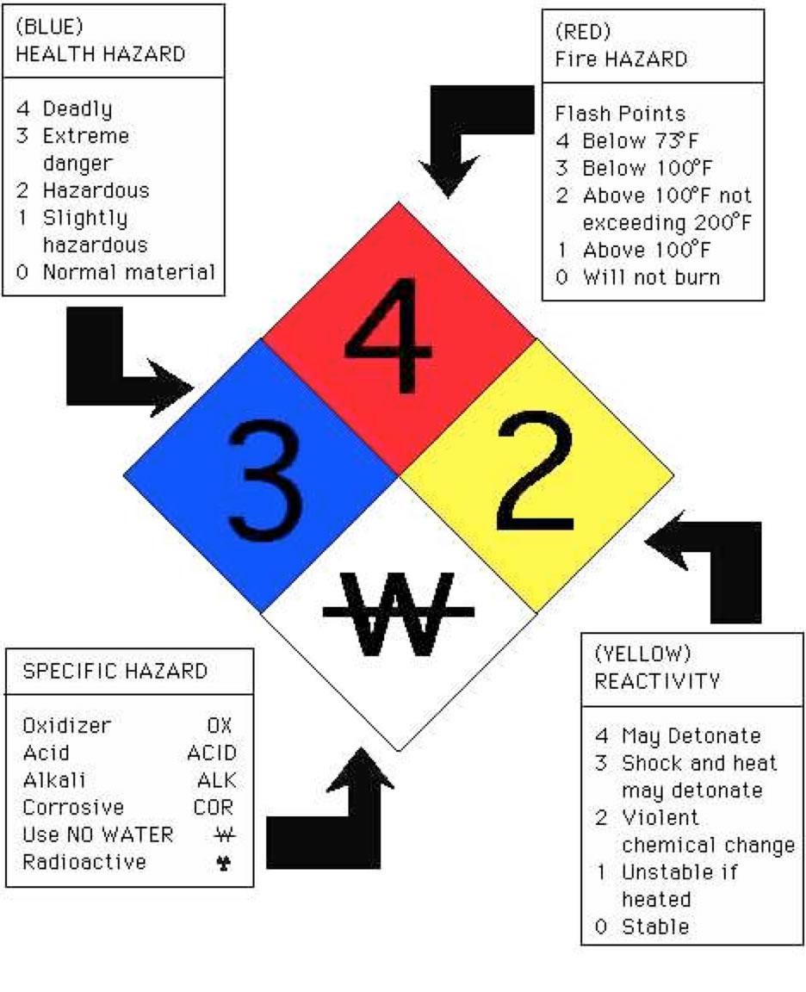
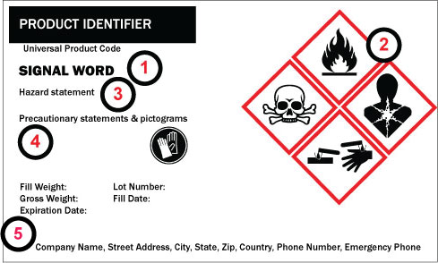
National Fire Protection Association
(NFPA)
Globally Harmonized System
(GHS)
LABELS

Slide 21
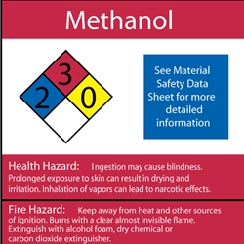
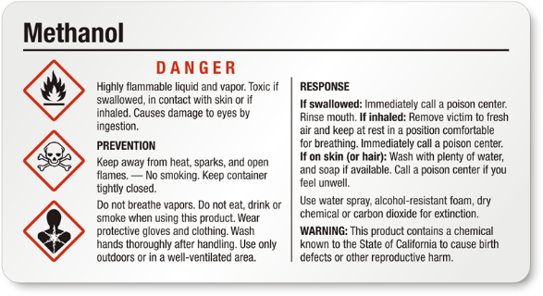
NFPA
GHS

Slide 22
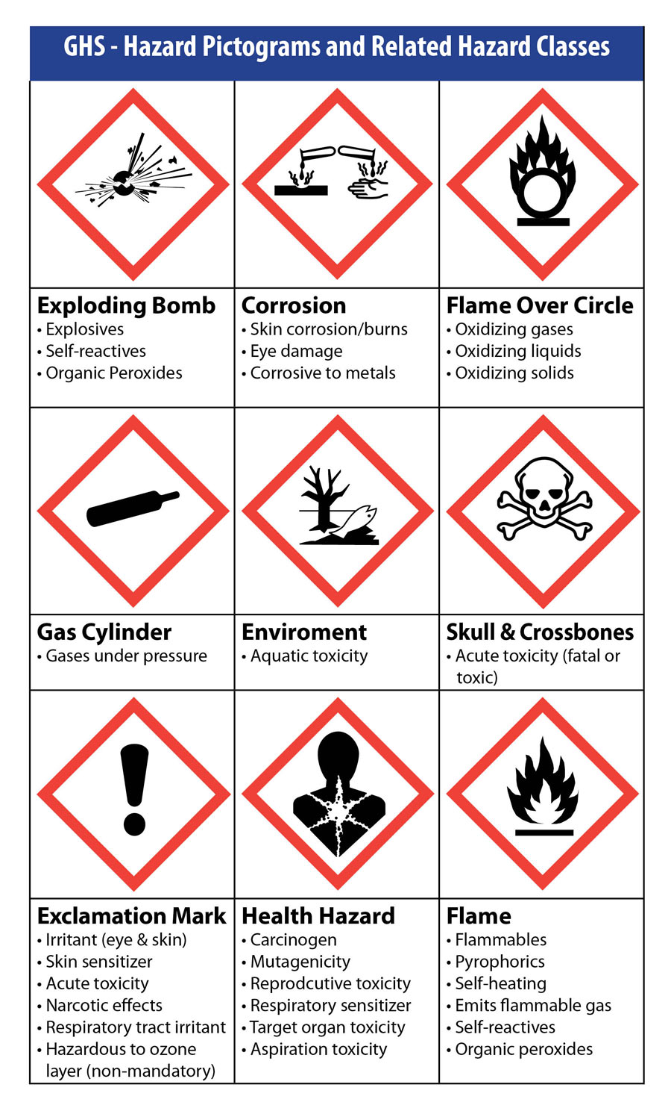
Product Identifier
Pictogram(s)
Signal Word
    Danger or Warning
Hazard Statement(s)
    Standardized and assigned phrases that describe the hazard(s) as determined by hazard Classification.
Precautionary Statement(s)
    Supplements the hazard information by briefly providing measures to be taken to minimize or prevent adverse effects from physical, health or environmental hazards. First aid is included in precautionary information.

Slide 23
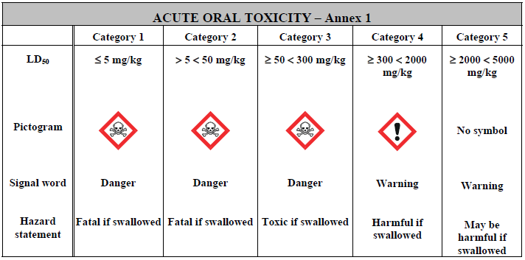
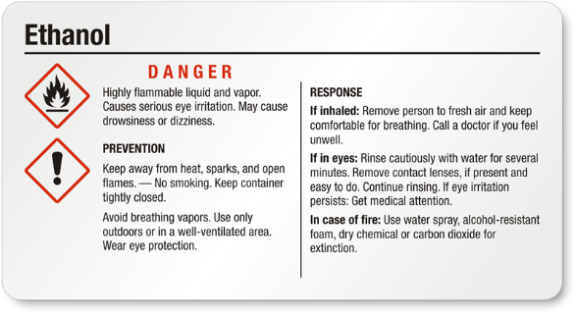

Slide 24


MSDS vs. SDS
=

Slide 25
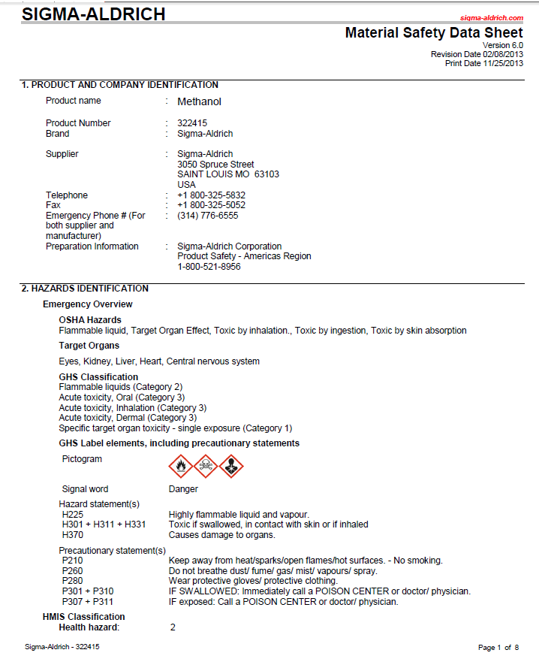
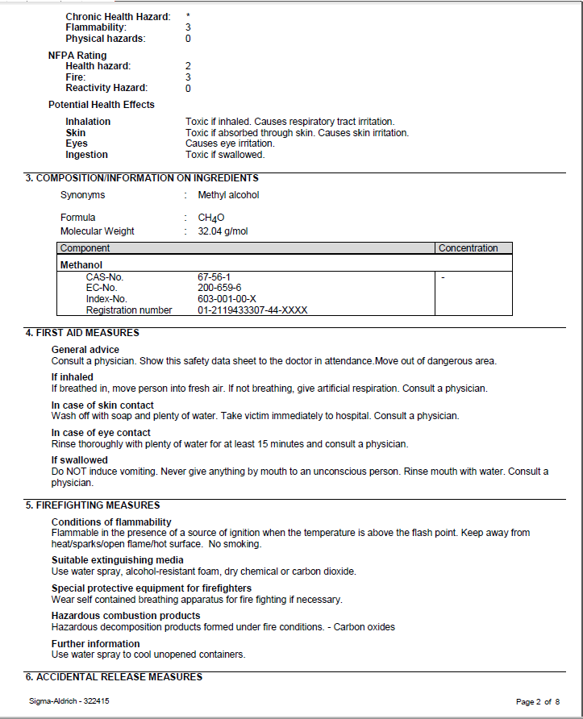

Slide 26
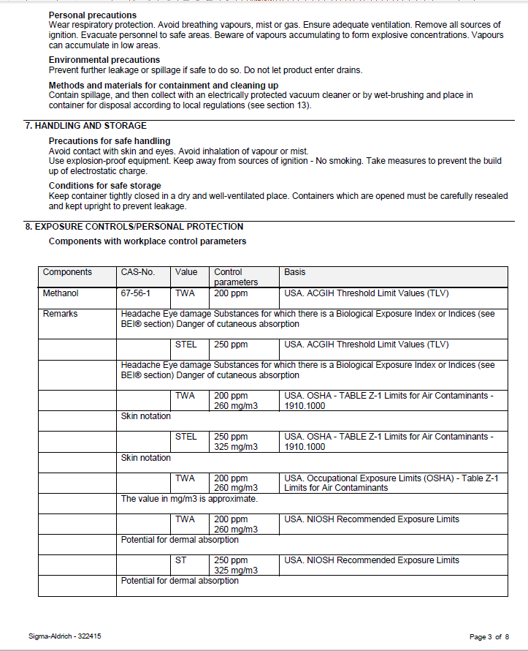
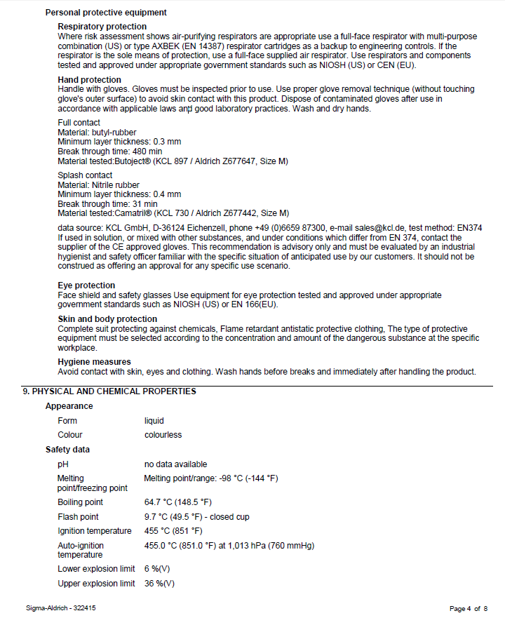

Slide 27
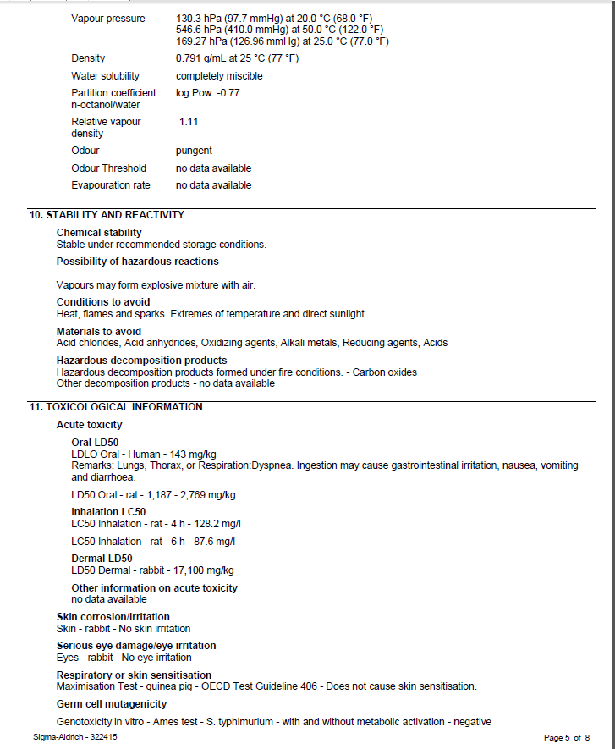
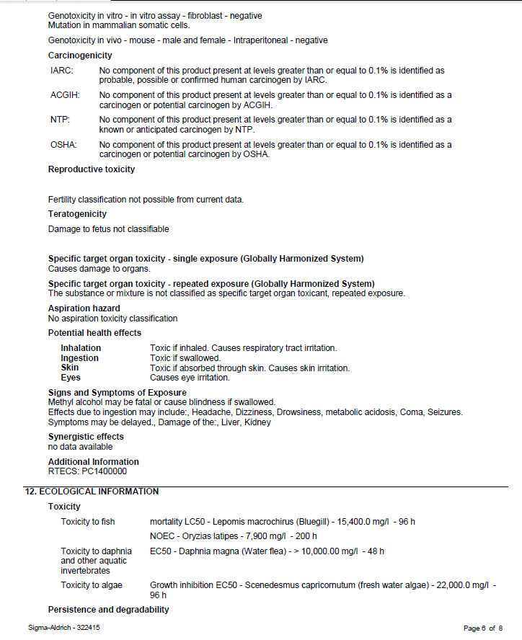

Slide 28
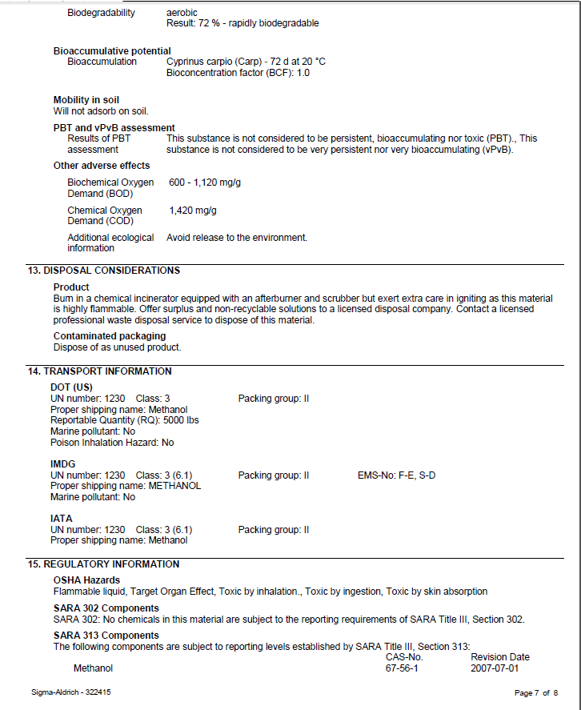
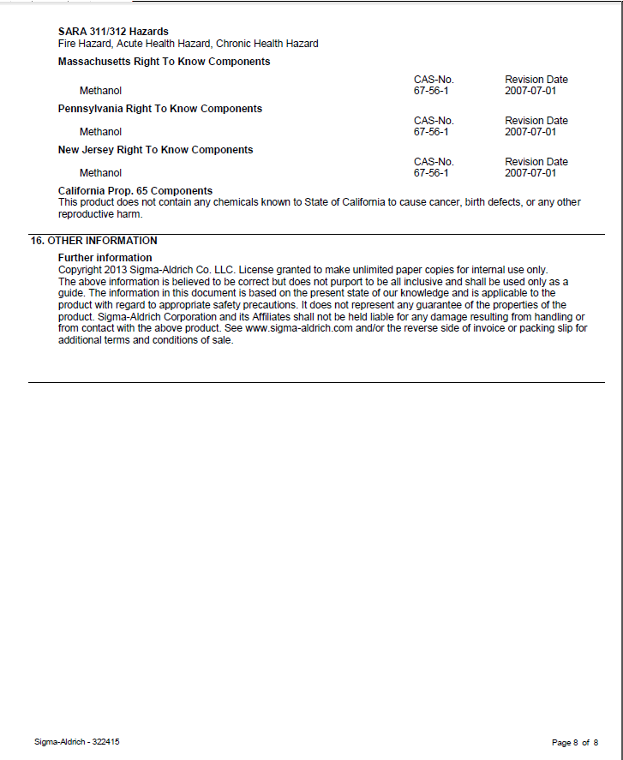

Slide 29

Chemical Storage
Avoid storing materials and equipment on top of cabinets
Do not store corrosive liquids above eye level.
Provide a specific storage location for each type of chemical, and return the chemicals to those locations after each use.
Avoid storing chemicals in the workspace within a laboratory hood, except for those chemicals currently in use.
If a chemical does not require a ventilated cabinet, store it inside a closable cabinet or on a shelf that has a lip to prevent containers from sliding off in the event of an accident or fire.
Do not expose chemicals to heat or direct sunlight.
Observe all precautions regarding the storage of incompatible chemicals.
Use corrosion resistant storage trays or secondary containers to collect materials if the primary container breaks or leaks.
Do not store flammable liquids in a refrigerator unless it is approved for such storage. Such refrigerators are designed with non-sparking components to avoid an explosion.

Slide 30
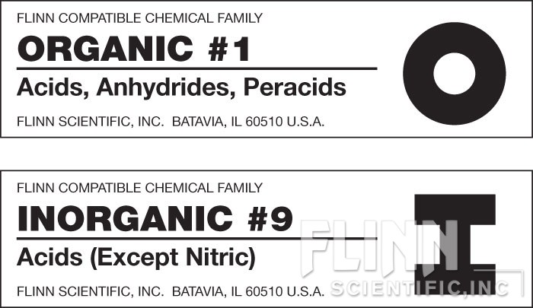
I1 – Metals, Hydrides
I2 – Acetates, Halides, Iodides, Sulfates, Sulfites,
Thiosulfates, Phosphates, Halogens
I3 – Amides, Nitrates (except Ammonium Nitrate),
Nitrites, Azides
I4 – Hydroxides, Oxides, Silicates, Carbonates, Carbon
I5 – Sulfides, Selenides, Phosphides, Carbides, Nitrides
I6 – Chlorates, Bromates, Iodates, Chlorites,
Hypochlorites, Perchlorates, Perchloric Acid,
Peroxides, Hydrogen Peroxide
I7 – Arsenates, Cyanides, Cyanates
I8 – Borates, Chromates, Manganates, Permanganates
I9 – Acids (except Nitric) Nitric Acid is isolated and stored by itself.)
I10 – Sulfur, Phosphorus, Arsenic, Phosphorous Pentoxide
IM – Miscellaneous
O1 – Acids, Amino Acids, Anhydrides, Peracids
O2 – Alcohols, Glycols, Sugars, Amines, Amides, Imines, Imides
O3 – Hydrocarbons, Esters, Aldehydes, Oils
O4 – Ethers, Ketones, Ketenes, Halogenated
Hydrocarbons, Ethylene Oxide
O5 – Epoxy Compounds, Isocyanates
O6 – Peroxides, Hydroperoxides, Azides
O7 – Sulfides, Polysulfides, Sulfoxides, Nitriles
O8 – Phenols, Cresols
O9 – Dyes, Stains, Indicators
OM – Miscellaneous

Slide 31
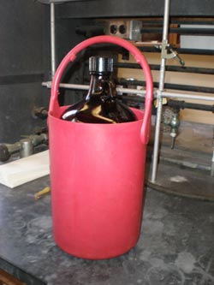
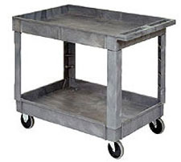
Transporting Chemicals
Use a bottle carrier, cart or other secondary container when transporting chemicals in breakable containers (especially 250 ml or more) through hallways or between buildings. Secondary containers are made of rubber, metal or plastic, with carrying handle(s), and are large enough to hold the entire contents of the chemical containers in the event of breakage.
Transport of hazardous chemicals in individual containers exceeding four liters between buildings is strongly discouraged.
When moving in the laboratory, anticipate sudden backing up or changes in direction by others. If you should stumble or fall while carrying glassware or chemicals, try to project them away from yourself and others.
The individual transporting the chemical should be knowledgeable about the hazards of the chemical and should know how to handle a spill of the material. (SDS)
When transporting compressed gas cylinders, the cylinder should always be strapped in a cylinder cart and the valve protected with a cover cap. Do not attempt to carry or roll cylinders from one area to another.
Keep chemicals in their original packing when transporting, if possible.

Slide 32










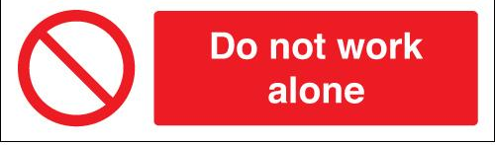

Slide 33

Personal Protective Equipment
(PPE)

Slide 34

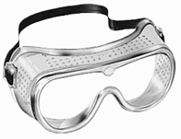



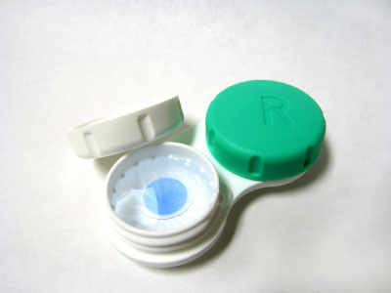
Eye Protection

Slide 35




Gloves
Consult the SDS

Slide 36




Clothing

Slide 37
When Chemical Exposure Occurs
Seconds Count!

Slide 38


Slide 39
Chemicals on Skin or Clothing
Immediately flush with water for no less than 15 minutes.
For larger spills, the safety shower should be used.
While rinsing, quickly remove all contaminated clothing or jewelry. Seconds count. Do not waste time because of modesty.
Use caution when removing pullover shirts or sweaters to prevent contamination of the eyes.
Check the Safety Data Sheet to determine if any delayed effects should be expected.
Discard contaminated clothing or launder them separately from other clothing. Leather garments or accessories cannot be decontaminated and should be discarded.
Do not use solvents to wash skin. They remove the natural protective oils from the skin and can cause irritation and inflammation. In some cases, washing with a solvent may facilitate absorption of a toxic chemical.
For flammable solids on skin, first brush off as much of the solid as possible, then proceed as described above.
Fill out an Incident Report!

Slide 40
Chemicals in Eyes
Immediately flush eye(s) with water for at least fifteen minutes. The eyes must be forcibly held open to wash, and the eyeballs must be rotated so all surface area is rinsed. The use of an eye wash fountain is desirable so hands are free to hold the eyes open. If an eyewash is not available, pour water on the eye, rinsing from the nose outward to avoid contamination of the unaffected eye.
Remove contact lenses while rinsing. Do not lose time removing contact lenses before rinsing. Do not attempt to rinse and reinsert contact lenses.
Seek medical attention regardless of the severity or apparent lack of severity. Explain carefully what chemicals were involved. If easily accessible, bring an SDS.
Fill out an Incident Report!

Slide 41



Chemical Inhalation
Close containers, open windows or otherwise increase ventilation, and move to fresh air.
If symptoms, such as headaches, nose or throat irritation, dizziness, or drowsiness persist, seek medical attention. Explain carefully what chemicals were involved.
Review the SDS to determine what health effects are expected, including delayed effects.
Accidental Ingestion of Chemicals
Immediately contact the Poison Control Center at 800-222-1222 for instructions.
Do not induce vomiting unless directed to do so.
Accidental Injection of Chemicals
Wash the area with soap and water and seek medical attention, if necessary.
Last but Not least
Fill out an Incident Report!

Slide 42
Spill Response and Clean-up Procedures
The individual(s) who caused the spill is responsible for prompt and proper clean-up
Immediately alert area occupants and evacuate the area, if necessary.
Contaminated clothing must be removed immediately and the skin flushed with water for no less than fifteen minutes.
Don personal protective equipment, as appropriate to the hazards. (Will a respirator be necessary?) (Now is not the time to read the SDS!)
Protect floor drains or other means for environmental release.
Loose spill control materials should be distributed over the entire spill area, working from the outside, circling to the inside.
Do not pick up broken glass with hands
When spilled materials have been absorbed, use brush and scoop to place materials in an appropriate container.
Complete a hazardous waste sticker, identifying the material as Spill Debris involving XYZ Chemical, and affix onto the container.
Decontaminate the surface where the spill occurred using a mild detergent and water.
Notify the Chemical Hygiene Coordinator!

Slide 43


Category | Size | Response | Treatment Materials
Small | up to 300cc | chemical treatment or absorption | neutralization or absorption spill kit
Medium | 300 cc - 5 liters | absorption | absorption spill kit
Large | more than 5 liters | call public safety | outside help

Slide 44
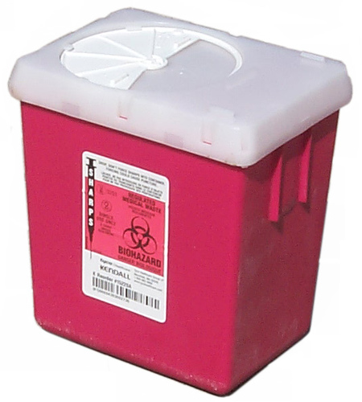
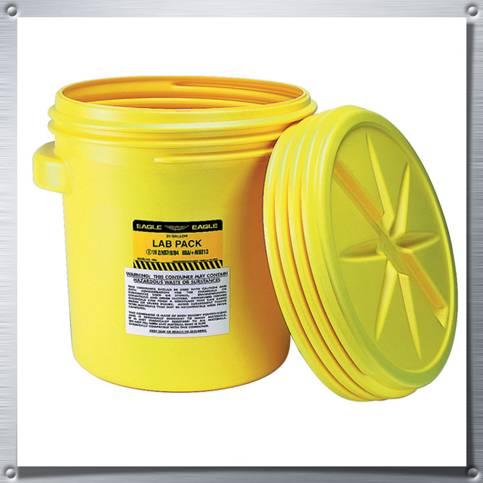

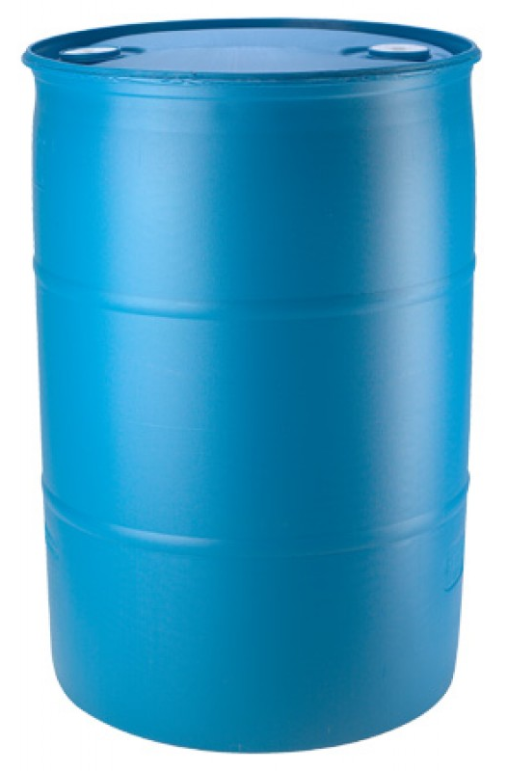
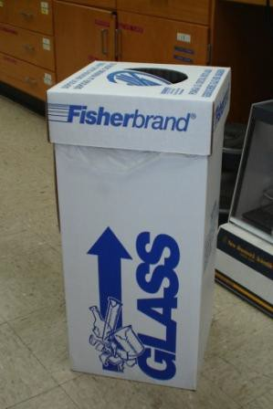

Waste Disposal

Slide 45
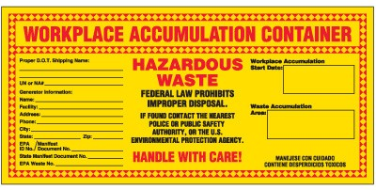

Slide 46

All faculty, Laboratory Managers, staff, and students are encouraged to give recommendations to improve safety and health conditions.

