Slide 1
Effects of Alcohol v. Academic Success
Utah Valley University
Kamrin Tarantino, Jantz Johnson, Bradley Wolf,
Jordan Twitchell, Derek Jones
03/28/2016

Slide 2
Purpose of Study
The purpose of this research study is to analyze the comparison of UVU students and alcohol use in regards to academic success and how alcohol affects study and testing.
This study is important because it is critical for students to understand and comprehend how alcohol can affect their academics as well as their personal life.
It is important because if students or persons have a dependency on alcohol or its consumption this study will show that problem and they can make necessary changes to improve academic success.

Slide 3
Question: Does the level of alcohol consumption directly affect the level of academic success while attending a University level setting?
Alcohol and College Students: National Statistics
Prevalence of Alcohol Use:
  Prevalence of Drinking: In 2013, 59.4 percent of full-time college students ages 18–22 drank alcohol in the past month compared with 50.6 percent of other persons of the same age.
  Prevalence of Binge Drinking: In 2013, 39 percent of college students ages 18–22 engaged in binge drinking (5 or more drinks on an occasion) in the past month compared with 33.4 percent of other persons of the same age.
  Prevalence of Heavy Drinking: In 2013, 12.7 percent of college students ages 18–22 engaged in heavy drinking (5 or more drinks on an occasion on 5 or more occasions per month) in the past month compared with 9.3 percent of other persons of the same age.
Consequences—Researchers estimate that each year:
  1,825 college students between the ages of 18 and 24 die from alcohol-related unintentional injuries, including motor-vehicle crashes.
  696,000 students between the ages of 18 and 24 are assaulted by another student who has been drinking.
  97,000 students between the ages of 18 and 24 report experiencing alcohol-related sexual assault or date rape.
  Roughly 20 percent of college students meet the criteria for an AUD. (Alcohol Use Disorder).
  About 1 in 4 college students report academic consequences from drinking, including missing class, falling behind in class, doing poorly on exams or papers, and receiving lower grades overall.
(http://www.niaaa.nih.gov/alcohol-health/overview-alcohol-consumption/alcohol-facts-and-statistics)

Slide 4
Question: How does alcohol affect the students here at Utah Valley University and is it a current problem?
We wanted to directly correlate the effect of alcohol consumption on UVU students and our peers in the classroom and if it has a prevalent presence here on campus.
It is important to understand that this survey was administered to see a sample of the student population and how they react to and treat alcohol along with how current student of all ages understand and feel about certain health risks along with academic risks, derived from our survey questions.
Should UVU allow alcohol on campus property, or should the consumption of alcohol on school property result in a punishable consequence?

Slide 5
Related Events
University of Utah: New high standards for alcohol possession and consumption in Greek Fraternities and Sororities, stating that less alcohol and stricter policies will decrease alcohol accidents and injuries on properties. Ex. High GPA, No Dean sanctions. March 13, 2013 (https://www.ksl.com/?sid=24393780)
Lord of the Rings actor speaks at UVU Conference on Addiction: Sean Astin speaks to a conference of 500 attendees, on the risks and struggles of addiction and how to to overcome hardships suffered by loved ones and those people that struggle overcoming addiction. March 4, 2016 (https://ksl.com/?sid=38764622)
College Students report more stress, less time to socialize: UCLA students report that there has been a homework increase and stress increase due to heavy burden of school workload. Report shows that there is a decrease in time to socialize. Translates into less alcohol related problems. February 5, 2015 (https://www.ksl.com/index.php?sid=33360309&nid=481)

Slide 6
Sample Size
With the first 500 students selected we only had 58 responses. By sending out reminder emails our response rate went up to 77. We asked for more randomly selected students, and with another 250 our response rate went to 111. We decided to keep the survey out for an extra week, sent out several reminder emails, and in the end had 147 responses.
 | Expected | Actual
Sample size | 500 | 750
Responses | 100 | 147

Slide 7
Data
We collected our data through an anonymous survey electronically sent out to students through their UVU email
  Freshman-Senior year students
  Male and Female
  Ages 18-50
  Problems we encountered- Problems contacting the IRb and getting our numbers
    Some people skipped questions on survey or did not complete survey

Slide 8
Literature Review
“The Relationship between Emotional Intelligence and Abuse of Alcohol, Marijuana and Tobacco among College Students” by Edith Claros and Manoj Sharma
  200 participants, ages 18-20, both male and female
  Examine the relationship between emotional intelligence and high risk behaviors of alcohol, marijuana, and tobacco
    Schutte Self Report inventory survey
    The Alcohol use Disorders Identification test
    Fagerstrom Test
    Marijuana assessment scale
  Results:
    Students who had used marijuana tested low on their ability for self-control and emotional management causing them to be risk takers and poor decision makers.
    Those who consumed alcohol showed no major improvement on their emotional coping test and tobacco results needed further research

Slide 9
Literature Review continued…
“Alcohol Consumption and Academic Retention in First-year College Students” by Gary Ligouri and Barb Lonbaken
  Examined the correlation of the use and consumption of alcohol as it pertained to first year students and as they moved into their second year of college
  820 first year college students both male and female, online survey regarding their alcohol consumption
  Results:
    Males were reported as heavier drinkers than females and males also had a significantly higher risk of lower retention rates associated with both social drinking and heavy episodic drinking
    Males had a higher chance of not returning back to school to complete their second year
    In regards to the academic success and retention of students, heavy drinking and mass consumption of alcohol can be detrimental to a students progression through school

Slide 10
Literature Review continued...
“Alcohol Consumption and Positive Study Practices among African American College Students” by B. DePyssler and V. Williams
  Results:
    There are a difference found in GPA scores among those who consumed alcohol versus those who did not.
    Those who consumed alcohol has a much lower GPA score than those who did not drink

Slide 11
Literature Review continued...
“The Relation Between Alcohol Abuse or Dependence and Academic Performance in First-Year college Students” by bert Aertgeerts and Frank Buntinx
  Articulate the negative relationship of first year students and their dependence on alcohol
  3,518 students
  Among the students surveyed, about 500 of these students admitted to having alcohol abuse problems and out of those 500, 128 were alcohol dependant.
  Over half (62.5 percent) of the students reported to failing their first year of college compared to 50 percent of the students who did not report these drinking problems
  Through this study there was shown a negative relationship between alcohol consumption and academic performance when they were paired with alcohol abuse

Slide 12
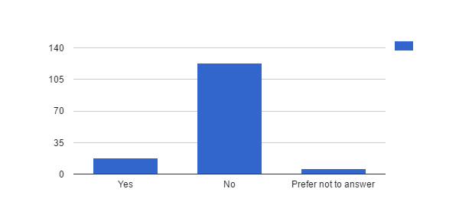
1. Do you currently drink alcoholic beverages?
# | Answer | Response | %
1 | Yes | 18 | 12%
2 | No | 123 | 84%
3 | Prefer not to answer | 6 | 4%
 | Total | 147 | 100%

Slide 13
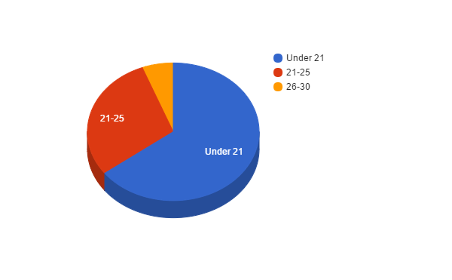
8. At what age did you start drinking alcoholic beverages?
# | Answer | Response | %
1 | Under 21 | 11 | 65%
2 | 21-25 | 5 | 29%
3 | 26-30 | 1 | 6%
4 | 31-35 | 0 | 0%
5 | 36-40 | 0 | 0%
6 | 40 or older | 0 | 0%
 | Total | 17 | 100%

Slide 14
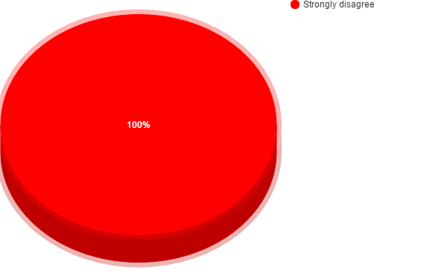
6. The use of alcohol determines my daily routine.
# | Answer | Response | %
1 | Strongly agree | 0 | 0%
2 | Agree | 0 | 0%
3 | Neutral | 0 | 0%
4 | Disagree | 0 | 0%
5 | Strongly disagree | 18 | 100%
 | Total | 18 | 100%

Slide 15
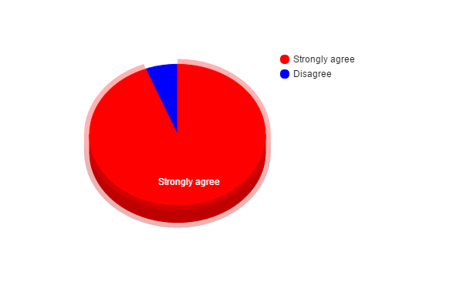
10. I am always able to stop drinking when I want to.
# | Answer | Response | %
1 | Strongly agree | 16 | 94%
2 | Agree | 0 | 0%
3 | Neutral | 0 | 0%
4 | Disagree | 1 | 6%
5 | Strongly disagree | 0 | 0%
 | Total | 17 | 100%

Slide 16
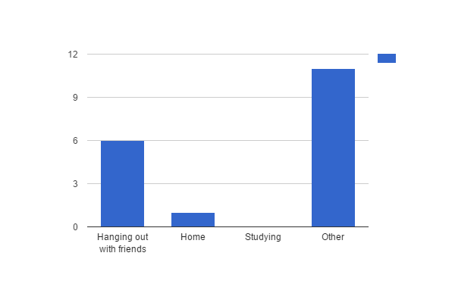
21. In what environment do you drink? Check all that apply.
# | Answer | Response | %
1 | Hanging out with friends | 6 | 35%
2 | Home | 1 | 6%
3 | Studying | 0 | 0%
4 | Other | 11 | 65%

Slide 17
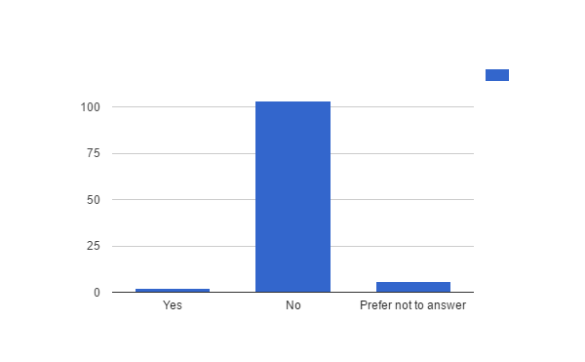
25. Do you drink alcoholic beverages while you study?
# | Answer | Response | %
1 | Yes | 2 | 2%
2 | No | 103 | 93%
3 | Prefer not to answer | 6 | 5%
 | Total | 111 | 100%

Slide 18
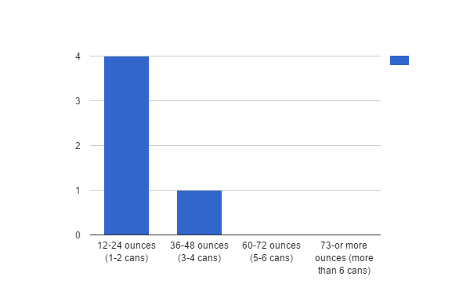
26. If yes, how much do you drink while you study?
# | Answer | Response | %
1 | 12-24 ounces (1-2 cans) | 4 | 80%
2 | 36-48 ounces (3-4 cans) | 1 | 20%
3 | 60-72 ounces (5-6 cans) | 0 | 0%
4 | 73-or more ounces (more than 6 cans) | 0 | 0%
 | Total | 5 | 100%

Slide 19
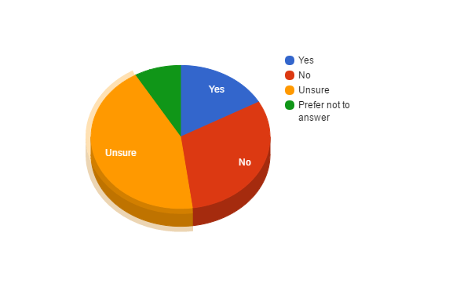
28. Do you feel that the consumption of alcoholic beverages affects your study habits?
# | Answer | Response | %
1 | Yes | 12 | 17%
2 | No | 22 | 31%
3 | Unsure | 31 | 44%
4 | Prefer not to answer | 6 | 8%
 | Total | 71 | 100%

Slide 20
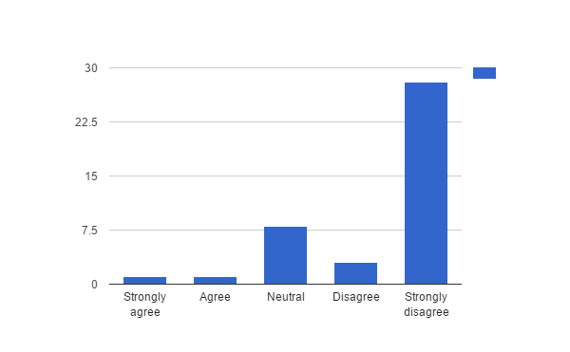
29. If yes, I feel alcohol has a positive effect on my grades.
# | Answer | Response | %
1 | Strongly agree | 1 | 2%
2 | Agree | 1 | 2%
3 | Neutral | 8 | 20%
4 | Disagree | 3 | 7%
5 | Strongly disagree | 28 | 68%
 | Total | 41 | 100%

Slide 21
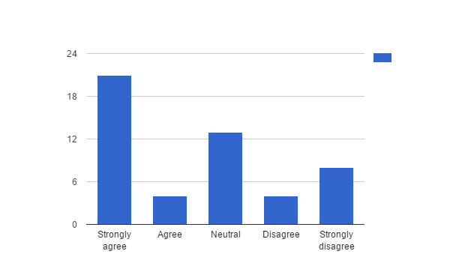
30. I feel alcohol has a negative affect on my grades.
# | Answer | Response | %
1 | Strongly agree | 21 | 42%
2 | Agree | 4 | 8%
3 | Neutral | 13 | 26%
4 | Disagree | 4 | 8%
5 | Strongly disagree | 8 | 16%
 | Total | 50 | 100%

Slide 22
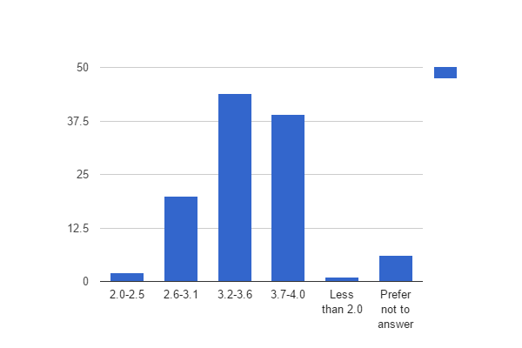
31. What is your GPA?
# | Answer | Response | %
1 | 2.0-2.5 | 2 | 2%
2 | 2.6-3.1 | 20 | 18%
3 | 3.2-3.6 | 44 | 39%
4 | 3.7-4.0 | 39 | 35%
5 | Less than 2.0 | 1 | 1%
6 | Prefer not to answer | 6 | 5%
 | Total | 112 | 100%

Slide 23
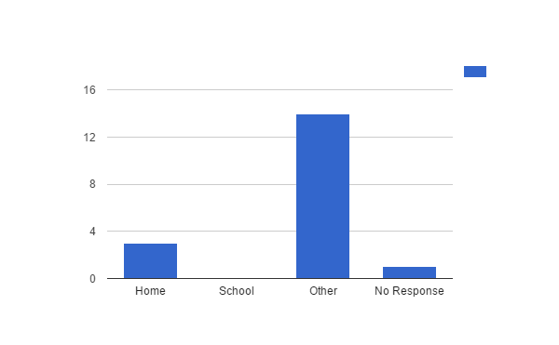
22. Where do you generally consume alcohol?
# | Answer | Response | %
1 | Home | 3 | 18%
2 | School | 0 | 0%
3 | Other | 14 | 82%
 | Total | 17 | 100%

Slide 24
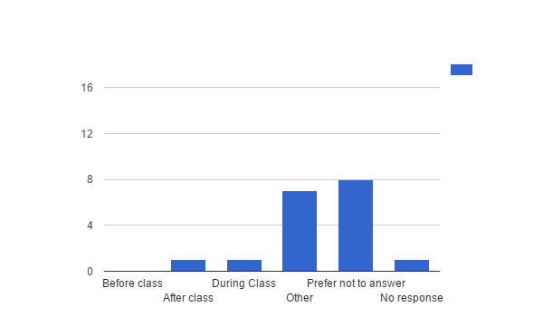
24. When do you drink on campus?
# | Answer | Response | %
1 | Before class | 0 | 0%
2 | After class | 1 | 6%
3 | During class | 1 | 6%
4 | Other | 7 | 41%
5 | Prefer not to answer | 8 | 47%
 | Total | 17 | 100%

Slide 25
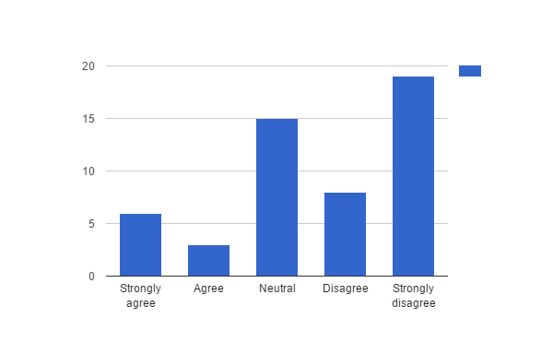
42. I feel guilty after drinking alcohol.
# | Answer | Response | %
1 | Strongly agree | 6 | 12%
2 | Agree | 3 | 6%
3 | Neutral | 15 | 29%
4 | Disagree | 8 | 16%
5 | Strongly disagree | 19 | 37%
 | Total | 51 | 100%

Slide 26
48. What is your age?
# | Answer | Response | %
1 | 21-25 | 60 | 65%
2 | 26-30 | 17 | 18%
3 | 31-35 | 8 | 9%
4 | 36-40 | 4 | 4%
5 | 41-45 | 1 | 1%
6 | 46-50 | 3 | 3%
7 | 51-older | 0 | 0%
 | Total | 93 | 100%

Slide 27
53. What year in school are you?
# | Answer | Response | %
1 | Senior | 21 | 21%
2 | Junior | 31 | 32%
3 | Sophomore | 30 | 31%
4 | Freshman | 16 | 16%
 | Total | 98 | 100%

Slide 28
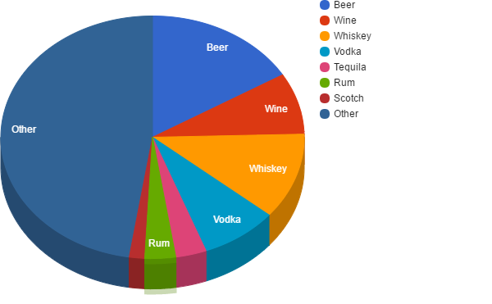
14. What is your alcoholic beverage of choice?
# | Answer | Response | %
1 | Beer | 10 | 16%
2 | Wine | 5 | 8%
3 | Whiskey | 7 | 11%
4 | Scotch | 0 | 0%
5 | Brandy | 0 | 0%
6 | Vodka | 5 | 8%
7 | Tequila | 2 | 3%
8 | Rum | 2 | 3%
9 | Scotch | 1 | 2%
10 | Other | 29 | 48%
 | Total | 61 | 100%

Slide 29
Conclusions
1.) Does the level of alcohol consumption directly affect the level of academic success while attending a University level setting?
By the results from the survey showed that there are not enough results to completely determine that drinking while in school has a negative effect on GPA. However results from the survey itself shows that the majority of students that completed the survey either don't drink or only drink at special occasions. We believe that most of the reasoning behind this is either for religious reasons due to the mainly LDS culture in the area or personal reasons. The majority of the students that took the survey had an average of about a 3.0 G.P.A. which shows that the people that dont drink have a good G.P.A. However the one that do don't drink couldn't be accounted for due to a lack of data.

Slide 30
2.) How does alcohol affect the students here at Utah Valley University and is it a current problem?
Since most of the student body is either LDS or doesn't drink for personal reasons there is little to no effect on the students here at Utah Valley University. However there is about one to two percent of the student body that does drink. Unfortunately we couldn't get enough data about that specific group in order to positively determine that drinking has any effect on them. However there was 5% (3 people) that take illicit drugs when they do drink so that indicates that of those that drink they not only drink but show a complete disregard for the law.

Slide 31
3.) Should UVU allow alcohol on campus property, or should the consumption of alcohol on school property result in a punishable consequence?
Utah Valley University is not just a school for those above the age of 21 to attend but even student that are still in high school. For that reason Utah Valley University should not allow the consumption of alcohol on campus do to the fact that there are students in high school and under the age of 21 in attendance. As well as yes there should be punishable consequences for those choosing to consume alcohol on the campus of Utah Valley University as well as even showing up to class under the influence.

Slide 33
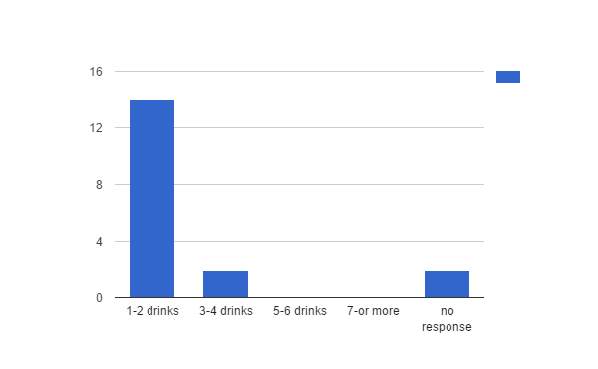
2. If you do drink alcoholic beverages, how many alcoholic drinks do you consume daily?
# | Answer | Response | %
1 | 1-2 drinks | 14 | 88%
2 | 3-4 | 2 | 13%
3 | 5-6 | 0 | 0%
4 | 7-or more | 0 | 0%
 | Total | 16 | 100%

Slide 34
2. If you do drink alcoholic beverages, how many alcoholic drinks do you consume daily?
Statistic | Value
Min Value | 1
Max Value | 2
Mean | 1.13
Variance | 0.12
Standard Deviation | 0.34
Total Responses | 16

Slide 35
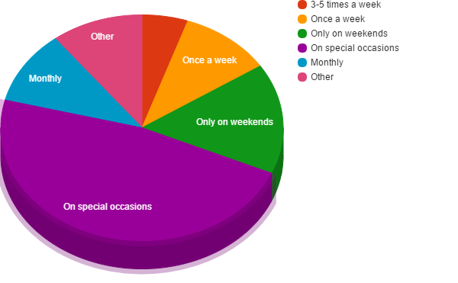
3. How often do you drink?
# | Answer | Response | %
1 | Everyday | 0 | 0%
2 | 3-5 times a week | 1 | 5%
3 | Once a week | 2 | 11%
4 | Only on weekends | 3 | 16%
5 | On special occasions | 9 | 47%
6 | Monthly | 2 | 11%
7 | Other | 2 | 11%
 | Total | 19 | 100%

Slide 36
3. How often do you drink?
Statistic | Value
Min Value | 2
Max Value | 7
Mean | 4.79
Variance | 1.62
Standard Deviation | 1.27
Total Responses | 19

Slide 37
4. When did you consume your last alcoholic beverage?
# | Answer | Response | %
1 | Yesterday morning | 0 | 0%
2 | Yesterday afternoon | 0 | 0%
3 | Last night | 5 | 100%
4 | This morning | 0 | 0%
5 | This afternoon | 0 | 0%
 | Total | 5 | 100%

Slide 38
7. On a scale of 1 to 10, 1 being low 10 being high, how high of a priority is drinking alcoholic be...
# | Answer | Response | %
1 | 1 | 12 | 71%
2 | 2 | 3 | 18%
3 | 3 | 2 | 12%
4 | 4 | 0 | 0%
5 | 5 | 0 | 0%
6 | 6 | 0 | 0%
7 | 7 | 0 | 0%
8 | 8 | 0 | 0%
9 | 9 | 0 | 0%
10 | 10 | 0 | 0%
 | Total | 17 | 100%

Slide 39
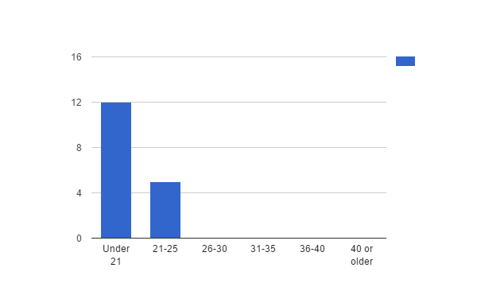
9. When did you first get intoxicated?
# | Answer | Response | %
1 | Under 21 | 12 | 71%
2 | 21-25 | 5 | 29%
3 | 26-30 | 0 | 0%
4 | 31-35 | 0 | 0%
5 | 36-40 | 0 | 0%
6 | 40 or older | 0 | 0%
 | Total | 17 | 100%

Slide 40
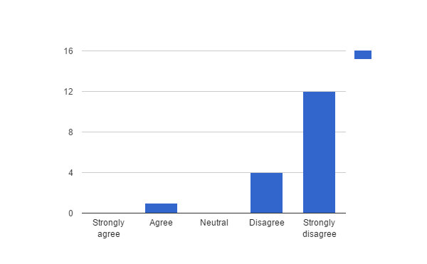
11. I constantly binge drink. (Binge drinking: The consumption of an excessive amount of alcohol in a...
# | Answer | Response | %
1 | Strongly agree | 0 | 0%
2 | Agree | 1 | 6%
3 | Neutral | 0 | 0%
4 | Disagree | 4 | 24%
5 | Strongly disagree | 12 | 71%
 | Total | 17 | 100%

Slide 41
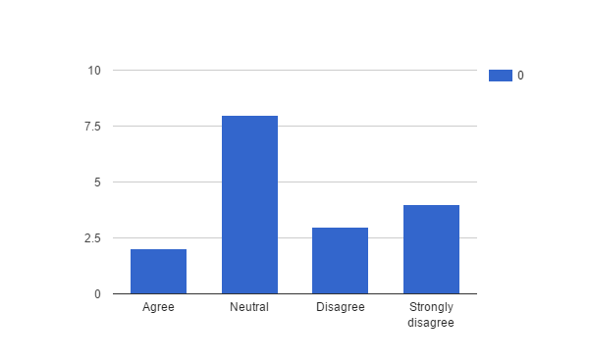
12. I drink to get drunk.
# | Answer | Response | %
1 | Strongly agree | 0 | 0%
2 | Agree | 2 | 12%
3 | Neutral | 8 | 47%
4 | Disagree | 3 | 18%
5 | Strongly disagree | 4 | 24%
 | Total | 17 | 100%

Slide 42
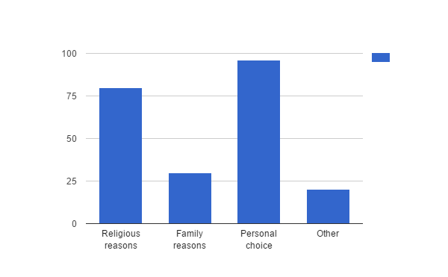
13. Why do you choose not to drink alcohol? Mark all that apply.
# | Answer | Response | %
1 | Religious reasons | 80 | 63%
2 | Family reasons | 30 | 23%
3 | Personal choice | 96 | 75%
4 | Other | 20 | 16%

Slide 43
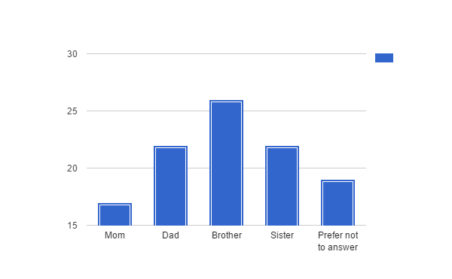
15. Who in your immediate family drinks alcohol? Check all that apply.
# | Answer | Response | %
1 | Mom | 17 | 24%
2 | Dad | 22 | 31%
3 | Brother | 26 | 36%
4 | Sister | 22 | 31%
5 | Prefer not to answer | 19 | 26%

Slide 44
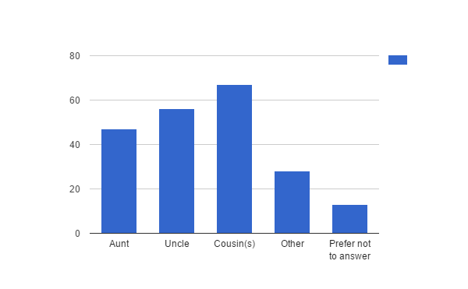
16. Who in your extended family drinks alcohol? Check all that apply.
# | Answer | Response | %
1 | Aunt | 47 | 44%
2 | Uncle | 56 | 52%
3 | Cousin(s) | 67 | 63%
4 | Other | 28 | 26%
5 | Prefer not to answer | 13 | 12%

Slide 45
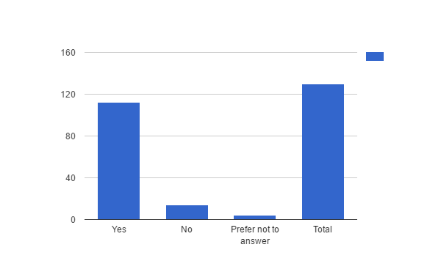
17. Do you have friends or acquaintances who drink alcoholic beverages?
# | Answer | Response | %
1 | Yes | 112 | 86%
2 | No | 14 | 11%
3 | Prefer not to answer | 4 | 3%
 | Total | 130 | 100%

Slide 46
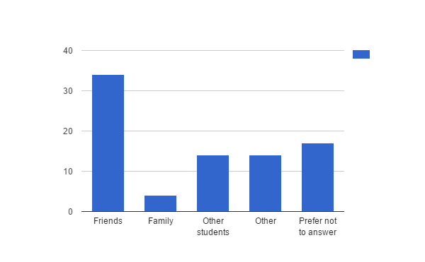
18. Who of your associates peer pressures you to drink alcohol? Check all that apply.
# | Answer | Response | %
1 | Friends | 34 | 54%
2 | Family | 4 | 6%
3 | Other students | 14 | 22%
4 | Other | 14 | 22%
5 | Prefer not to answer | 17 | 27%

Slide 47
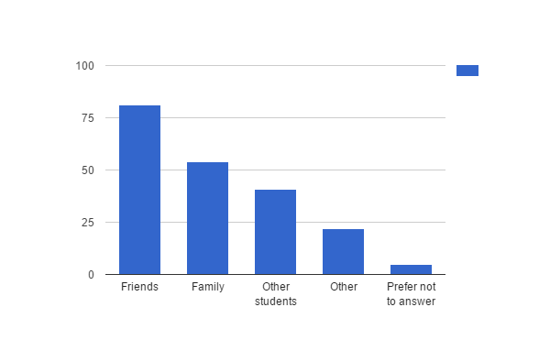
19. Who are your associates who drink alcoholic beverages? Check all that apply.
# | Answer | Response | %
1 | Friends | 81 | 75%
2 | Family | 54 | 50%
3 | Other students | 41 | 38%
4 | Other | 22 | 20%
5 | Prefer not to answer | 5 | 5%

Slide 48
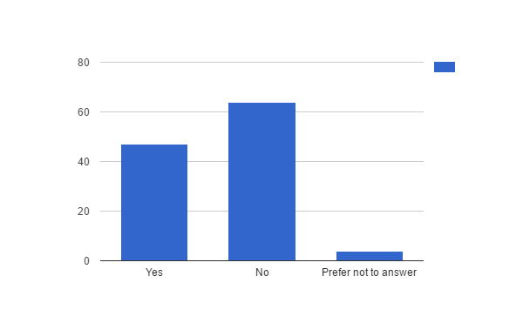
20. Do you attend parties where alcoholic beverages are present?
# | Answer | Response | %
1 | Yes | 47 | 41%
2 | No | 64 | 56%
3 | Prefer not to answer | 4 | 3%
 | Total | 115 | 100%

Slide 49
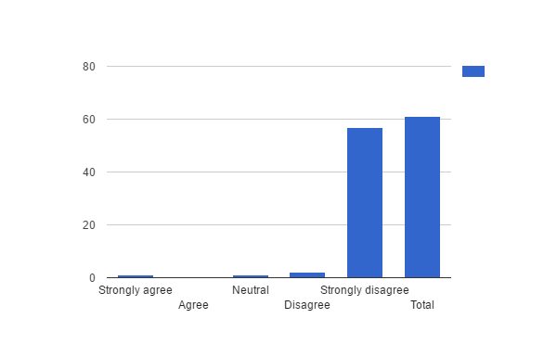
23. I have missed class due to drinking alcohol.
# | Answer | Response | %
1 | Strongly agree | 1 | 2%
2 | Agree | 0 | 0%
3 | Neutral | 1 | 2%
4 | Disagree | 2 | 3%
5 | Strongly disagree | 57 | 93%
 | Total | 61 | 100%

Slide 50
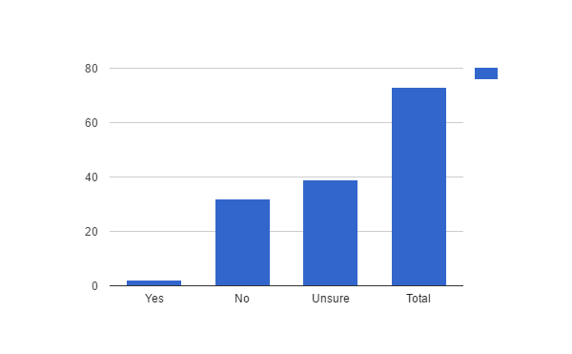
27. Do you test better when you consume alcohol or liquor?
# | Answer | Response | %
1 | Yes | 2 | 3%
2 | No | 32 | 44%
3 | Unsure | 39 | 53%
 | Total | 73 | 100%

Slide 51
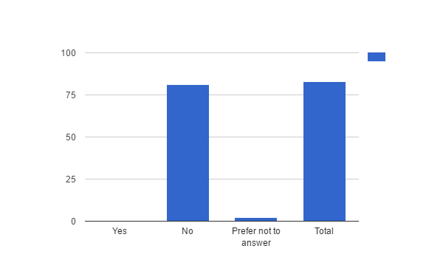
32. Do you drink alcoholic beverages to function better?
# | Answer | Response | %
1 | Yes | 0 | 0%
2 | No | 81 | 98%
3 | Prefer not to answer | 2 | 2%
 | Total | 83 | 100%

Slide 52
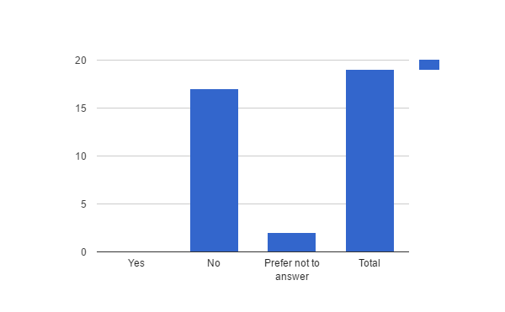
33. Have you ever failed a class due to alcohol?
# | Answer | Response | %
1 | Yes | 0 | 0%
2 | No | 17 | 89%
3 | Prefer not to answer | 2 | 11%
 | Total | 19 | 100%

Slide 53
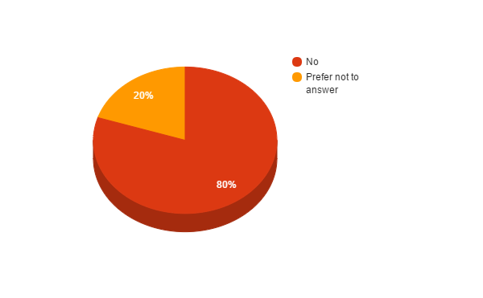
34. Have you ever had an academic suspension due to alcohol?
# | Answer | Response | %
1 | Yes | 0 | 0%
2 | No | 8 | 80%
3 | Prefer not to answer | 2 | 20%
 | Total | 10 | 100%

Slide 54
35. On a scale of 1 to 10, 1 being low 10 being high, how high of a priority is education to you?
# | Answer | Response | %
1 | 1 | 0 | 0%
2 | 2 | 0 | 0%
3 | 3 | 0 | 0%
4 | 4 | 0 | 0%
5 | 5 | 0 | 0%
6 | 6 | 0 | 0%
7 | 7 | 3 | 9%
8 | 8 | 6 | 19%
9 | 9 | 11 | 34%
10 | 10 | 12 | 38%
 | Total | 32 | 100%
Statistic | Value
Min Value | 7
Max Value | 10
Mean | 9.00
Variance | 0.97
Standard Deviation | 0.98
Total Responses | 32

Slide 55
36. Have you ever passed out (blackout) due to drinking alcoholic beverages?
# | Answer | Response | %
1 | Yes | 0 | 0%
2 | No | 17 | 94%
3 | Prefer not to answer | 1 | 6%
 | Total | 18 | 100%

Slide 56
37. Have you ever experienced memory loss due to drinking alcoholic beverages?
# | Answer | Response | %
1 | Yes | 1 | 5%
2 | No | 17 | 89%
3 | Prefer not to answer | 1 | 5%
 | Total | 19 | 100%

Slide 57
38. Alcohol has had a negative affect on my memory.
# | Answer | Response | %
1 | Strongly agree | 0 | 0%
2 | Agree | 1 | 100%
3 | Neutral | 0 | 0%
4 | Disagree | 0 | 0%
5 | Strongly disagree | 0 | 0%
 | Total | 1 | 100%

Slide 58
39. Have you ever felt nauseous due to drinking alcohol?
# | Answer | Response | %
1 | Yes | 2 | 13%
2 | No | 13 | 81%
3 | Prefer not to answer | 1 | 6%
 | Total | 16 | 100%

Slide 59
40. Have you ever had a loss of balance due to alcohol?
# | Answer | Response | %
1 | Yes | 2 | 100%
2 | No | 0 | 0%
 | Total | 2 | 100%

Slide 60
41. Do you drink to escape pain, either physical or emotional?
# | Answer | Response | %
1 | Yes, physical pain only | 0 | 0%
2 | Yes, emotional pain only | 1 | 1%
3 | Yes, both physical and emotional pain | 2 | 2%
4 | No | 73 | 88%
5 | Unsure | 3 | 4%
6 | Prefer not to answer | 4 | 5%
 | Total | 83 | 100%

Slide 61
43. I take illicit drugs when I drink alcoholic beverages.
# | Answer | Response | %
1 | Always | 0 | 0%
2 | Sometimes | 3 | 5%
3 | Never | 56 | 90%
4 | Prefer not to answer | 3 | 5%
 | Total | 62 | 100%

Slide 62
44. I take prescription drugs when I drink alcoholic beverages.
# | Answer | Response | %
1 | Always | 0 | 0%
2 | Sometimes | 0 | 0%
3 | Never | 59 | 95%
4 | Prefer not to answer | 3 | 5%
 | Total | 62 | 100%

Slide 63
45. Do you drink and drive?
# | Answer | Response | %
1 | Yes | 0 | 0%
2 | No | 94 | 97%
3 | Prefer not to answer | 3 | 3%
 | Total | 97 | 100%

Slide 64
46. If yes, have you ever been pulled over for a DUI?
# | Answer | Response | %
1 | Yes | 0 | 0%
2 | No | 57 | 93%
3 | Prefer not to answer | 4 | 7%
 | Total | 61 | 100%

Slide 65
47. If yes, where were you pulled over for a DUI?
# | Answer | Response | %
1 | College campus | 0 | 0%
2 | Highway | 0 | 0%
3 | Local neighborhood | 0 | 0%
4 | Other | 4 | 100%
 | Total | 4 | 100%

Slide 66
49. What gender are you?
# | Answer | Response | %
1 | Male | 52 | 52%
2 | Female | 47 | 47%
3 | Prefer not to answer | 1 | 1%
 | Total | 100 | 100%

Slide 67
50. What is your ethnicity?
# | Answer | Response | %
1 | Black, not Hispanic | 1 | 1%
2 | American Indian | 2 | 2%
3 | Asian | 0 | 0%
4 | Hispanic | 5 | 5%
5 | Caucasian | 90 | 92%
6 | Islander | 0 | 0%
7 | Other (please specify) | 0 | 0%
 | Total | 98 | 100%

Slide 68
51. What is your marital status?
# | Answer | Response | %
1 | Married | 36 | 36%
2 | Single | 48 | 48%
3 | Engaged | 12 | 12%
4 | Other | 3 | 3%
 | Total | 99 | 100%

Slide 69
52. Who do you live with?
# | Answer | Response | %
1 | Friends | 27 | 29%
2 | Parents | 20 | 22%
3 | Extended family | 9 | 10%
4 | Alone | 4 | 4%
5 | Other | 32 | 35%
 | Total | 92 | 100%

Slide 70
54. What is your major?
Text Response
Emergency services
History Ed
Communications
Comm
generals
Undecided
School health education
Physics
Social Work
International business
Technology Management
Journalism
aeorspace engineering
Communication
Nursing
Comm
Marketing
undecided
Behavioral Science
anthropology
DENTAL HYGIENE
Pre-engineering
Behavioral Science
Anthropology
Outdoor recreation
Psychology
Nursing
Photography
Communications
Behavioral Science-Psychology Emphasis
Behavioral Science
behavioral science
Healthcare management
BFA
Community Health
Biology
Computer Engineering
Cmgt
Computer programming
Outdoor rec
Graphic Design
genrals
EMergency Services
Marketing
DGM
Business Management
Biochemistry
Culinary Arts
Genetics
Business Management
Aviation Science
Accounting
Exercise sports science
Pre engineering
Accounting
Business
Philosohpy
Comm
undecided
emergency services

Slide 71
54. What is your major?
Statistic | Value
Total Responses | 60

Slide 72
55. If you are a senior, when do you plan to graduate?
# | Answer | Response | %
1 | This semester (Spring 2016) | 10 | 27%
2 | Next semester (Summer 2016) | 6 | 16%
3 | Next Fall (Fall 2016) | 2 | 5%
4 | Anytime past Fall 2016 | 19 | 51%
 | Total | 37 | 100%

