Slide 1
Domestic Violence Rates & Causes at UVU
Hannah Stoner, Danita Knickerbocker, Jessica Bordallo, &
Jose Pereira

Slide 2
Research Questions
The specific questions that we wanted to answer is what convinces an abused partner to stay with their aggressive partner despite the aggression shown towards them. It is a very perplexing situation that we didn’t quite understand; if the partner is treating the victim so poorly, why do they not just leave the individual?
From conducting the survey, we hoped to learn more about partner dating abuse in the area and at UVU and present the information to local agencies that deal with this issue in hopes that they learn the best way to help victims of domestic violence.

Slide 3
Research Design & Data
To collect our data, we sent out a 15 question survey asking the participants about their experiences with romantic relationships and if they had ever had experiences with domestic violence within those relationships and their general feelings about domestic violence. We choose to do a survey rather than interviews because given the sensitive nature of the topic, we felt that we would be able to obtain more information. The participants for the survey were randomly selected from the IRI. We required that all participants be over the age of 18 to eliminate the need for parental consent.
Given the sensitive nature of the topic, the goal was to conduct a double blind survey; the participants didn’t know who we were and we didn’t know who the participants were. While the identities of the participants remained anonymous, the name of the primary investigator on the research team was disclosed so that any questions or concerns could be discussed directly with the research team meaning it was not a completely double blind survey.

Slide 4
Research Design & Data
The actual data collection was done by Qualtrics; where we had our survey located. By having the survey on Qualtrics, we were able to send out individual emails to all of the randomly selected participants.
About 4 days after the initial email was sent out, a follow up reminder email was sent out to those who had yet to complete or start the survey.
About 7 days after the initial email was sent out, the second and final email reminder was sent out to those who had yet to complete or start the survey.
The final response rate after the reminder emails was 10%; meaning we had 30 responses out of the 300 participants selected.

Slide 5
Literature Review
In the Ismail, Berman, and Ward-Griffin study examines the seriousness of dating violence for young women and why many of them stay in unhealthy, violent relationships. The authors found that many of these women feel that there is a severe lack of resources and support to help them with these issues. The authors note that the women’s efforts to obtain support were often met with skeptical and dismissive attitudes from health care professionals among other adults.
Ismail, F., Berman, H., & Ward-Griffin, C. (2007). Dating violence and the health of young women: a feminist narrative study. Health Care For Women International, 28(5), 453-477 25p.

Slide 6
Literature Review
The quantitative study completed by Diaz-Aguado and Martinez (2014) probed into the abuser’s behaviors and attitudes towards women in dating relationships. The purpose of the study was to look into the abusers’ feelings about male dominance in romantic relationships and if there was a correlation between their feelings and reported violent actions. The subjects, 4147 boys between the ages of 14 to 18 were separated into four groups based indicators of emotional abuse, intimidation, coercion, threats, physical violence, and violence transmitted via communication technologies. In the first group, it consisted of non-violent adolescent boys. The second group comprised of those boys who isolated and controlled their partners. Boys who exerted only medium-level emotional abuse form the third group, whereas the fourth is formed by boys who frequently engaged in all types of violence.
The results from the study indicated that as compared to non-violent adolescents, the adolescents in the study appeared to show lower values of self-esteem and as a result, greater justification of male dominance and IPV against women. In addition, they appeared to show greater justification in using aggression in conflict resolution and received messages of approval from their families regarding their violent behaviors which only perpetuated their actions.
Diaz-Aguado, M. m., & Martinez, R. (2015). Types of Adolescent Male Dating Violence Against Women, Self-Esteem, and Justification of Dominance and Aggression. Journal Of Interpersonal Violence, 30(15), 2636-2658.

Slide 7
Literature Review
The Edwards, Gidycz, and Murphy (2014) quantitative study was to examine the process that women go through while attempting to leave an abusive dating relationship. The study’s subjects, 169 college aged women who were in abusive relationships, took a survey at two separate points in time which allowed the researchers to assess changes in intimate partner violence in the subjects’ relationships. The results of the study showed that although both are suitable for this research topic, the theory of planned behavior was the best fit for the data.
Edwards, K. M., Gidycz, C. A., & Murphy, M. J. (2015). Leaving an Abusive Dating Relationship. Journal Of Interpersonal Violence, 30(16), 2908-2927.

Slide 8
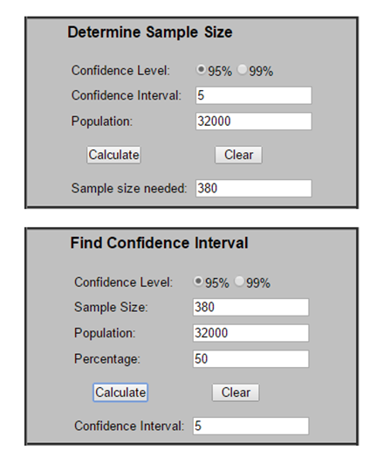
Sample Size & Response Rate
According to the calculations to the right, our sample size would need to be 380 participants in order to obtain a 95% confidence level, confidence interval of 5, and population of 32,000 students.
However, the UVU IRI would only allow us to have a sample size of 300 which was the sample size that we used in our survey.

Slide 9
Sample Size & Response Rate
As mentioned in a previous slide, we received a response rate of 10%; meaning that 30 people out of 300 responded and completed the survey.
We were able to achieve this rate because of the reminder emails that we sent out. The emails boosted our response rate significantly; it appeared that many participants were interested in the survey and had forgotten to take the survey when they originally opened the email.

Slide 10
Research Findings
60% of the participants who took this survey were married while 40% were single; never married. None of the participants had ever been divorced or widowed.
The average age of participant involved in the survey was between 19-23. There were also a large number of participants around the age of 28.
The average age and marital statuses involved may have had an influence on the way that the participants thought about the questions. If we had had participants who were divorced or had a different age range, we might have got different responses because of different biases.

Slide 11
Research Findings
75% of the participants in the survey had been involved in 1 or 2 romantic relationships. Their lack of experience in romantic relationships might have influenced the way that they answered the questions about domestic violence.
None of the participants had ever been involved in a romantic relationship involving domestic violence. Since none of them had personal experience with domestic violence, this changed the responses we got compared to if our participants had experience with domestic violence.

Slide 12
Research Findings
Question 11 asks the participants to rank what they believe to be the causes of domestic violence.
The most commonly chosen answer for the main reason that domestic violence occurs was that the abuser wants to have control over the victim. The support for this answer indicates that a majority of UVU students recognize that controlling behavior can lead to an unhealthy relationship.
The most commonly chosen answer for the least important cause of domestic violence was that the victim wasn’t conforming to the abuser’s demands/requests. Again, this is encouraging that students recognize that victims should not be blamed in these situations.

Slide 13
Research Findings
Question 13 of the survey asked what the participants believed constituted a healthy relationship.
The most commonly chosen answers were mutual respect and trust, good communication, and mutual support. The large support of these answers indicates that many people believe in fairness and equality in romantic relationships.
The least common answers were fairness and having separate identities. A lack of fairness and separate identities indicates that one partner may be more dominant over the other.

Slide 14
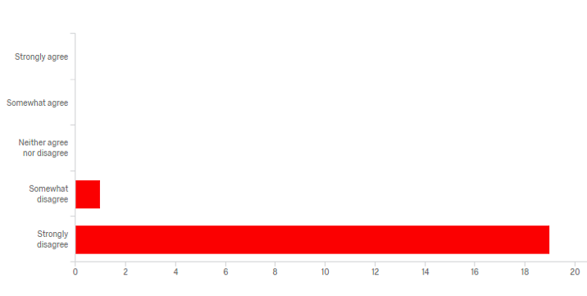
Research Findings
Question 12 asks if they believe dating violence is ever appropriate.
A majority of the participants said that they strongly disagree that dating violence is ever appropriate.
A few of the respondents said that they somewhat disagree that dating violence is ever appropriate. It would be interesting to speak with those respondents and ask them why they chose this answer as it seems to indicate that they might think that it is sometimes ok.

Slide 15
Final Conclusions
For the most part, we saw encouraging statistics regarding UVU student’s attitudes and beliefs about domestic violence in a romantic relationship. In many of the questions, students answered that domestic violence is never ok and were able to identify signs of healthy relationships.
If we were to do the survey over, we might want to talk with actual domestic violence victims because the sample that took our survey did not include any of those victims which might have limited the conclusions we could make about the attitudes and beliefs about domestic violence from UVU students.
It might be appropriate to include a question if the participants had friends or family that were involved in dating violence as that might bias their responses.

Slide 16
Final Conclusions
While the outcome of the survey did not turn out as expected because of the lack of domestic violence experience among the participants, the information we provide to local agencies will change slightly from what we anticipated.
Some information that we would provide local agencies such as UVU & local police departments would include the participants opinions and knowledge about domestic violence. In Question 13, all of the options were signs of a healthy relationship. However, many of the participants only selected some, not all meaning that they may not have a full knowledge of the topic. If local police departments held informational sessions on the topic, victims and others might be more aware of the signs and be more willing to share that information with police departments.

