Slide 1
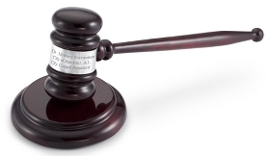
Do UVU Students Understand How A Criminal Sentence is Decided and Do They Think the Process is Fair?
Cody johansen
delmy orduna
nik putman
tayler smith

Slide 2
The Survey Questions
The first Problem…Do you understand our system?
The second Problem…Do you feel that it is fair?
We needed to prove or see what an average person knows about the judicial system
Questions needed to be simple enough for someone who has or has not had experience with our criminal law
We wanted to find peoples’ idea of how they feel about our justice systems.
We needed to change the dynamic of our survey and its questions for more accurate responces.

Slide 3
The Survey Set Up
The Knowledge Set Up
The Fairness Model
Mostly simple questions all of us know on a whim
True or False: can the polices detain you because you upset them
How much evidence is considered probable cause
They were leveled answers so we could get a good idea how they feel about the justice system.
In your opinion….Questions
Sentences are equal to the crimes and the justice system is fair

Slide 4
Our sample we received was 500 out of UVU’s stated 34,977 students for Fall 2016
Not the best response rate ☹ One more response needed to get 3%
Our survey was thrown out to the world for two weeks
The first week we only 5 responses
Two reminder emails were sent and nearly tripled our response rate before we closed our survey.

Slide 5
Weaknesses
Did embedding the question help?
I froze every question, did that make it to linear?
We could have disclosed the exact number of questions so they knew it wasn’t too long.
We did our best by sending reminder emails.
And Thanking them and letting them know the importance of the survey

Slide 6
Literature Reviews
Julian V. Roberts: public opinion regarding mandatory sentencing laws
Anthony N. Doob: public attitudes towards sentencing in Canada should move away from the simple rhetoric hash or soft sentencing
Mark A. Cohen, Roland T Rust and Sara Steen: methodology looked at the public access to and the priorities in the criminal justice sending
Michael Turner, Francis Cullen, Jody Sundt and Brandon Applegate: public attitudes toward rehabilitation were studied by means of a survey of a randomly selected sample of 1,000 Ohio residents

Slide 7
Methodology
Application turned in to IRB on November 1
The IRB approved our request on November 8
We used a quantitative research approach
We administered a survey that consisted of data that can be ordered in terms of magnitude
We did not use qualitative research because we did not do participant observation, interviewing, or ask open ended questions to the participants in our survey

Slide 8
Our Study
Survey was distributed to 500 Random Utah Valley University Students
The survey was sent out 3 different times
Total of 1500 emails were sent out
We received 14 responses and 8 completed the survey

Slide 9
Problems with the study
Sample of 500 is a small number and may not be a true representative sample of the thousands of students enrolled at UVU
Some individuals may have felt that an email survey isn’t anonymous
Limited amount of time people were able to respond to survey may limit the number of respondents
Of the surveys received not all were complete

Slide 10
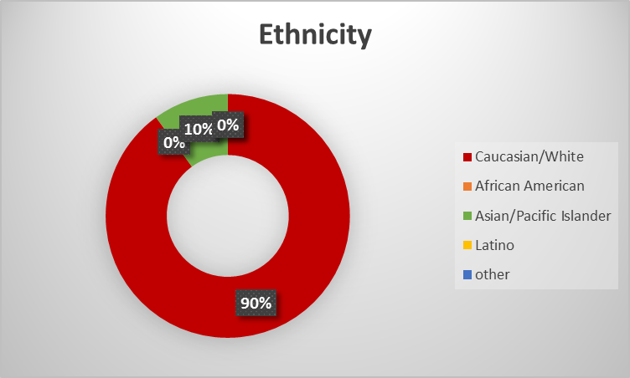
Demographics
10 people participated in our survey
6 were male
4 were female
9 were Caucasian
1 was Asian or pacific Islander
0 African American, Hispanic or any other race
1 Caucasian and 1 Asian or pacific Islander did not finish all the questions

Slide 11
Responses
Correct answers were 112 (72.3%)
Incorrect answers were 43 (27.7%)

Slide 12
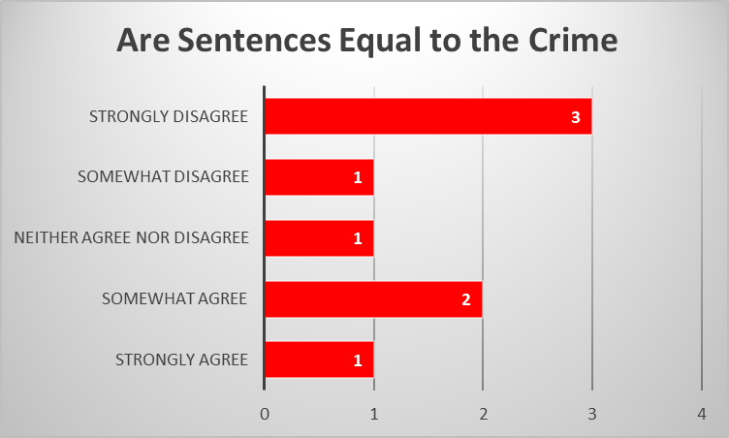
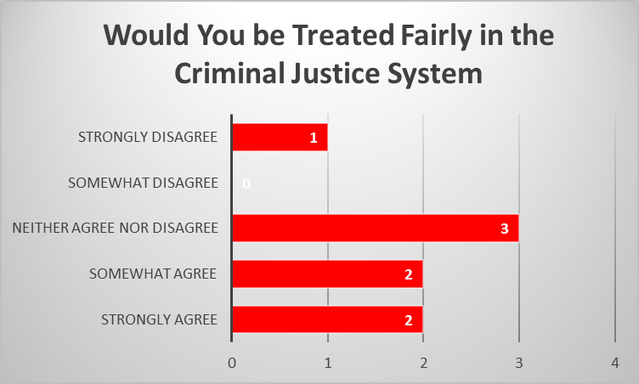
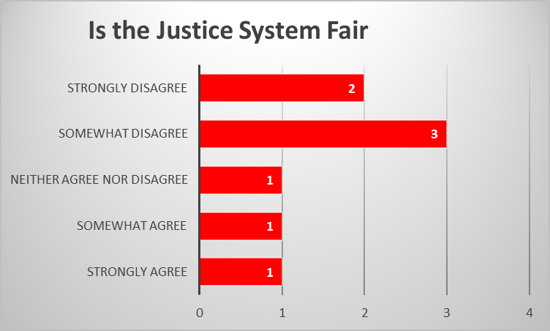
Opinions

Slide 13
Conclusion
Unfortunately we did not have enough time to get good results for the study. A study like this can not be done within a few months or even just two weeks
Non the less this study could still help with contributing to the knowledge on our students. Do we need to do seminars on the law to educate our students
The results show that students were fairly knowledgeable about the criminal justice system
The majority of the results came from Caucasian, and we only received in total 14 surveys completed
This project was just the beginning and could be further worked on to get a better look on what students really know about the criminal system

