Slide 1
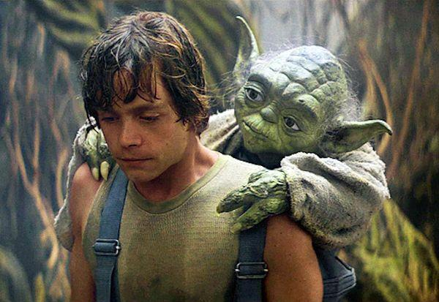
Childhood Mentors
Austin Kennington, Edward Spreen, Jamie Wood, Matthew Reams, and Michael Alexander

Slide 2
Reasons for our research
Service Learning Project Summer 2015
Big Brothers Big Sisters Utah referred me to the Village Project
Went through process to become a mentor
Mentored the kid with which I was paired for 6 months
We wanted to know more!

Slide 3
OBJECTIVES
Gather data to find out how many people have had good role models in their lives and if having these role models has deterred them from committing deviant acts or criminal behavior.
Ideally, we would like to gather information on people from many different backgrounds and find any other correlations between certain demographics and juvenile offenses.
We would like to see the views participants hold when it comes to current juvenile punishment.
We would also like to know if participants think more sponsored mentor programs for troubled youth would be beneficial for juvenile offenders.

Slide 4
Literature Review
“The Relationship between Adverse Childhood Experiences (ACE) and Juvenile Offending Trajectories in a Juvenile Offender Sample.”
Increased risk for delinquency for: fighting, dating violence, weapon, mental health, substance abuse
75 – 93% of juveniles in the JJS had some kind of traumatic experience
They need support!
“Availability of treatment to youth offenders: Comparison of public versus private programs from a national census.
Incarcerated youth, 65 – 70% have some kind of mental health issue.

Slide 5
Literature Review
“Absenteeism and truancy issues: Are mentoring programs funded by the office of juvenile justice and delinquency prevention the answer?”
Truancy is the first step towards a criminal path
After school mentoring program reduces teenage criminal activity
“Youth mentoring relationships in context: Mentor perceptions of youth, environment, and the mentor role.”
Defines what constitutes a mentor
Show relationship between youth and mentor through mentor’s perspective
Notes:
MATT

Slide 6
Possible issues with the IRB
Use a third party for recruiting subjects, obtaining consent, and collecting data (including interviewing). The data must be held by the third party and not given to the instructor until the course is completed and grades are submitted.
If the instructor is using as research data the assignments of students that would normally be given during the course, the instructor may request from each student permission to use the student’s work AFTER the course is completed and grades are submitted.
If the study is anonymous, the instructor may perform the study. In such a study, no signatures or identifiers or any kind are obtained. The instructor passes out an informed consent document to the class. A survey is handed out to everyone. The instructor then tells the class that if anyone would like to complete the survey, they may do so outside of class time and leave the survey in a designated location other than the classroom.
A data breach may result from a violation of the Privacy Plan in the protocol (in which case it would be reported as a Protocol Violation. However, there may also be a data breach that does NOT result from a Protocol Violation and meets the criteria for an Unanticipated Problem. If the Data Breach (not resulting from a Protocol Violation) meets all 3 of the following criteria below it would be reported using the Unanticipated Problem Reporting Form:
Is unexpected in terms of the nature, severity or frequency given the research procedures that are described in the protocol –related documents AND in the characteristics of the population under study.
Is related or possibly related to participation in research. This means that there is a reasonable possibility that the incident may have been caused by the procedures involved in the research study.
Notes:
EDWARD

Slide 7
IRB issues
No issues with the IRB.
Specific in details outlined in application.
Outlined who was eligible to participate in research.
The risks and benefits were key in IRB approval.
Notes:
MATT

Slide 8
10.49%
We sent our email to 505 people and got 53 responses.

Slide 10
Sample of our Questions:

Slide 11
When growing up, did you have a role model?

Slide 12
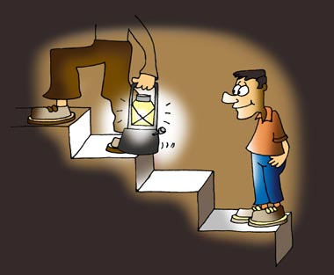
How did you meet this role model?
School Program
Church Group
Family Member
Family Friend
Court Appointed
Other (please specify)
7% - 4
10.7% - 6
73.6%- 42
1.7% - 1
0% - 0
7% - 4

Slide 13
During the majority of your childhood, what was the employment status of your primary legal guardian?
Employed
Unemployed
Other (please specify)
49 people chose employed
3 people chose Unemployed
Four people chose ‘Other’
Self employed
Inconsistently self-employed
Mother
School

Slide 14
Growing up, what type of school were you enrolled in: (select all that apply)

Slide 15
As a minor, did you ever commit an offense which could have led you to juvenile court?

Slide 16
Approximately how many hours during the week were you left unsupervised?
Minimum Value | Maximum Value | Average Value | Standard Deviation | Responses
0.0 | 15.00 | 8.51 | 5.46 | 45

Slide 17
How often did you meet with your role model (in one week's time)?

Slide 18
Did you regularly participate in extracurricular activities?

Slide 19
If a minor is arrested for any of the following crimes, is it better for them to be given a second chance, or to lock them up?

Slide 20
Cross Tabulation

Slide 21
Conclusions
Did participants have a role model as a juvenile? Did having a role model prevent them from committing crimes?
82% of our participants had a role model or someone they looked up to while they were growing up.
85% (44 of 53) participants did not commit crimes as juveniles that led them to court.
Additionally, on a 1-5 scale participants gave an average score of 3.83 when asked how influential their role model was when it came to making decisions.
While you can’t draw any serious conclusions from a sample size of fifty-three, you can safely say that in our survey there is a strong correlation between participants that had a role model growing up and and non delinquent behavior.

Slide 22
Conclusions
Are there are any strong correlations between demographics and juvenile offenses?
We left our demographic questions for the end of the survey and many people had checked out by then. At UVU there is diversity, but less than would have been helpful for our survey.
Nearly 80% of our participants (that answered these questions) were caucasian.
Nearly everyone came from a family with both parents still married, and fell into middle class socioeconomic status.
80% of our participants that had role models growing up considered someone in their family to be their role model.
As far these demographics go when compared to crime, there is just not enough diversity to be able to draw any real conclusion.

Slide 23
Conclusions
How do participants feel about punishments for juvenile corrections?
It seems that most of our participants are willing to give juveniles that offend another chance. When asked if first time juvenile offenders should be punished to the full extent of the law 77% (41 of 53) answered no or undecided.
When asked if minors should be sentenced to programs (such as a mentoring program) that could help them become better 97% (37 of 38) thought that they should.
With the exception of violent offenses, most of our participants did not see a reason to put first time juvenile offenders behind bars.
Based on these responses we feel it is safe to conclude people do not feel that time behind bars is the best form of punishment for juvenile offenders.

Slide 24
Conclusions
Do participants personally feel that mentoring programs would be a good way to reduce criminal behavior among troubled youth?
When asked the above question multiple times in different ways, about 80% of our participants consistently agreed that mentoring programs, whether court mandated or otherwise, would be of benefit to youth at risk of offending.
Between 80-90% said they would even be willing to volunteer with mentoring programs for troubled youth for anywhere between four and ten hours a week.
We feel that this information confirms that there is a general agreement when it comes to the benefits of mentoring troubled youth.

Slide 25
This presentation was brought to you by Alpha Group

