Slide 1
Police Professionalism
Through the eyes of the parents at the children's justice center

Slide 2
Group 5

Slide 3
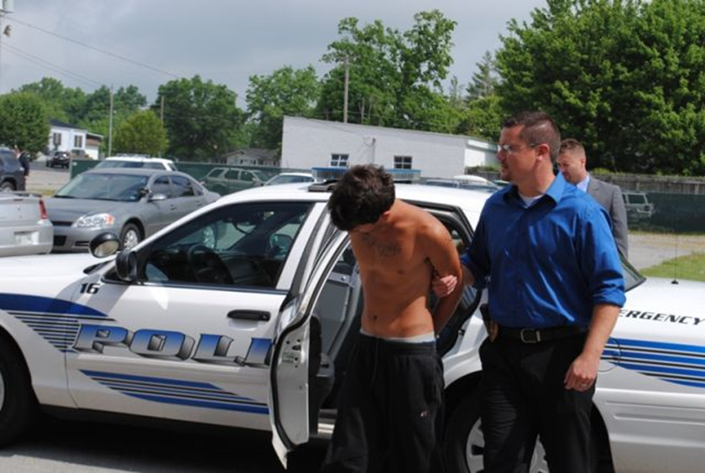
How is Law Enforcement in Utah Valley doing when dealing with child victims of sexual abuse from perspective of their caregivers?

Slide 4
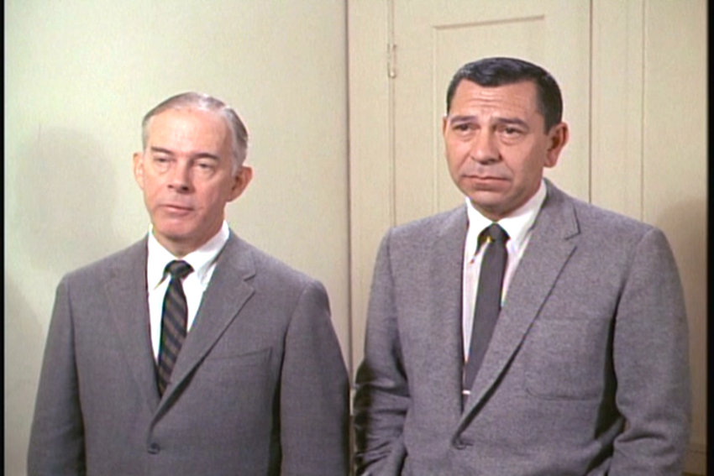
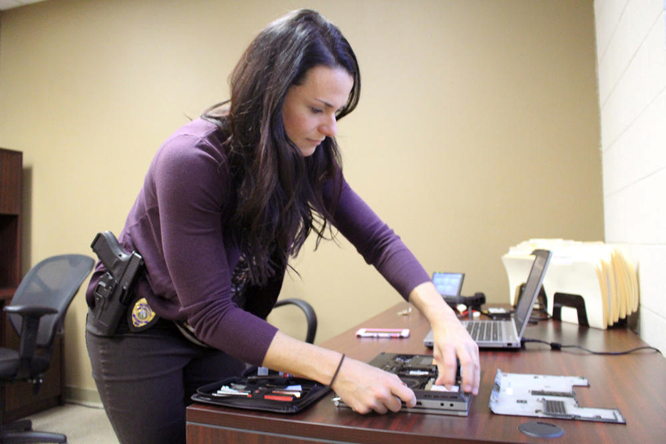
“Just the facts, kids!”

Slide 5
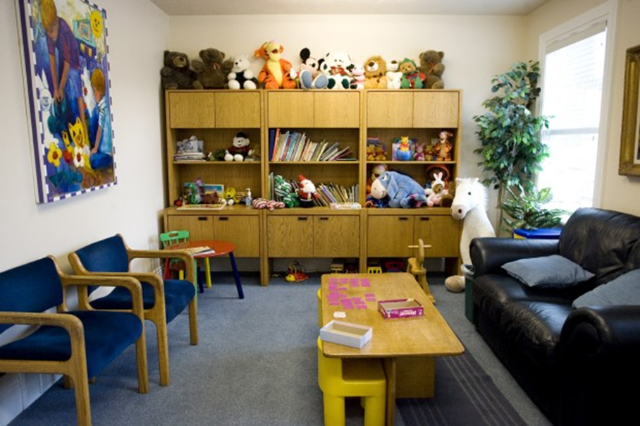
The Children's Justice Center for Utah Valley

Slide 6
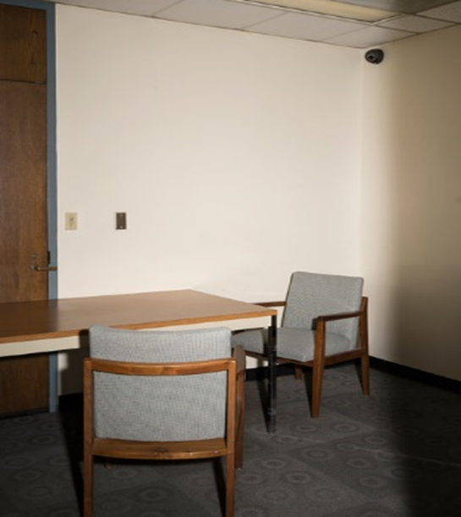
Forensic interviewing of children
That was then…
This is now…

Slide 7
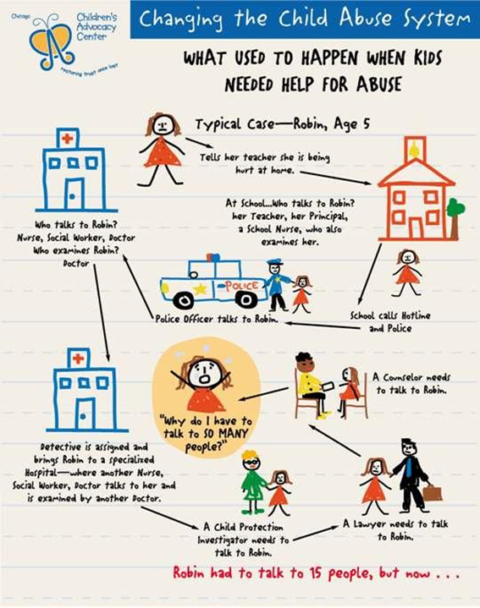
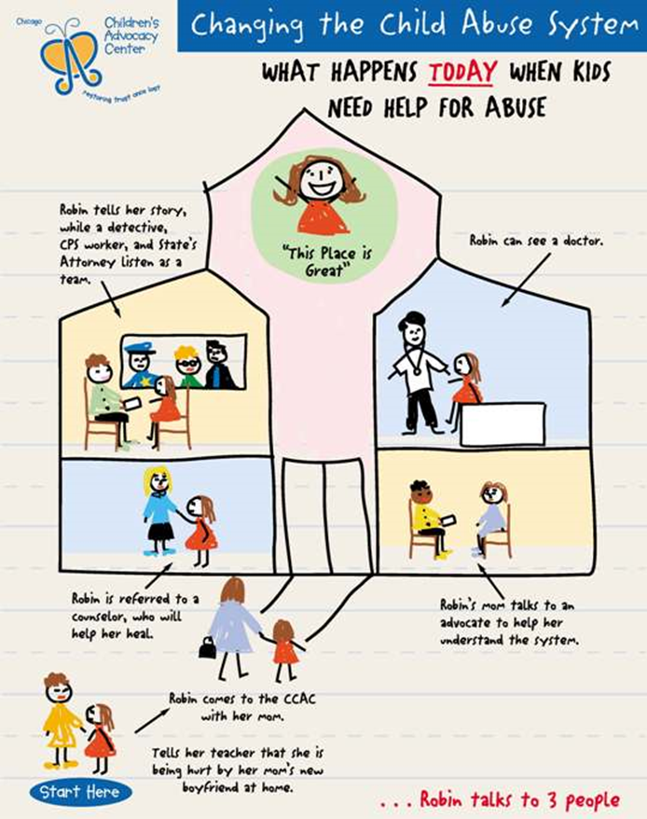
Today’s child interviews are much less invasive than a few years ago

Slide 8
Concerns with the project
“The caregivers are often in crisis when they are the Children’s Justice Center so they may not be in the best frame of mind to be answering survey questions.”
- CJC Staff
Complete anonymity for the families involved
How the survey would be administered

Slide 9
Application of the Survey
The CJC staff administered the 10 question paper surveys to the parents while their child was being interviewed by LE or DCFS.
Most willingly accepted the survey.
They were asked only once to complete the survey so not to feel pressured.
Appeared to be “brutally” honest.
CJC staff was very helpful and excited for such a survey.

Slide 10
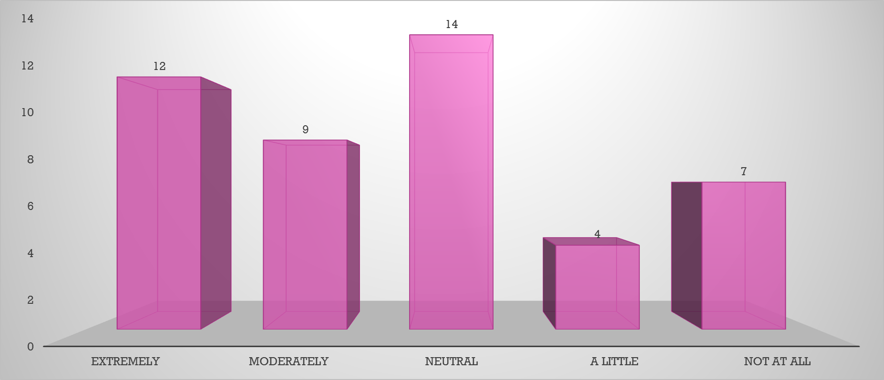
How beneficial do you think it would be to have a female officer on your case?

Slide 11
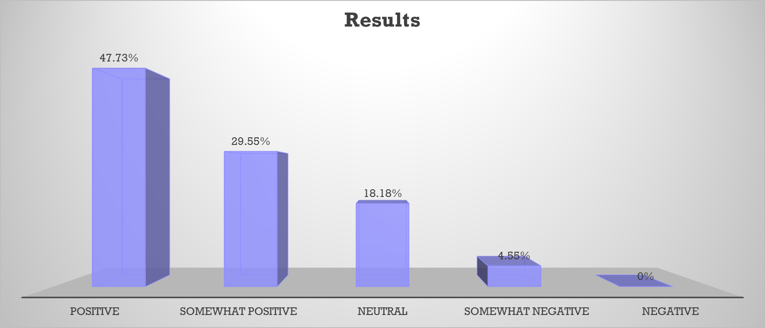
What was your attitude towards law enforcement before the incident?

Slide 12
What is your attitude towards law enforcement now?

Slide 13
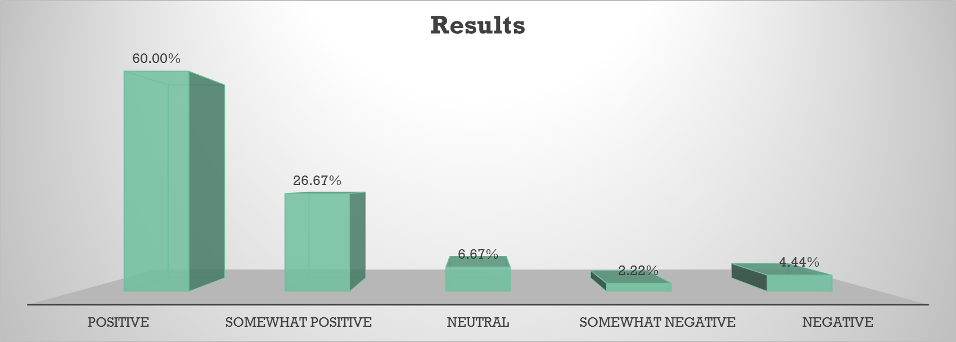
If you had to give a review of the police offer you’re working with,
what would it be?

Slide 14
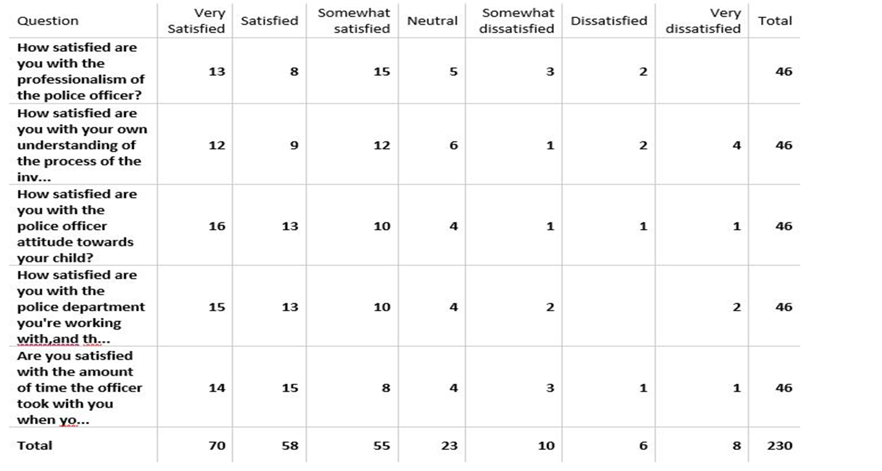

Slide 15
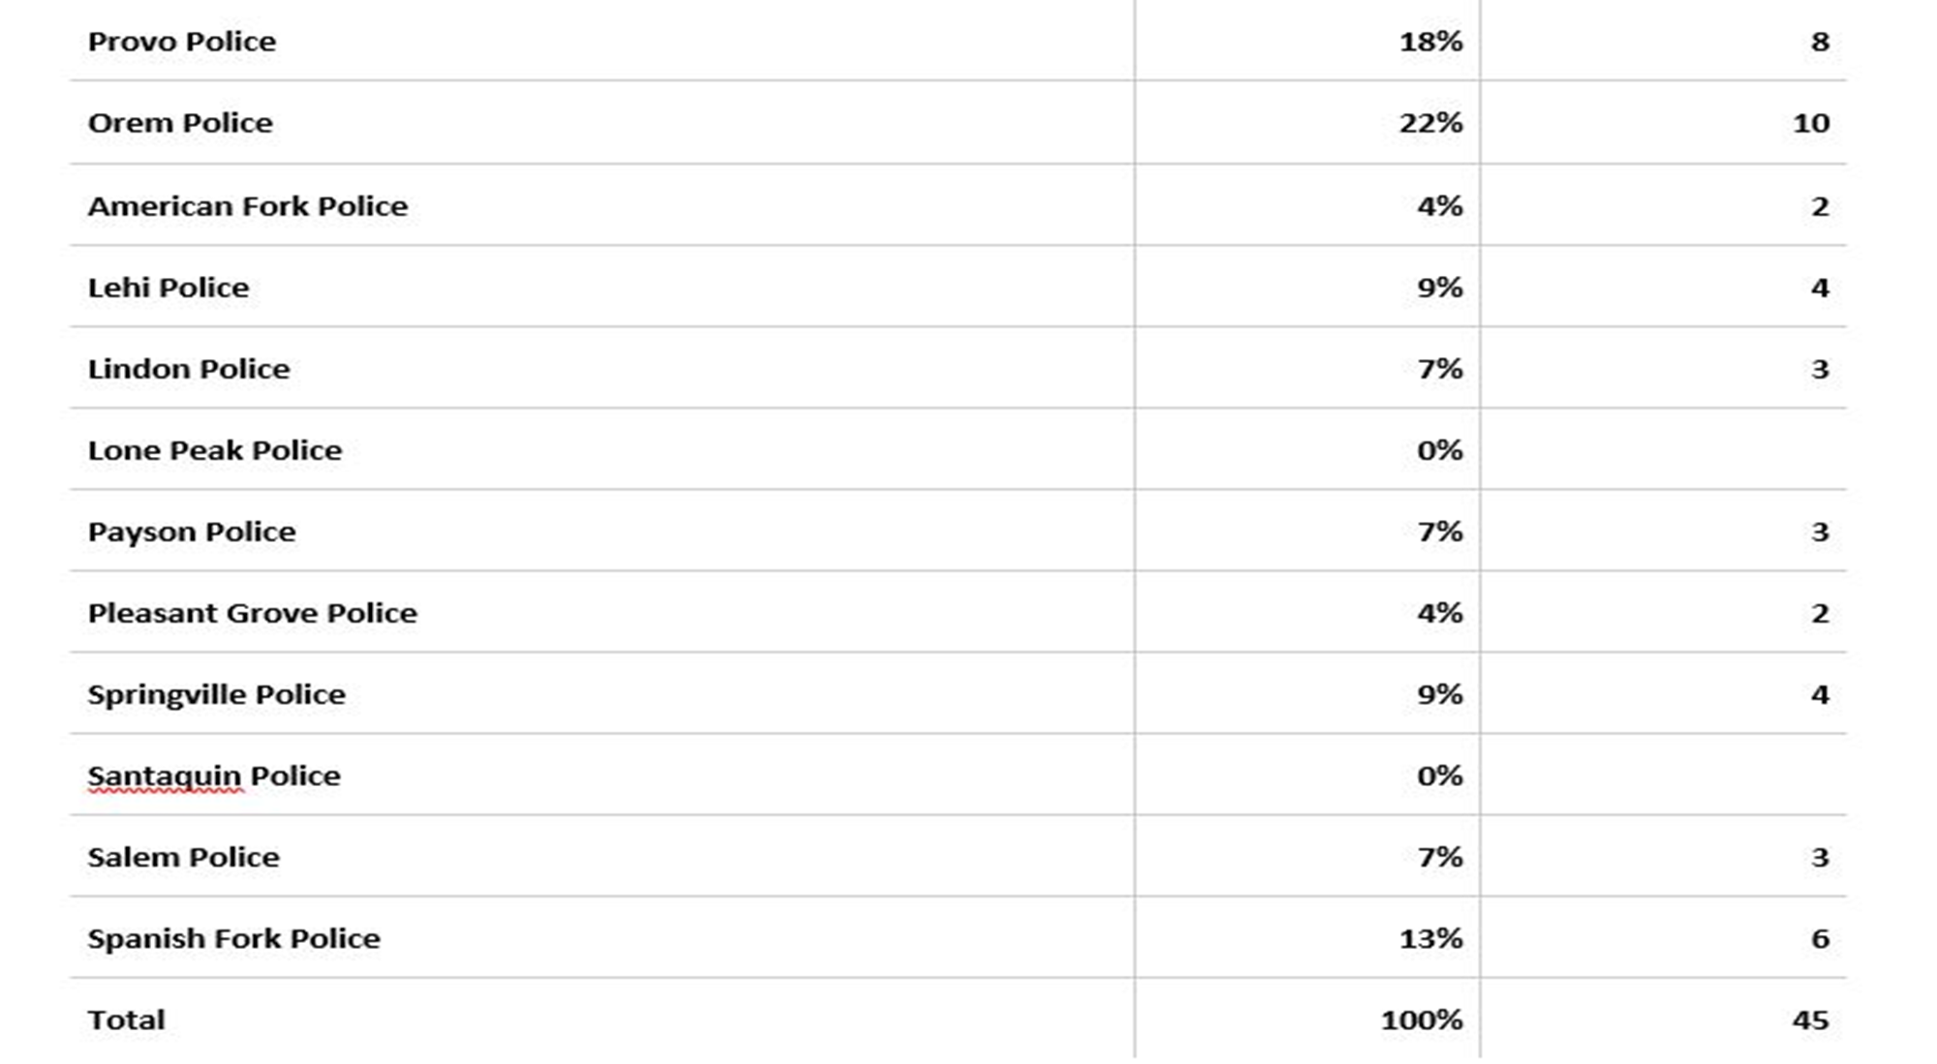

Slide 16
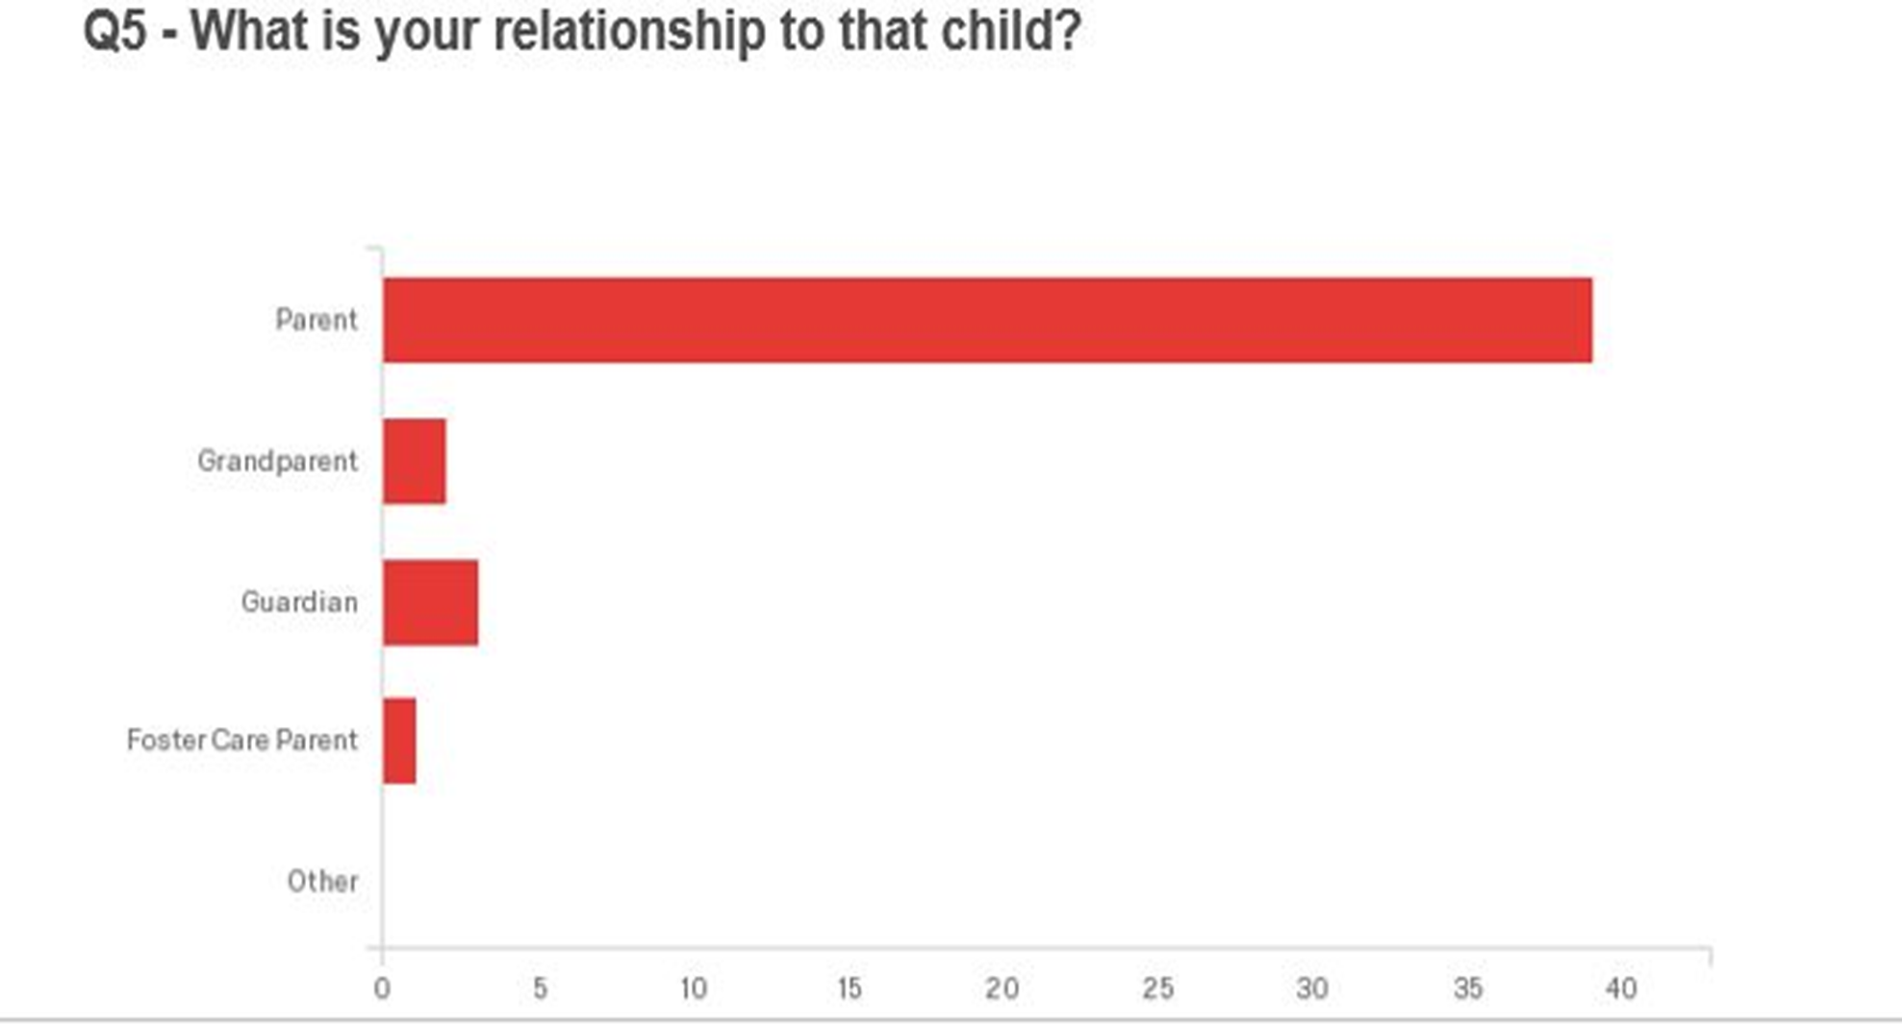

Slide 17
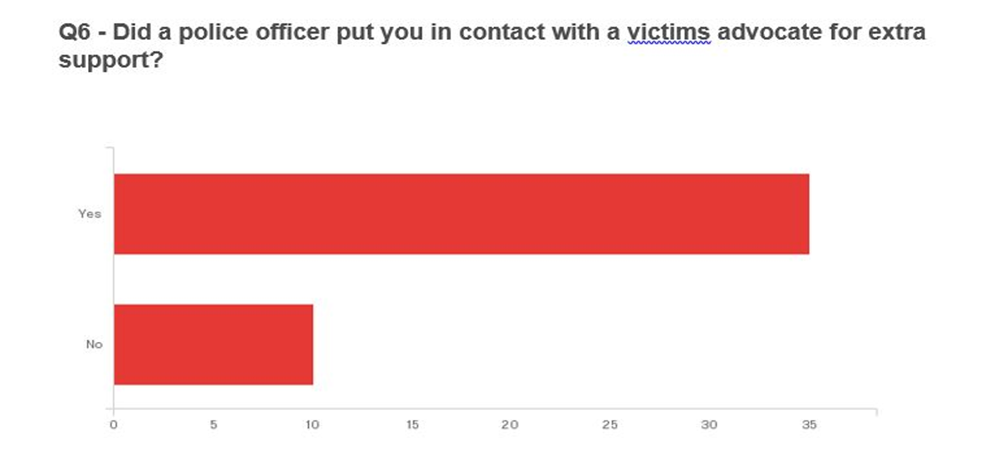

Slide 18
Results
Things that currently effect the attitude towards law enforcement, and why we wanted to study it:
External environment: Effects of the media
Stressful circumstances: Dealing with children and sexual abuse
How are our police departments doing?

Slide 19
Results
78% of our subjects had a positive outlook on police before the incident
88% of our subjects had a positive outlook on police after the incident
This number grew by 10%

Slide 20
Results
So far in 2016 there are 224 child related cases for Utah County
CJC stated they do at least 1000 interviews with children every year
With those statistics in mind:
Number of surveys we received back
10 different Police Departments in Utah County
Multiple responses from each police department

Slide 21
Conclusion
87% would rate their police department positively
6% Neutral
7% Negative
Positive results!
Negative, what is it contributed to?

Slide 22
Any Questions?

