Slide 1
The Local Perception of Police and the Influences of the Media
By: Caden Walker, Magen Christensen, Cam Zollinger & Maddie Taylor

Slide 2
Question and Purpose
What is the perception of the police from Utah Valley Students, and how does the media affect this perception?
Depending on the results of our survey, we will be able to determine…
If the police need to search for ways to improve their public image.
If the media is a reliable and positive source for Utah Valley Students to base their opinions around.
How the perception from Utah Valley/ Utah County compares to the national perception of police.
What role ethnicity has on the perception of law enforcement.
If Utah County is a desirable place to live due to the perception of Local law enforcement’s ability to protect the community.

Slide 3
Related Literature Reviews
U.S. Department of Justice: Factors That Influence Public Opinion of the Police
Measuring Influences On Public Opinion of the Police Using Time-Series Data: Results of a Pilot Study
International Journal of Police Science & Management: Unpacking Public Attitudes to the Police: Contrasting Perceptions of Misconduct with Traditional Measures of Satisfaction.
Journal of Criminal Justice: Public Perceptions of Police Misconduct and Discrimination: Examining the Impact of Media Consumption
The Media, the Public, and the Law Enforcement Community: Correcting Misconceptions

Slide 4
Design and Data/ Problems Encountered
Our research involved a survey, including skip logic and a matrix of similar questions to gage what people thought of the police, both locally and nationally.
Demographic questions were included, such as asking about political affiliation, age, gender, race, etc.
With opinion based questions like this, the response can vary based on the current “climate”, or events surrounding the research.
We had a sample of 500 UVU students, excluding those under 18, possibly incidentally including pregnant women or elderly individuals. However, this should not have affected our survey.
With a sample of 500 people, non-response was a bigger problem and more noticeable.

Slide 5
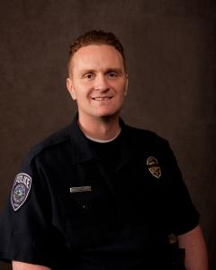
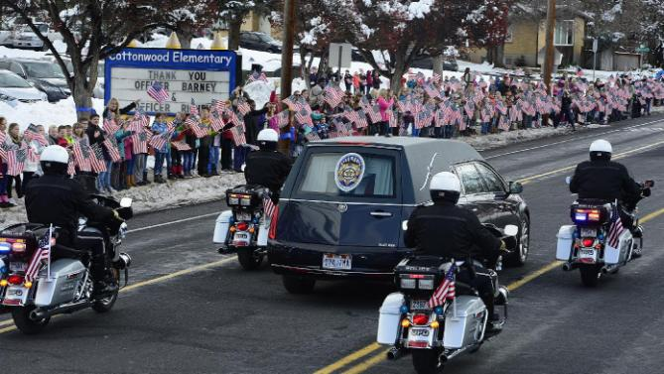
Local Events Surrounding Our Research:
Officer Doug Barney, shot and killed January 17th, 2016 during a routine traffic stop.
The public support for this fallen officer was amazing. Tens of thousands of people lined the street for his funeral procession. Public support for police in this area increased quite a bit during this time.

Slide 6
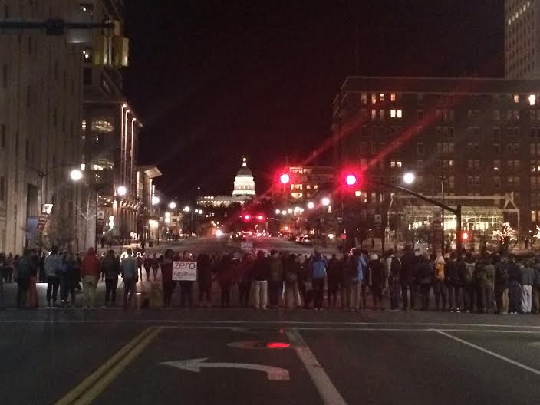
Local Events Surrounding Our Research:
On February 27th, 2016 Abdullahi Omar Mohamed, age 17, was shot by SLPD after he refused to stop beating a man with a broomstick, then allegedly charged police with the same weapon.
Angry protests were held and rocks were thrown at police officers.
When body cam videos were not immediately released, some believed the department was not being transparent.
Our survey was released March 3rd, just days after.

Slide 7
Survey Distribution
Desired Outcome
Sample Size
500 UVU Students
Expected Response
252
Interval
4.35
Actual Outcome
Sample Size
500 UVU Students
Response
43
Interval
2.46
Survey sent on March 3 - received 30 responses
Survey sent on March 15 - received 13 more responses

Slide 8
Survey Results

Slide 9
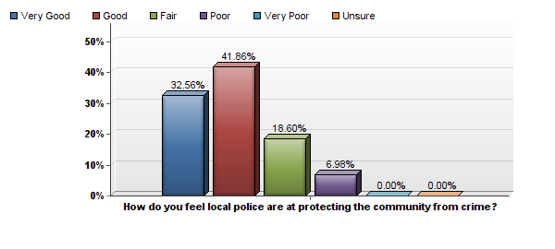
Effectiveness of Local Law Enforcement

Slide 10
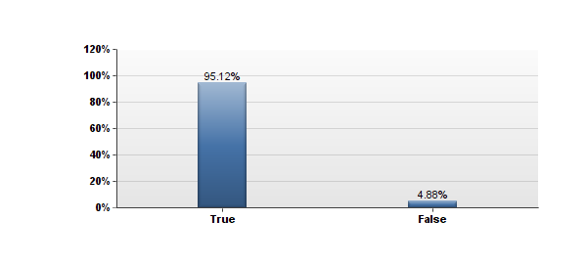
Confidence in Local Law Enforcement
I have confidence in the Local Police.

Slide 11
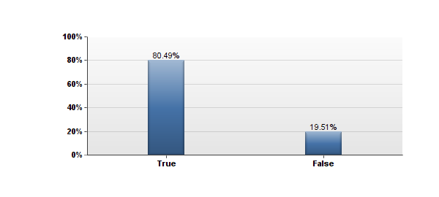
Confidence in National Law Enforcement
I have confidence in the National Police.

Slide 12
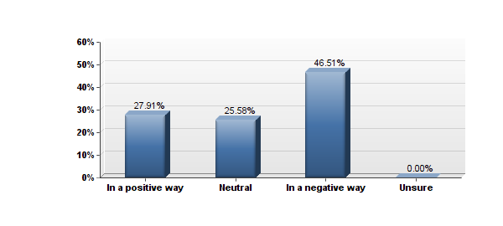
Local Media Portrayal of Law Enforcement
How would you say the Local news that you have read, heard, or seen recently, has portrayed law enforcement?

Slide 13
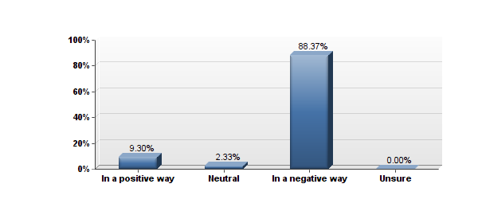
National Media Portrayal of Law Enforcement
How would you say the National news that you have read, heard, or seen recently, portrayed law enforcement?

Slide 14
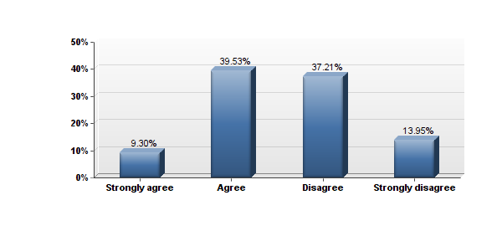
Local Media Portrayal of Law Enforcement
The media portrays Local law enforcement in a positive way.

Slide 15
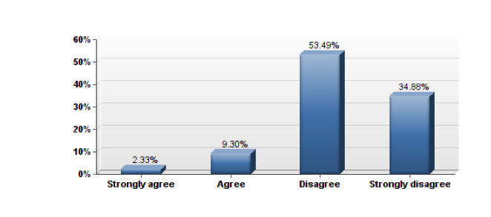
National Media Portrayal of Law Enforcement
The media portrays National law enforcement in a positive way.

Slide 16
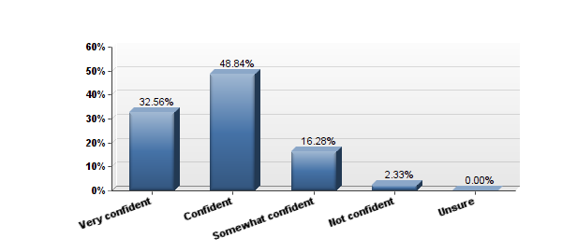
Gaining Trust
How confident are you that the police can gain the trust of the community?

Slide 17
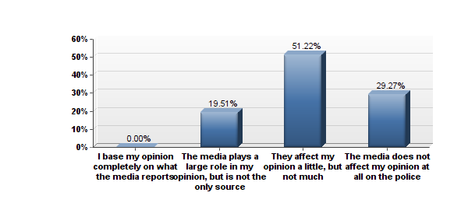
Influence of the Media
How much does the media affect your opinion of law enforcement?

Slide 18
How Viewing the Local News Affects Perceptions

Slide 19
How Viewing the National News Affects Perceptions

Slide 20
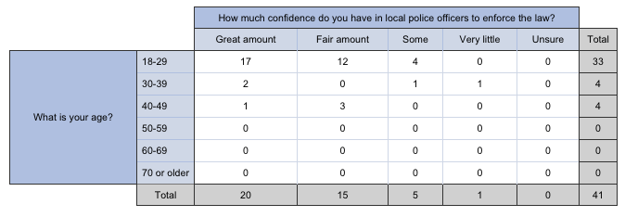
How Age Relates to Confidence in Local Law Enforcement

Slide 21
How Ethnicity Relates to Confidence in Local Law Enforcement

Slide 22
Ethnicity As it Relates to Treatment of Minorities

Slide 23
Brutality and the Effects on the Public’s Perception

Slide 24
Conclusions
Do the police need to search for ways to improve their public image / perception?
The public perception of law enforcement, especially Local law enforcement, seems to be very positive regardless of how the media portrays them. Our sample exhibited a high level of confidence in law enforcement due to the effectiveness and ability of law enforcement to protect the community. Therefore, law enforcement has created a quality public image through effective policing and needs to continue enhancing their image through their strong efforts.
Is the media a positive and reliable source for Utah Valley students to base their opinions around?
While both National and Local media sources were reported to portray law enforcement in more of a negative than positive way, our results concluded that the Local media provided a dramatically greater rate of portraying Law Enforcement in a positive way than the National news. Therefore, Utah Valley students are more exposed to a positive media influence than the national population, but still cannot rely solely on the media for accurate information.
How does the perception of law enforcement from Utah Valley Students differ from the National perception?
According to our results, the public’s perception of both National and Local law enforcement agencies are very positive, but Utah Valley students show an even greater appreciation and confidence in Local law enforcement. Once again, these results are a product of the ability of Local law enforcement to do their job and maintain a good public image.

Slide 25
Conclusions
What role does ethnicity have on the perception of law enforcement?
We do not believe that enough data was gathered to make a valid conclusion due to the lack of diversity among respondents. With that being said, all ethnicities that responded expressed confidence in Local law enforcement. The majority of minority respondents believe that Local law enforcement treats everyone equal, while almost 25% of caucasian respondents believe that minorities are treated unequally by Local law enforcement. This data cannot be considered conclusive until a more diverse sample is taken.
Is Utah County a desirable place to live due to the perception of Local law enforcement’s ability to protect the community?
The perception and confidence in Local law enforcement to protect the community is so high that Utah County emerges as an exceedingly desirable place to live. Students and families that are concerned with safety can look at the results of our project and discover that the public perceives Utah County as a remarkably safe place to live due to the ability of Local law enforcement to protect the community.

