Slide 1
Sexual Assault at UVU
By Mashari Alenazi
Shaun Byars
Jon Perry
Makailee Schiess

Slide 2
Introduction
This study consisted of a survey which was available to students and faculty who are part of Utah Valley University. This was geared to find the psychological impact that sexual assault can have on women. It was also used as a tool to help and protect women who attend UVU. All the answers that were provided were anonymous and only the data that was collected will be made available to Utah Valley administrators. Although the survey was voluntary, everyone who participated had to be at least 18 years of age. As we are aware this is a sensitive subject, we allowed participants to skip over questions they did not feel comfortable answering. The survey took about 15 minutes on average to complete and was approved by the Institutional Review Board. We also provided the number to a Sexual Assault 24-hour Hotline that participants could reach out to, if needed.

Slide 3
Research design
Our survey consisted of 50 questions. These questions included background questions such as asking if they were registered students of UVU and what year in school they were. Our questions were a variety of asking whether or not the participants had been touched inappropriately without their consent, and how old they were at the time. Other questions include whether sexual intercourse had been forced on the participants at any given point while they were under the influence. One of the key points that we focus on is the fact that most of the sexual assaults are committed by someone the victim already knows.

Slide 4
results
We received a total of 37 responses. With feedback that we got, we discovered that 71.43% of those who participated in our survey were seniors, 21.43% were juniors and 7.14% were sophomores. None of the participants were freshman. Slightly over half of those who submitted a response participate in extracurricular activities. One of the key questions in our survey was whether participants felt safe on campus. An astonishing 78.57% claimed to feel safe on campus, while 17.86% were neutral and a low 3.57% said to feel unsafe.

Slide 5
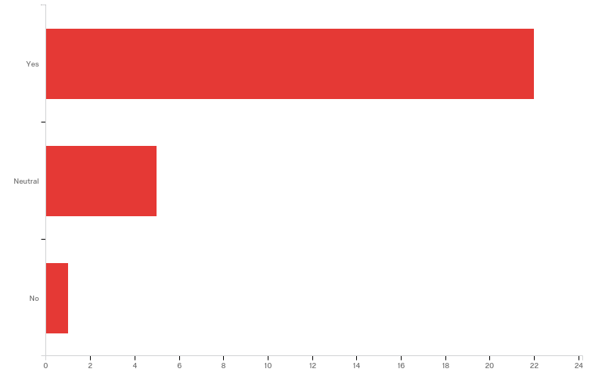
Q54 - Do you feel like UVU is a safe campus?

Slide 6
Results continued…
As the survey went on, it asked more personal questions. One of the questions asked was if any male had ever made the participants feel uncomfortable. 65.52% responded that they had not been made uncomfortable by males, while 31.03% said they did, and 3.45% refused to answer. Drawing conclusions from the option “refused to answer,” we might assume that those who chose this answer, were made to feel uncomfortable by males. These participants more than likely experienced a similar event and might have felt uncomfortable with the question, therefore avoiding to provide a straight answer.

Slide 7
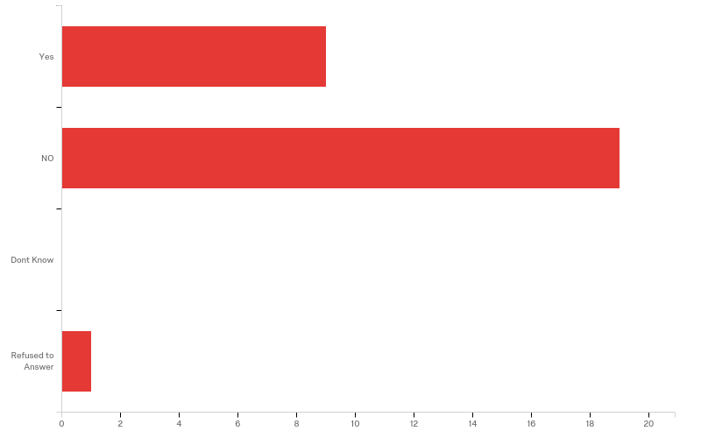
Q4 - Regardless of how long ago it happened or who did it, ... has a man, or boy EVER made you have sex by USING FORCE OR THREATENING TO HARM you or someone close to you? Just so there is no mistake, by sex we mean a penis in a vagina

Slide 8
Continued…
Another question asked was whether or not these female participants were ever forced into having anal sex. While 96.43% said they had never been forced, 3.57% said that they had been forced at some point in their lives. This we sort of predicted due to the statistics of women reporting these crimes, but one question that was higher than we thought it would be was whether or not participants had been penetrated against their will with either fingers or any object in the vagina or anus. Seventy-five percent said no, but 25% answered that they had. This stood out to us the most as we did not think that this many women would be willing to admit they had been penetrated against their will.

Slide 9
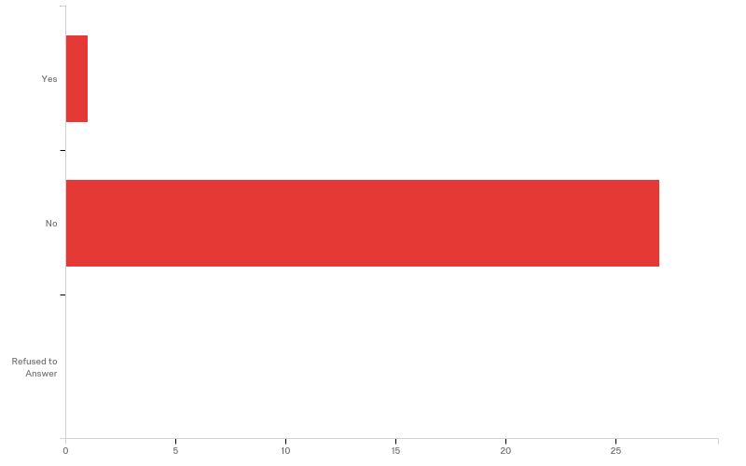
Q10 - Has anyone EVER made you have anal sex by using force or threat of harm?

Slide 10
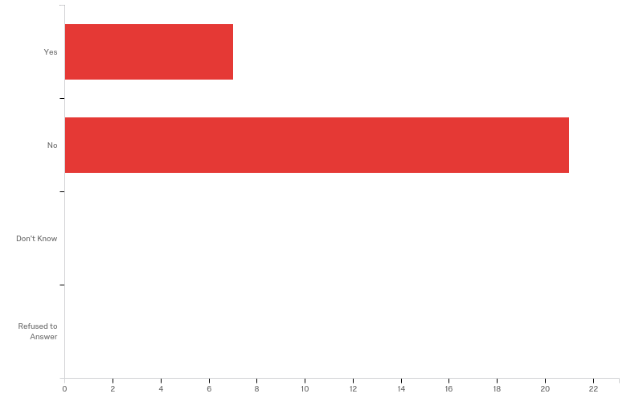
Q13 - Has anyone EVER put fingers or objects in your vagina or the anus against your will by using force or threats?

Slide 11
Continued…
Another question that is related to the previous one was whether the individual who had forced them to have any sort of intercourse was their husband or boyfriend at the time. 7.69% claimed that their husband had forced them.30.77% said that their boyfriends had forced them and 61.74% said that no one had forced them to have sexual intercourse. This is a big eye opener as many other studies showed that those who fall victims of sexual assault fall to individuals who know them, or are around them frequently.

Slide 12
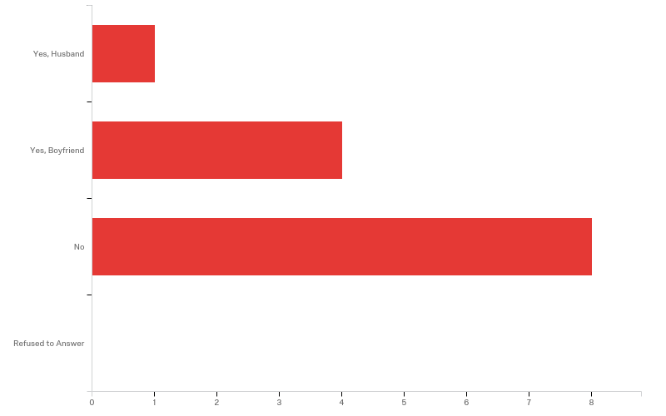
Q25 - During your lifetime, has your current or a past relationship partner (husband,or boyfriend) ever made you or tried to make you have any kind of sexual intercourse against your will? (Sexual intercourse includes sex, oral sex, anal sex, or penetration with fingers or objects.)

Slide 13
Continued…
Those participants who admitted to being sexually assaulted, 42.86% said that they seeked medical help after their assault to check for sexually transmitted diseases. 28.57% seeked medical help to check for pregnancy, and 28.57% refused to answer. Unfortunately, not everyone seeks medical help after they experience an assault. 20% did not seek medical attention as they were not physically injured. 40% say that that they were too young to ask for help, another 20% were scared that someone would find out they were assaulted and another 20% refused to answer.

Slide 14
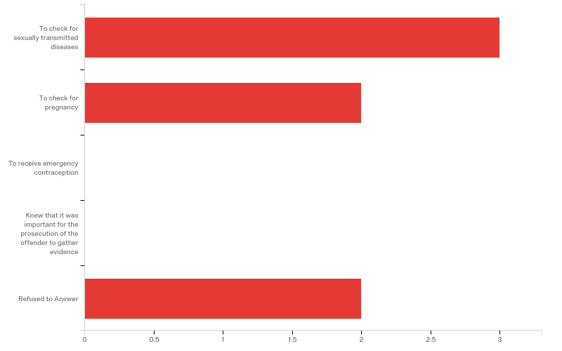
Q43 - Why did you seek medical care?

Slide 15
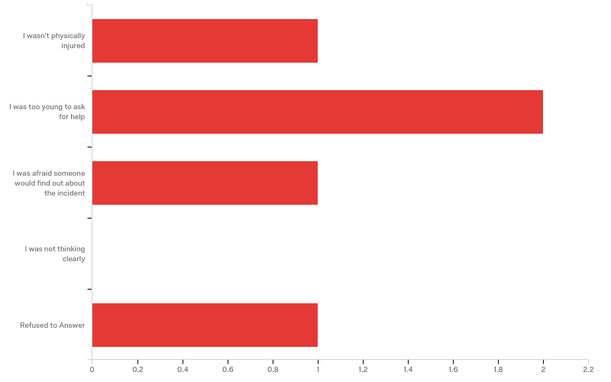
Q42 - Why didn't you go to a doctor?

Slide 16
Continued…
Those who were assaulted and those who reported, 66.67% reported their incident to the police within 24 hours of their attack and 33.33% reported within a week. This helps us notice that this is one of the areas that needs work. It is important to promote to victims that they should get immediate care. There is so much shame associated with sexual assault that most victims do not seek medical help whatsoever.

Slide 17
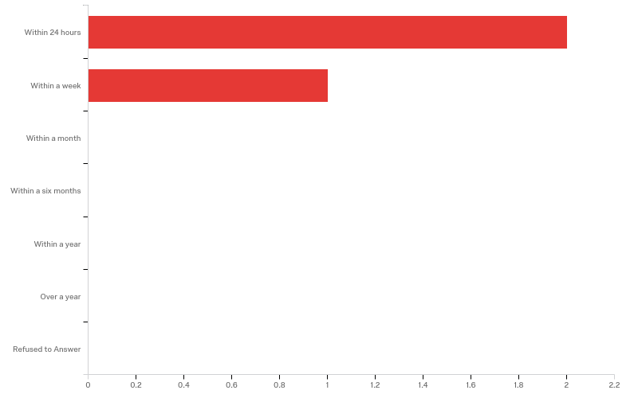
Q45 - How soon after the incident was it reported to the police?

Slide 18
Sample size and complications
Our sample size for this survey consisted of 500 registered female student body. Some of the problems we faced were 1 getting responses back from the students we sent the survey out to. We sent out the survey on November 22nd and received almost 18 responses and 25 views in the first night, things were looking great. Unfortunately we only received a few responses after that so our sample size was very small. This makes it difficult to get accurate numbers. Another problem which adds to low sample size was a lack of time, the IRB was very busy and it took longer than expected to receive our approval letter, which lead to minimal time alloted to keep the survey active. Finally the biggest difficulty is what we are trying to change in our society, that this crime is not talked about or reported nearly enough. We had 47 people start the survey and only 29 actually respond. This is a trend that must change in order to make a difference.

Slide 19
Literature review
The articles and book listed above proved significant research and data on sexual assault that occurs on college campuses. Jon Krakauer book Missoula actually held at least 6 case studies involving female students and their experience as victims of sexual assault while in the rape capital of the world. Those case studies and the coinciding federal investigation of Missoula in 2012 unveiled college campuses as a breeding ground for sexual assault. That is why all of the studies listed above that deal with sexual assault on college campuses came after 2012 and consequently why it is part of this study. The vast majority of these studies focused on the women’s response to sexual assault which is why it became the focal point of this research.

Slide 20
Literature review sources
‘Burleigh, N. (2014). CONFRONTING CAMPUS RAPE. Rolling Stone, (1211), 46
Ciarra Resendiz, Brock Boutelle, Alex Morehead, and Taylor Cabe. Sexual Assault Reporting on Campus. Student research. Orem: UVU criminal jusice department, 2015.
Kaila Hempel, Gina Proctor, Ray Reynoso, Bryson Lystrup, Jeremy Baker. UVU Women Sexual Assault and Substance Use. student research project. Orem: UVU criminal justice department, 2015.
Krakauer, Jon. Missoula, Rape and the Justice System in a College Town. New York: Anchor Books, 2015.

Slide 21
Sources continued…
Street, A. E., Gradus, J. L., Stafford, J., & Kelly, K. (2007). Gender differences in experiences of sexual harassment: Data from a male-dominated environment. Journal Of Consulting And Clinical Psychology, 75(3), 464-474. doi:10.1037/0022-006X.75.3.464
Stotzer, R. L., & MacCartney, D. (2016). The role of institutional factors on on-campus reported rape prevalence. Journal Of Interpersonal Violence, 31(16), 2687-2707. doi:10.1177/0886260515580367
Turchik, J. A. (2012). Sexual victimization among male college students: Assault severity, sexual functioning, and health risk behaviors. Psychology Of Men & Masculinity, 13(3), 243-255. doi:10.1037/a0024605.

Slide 22
conclusion
The focus of this research project was directed to how females at Utah Valley University felt about their safety while attending the institution. The survey was sent to current members of the college campus society. Through the results it was found that while the fast majority of the respondents had a positive view of the campus and how safe they felt while on it there was a couple that did not feel safe. Along while the feeling of uneasy was lack of desire for any of their friends or loved ones going to UVU. These results find that UVU is doing a good job at creating a safe campus to achieve a higher education, however so work still needs to be done in ensuring that everyone feels comfortable there.

