Slide 1
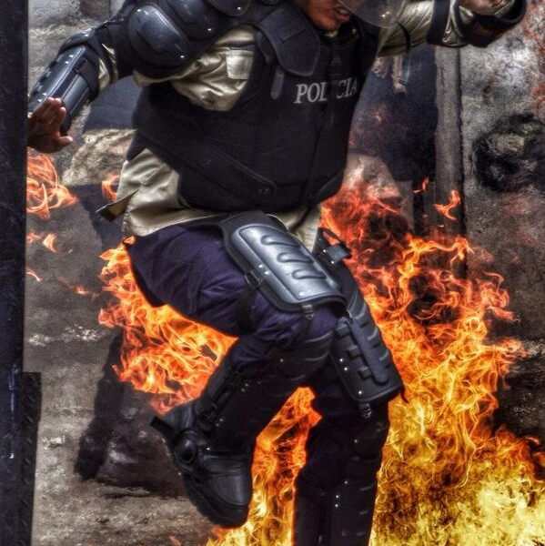
VIOLENCE TOWARDS POLICE:
THE CAUSES
Jeff (Cj) Crawshaw
Kari Dennis
Natalie Wheeler
Lehi Dominguez

Slide 2
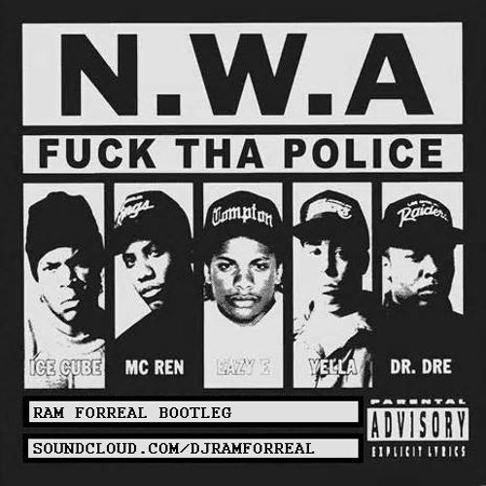
The Pendulum:
The fine line between love and hate Of Police officers
Background Information
Early 1990’s:
Rap group NWA’s album Straight Outta Compton gains national attention, highlighting life in the ghettos, with strong lyrics promoting violence against police.
Video footage is leaked and shown nationally on TV, showing the severe beating of a black man, Rodney King, by 4 police officers.
Massive Rioting in LA followed
The issue of racial profiling is covered and discussed heavily in the media

Slide 3
The Pendulum, continued
Mid 1990’s:
OJ Simpson trial
Re-ignites the race issue
Found “Not Guilty”
One black jury member later admits it was “Payback for what happened to Rodney”

Slide 4
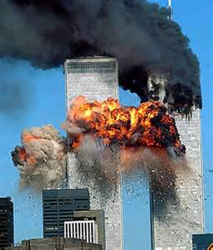
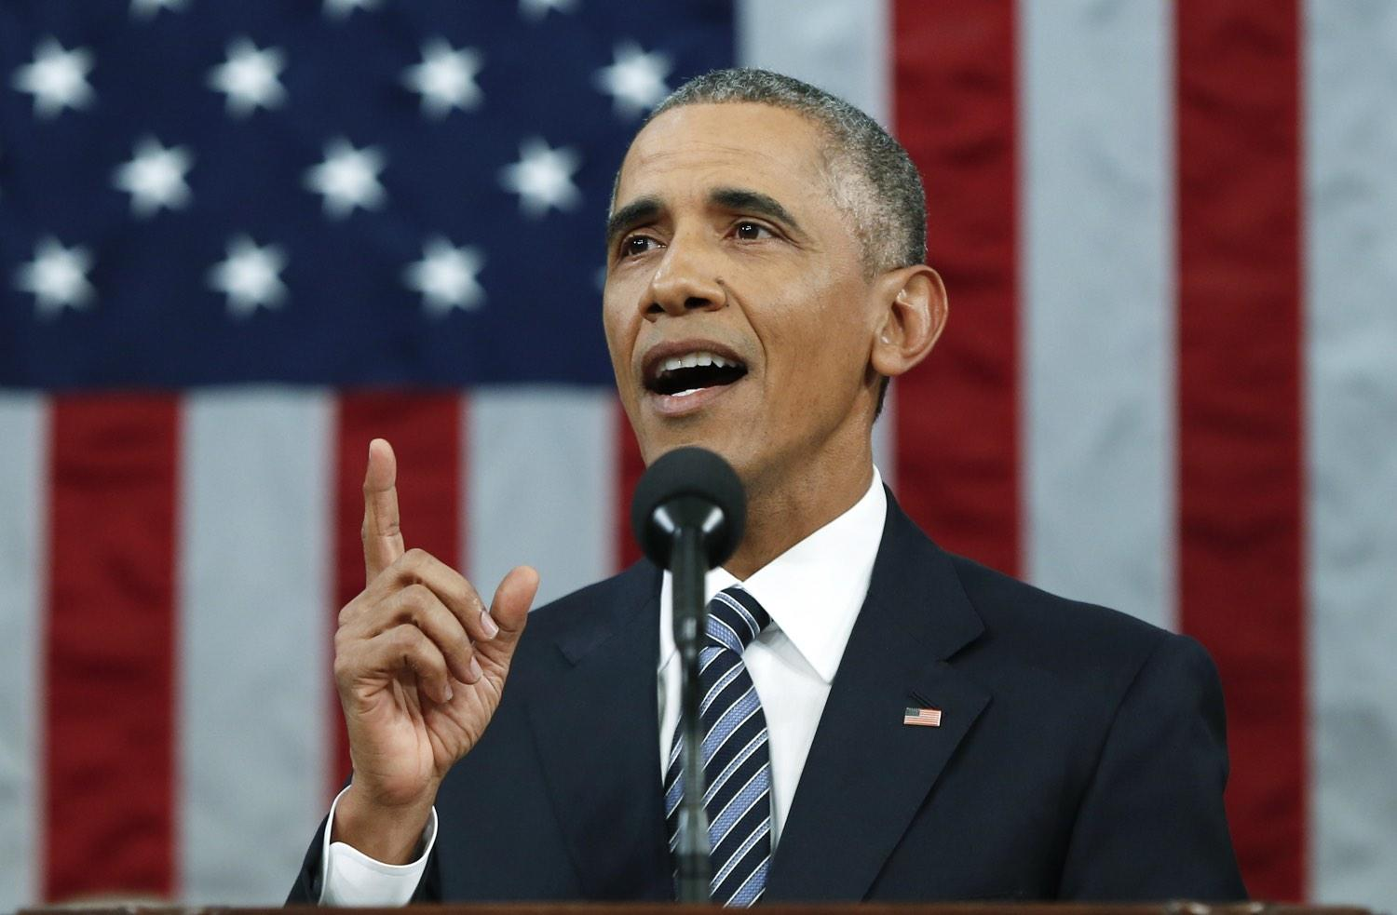
The Pendulum, continued
September 11, 2001, terrorist attack
Aftermath:
“We love our local heroes”: Police and military personnel
“War on Terror”
2008, Barack Obama elected the first black president of the USA.
Aftermath
Become the poster child for black rising above “white oppression”
Samuel L. Jackson “I voted for him simply because he was black.”

Slide 5
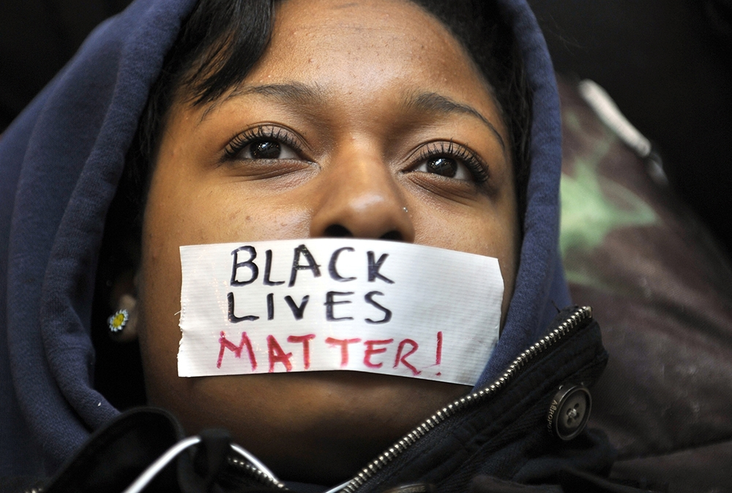
The Pendulum, continued
2012, President Obama is re-elected for a second term
Years of ignored white on black racism, perceived and actual, begins rising to the top once more
2013, Trayvon Martin, dies by gunshot wound from George Zimmerman
Aftermath
Zimmerman acquitted at trial
#BlackLivesMatter seen on many social networks

Slide 6
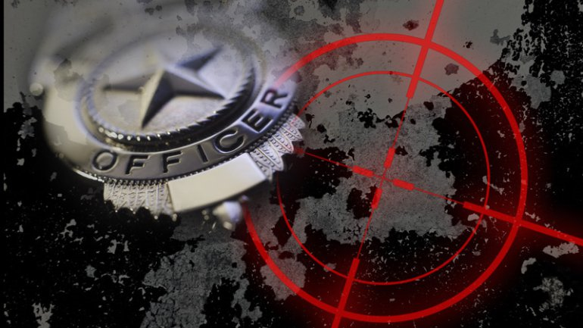
The Pendulum, conclusion.
2014-Present Day:
Police involved shootings/deaths of black people have been followed by mass rioting
The last few months have seen police officers hunted down and shot/killed, via sniper or point blank range, when no stop, arrest, or altercation of any individual was even taking place

Slide 7
Specifics: The last few years have seen a massive rise in violence towards police. The media has seemingly sensationalized this violence, and its attendant events. Two specific events seem to be the tipping point:
Death of Freddie Gray, 25 yr old black male, while in police custody.
Baltimore, Maryland, April 25, 2015.
Shooting of Michael Brown, 18 yr old black male, by white officer, Darren Wilson.
Ferguson, Missouri, August 9, 2014.

Slide 8
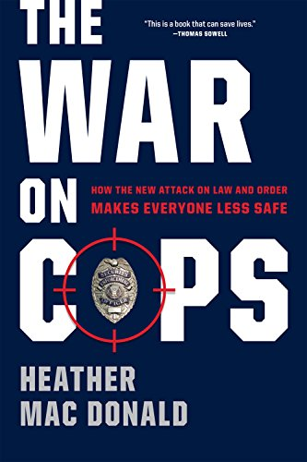
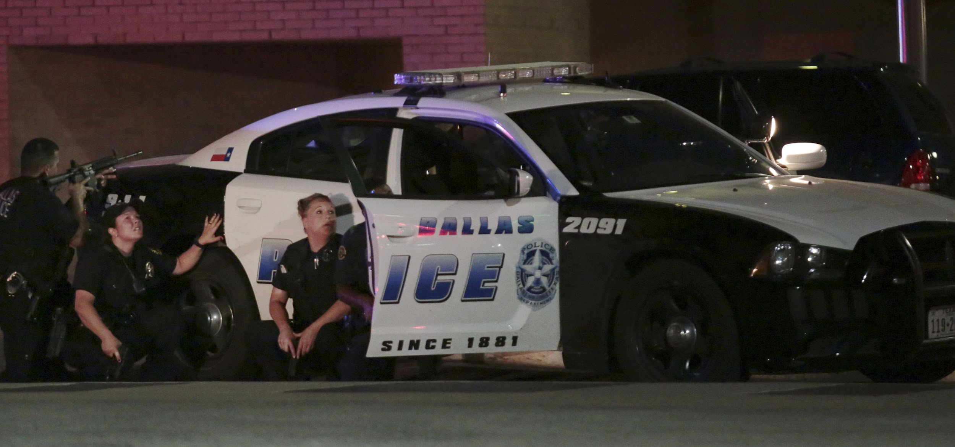
Our Question:
What are the CAUSES of violence towards police?

Slide 9
Hypothesis
Violence is the after-effect of the media’s influence on the public at large.
Through media, televised, as well as social, people are told, directly and indirectly, that police are the enemy, despite any legal reason police may have for stopping anyone.
The opinion of the media does not reflect the overall opinion of UVU students at large.

Slide 10
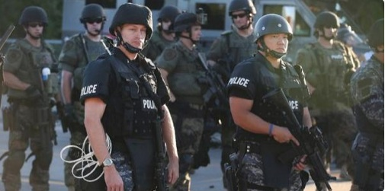
Literature Review
There have been case studies involving police violence, examining possible reasons violence towards police may happen, although many studies pre-date 2014.
Factors examined include:
How offenders provoke officers to commit violence
Geographical area
Influence of alcohol
Use of force
Racial profiling

Slide 11
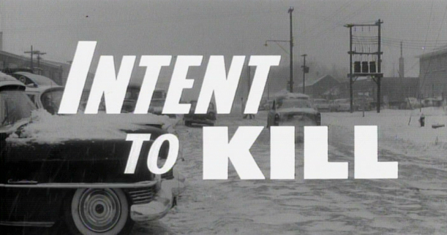
Michelle Covington: 2010, Correlates and Causes of Violence Against Police Officers
Facts:
Consumption of alcohol plays a major part in violence towards police.
Out of all arrests:
38% who initiated violence against an officer did so mainly to avoid arrest
Of the other 42%,
19% were attempts to kill the officer(s)
14% were attempts to frighten the officer(s)
7% were attempts to wound the officer(s)
2% were attempts to immobilize the officer(s)

Slide 12
Bradley Anders: 2011, Racial Profiling and its Relation to Proactive Profiling
Facts:
Found no relationship between arrests or stops due to racial profiling.
Surprising amounts of reverse profiling when officers make arrests.
Several agencies tell officers to NOT stop minorities to avoid accusations of racial profiling.
Suggests that the states that mandate Racial Profiling Laws should keep in mind that if an officer is stopping more minorities...that race may not be the issue.
Most of the time the officer didn’t know the race of the person when pulling someone over for a traffic offense.

Slide 13
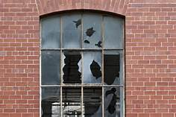
Andrea Ritchie, 2016,
Black Lives Over Broken Windows
Facts:
Following the events of Ferguson, Missouri,
residents took to the streets to decry what they perceived was “Broken Windows” policing, wherein law enforcement was “marked by aggressive policing of minor offenses and heavy police presence in low income black communities.”

Slide 14
Andrea Ritchie, continued.
Broken Windows policing is what led to the death of Eric Garner, a 43 yr old Staten Island resident who was killed earlier that summer by NYPD officer Daniel Pantaleo, using a banned police chokehold during an encounter that was initiated over Garner’s alleged sale of loose cigarettes.
In 2015, Baltimore Maryland. Freddie Gray was initially stopped while allegedly fleeing police officers in his low income black community and who died after his spinal cord was severed while he was in police custody.

Slide 15
FBI UCR: Law Enforcement Officers Killed and Assaulted
Facts:
Yearly report that has to do with officers that are killed in the line of duty, either feloniously or accidentally.
Because of this and 40 years of other data, a program called Officer Safety Awareness Training (OSAT) has been developed and is available to cities, universities and colleges, state, county, federal, tribal, and international law enforcement agencies at no cost…
The OSAT training program focuses on the WHY an incident happened and NOT WHAT HAPPENED. By focusing on the why, this helps officers gain lifesaving information that can be implemented in their day to day operations to help prevent and possibly avoid any type of assault against officers.

Slide 16
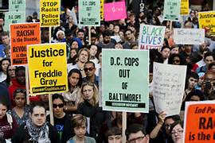
The studies listed above show data collected about violence towards police, whereas our main focus was on what students feel is the leading cause in why violence towards police occur.
Notes:
Data gives support to our question of causes of violence towards officers

Slide 17
Limitations of Study
A random sample of Utah Valley University students provided by the IRI
Respondents may not respond to an email survey due to the possibility of it not being anonymous
Our response timeframe was limited due to a three week span waiting for approval from IRB and fall break happening at the same time.
Possibly false responses given due to respondents just marking answers

Slide 18
Methodology
We used a quantitative research approach
Survey design had skip logic so respondents answered questions based on their opinion and knowledge of topic
It was administered using Qualtrics
We used the IRI to gather our random anonymous sample of 500 emails

Slide 19
The Survey
500 surveys sent out to Utah Valley University students at large
We planned for 75 responses we closed the survey at 84 responses.
84 respondents started the survey
32 completed the survey 100% giving us a 38.1% response rate of total opened
14 completed the survey 90% providing a 16.67% response rate
Did not include anyone under the age of 18
Opinion based questions, most in a matrix to eliminate open ended questions
Background questions asking opinions on police brutality were asked to provide a mindset of the respondents
We stated in the consent that it would take 8-10 minutes to complete
Most took 4 minutes to complete with the longest taking 1:32:00
Students had two weeks (15 days) to respond. Reminder emails were sent twice during that time to increase response rate.

Slide 20
Issues with survey once sent out
We took the advice of the IRI and embedded one of the questions to the email that we sent out to the students.
We believe that did not help get responses. When looking at the surveys that were not complete, most of the surveys only answered the one question that was embedded.
This could have made respondents feel it was the only question to the survey or that once started they decided to not complete the survey.
We feel that if we had more time to keep the survey open we could have gotten a larger return rate, due to the time frame of the semester end date.

Slide 21
Do you feel violence towards law enforcement officers is warranted?

Slide 22
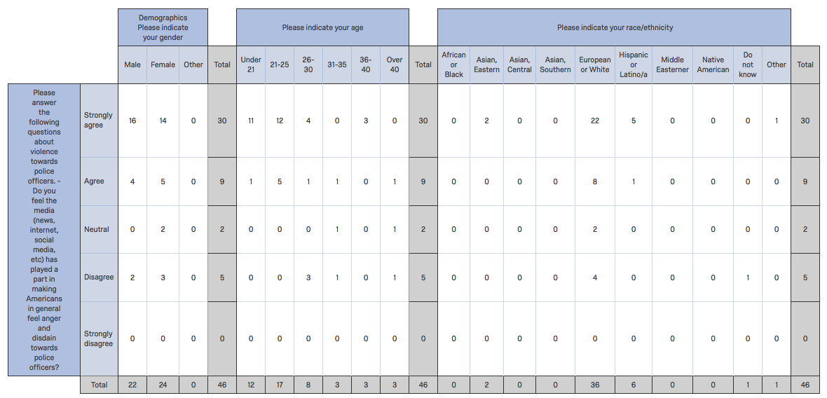
Do you feel the media (news, internet, social media, etc) has played a part in making Americans in general feel anger and disdain towards police officers?

Slide 23
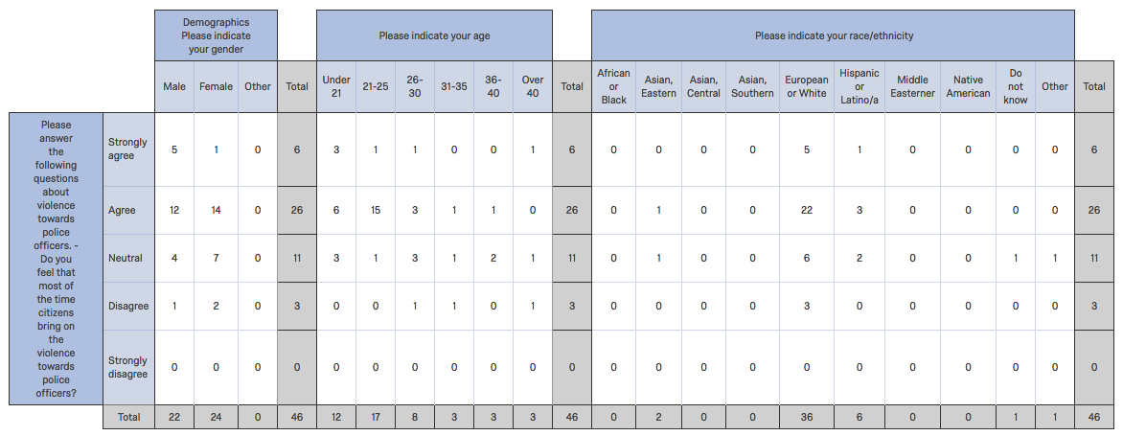
Do you feel that most of the time citizens bring on the violence towards police officers?

Slide 24
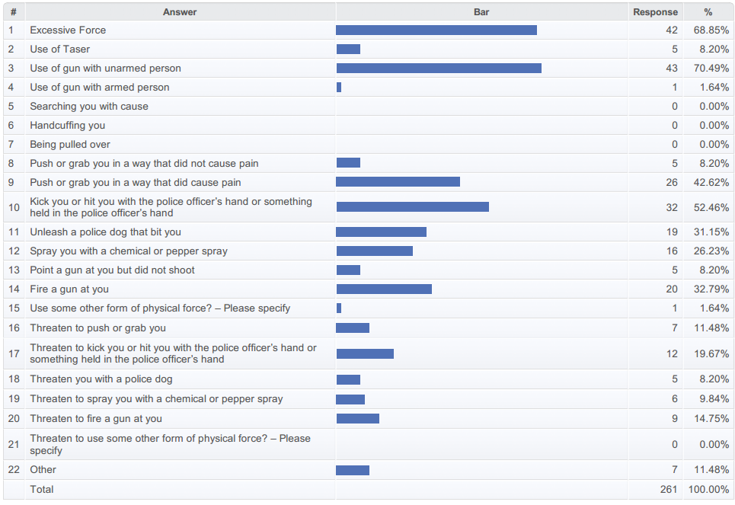
Q9:What would you define as police brutality?

Slide 25
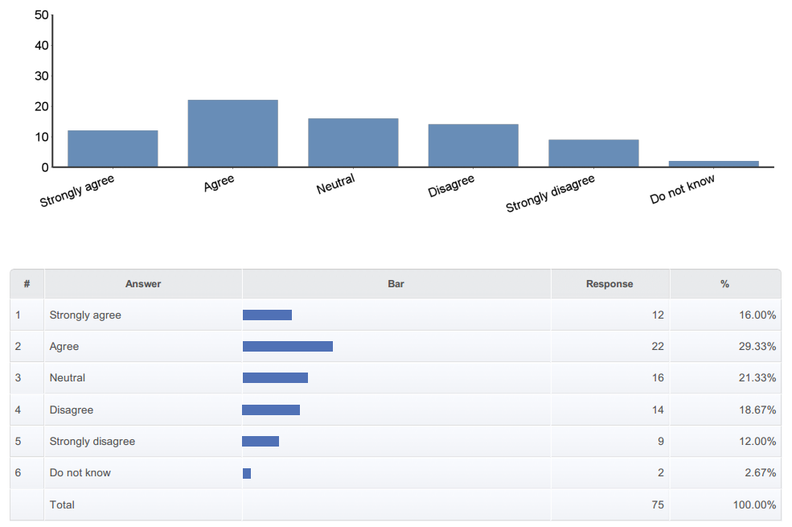
Q12 - How strongly do you believe that racial profiling leads to police brutality

Slide 26
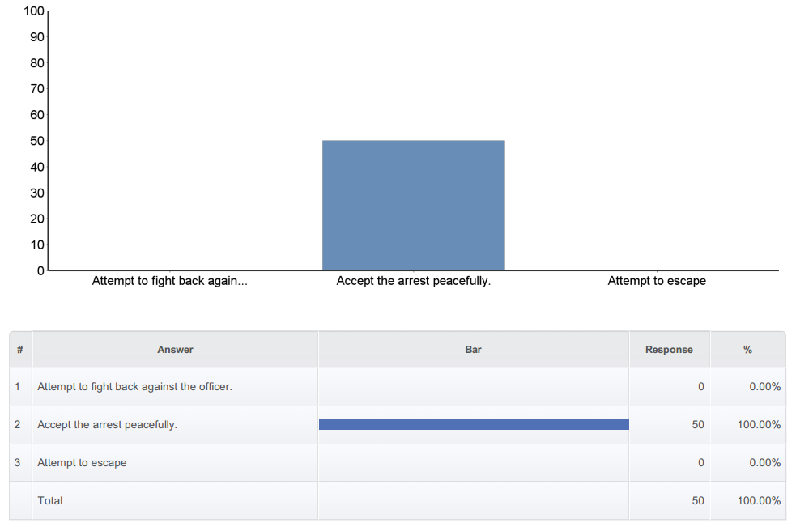
Q25 - If you found yourself being arrested, whether or not you felt it was legally justified would you...

Slide 27
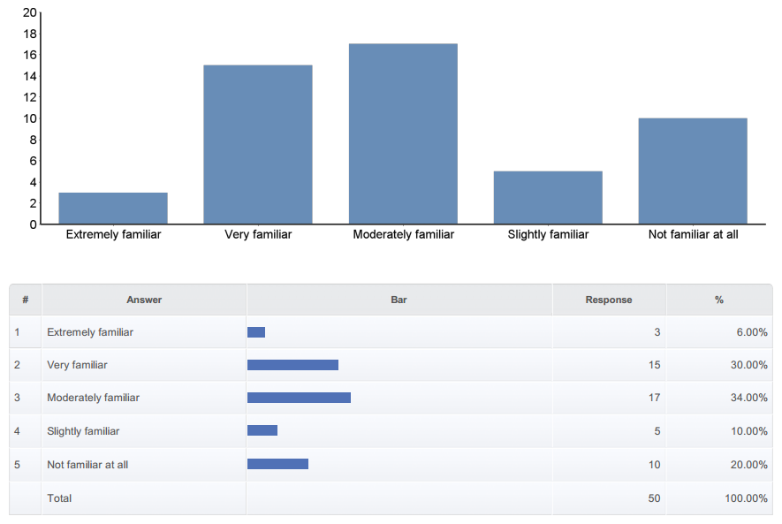
Q28 - How familiar are you with the ensuing riots that followed the deaths of Michael Brown of Ferguson, Missouri and/or Freddie Gray of Baltimore, Maryland?

Slide 28
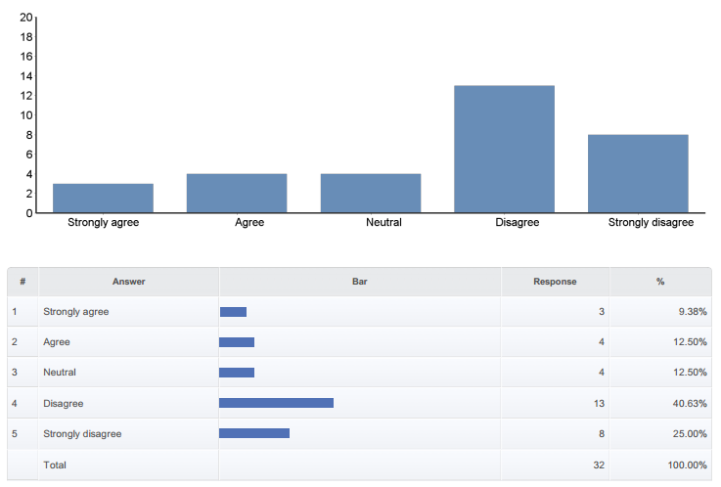
Q29 - If you are familiar with the above question, do you feel the riots were ethically, though not legally, justified?

Slide 29
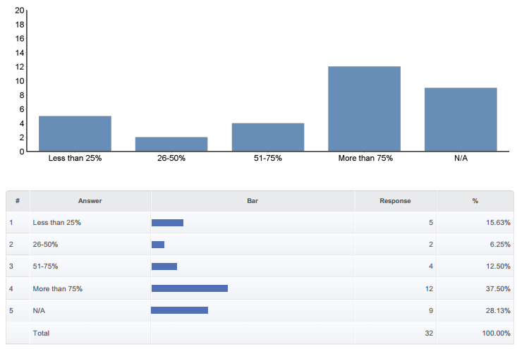
Q32 - If you agree to the above, to what percentage do you feel the media has contributed to this overall feeling?

Slide 30
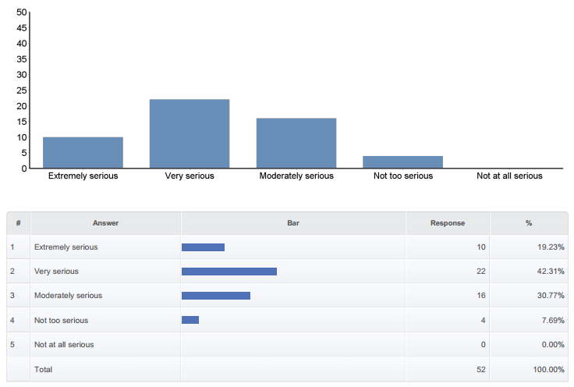
Q33 - How serious a problem do you think violence towards law enforcement officers violence is in the United States?

Slide 31
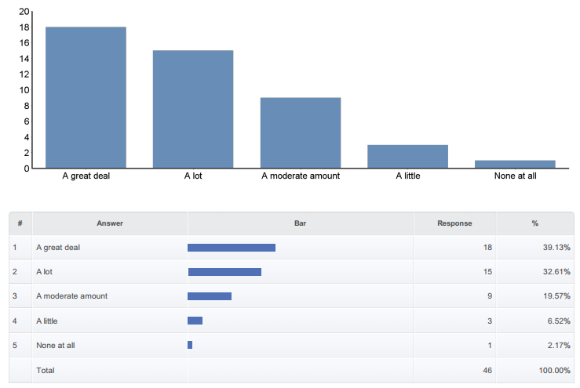
Q34 - How much of the time do you think you can trust the police to do what is right for you and your community?

Slide 32
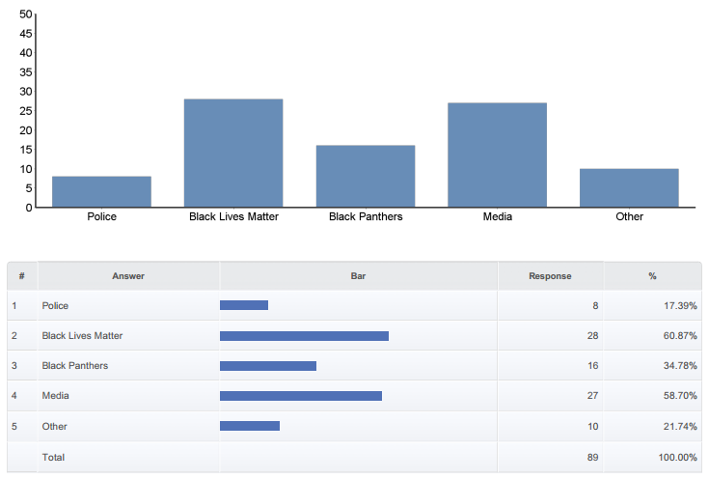
Q36 - Do you feel there is a certain group who bring on the violence towards police officers? (Mark all that apply)

Slide 33
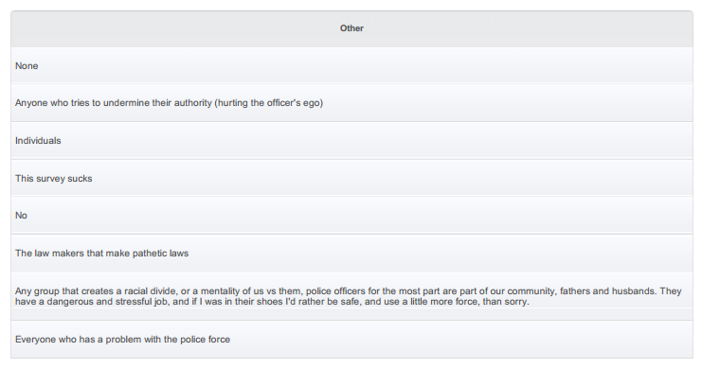
Other

Slide 34
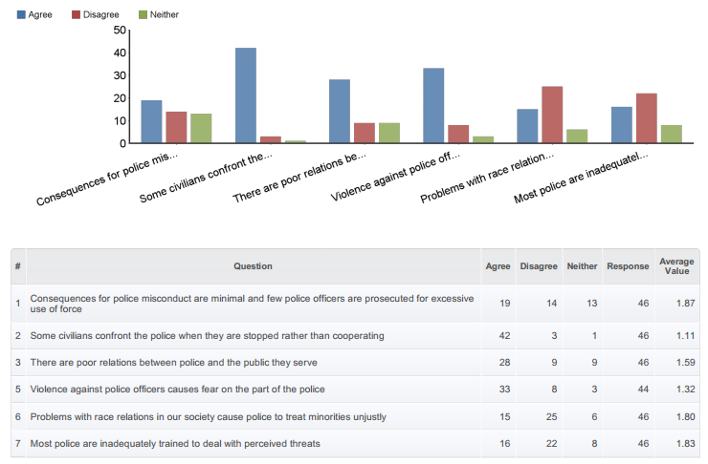
Q37 - Here are some reasons that have been given for police violence against civilians. For each one, please indicate whether you agree, disagree or neither.

Slide 35
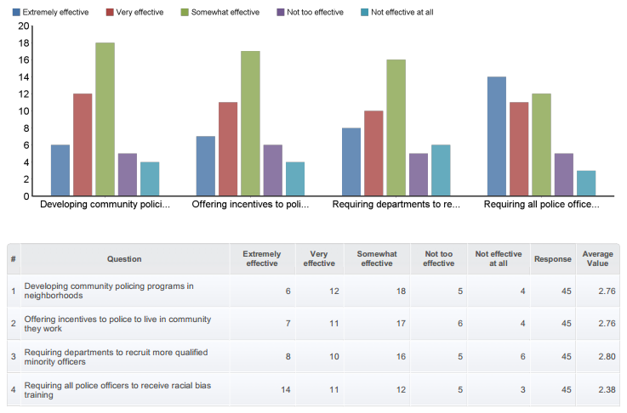
Q38 - Here are some policy changes that have been suggested to reduce tension between minority communities and the police. For each one, please tell me whether you think it would be extremely effective, very effective, somewhat effective, not too effective, or not effective at all.

Slide 36
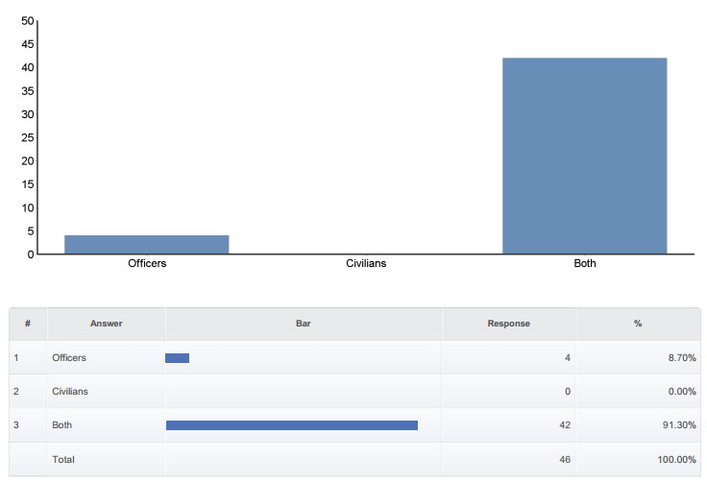
Q44 - How upsetting is it to you when you hear in the media about a law enforcement official being attacked or killed?

Slide 37
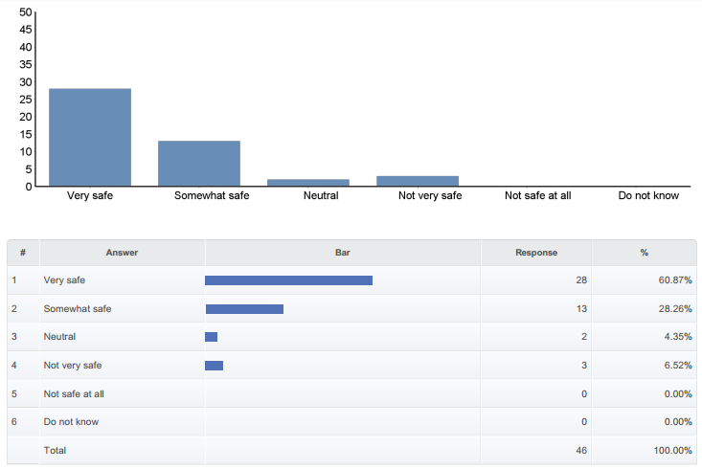
Q45 - From a college student’s perspective how safe do you feel about law enforcement in your community?

Slide 38
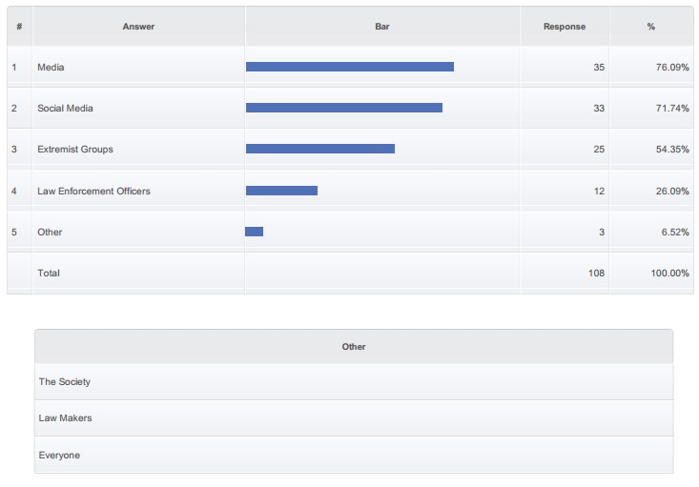
Q46 - Who do you think is more responsible for societies view of law enforcement? (Mark all that apply)

Slide 39
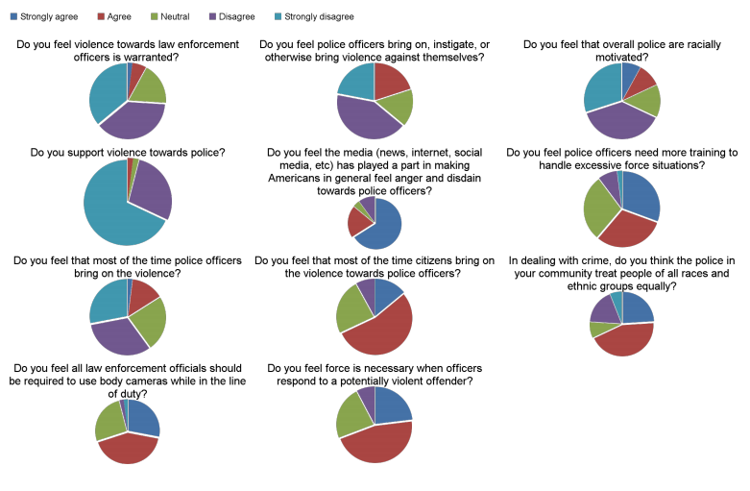
Q50 - Please answer the following questions about violence towards police officers.

Slide 40
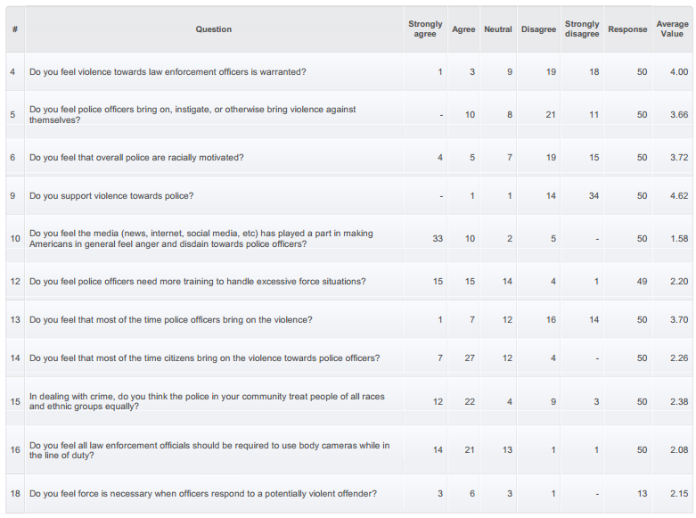
Q50 - Please answer the following questions about violence towards police officers.

Slide 41
Survey Findings
Many students are very familiar w/ the events of Ferguson, Missouri and Baltimore, Maryland.
The riots were unethical and unjustified
75% felt the Media made things worse by pitting civilians against police officers

Slide 42
Findings, continued
Survey results show that UVU students feel media, social media, and groups like BLM paint a poor picture of law enforcement

Slide 43
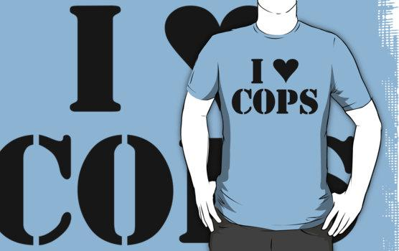
More Findings...
Students also support law enforcement and do find it disturbing when they hear in the news law enforcement being attacked or killed

Slide 44
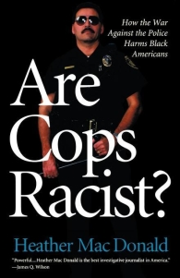
Conclusion
Violence against police is a real issue, that is still a huge media hot topic
Cops would be under less scrutiny and attack if presented in a better light by the media
The constant pressure of being labeled as racist has prevented law enforcement from doing their job properly

Slide 45
Conclusion
Law enforcement is under constant media scrutiny and now they have to be trained in a manner to protect themselves
Students at UVU not only support Law Enforcement but also find media to blame

