Slide 1
Study Abroad London & Florence
UVU English & Literature

Slide 2
4 Reasons to Study Abroad:
Earn 6 credits in 6 weeks!
Choose from a variety of courses.
Live and study in central London.
Travel across England with our field trips.
Immerse yourself in the stunning art and architecture of Florence, Italy.

Slide 3
Course Offerings
ENGL 2610: Medieval and Early Modern Cultures of the Book
Fulfills ENGL 2610: British Literature before 1800 OR HONR 2000: Ancient Legacies
Prerequisite: ENGL 1010 or Honors Program
ENGL 2620 & ENGL 3710: British Women Writers
Lower division fulfills ENGL 2620: British Literature after 1800 OR HONR 2100: Modern Legacies
Upper division fulfills literature elective.
Upper and lower division courses meet together.
Prerequisite for ENGL 2620: ENGL 1010 or ENGH 1005
Prerequisite for ENGL 3710: ENGL 2010 and University Advanced Standing*
ENGL 276R: Spatial Imagination and the Construction of Identity
Fulfills elective requirements.
Prerequisite: ENGL 1010 or ENGH 1005
ENGL 3610: Medieval Literature
Fulfills emphasis requirement, Brit. Lit. Pre-1800
Prerequisite: ENGL 2010 and (ENGL 2610 or ENGL 2620), both with a grade of C- or higher and University Advanced Standing*

Slide 4
Program Dates Deadlines & Fees
June 29th – August 7th 2020 (6 weeks)
5 weeks in London
1 week in Florence
Applications due Feb. 1st
Application fee: $75
Program fee: $4250
Tuition: $990

Slide 6
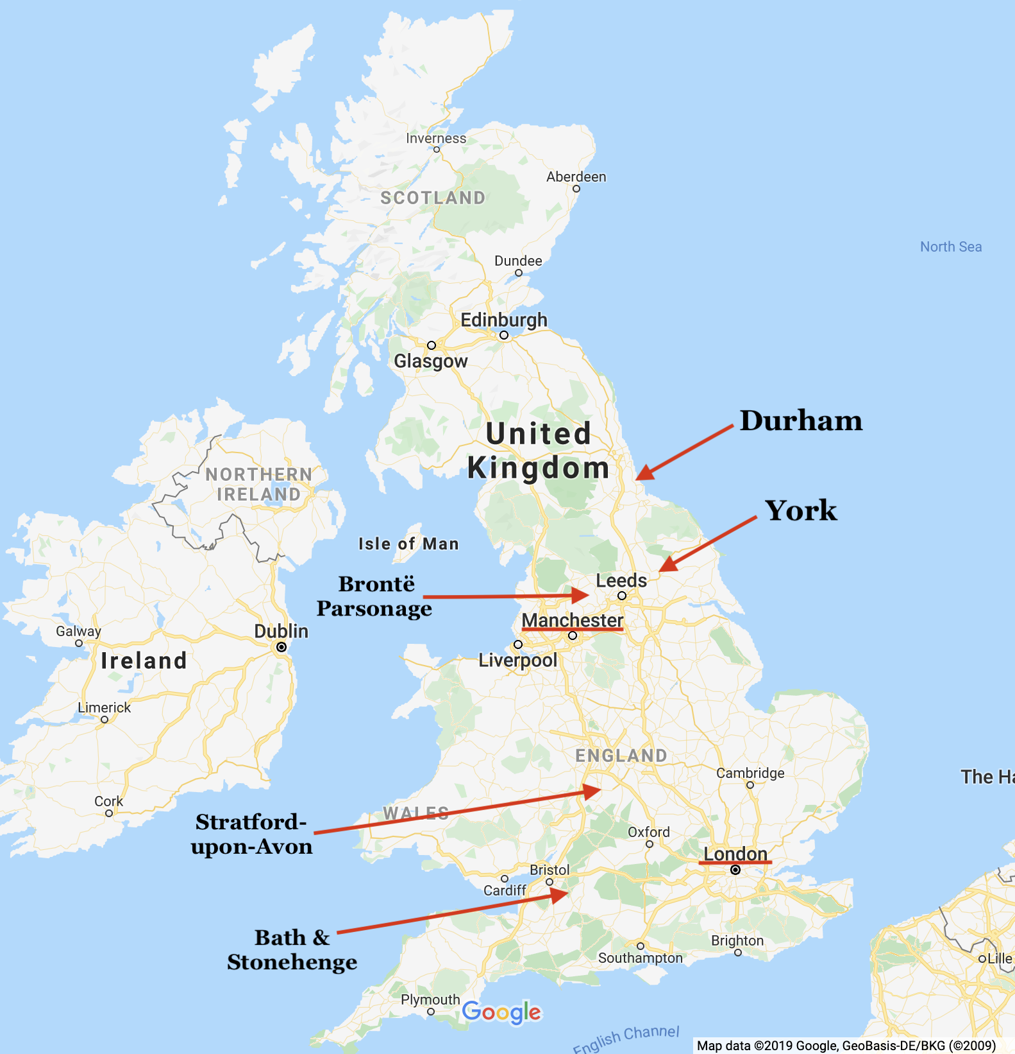
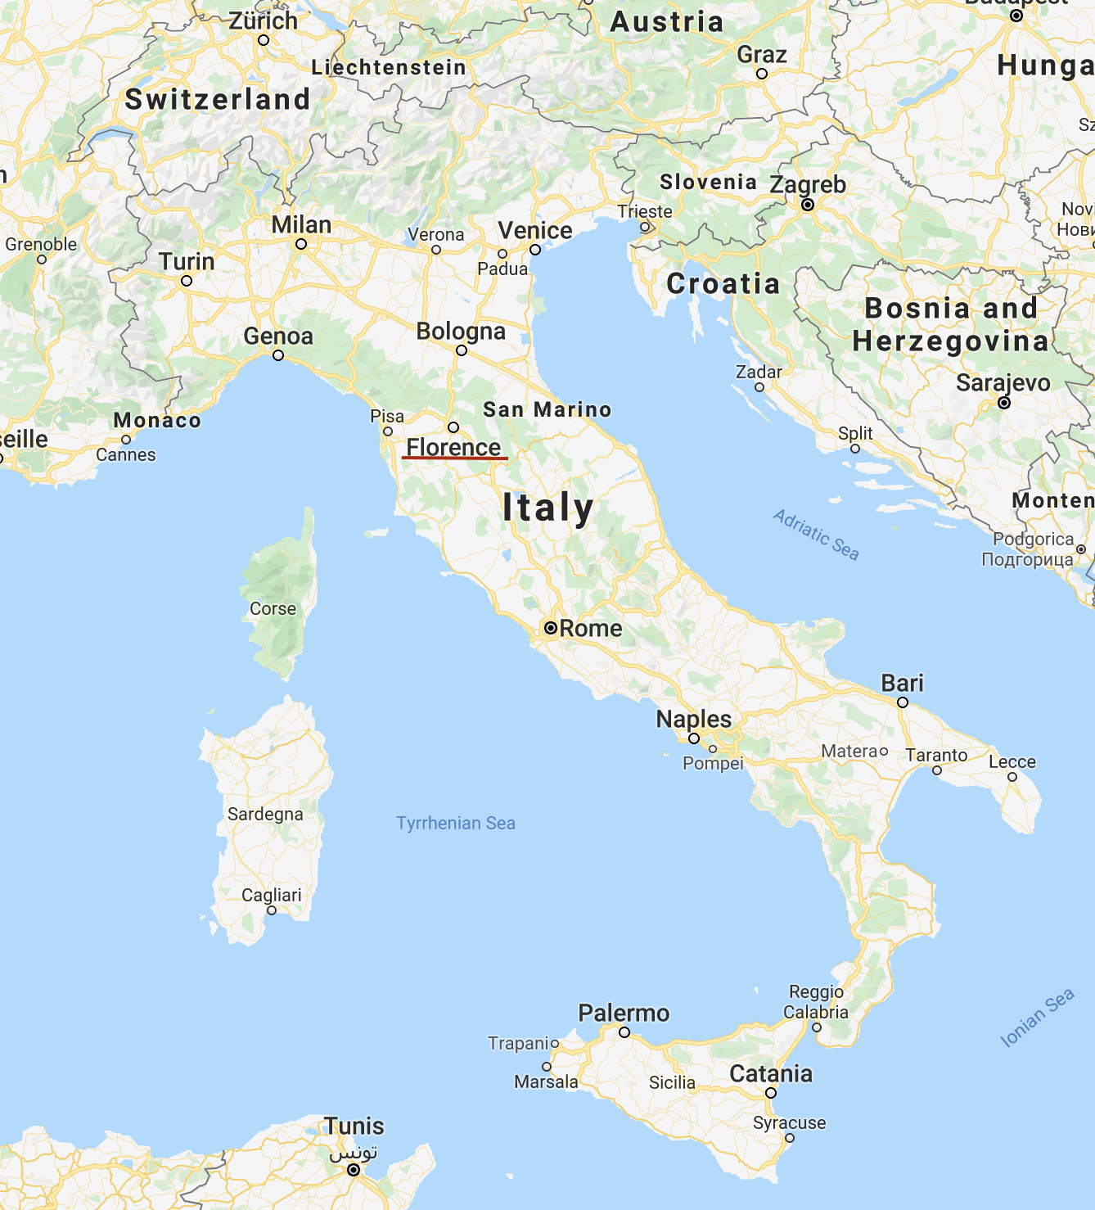

Slide 7
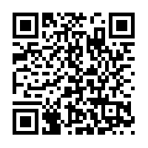
Contacts
Program information and application link: https://www.uvu.edu/global/students/study-abroad/uk/lonflo-lit20.html
Prof. Ruen-chuan Ma
rma@uvu.edu
CB 402G
Prof. Ashley Nadeau
Anadeau@uvu.edu
CB 407G

