Slide 1
All Things GE
Rough outline:
Big picture items
Top 30 Courses
Gen Ed
“Most Failed Courses”
Student Survey Data on GE
Qualitative Data
Information on Completions
Information on Excess Credits
Timing of GE credit
Course Profile Tool
Questions / Suggestions / Areas for further exploration

Slide 2
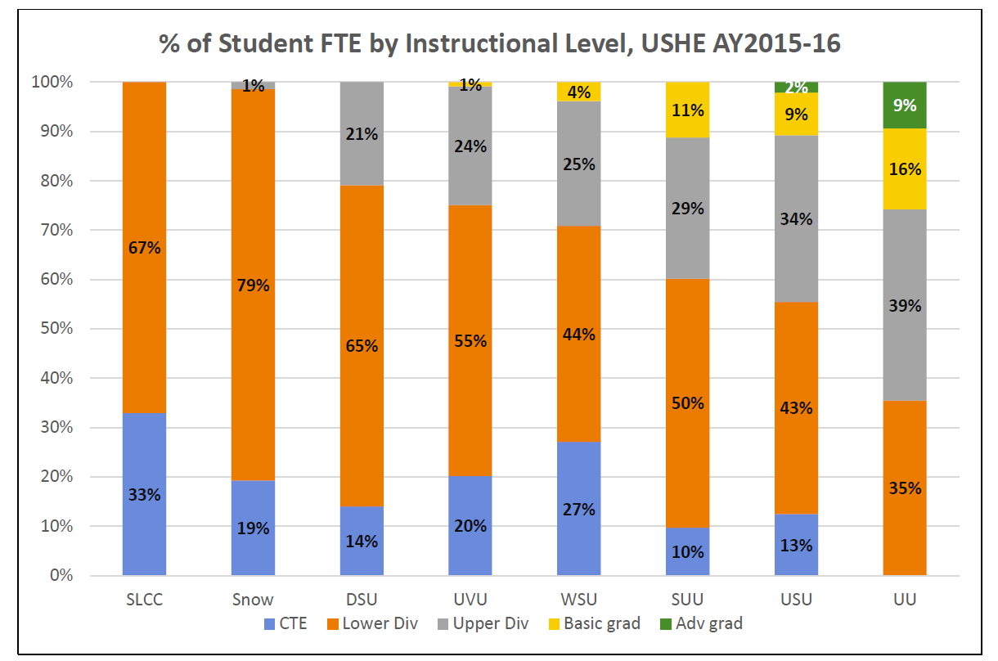

Slide 3
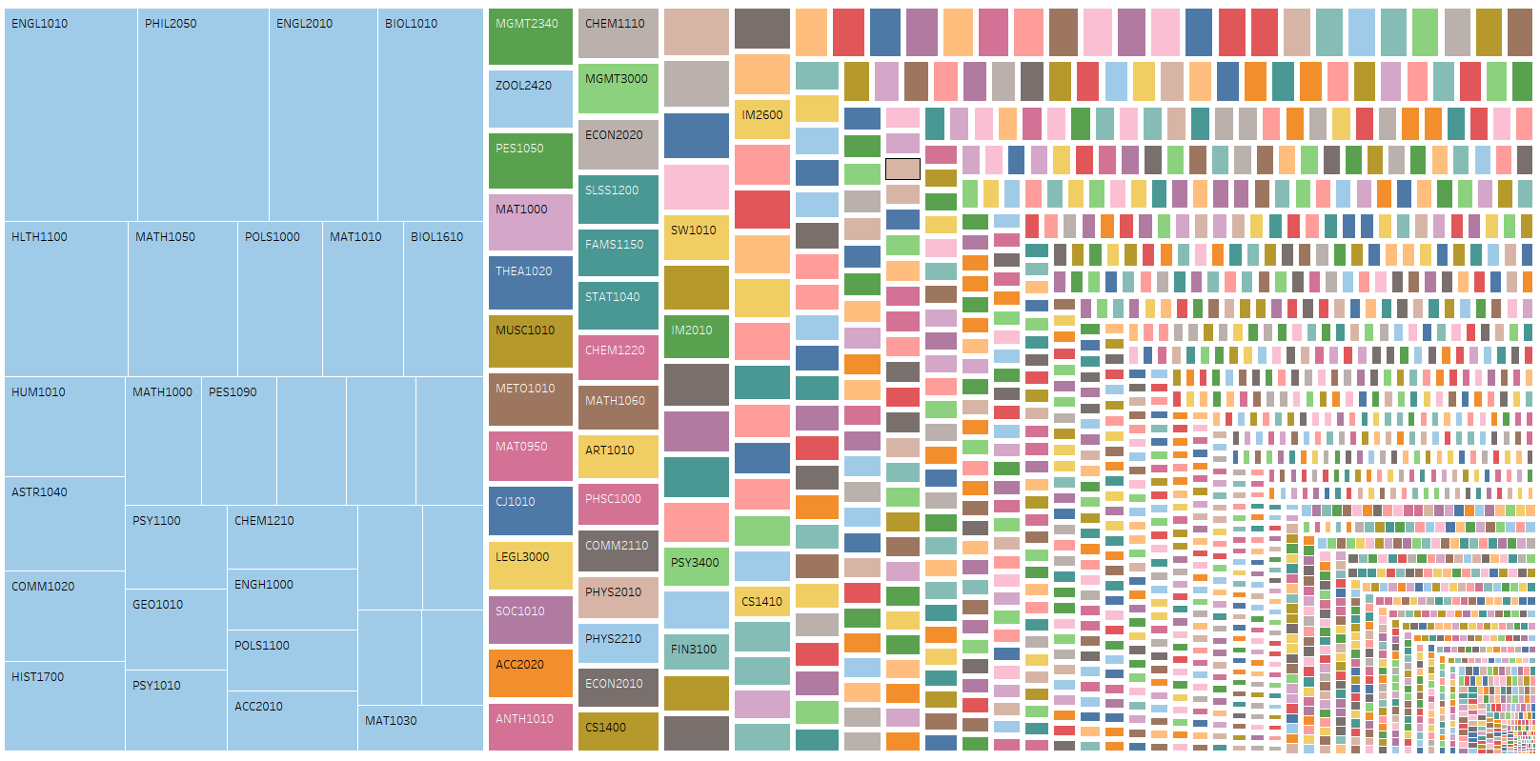
30 Largest Courses on Campus
(excluding concurrent enrollment)

Slide 4
Top 30 courses
Percent of enrollments
Percent of students

Slide 5
Percent of Instruction by Full-time Faculty, Fall Semester
Goal

Slide 6
30 Largest Courses on Campus
(Size by % of full-time faculty instruction, excluding concurrent enrollment)

Slide 7
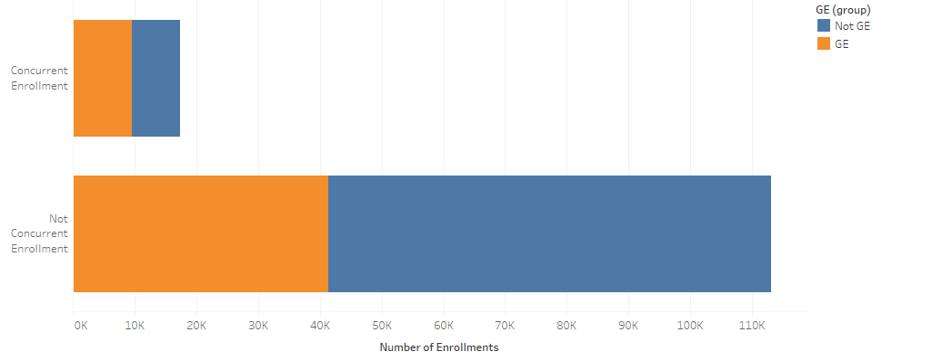
Portion of Enrollments in GE classes

Slide 8
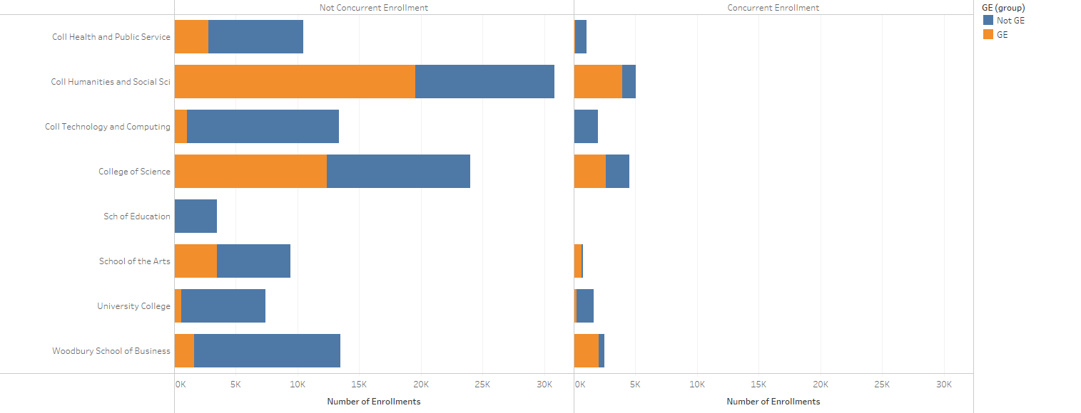
Portion of Enrollment in GE courses, by College

Slide 9
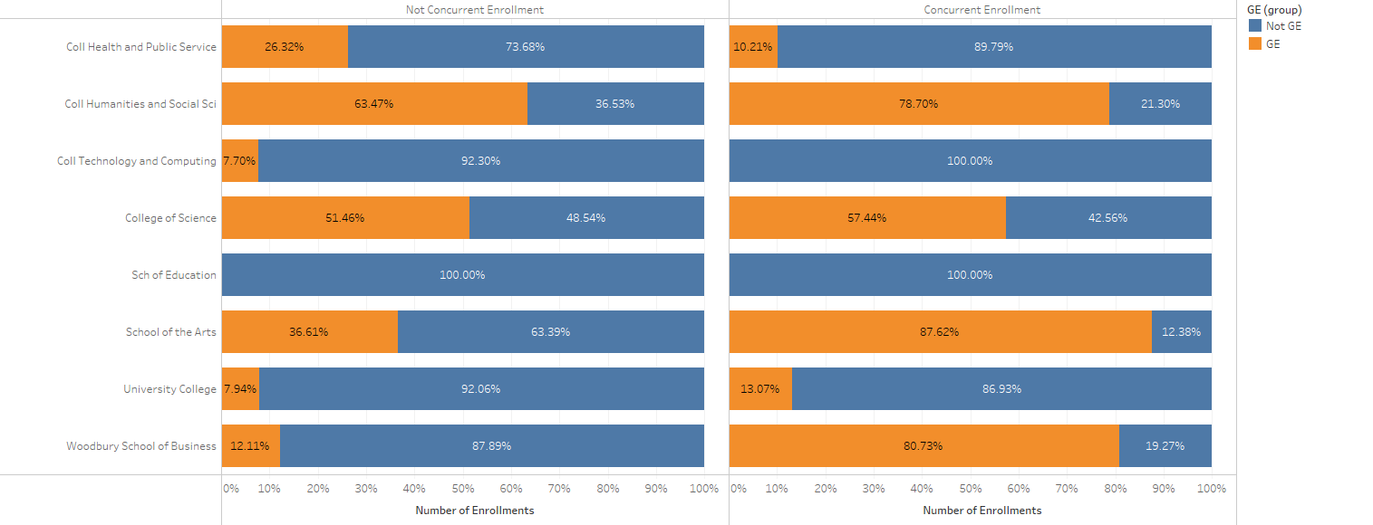
Percent of enrollment in GE courses by college

Slide 10
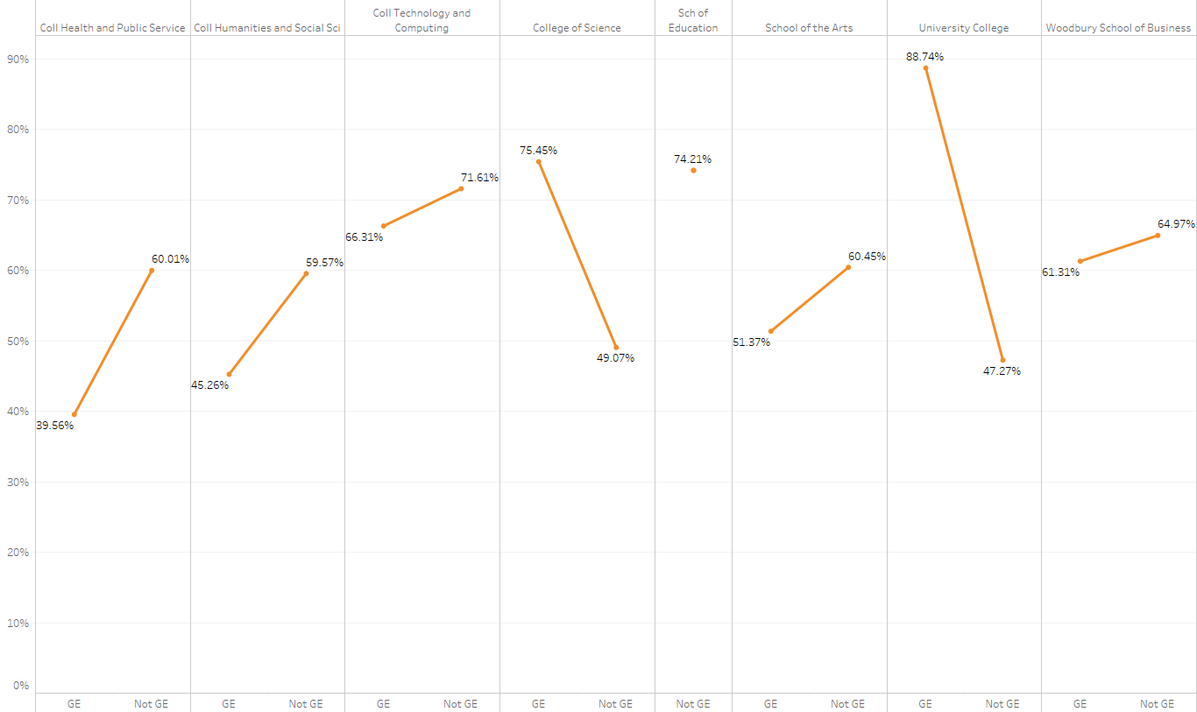
Who teaches GE courses?(Excludes concurrent enrollment)
UVU Overall

Slide 11
Most Failed Courses
https://www.uvu.edu/iri/enrollment/failed.html

Slide 12
Surveys and focus groups

Slide 13
Student Opinion survey
This survey is administered every Fall and Spring semester and seeks to collect student feedback on their experience at UVU. Approximately half of current students are randomly selected and invited to participate via email

Slide 15
What ‘other’ method?
Count | Other method (n=40)
10 | I transferred, took them elsewhere
7 | Does not apply
4 | Took what I wanted
4 | What my degree required
3 | Things to complement my major
3 | High School CE
< 3 | Career relevance
< 3 | other classes counted as GE
< 3 | whatever I could get in to
< 3 | minor classes
< 3 | Military

Slide 16
2016 Focus groups
January 19-21, 2016
Three focus group sessions were held on UVU campus in Orem, Utah. The groups were comprised of 4 – 6 student participants each for a total of 14 participants.
Participants included UVU students from two different categories: 1) New freshmen who came into UVU without concurrent enrollment credit or declared majors; 2) Juniors or seniors who fit similar criteria when they were incoming freshmen.
February 9-10, 2016
The groups were comprised of 3-5 student participants each for a total of 8 participants. Students were all second semester new freshmen here at UVU

Slide 17
Findings—How have you chosen your GE classes?
Attitudes of the February participants were very similar to the earlier groups. They knew about GE, they weren’t thrilled with it, and they figured out their class schedule according to what time the class was taught.
Student comments, GE courses:
GE is a drag. They don’t work for me but I HAVE TO take them. I do it grudgingly.
Hard to be enthusiastic about (GE classes) when I’m forced into it. It takes the enjoyment out of it.
I like to mix my hard classes (the GEs) with the enjoyable classes (those that I’m interested in).
There are too many GEs that are required!
I try to pick classes that are more applicable to real life. I want practical skills and not waste time/money.
I know exactly why the university requires GE courses. MONEY! It’s all about getting more money for the school. That’s all.

Slide 18
Student comments, how I select classes:
Yes! Definitely time of day! I want morning classes only so I can go to work the rest of the day!
The time of day the course is taught is the MOST IMPORTANT thing- that’s how I pick it.
Mostly I choose classes that fit my time schedule. Like right now I only want classes in the afternoon and the professor doesn’t matter to me, just what time it is taught. I am NOT a morning person.

Slide 19
How have you chosen your GE classes?
Awareness
Participants mentioned that they were familiar with the concept of GE courses coming into college.
They realized that the purpose of GE courses was to give students a ‘well rounded’ education.
Strategy
Most participants said they looked for GE classes that fit their schedule.
Most did not want to take classes that “sounded hard.”
Several mentioned being a bit confused and overwhelmed.
Several received guidance from their high school counselors, UVU advisors, and family members.
Several students wanted to sample courses in order to discover their academic preferences (i.e.: geology, ceramics, theater, and auto mechanics).
Some aimlessly tried to find required classes and just fit them into a schedule.
Some were excited to explore different academic subjects.
One used “Rate My Professor”.

Slide 20
Student comments:
I just tried to start off as a freshman by knocking out some of the GE requirements.
I didn’t know what to do so I tried to find required GE classes that just fit into my preferred schedule.

