Slide 1
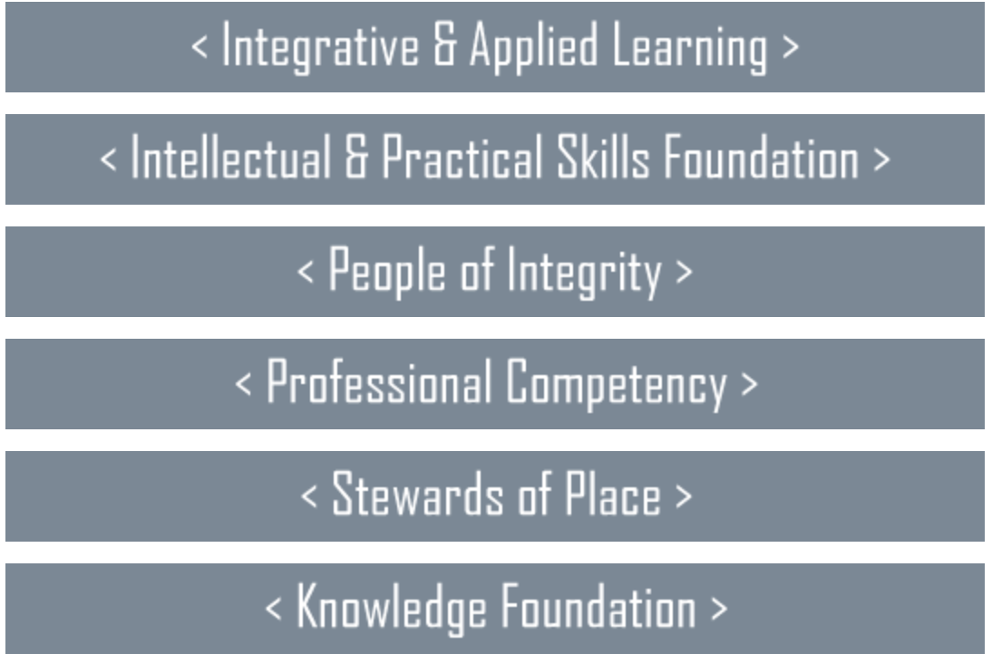
We do not need to reinvent the wheel.
We have a GE framework here at UVU that is:
Comprehensive
Based on Research
Vetted
Philosophically Visionary and Aspirational
Down-to-Earth, Practical
Masterful
Presents Us with OPPORTUNITIES Not Constraints
Aligns with USHE
Powerful and Empowering

Slide 2
What we do NOT have with this existing framework:
Buy-in from faculty
Buy-in from our student body
Meaning and understanding associated with the ELOs
Application and logistics
Accountability
We may have the “WHAT” but we don’t yet have
the “HOW” and the “WHY.”

Slide 3
GE- the “why” for students
Stewards of Place
You need to be able to:
Demonstrate awareness of issues related to creating and maintaining a sustainable local economy
Demonstrate awareness of issues that impact the national community
Identify relations among the local and global economies
Professional Competency
You need to be able to:
Work in groups effectively
Initiate, implement, and assess change
Formulate and recognize a coherent problem and reasonable solution
People of Integrity
You need to be able to:
Recognize ethical issues
Cultivate tolerance toward disagreement
Elicit a sense of moral obligation and develop a personal code of ethics
Knowledge Foundation
You need to be able to:
Understand and demonstrate knowledge of human cultures, arts, history, humanities, languages, science & mathematics, and social sciences.
Intellectual & Practical Skills
You need to be able to:
articulate your self in written & verbal speech
Gather, interpret, & evaluate information critically
Evaluate the credibility of information
Integrative & Applied Learning
You need to be able to:
Complete an insightful , thoughtful peer review.
Connect knowledge with choices and actions
Engage meaningfully with enduring, comprehensive questions and challenges of real life.

Slide 4
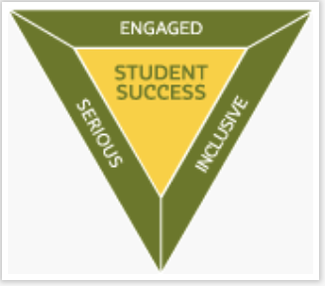
Imagine a matrix (or a table or a rubric) that aligns our best ideas, courses, and practices.
This is
WHO WE ARE
Integrative & Applied Learning | Intellectual & Prac Skills Found. | People of Integrity | Professional Competency | Stewards of Place | Knowledge Foundation
HIP: First-Year Experience | Pillar: Research & Creative | Course: Ethics & Values | Programs: Internships | Pillar: Global & Intercultural | Quantitative Literacy
Engaged Curriculum | Engaged Curriculum | Engaged Curriculum | Engaged Curriculum | Engaged Curriculum | Engaged Curriculum
This is
WHAT WE NEED TO DO TO GET THERE AND STAY THERE

