Slide 1
Utah Valley University
an engaged University
ReEnvisioning: The How Group
March 29, 2018

Slide 2
How:
being engaged at UVU
Ideas
Digital Credentialing, Alternative transcript, GE only
Size
Allow students more freedom, try for small classes
Ownership
Colleges submit classes to be certified, but courses exist only under GE
Delivery
Focus on HIPs and other important skills

Slide 3
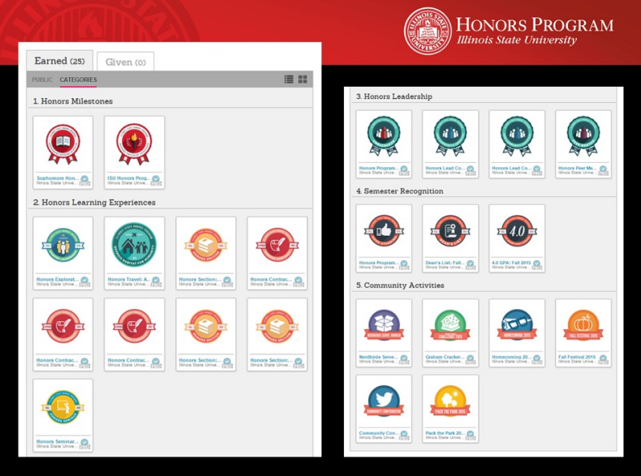
Ideas: Outcomes over Content
Many universities using alternative transcripts, badges, or digital credentialing to document outcomes
Measures outcomes rather than content – What can you do?
credly.com
Blockchain
MyMantl.com

Slide 4
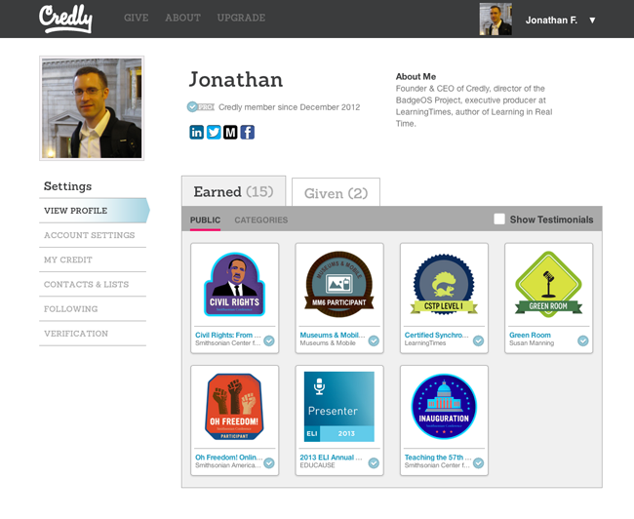
Ideas: Outcomes over Content
Allows UVU freedom to ReEnvision outside the “constraints” of the R-470
Skills – Advanced Writing, Oral Communication
HIP – Service-learning, teamwork, capstone
Allows students to document what they can do to employers, can be shared to LinkedIn, etc.

Slide 5
Ideas: Freshman Seminar
Freshman Seminar
Offered at convenient times and in multiple structures
Faculty who teach at same time can rotate classrooms and present information on various majors/areas
Other content includes
What GE means, critical thinking, being a student at UVU
What they can take advantage of at UVU – services, speakers, clubs, events, etc.
Notes:
Freshman Seminar
• Freshman seminar—courses scheduled at the same time with faculty rotating through the courses
• A unit for personal finances
• Introduction to what it means to be part of an academic community—what GE means, what critical thinking means, what it means to be a student at UVU
• What they can take advantage of at UVU—speakers, events, conferences, clubs
• Introduction to resources and services
• 3 credit within GE—how much room do we have for this
• Focus on maintaining mental and physical health and how they’re important to success as a student
• What would be a workable model for this?
o A hybrid course? Hybrid materials the same across campus but what happens in class could be up to the faculty teaching that day.
o Rotating faculty?
o Small classes
o Faculty time would be focused on working with students and online materials would be automatically scored or have “graders”—this would allow students to start making personal connections with faculty and would give the faculty time to make those connections with students; maybe these faculty could cover multiple sections (teach one section a day, teach 3 days a week)
o Students could be introduced to hybrid/online classes early while still having students support

Slide 6
Size
Based on student feedback and practices at other USHE institutions, reduce GE to 30 hours
Eliminate Fitness for Life/Health and Ethics and Values as required GE (however, include courses in Breadth GE options)
Eliminate 3rd Science requirement (Freshman Seminar as alternative)
Faculty affected by change could teach Freshman Seminar as an alternative opportunity
Allows majors to avoid “double-dipping”
Notes:
“Double-dipping”: majors who use GE courses as required courses for their major in order to include more required credits than they have room for. We want GE courses to be GE Only

Slide 7
Ownership and other issues
Departments would not own courses
Instead, courses would be certified as distribution or other GE classes (similar to Honors program)
Certification would include pedagogy requirements – HIP or other outcomes.
No/Very limited Prereqs for any GE course
GE courses cannot be courses required for degree programs—GE Only
Notes:
Courses Certified as GE
Courses that are certified as GE meet particular pedagogical requirements—HIPs, small classes, engaged pedagogical approaches
OER or at least cheaper materials—faculty know what their books cost (doing our best to lower costs for students)
No GE courses have prereqs
Courses need to be frequently offered
Courses that qualify as GE should be for all students, not focused on what “majors” need to know

Slide 8
Delivery
Focus of ReEnvisioning should be on High Impact Practices rather than course content
Emphasize the GE “message” (whatever we develop)
Play in the R470 sandbox (their course requirements), but ReEnvision through pedagogy
Use graduation requirements (G/I) and digital credentialing to improve, track, and assess.
Notes:
Courses Certified as GE
Courses that are certified as GE meet particular pedagogical requirements—HIPs, small classes, engaged pedagogical approaches
OER or at least cheaper materials—faculty know what their books cost (doing our best to lower costs for students)
No GE courses have prereqs
Courses need to be frequently offered
Courses that qualify as GE should be for all students, not focused on what “majors” need to know

Slide 9
Most Important Take-Aways
Limiting to 30 credits→ Allows for more credits to be given to the majors
Focusing on pedagogy of courses allowed to be GE
GE courses are only GE courses
Limit or eliminate prereqs
GE courses explicitly designed for non-majors→ One-off rather than a prereq for a course in the major

