Slide 1
Ideating the Undergraduate Experience
Cheryl Hanewicz and Sean Tolman
February 8, 2018

Slide 2
Design Process Reminder
“How”
“What”

Slide 3
Committee Approach
Initial “SLO” Exercise
(Feb 1)
Explore Options for Achieving SLOs
(Feb 15-22)
Refine & Aggregate SLOs
(Feb 8)
Prototype
Test
“How”
“What”
TBD

Slide 4
Goal For SLOs
Defines the “What” for our Re-envisioning.
Statements that capture the student outcomes
Should be measurable or observable.
We need to reach consensus.

Slide 5
Consensus
“I can live with it, and I will support it.”
NOT
“I think this is the best solution that can be.”
“I’ll just agree with the loud person”
“It’s not my idea”

Slide 6
SLO Exercise
Split into 8 groups of 5.
Read the aggregated statements.
On the back of the page, write a summary statement.
Pass 3 times and repeat.
Pass a 4th time. Last group summarizes 3 previous statements and presents.
Group votes to accept
Not policy or scripture, gives us a direction.

Slide 7
5-finger voting
5 – Strongly agree
4 – Agree
3 – can see pluses and minuses, but willing to go along with the group
2 – Disagree
! – Strongly disagree and can’t support

Slide 8
SLOs
Students will make an informed choice regarding their field(s) of study and career path will be prepared to succeed therein.
Students will demonstrate proficiency in both oral and written communications.
Students will be able to collaborate, negotiate, and reach consensus with individuals of diverse backgrounds, abilities, and perspectives.
Students will gather, interpret and analyze data in order to solve problems and draw valid conclusions.
Students will be able to balance competing demands, adapt to changes, and navigate challenges while maintaining personal care,
Students will recognize their ethical responsibilities and act with integrity as they engage in their local and global communities.
Students will be able to demonstrate a broad conceptual understanding and apply epistomologies of various disciplines.
Students will exhibit a curiousity and love of learning?

Slide 9
Committee Approach
Initial “SLO” Exercise
(Feb 1)
Explore Options for Achieving SLOs
(Feb 15-22)
Refine & Aggregate SLOs
(Feb 8)
Prototype
Test
“How”
“What”
TBD

Slide 10
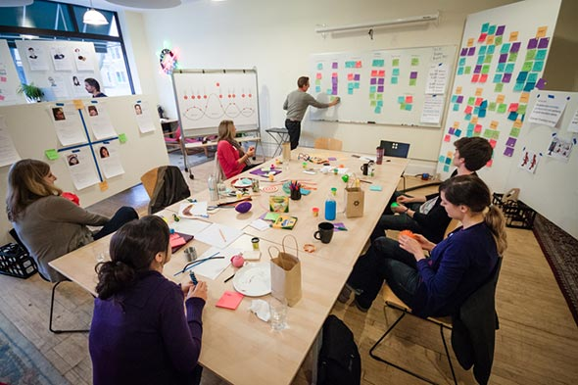
Ideation
Quantity not Quality
Defer Judgement
Encourage Wild Ideas
Build on the ideas of others
One person talks at a time
Capture ideas
Useful Links:
7 Brainstorming Techniques
Best Ideation Methods

Slide 11
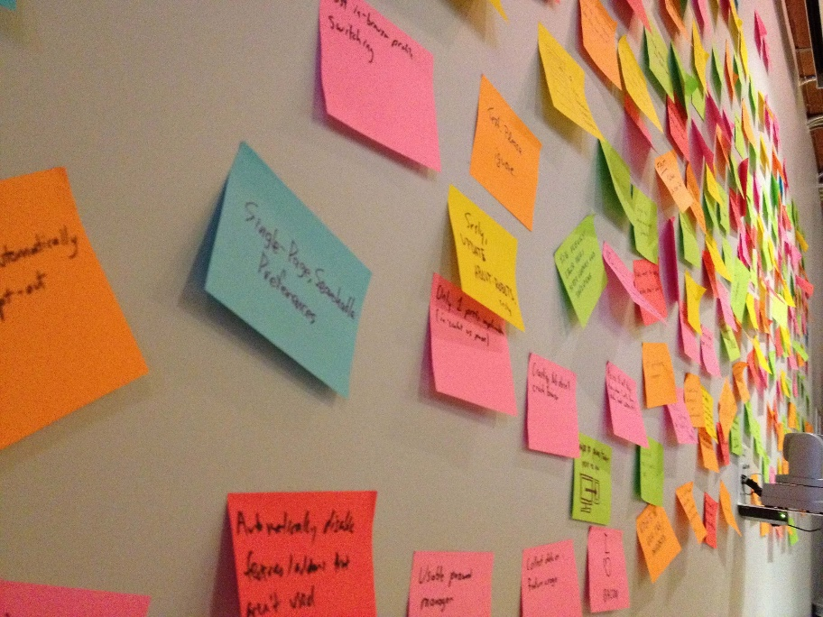
Launch into Ideation
Braindumping
Individual activity
Write down as many ideas as you can
Brainwalking
Group activity
Kinetic (moving from place to place)
Build on the ideas of others
Brainstorming
Group activity
Capture as many ideas as possible
100 ideas in 30 min
“How might we…”

Slide 12
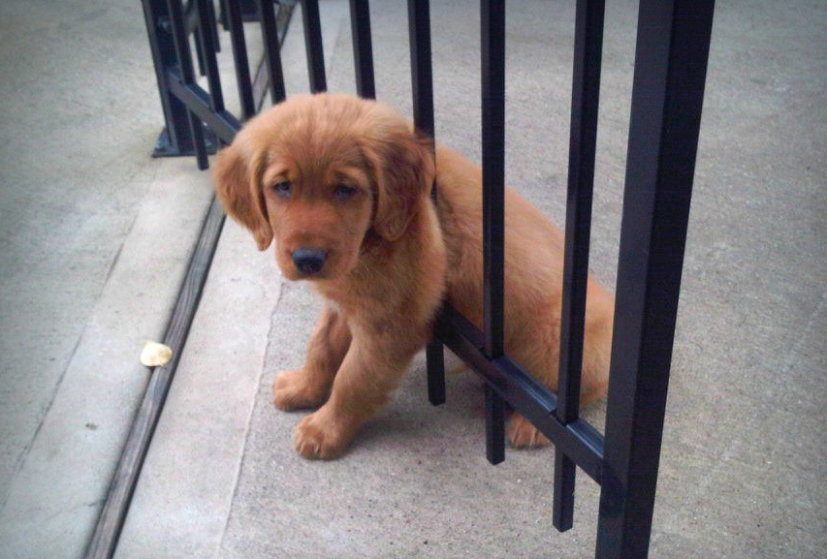
Stuck?
What’s the worst idea you can think of?
What’s the most expensive idea?
What assumptions are built into your ideas? Eliminate them.
If you could use magic or the force what would you do?

Slide 13
Groups for Ideation
Pick your top 3 SLO that you would like to Ideate on
Email Cheryl Hanewicz
We will send out new groups on Friday

Slide 14
Homework
Ideate with your group
Take SLOs to college and get feedback and ideas

