Slide 1
AA/AS - Pathways
Jessica Gilmore
Utah Valley University

Slide 2
AA/AS Pathways to Transfer
Pathways are the vehicle to increasing student success within the community college mission
Without Pathways the Dual Mission exists only as a unique organizational structure but not a reality for students and timely completion
The issue of transferability is not a new problem- it is often cited as one of the biggest problems in academia and few if any have solved it
85% of CC students are bachelor’s intent
35% actually transfer
15% complete

Slide 3
Goals for Pathways & Transfer
Fewer entry points requiring choice in the first semester
Fewer extraneous courses on the way to completion
Earned credentials along path to final degree completion
Financial aid eligibility throughout pathway
Ease of transfer from Associate to Bachelor within institution AND between institutions

Slide 4
Defining Pathways & AA/AS
A grouping of programs within career clusters sharing a common set of lower division courses.
Students experience a common base of introductory/lower level preparatory courses leading to an AA/AS as a milestone towards a BA/BS.
Students changing their major within a given set of common programs or closely related programs should be able to change with minimal disruption the earlier they make that decision reducing the need for additional courses.
Students may still choose a “major” but for those that are not sure pathways allow exploration of an area of study while taking courses that will be of value to them no matter which direction they choose. This assumes they do not make substantial changes in their direction. The greater the change in direction the more courses a student will need.

Slide 5
Examples @ UVU
STEM- 9 Degrees Included- examined degree plans 1st two semesters
Civil Eng., Computer Eng., Electrical Eng., Mechanical Eng., Mechatronics, Software Eng., Computer Science, Physics, Mathematics
Only one course in all 9- ENGL 1010
MATH 1210 was found in 8
MATH 1220 in 5
PHYS 2210 in 5
ENGL 2010 only in 4
Social Sciences- 17 Degrees Included- examined degree plans 1st two semesters
Anthropology, Economics, Psychology, Sociology, Criminal Justice, Family Studies, Family Science, Social Work, Comm. Studies, Journalism, Public Relations, American Gov., Global Politics, Indian Affairs, Peace & Justice, Public Admin, Public Law
Two Courses in all 17- ENGL 1010 & 2010
American Institutions- 14
HLTH/PES 1097- 13
Fine Arts- 11
Biological Sciences- 9
Humanities GE- 9

Slide 6
https://www.wsac.wa.gov/sites/default/files/Transfer.Student.Rights.Responsibilities.pdf

Slide 7
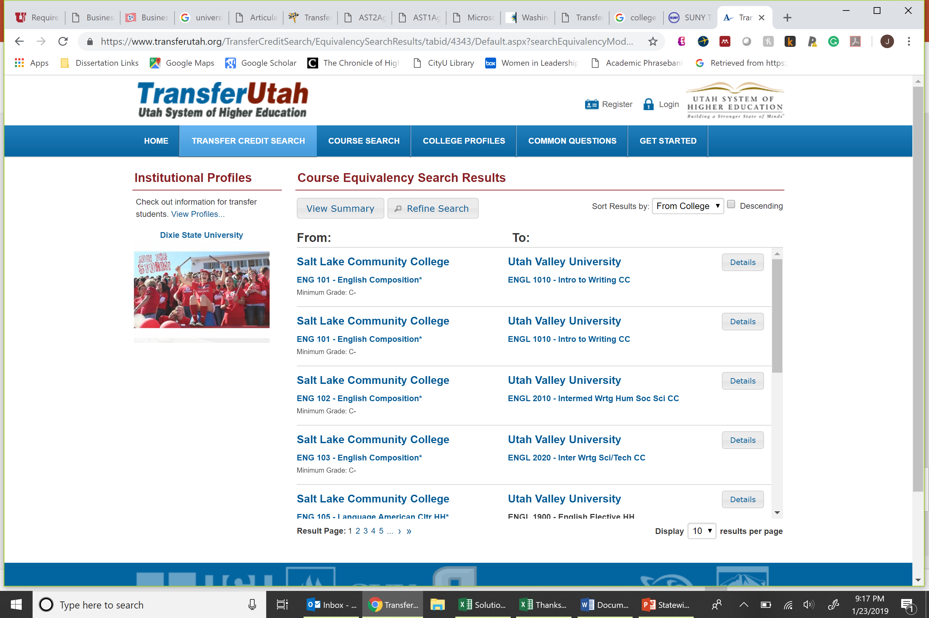
USHE Pathway Context

Slide 9
TRANSFERRING TO A UNIVERSITY The Statewide Articulation Agreement designates the associate in arts degree as the transfer degree to Florida’s state universities. In doing so, the agreement guarantees that:
1. Students who earn an associate in arts degree holders will be granted admission to one of twelve (12) state universities but not necessarily to limited access programs or the student’s first program of choice.
2. Upon transferring to a state university, associate in arts degree graduates will be awarded at least 60 credit hours towards the baccalaureate degree.
3. The university catalog in effect the year the associate in arts degree student first enrolled at the college will remain in effect for the student's program, provided the student maintains continuous enrollment as defined in that catalog.
4. Once a student has completed the General Education Core and this is so noted on the transcript, regardless of whether or not an associate in arts degree is awarded, no other state university or college to which the student may transfer can require additional courses to the General Education Core.
5. When transferring among institutions participating in the statewide course numbering system, a receiving institution must accept all courses taken at the transfer institution, if the same course with the same course number is offered at the receiving institution.
6. Credits earned through acceleration mechanisms within the associate in arts degree will be transferable to the state university.

Slide 10
Every major across every institution is mapped to all other colleges – no common course numbering. Online system supports self-service.

Slide 11
Direct Transfer Agreement
AS-T Track 1
AS-T Track 2
Negotiated acceptance at all state-funded institutions and many of the private institutions throughout the state.

Slide 12
AA/AS for UVU
Supports student transfer between USHE institutions
Supports the dual mission & the CC mission institutions
Aligns pathways by reducing entry points while increasing completions
Award credentials along the path to reduce some college no degree
Increases clarity for FGCS and families when choosing path to completion

Slide 13
Questions & Conversation

