Slide 1
Re-envisioning
Process Discussion
Cheryl Hanewicz and Sean Tolman
February 22, 2018

Slide 2
Follow-up on Last Week’s Meeting
Thoughts on Pres. Holland’s remarks.
Committee didn’t ask him a lot of questions.
Thoughts on Liz Hitch’s (aka Big TV Lady) ideas.
Follow up questions?

Slide 3
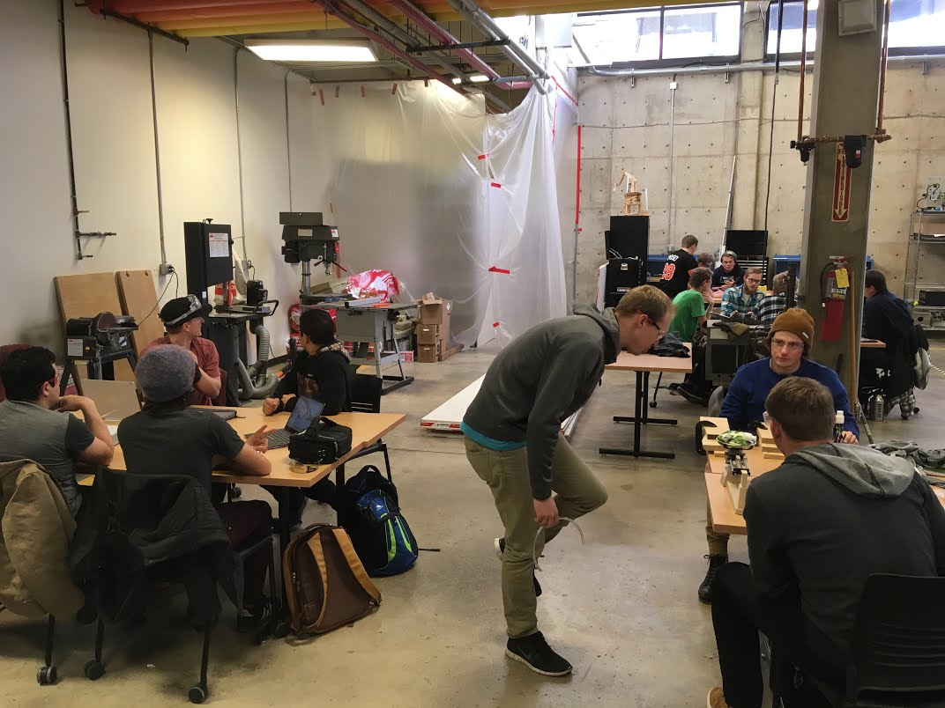
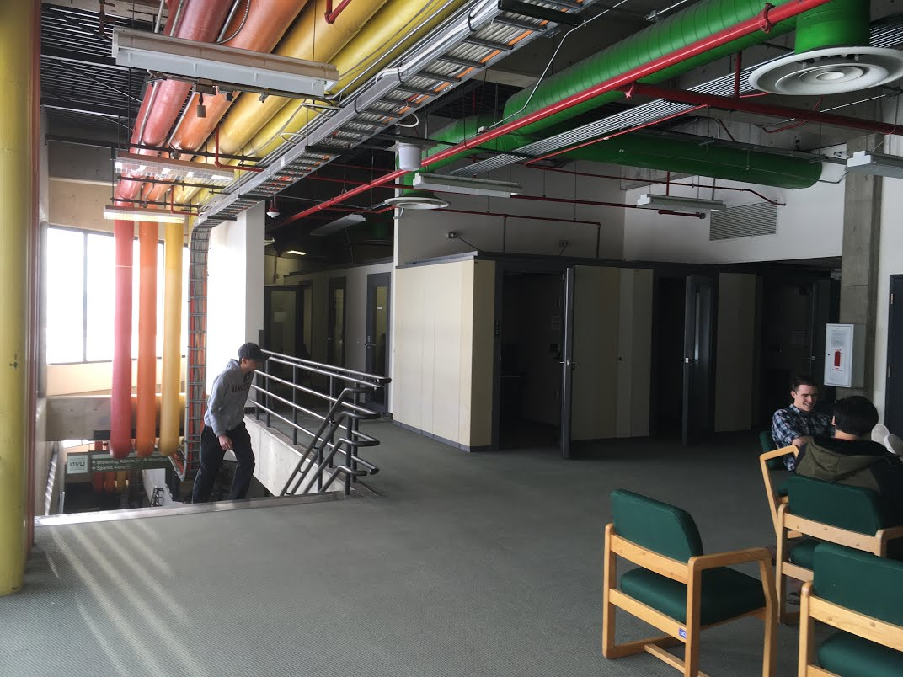
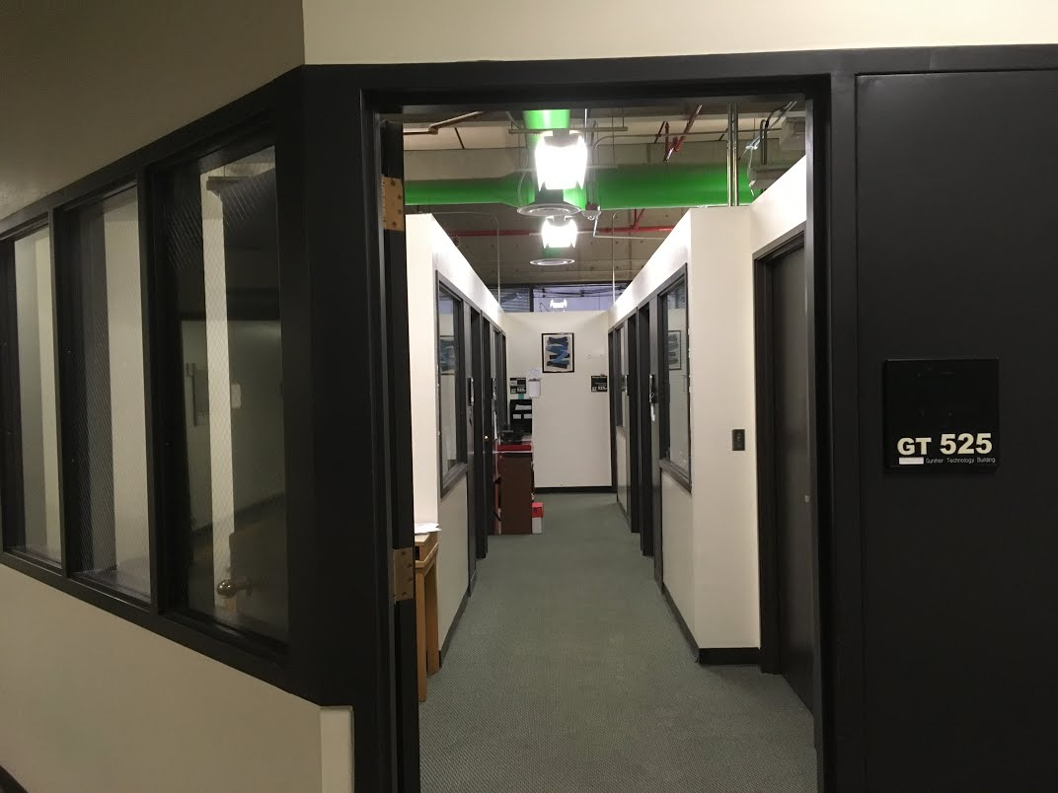
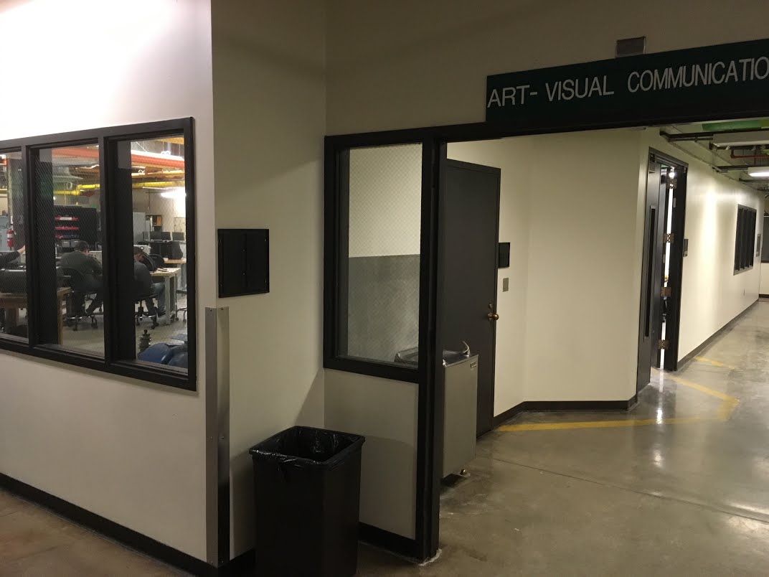
Analogy - Re-design vs. Re-model
Gunther Technology Building
It works, but not ideal
What would the School of the Arts do if they could build a NEW building?
Re-envisioning = Re-design
Not constrained by existing structures
Motivated primarily by needs

Slide 4
Current Strategy
Define the Problem
Gather Ideas
Evaluate Ideas
Concept
Charge Statement
Student Learning Outcomes
Student Input (Lunches, Panel, Survey)
Employer Input (Presentation, Panel)
Research other institutions
Creative brainstorming
AAC&U Conference
Evaluate and select key ideas
Research and apply constraints
Develop ideas into workable concept
Present concept for evaluation by University Community
May require revisions
Implementation not part of this process

Slide 5
Process Notes
Identified a process for Re-envisioning based on design thinking
It is ok that the process is a bit messy at times
We have generated process work product (Not final product or deliverables)
Defined the scope of our activity with charge statement
Process work product, not final product
Still some confusion about scope
Identified the important aspects of undergraduate education for UVU students with SLOs
Also Process work product, not final product
Validated existing institutional ELOs
Have begun research and idea gathering phase
Constraints are important and will be considered in the next step
Concerned about committee members’ motivations

Slide 6
Opposing Committee Feedback
Re-envision something new
Spend more time “Empathizing”
Work together during meeting
Re-form groups
Working too slow
Keep/remodel what we have
Spend more time understanding current GE
Activities are just busy work
Don’t re-form groups
Working too fast

Slide 7
Discussion
What are your thoughts on the process?
What are we missing in the process?
What is preventing you from participating?

