Slide 1
Re-envisioning Strategy
Cheryl Hanewicz and Sean Tolman
January 25, 2018

Slide 2
“Design” = Problem Solving Approach
“How”
“What”

Slide 3
Not just a Hammer Looking for a Nail…

Slide 4
Key Concept: “What” before “How”
Postpone jumping to solutions
Don’t want to solve the wrong problem

Slide 5
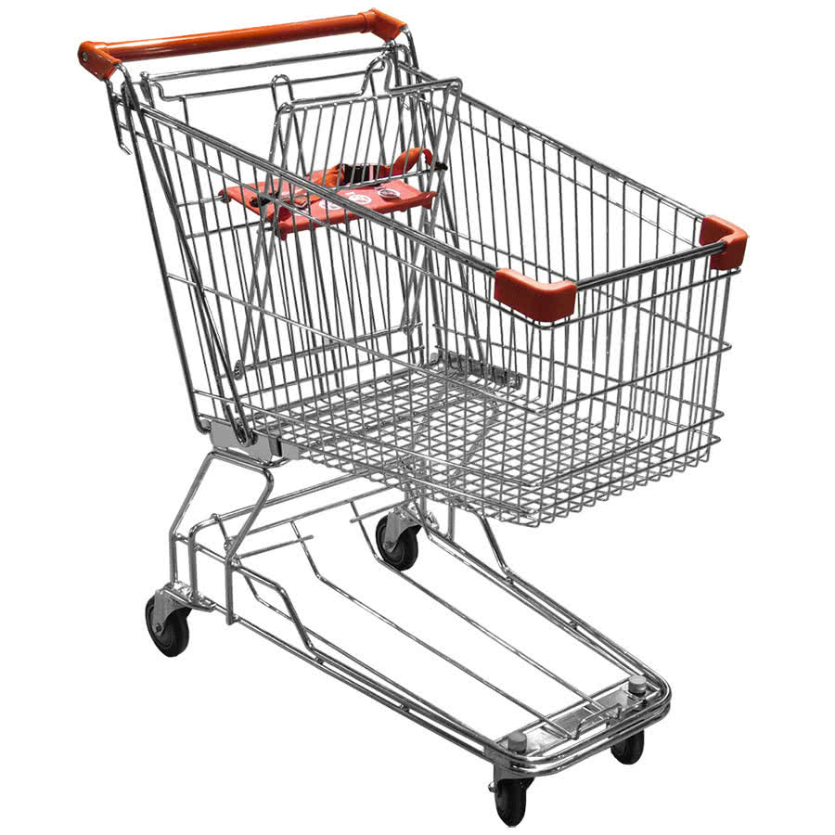
Key Concept: Ideation
Allow “Wild Ideas”
Shopping Cart Child Seat
Velcro Pants and Seat
Postpone Judgment
Think Outside the Box

Slide 6
Committee Approach
Initial “PLO” Exercise
(Feb 1)
Explore Options for Achieving PLOs
(Feb 15-22)
Refine & Aggregate PLOs
(Feb 8)
Prototype
Test
Parallel Activities
Guest Speakers
Student Panel
AACU Conference Reports
TBD

