Slide 1
Re-envisioning Meeting
Re-envisioning Committee
September 13, 2018

Slide 2
Today
Alumni Update- IR and Others
Stakeholders- what else?
Assessment Model
School/College Meetings
Groups

Slide 3
Alumni- Open Responses
Years since graduation (and total number of responses for each year)
1: 10,224, 3: 1,599
5: 1,948 10: 1,511
Total Responses: 15,282
Best Aspects:
The professors
Small class sizes
Convenience/flexibility (online classes, campus nearby, easy commute)
Improvements:
Scheduling!!
Make classes more applicable to job/career
Not sure how to improve/satisfied with experience
Some gen ed classes were a waste of time/money
Missing from program:
Technology related skills
Better financial understanding
Help with networking
Most recommended classes: Digital literacy and financial literacy

Slide 4
Stakeholder Summary
Business Community
Biggest concerns/skills needed:
Critical thinking
Oral and written communication
Teamwork (social skills)
Digital Literacy
Like internships – would like them even earlier
Some concern that there is obsolescence with university instruction; just teaching students to jump through hoops
Suggestions:
Make gen ed more career path related and targeted (avoid repeat of high school)
Authentic experiences earlier
Gen ed should teach students how to write properly including emails and verbal communication
Most recommended class: Business Communications

Slide 5
Stakeholder cont….
Students
Concerns:
Do not feel general education classes are applicable to their lives; hoops to jump through
Feel that some classes are a repeat of high school; waste of time
Scheduling issues
Suggestions:
Courses with more real world application
More meaningful content (why memorize when can Google?)
Less GE
Most requested class: Financial literacy course (how to “adult”)

Slide 6
Proposed Structure
AQA- Staff Support
Academic Program Assessment Comm.
Departmental Committees- Chairs Constitute College/School Comm.
College/ School Assessment Comm.
Chairs- 5 Yr Terms
IR: Provides embedded Support at College/School Level
APAC Charge:
Oversee the assessment of ELO’s and Program Evaluations on determined schedules
Members:
8 College/School Chairs
GE,G/I, Honors & WE Reps. (4)
Ex-officio: IR designee, AQA designee, Accreditation designee, AVP- Academic Programs
Chair elected by Senate from current APAC members serves renewable one-year term
Chairs/Reps
GE
G/I
Honors
WE

Slide 7
Meeting Schedules
School/College RUEC Forums
School/College | Date 1st Week | Time | Room
CHPS | Sept. 27 (R) | 2-4 | NG 167
CHSS | Sept. 27 (R) | 3-5 | CB 101C
Arts | Sept. 26 (W) | 3-5 | CS 404
Education | Sept. 24 (M) | 3-5 | CB 101B
UC | Sept. 26 (W) | 2-4 | CB 101A
Engineering & Technology | Sept. 25 (T) | 3-5 | CS 404
Science | Sept. 26 (W) | 3-5 | SB 134
WSB | Sept. 25 (T) | 2-4 | Centre Stage

Slide 8
Meeting Schedules
School/College RUEC Forums
School/College | Date 2nd Week | Time | Room
CHPS | Sept. | 2-4 | ES 147
CHSS | Sept. | 2-4 | CB 101C
Arts | Sept. | 3-5 | CS 404
Education | Sept. | 3-5 | CB 101B
UC | Sept. | 3-5 | CB 101A
Engineering & Technology | Sept. | 3-5 | CS 404
Science | Sept. | 2-4 | SB 134
WSB | Sept. | 3-5 | Centre Stage

Slide 9
College/School Mtgs

Slide 10
College/School Mtg Objectives
Provide brief update on RUEC activities
Provide preliminary “look” at what the committee is considering- nothing is decided
Soliciting feedback regarding the positive and negative implications of existing Big Ideas
Soliciting additional ideas regarding other possible initiatives and associated implications
Who will facilitate College/School Mtgs?
Who else should attend?

Slide 11
RUEC Charge
“Create an adaptable strategy that will lead to retention and completion of students who are prepared to thrive personally and professionally in a multi-faceted world.”

Slide 12
Key Developments
Developed committee charge
USHE – Policy and Considerations
Reaffirmed Essential Learning Outcomes (ELO’s)
Facilitated stakeholder feedback
Began exploring “Big Ideas”
Proposed development of an Assessment Committee
Proposed moving GE Committee under UCC
Developed process for proposal review and evaluation

Slide 13
Big Ideas
First Year Seminar(s)
High Impact Practices
Pathways
Ownership of GE
Communicating the value of GE

Slide 14
Some Big Questions
What does the configuration of GE look like?
How many credits (30-39)(currently 35)?
What might be added or dropped? (e.g. first year seminar(s), HIPs, third science, Ethics & Values, Fitness for Life)
How do we infuse and asses the ELO’s in all courses and degrees?
If GE is not as departmental- then where?
How do you do a First Year Seminar(s) at scale?

Slide 15
Discussion
Which of the “Big Ideas” resonate or concern you and why?
What are the implications for your department and college/school?
What other ideas do you have and what would the implications of your idea include?
What concerns you and why?

Slide 16
Board or Regents
The Board of Regents adopted a ten-year strategic plan in 2016, and it provided an update to its efforts in a 2017 progress report. In 2018 the Board has renewed its focus on its primary mission to "provide strategic leadership and link system capacity to the economy and workforce needs" (according to the duties defined in 53B-1-103-3 of the Utah Code).
With that in mind, the Board reaffirms its existing strategic goal:
Increase the educational attainment of Utahns to enhance their overall quality of life, and to meet Utah's current and future workforce needs.

Slide 17
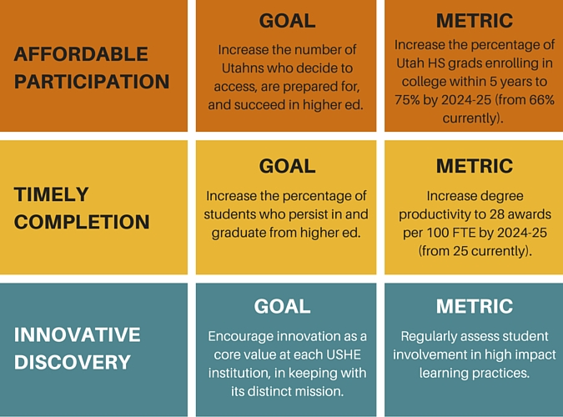
BoR Continued…. Initial Outlook: 2015

Slide 18
BoR Continued…..
Strategic Objectives
Affordable Access- The Board of Regents wants to ensure all Utahns can affordably access a quality postsecondary education with the tools, resources and information that start them on the path to completion, especially for underserved populations and first-generation college students.
Timely Completion - Utah's public colleges and universities help students realize their potential by supporting them on their path to an on-time graduation.
Workforce & Research- Higher education institutions enable Utahns to adapt to the seismic shifts in today's global economy. The base of Utah's economic activity is formed by students becoming life long learners and creators through cutting-edge research and real workforce opportunities while in college.
Capacity & Growth- Utah uniquely stands out across the country with its white-hot economy amidst an increasing population, buttressed by a vibrant and growing number of K-12 students. While positive, these factors are also stretching the capacity limits of Utah's public colleges and universities, requiring cost-effectiveness and thoughtful oversight of limited resources to ensure a student's quality education.

Slide 19
GE Reminders- R470
3.1 General Education Credit Requirements- Range from 30-39 Credits
This must include at least four courses in the Core Requirements- Written Communication (2: 6 credits), Quantitative Literacy (1: 3-4 credits) and American Institutions (1: 3-6 credits).
“An interdisciplinary course or multiple courses that fulfill the outcomes may also satisfy the requirement”
Then at least ONE course (of at least 3 credits) from each of the five Breadth Areas (Arts, Humanities, Life Sciences, Physical Sciences, and Social and Behavioral Sciences).
“Traditionally, this has been met by institutional General Education programs, but may be met through innovative programs that meet the same outcomes specified in this document.”
“USHE institutions may create additional Breadth Areas as they deem appropriate.”
Two campus issues: Hidden pre-reqs and upper division courses in our GE

Slide 20
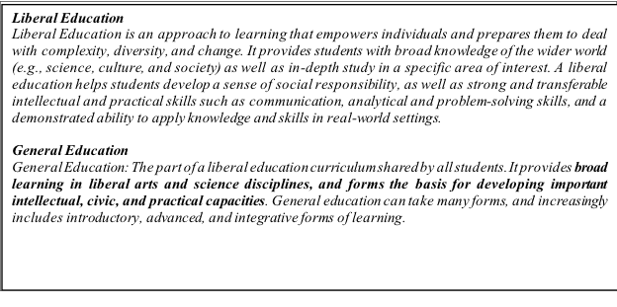
AAC&U Definitions

Slide 21
Committee Work
Reaffirmed the ELO’s and their role in Undergraduate Education: The Committee strongly recommends these be reinvigorated across the curriculum

Slide 22
Committee Work
The Committee has recommended the creation of a faculty assessment committee charged with the assessment of ELO’s and GE offerings along with the oversight of program assessment activities. The Faculty Senate is currently considering this.
The Movement of the General Education Committee under the Curriculum Committee- the Faculty Senate is considering this.

Slide 23
Stakeholder Summary
Business Community
Biggest concerns/skills needed:
Critical thinking
Oral and written communication
Teamwork (social skills)
Digital Literacy
Like internships – would like them even earlier
Some concern that there is obsolescence with university instruction; just teaching students to jump through hoops
Suggestions:
Make gen ed more career path related and targeted (avoid repeat of high school)
Authentic experiences earlier
Gen ed should teach students how to write properly including emails and verbal communication
Most recommended class: Business Communications

Slide 24
Stakeholder cont….
Students
Concerns:
Do not feel general education classes are applicable to their lives; hoops to jump through
Feel that some classes are a repeat of high school; waste of time
Scheduling issues
Suggestions:
Courses with more real world application
More meaningful content (why memorize when can Google?)
Less GE
Most requested class: Financial literacy course (how to “adult”)

Slide 25
Alumni- Open Responses
Years since graduation (and total number of responses for each year)
1: 10,224, 3: 1,599
5: 1,948 10: 1,511
Total Responses: 15,282
Best Aspects:
The professors
Small class sizes
Convenience/flexibility (online classes, campus nearby, easy commute)
Improvements:
Scheduling!!
Make classes more applicable to job/career
Not sure how to improve/satisfied with experience
Some gen ed classes were a waste of time/money
Missing from program:
Technology related skills
Better financial understanding
Help with networking
Most recommended classes: Digital literacy and financial literacy

Slide 26
Big Ideas
This is a list of some “Big Ideas”- there is no order nor any attempt provided at how they might “interact” in a new system, etc.
First Year Seminar(s)- how many and based on what content (student development or multi-disciplinary problem based courses, etc.)
High Impact Practices (HIP’s)- USHE/Regents have “asked” that we include two of these in the curriculum- one in the first 60 hrs and one on the second 60 hrs
Who should own GE and is our existing model the most effective?
Must communicate the value of GE and a liberal education with various stakeholders much better- How?
Fully developed Pathways for all degrees

Slide 27
Some Big Questions
What does the configuration of GE look like?
How many credits (30-39)(currently 35)?
What might be added or dropped?
First Year Seminar(s)
Various HIP’s (internships, study abroad, etc.)
3rd Science
Ethics and Values
Fitness for Life/Personal Health and Wellness
ETC
How do we infuse and asses the ELO’s in all courses and degrees?
If GE is not as departmental- then where?
How do you do a First Year Seminar(s) at scale?

Slide 28
More than just GE the first 60 credits are in the “space” of a Pathway and should coordinate and work across Pathways as much as possible
Pathways to Majors
Degree Programs~ Required & Elective Courses
Ownership: Departments and Programs
Pathways and General Education
Changes: Program initiate- Defined Process
Approval: Process- UCC, Trustees, Etc.
Ownership: ???
Assessment: Course & Program Level
Changes: ???
Assessment: Courses by Program but Overall???
Approval: ???
Year 1
Year 2
Year 3
Year 4+

Slide 29
Questions
Thinking about the “Big Ideas” presented which ones resonate or concern you and why?
What are the implications for your department and college/school?
What other “Big Ideas” do you have and what would the implications of your idea include?
What Concerns you and why?

