Slide 1
Re-Envisioning the Undergraduate Experience
Open Meeting – Fall 2019 Kickoff
8/22/2019

Slide 2
About the Committee
Established by a majority vote of the Faculty Senate
40 original members, including
28 Faculty elected from each college and school
3 Student representatives
9 other campus and community members
Welcome to the new members! (Introductions)
Mission:
Create an adaptable strategy that will lead to retention and completion of students who are prepared to thrive personally and professionally in a multi-faceted world.

Slide 3
About the Committee
Established by a majority vote of the Faculty Senate
40 original members, including
28 Faculty elected from each college and school
3 Student representatives
9 other campus and community members
Welcome to the new members! (Introductions)
Mission:
Create an adaptable strategy that will lead to retention and completion of students who are prepared to thrive personally and professionally in a multi-faceted world.
Student success
Retention
Completion

Slide 4
Activities & Outcomes 2018-2019
Established a mission and process
Revisited UVU’s Essential Learning Outcomes (ELOs)
Created an Assessment Committee
Moved GE Committee to be under Faculty Senate (UCC)
Established four areas for further study this year: HIPS, FYS, Pathways, and GE enhancements.
RUEC recommendations have been fully supported by the Faculty Senate (both years).

Slide 5
Activities & Outcomes 2018-2019
Established a mission and process
Revisited UVU’s Essential Learning Outcomes (ELOs)
Created an Assessment Committee
Moved GE Committee to be under Faculty Senate (UCC)
Established four areas for further study this year: HIPS, FYS, Pathways, and GE enhancements.
RUEC recommendations have been fully supported by the Faculty Senate (both years).
Our constant battle: balancing the visionary and transformational against the realistic constraints of UVU’s students, faculty, budget, etc.

Slide 6
2019 Initiatives
Pathways
Why? - Crucial to Integrated Mission. Helps with retention by allowing students to see how to navigate through a degree program.
Special attention to Gateway courses
First Year Seminar (FYS)
Why? - Proven effectiveness in student success, particularly with retention from year 1 to 2, and with under-prepared and under-represented minority students.
Academic GE multidisciplinary curriculum
High Impact Practices (HIPs)
Why? - Proven effectiveness especially for first generation and minority students. Required by USHE.
GE Modifications
Training and marketing: help students and faculty appreciate the value of GE and liberal education
Why? – Help students navigate college efficiently, achieve the ELOs, become a learner, and not be overwhelmed in the process.
Structural simplification leads to significant increases in graduation rates
Cost, disruption, and outcomes will depend on the model adopted
Requires significant curriculum changes and faculty buy-in
Examples: FYS, student research certificate, internships, study abroad, capstone projects.
Need to track, implement, and train
Scalability issues
Credit hour or requirement changes may be needed to accommodate other initiatives

Slide 7
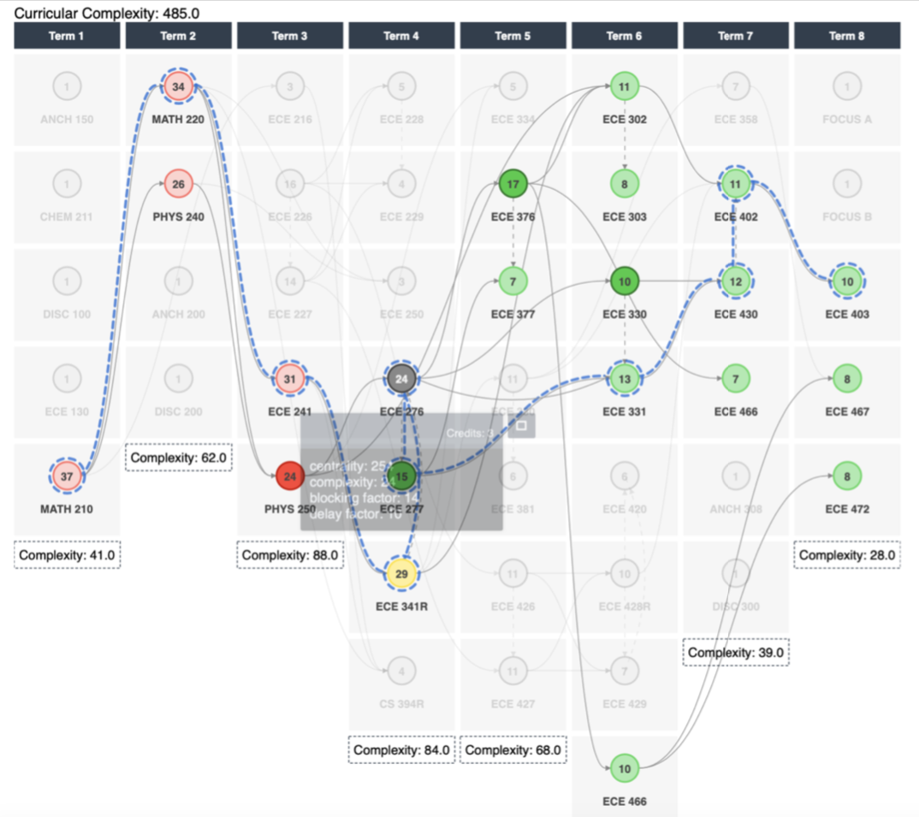
2019 Initiatives
Pathways
Why? - Crucial to Integrated Mission. Helps with retention by allowing students to see how to navigate through a degree program.
Special attention to Gateway courses
First Year Seminar (FYS)
Why? - Proven effectiveness in student success, particularly with retention from year 1 to 2, and with under-prepared and under-represented minority students.
Academic GE multidisciplinary curriculum
High Impact Practices (HIPs)
Why? - Proven effectiveness especially for first generation and minority students. Required by USHE.
GE Modifications
Training and marketing: help students and faculty appreciate the value of GE and liberal education
Why? – Help students navigate college efficiently, achieve the ELOs, become a learner, and not be overwhelmed in the process.
Structural simplification leads to significant increases in graduation rates
Cost, disruption, and outcomes will depend on the model adopted
Requires significant curriculum changes and faculty buy-in
Examples: FYS, student research certificate, internships, study abroad, capstone projects.
Need to track, implement, and train
Scalability issues
Credit hour or requirement changes may be needed to accommodate other initiatives

Slide 8
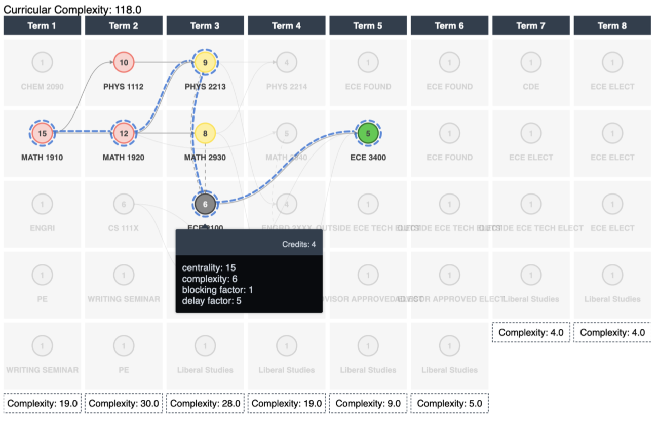
2019 Initiatives
Pathways
Why? - Crucial to Integrated Mission. Helps with retention by allowing students to see how to navigate through a degree program.
Special attention to Gateway courses
First Year Seminar (FYS)
Why? - Proven effectiveness in student success, particularly with retention from year 1 to 2, and with under-prepared and under-represented minority students.
Academic GE multidisciplinary curriculum
High Impact Practices (HIPs)
Why? - Proven effectiveness especially for first generation and minority students. Required by USHE.
GE Modifications
Training and marketing: help students and faculty appreciate the value of GE and liberal education
Why? – Help students navigate college efficiently, achieve the ELOs, become a learner, and not be overwhelmed in the process.
Structural simplification leads to significant increases in graduation rates
Cost, disruption, and outcomes will depend on the model adopted
Requires significant curriculum changes and faculty buy-in
Examples: FYS, student research certificate, internships, study abroad, capstone projects.
Need to track, implement, and train
Scalability issues
Credit hour or requirement changes may be needed to accommodate other initiatives

Slide 9
2019 Initiatives
Pathways
Why? - Crucial to Integrated Mission. Helps with retention by allowing students to see how to navigate through a degree program.
Special attention to Gateway courses
First Year Seminar (FYS)
Why? - Proven effectiveness in student success, particularly with retention from year 1 to 2, and with under-prepared and under-represented minority students.
Academic GE multidisciplinary curriculum
High Impact Practices (HIPs)
Why? - Proven effectiveness especially for first generation and minority students. Required by USHE.
GE Modifications
Training and marketing: help students and faculty appreciate the value of GE and liberal education
Why? – Help students navigate college efficiently, achieve the ELOs, become a learner, and not be overwhelmed in the process.
Structural simplification leads to significant increases in graduation rates
Cost, disruption, and outcomes will depend on the model adopted
Requires significant curriculum changes and faculty buy-in
Examples: FYS, student research certificate, internships, study abroad, capstone projects.
Need to track, implement, and train
Scalability issues
Credit hour or requirement changes may be needed to accommodate other initiatives
Reduce degree complexity
Promote more Associates degrees or intermediate certifications
Allow for more flexibility and efficiency to exit and re-enter degree programs
“Stackable” degrees

Slide 10
2019 Initiatives
Pathways
Why? - Crucial to Integrated Mission. Helps with retention by allowing students to see how to navigate through a degree program.
Special attention to Gateway courses
First Year Seminar (FYS)
Why? - Proven effectiveness in student success, particularly with retention from year 1 to 2, and with under-prepared and under-represented minority students.
Academic GE multidisciplinary curriculum
High Impact Practices (HIPs)
Why? - Proven effectiveness especially for first generation and minority students. Required by USHE.
GE Modifications
Training and marketing: help students and faculty appreciate the value of GE and liberal education
Why? – Help students navigate college efficiently, achieve the ELOs, become a learner, and not be overwhelmed in the process.
Structural simplification leads to significant increases in graduation rates
Cost, disruption, and outcomes will depend on the model adopted
Requires significant curriculum changes and faculty buy-in
Examples: FYS, student research certificate, internships, study abroad, capstone projects.
Need to track, implement, and train
Scalability issues
Credit hour or requirement changes may be needed to accommodate other initiatives
General Education class with disciplinary focus; not a student success class or “intro to college”
Required for all students in the first year (with some logical exceptions)
Academic home

Slide 11
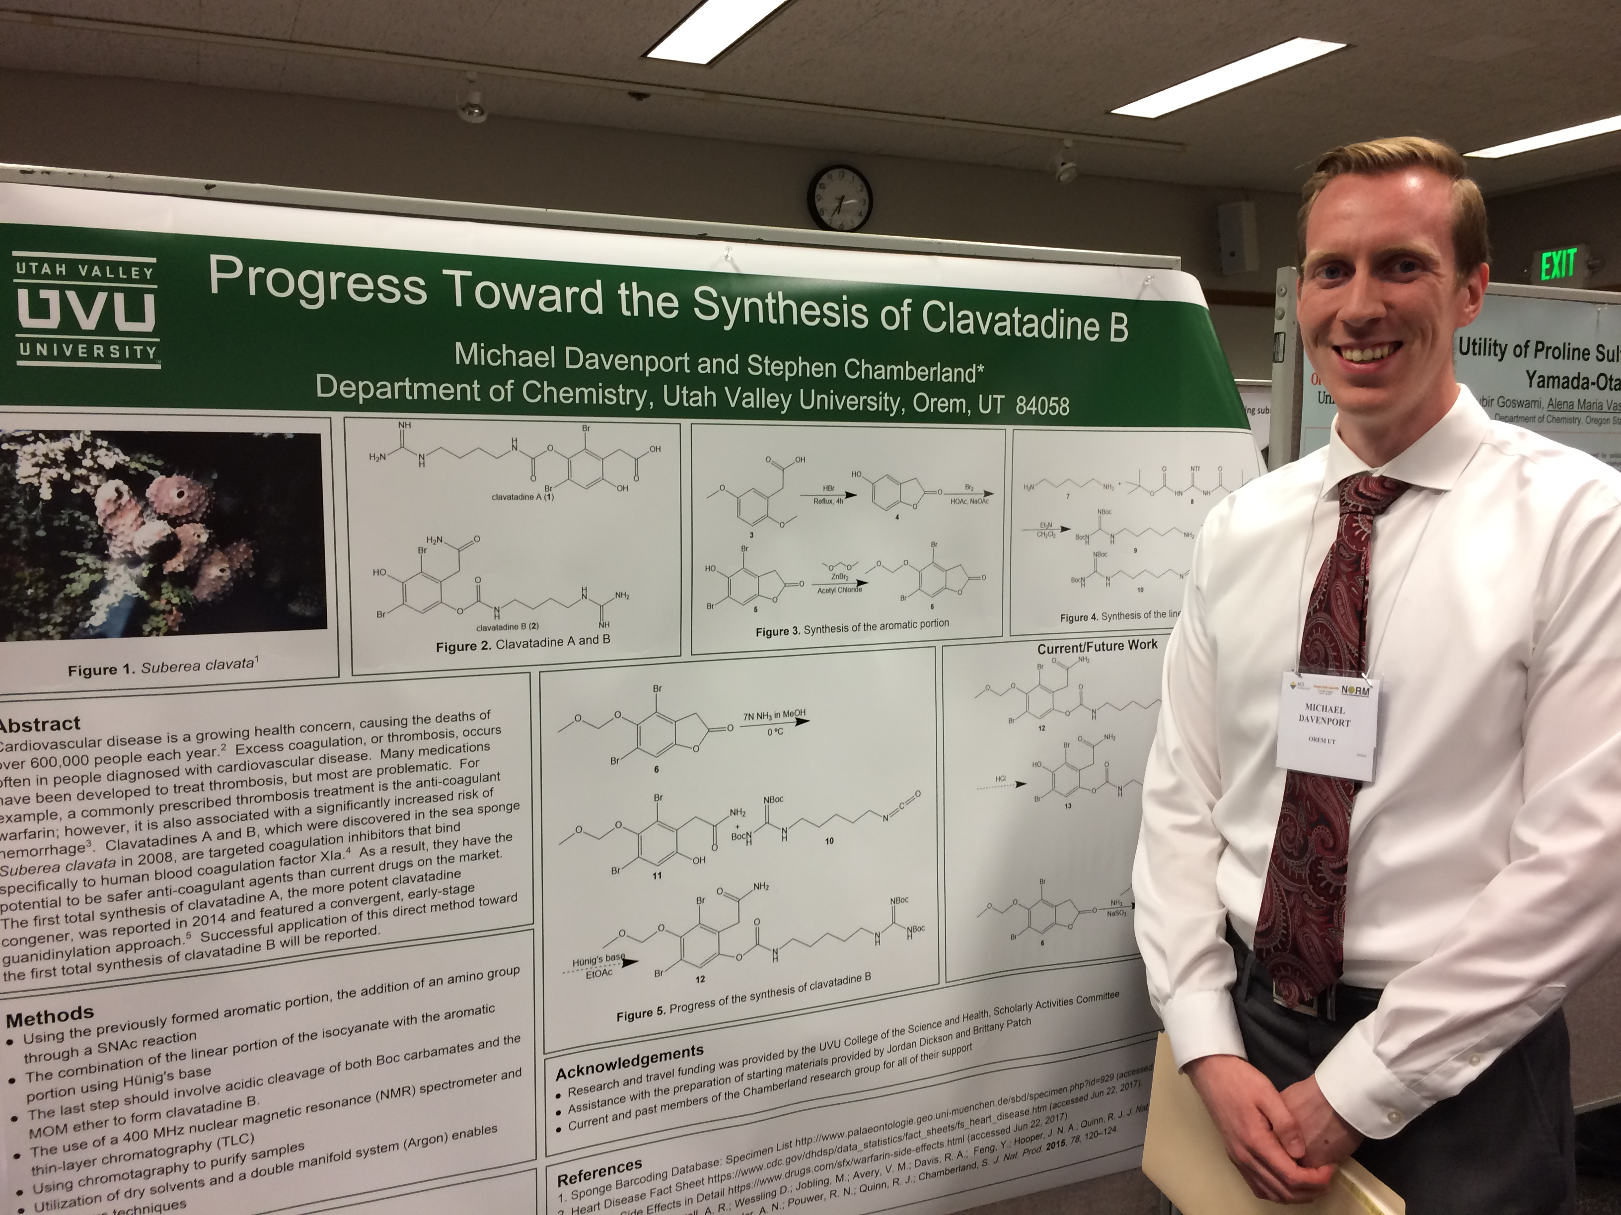
2019 Initiatives
Pathways
Why? - Crucial to Integrated Mission. Helps with retention by allowing students to see how to navigate through a degree program.
Special attention to Gateway courses
First Year Seminar (FYS)
Why? - Proven effectiveness in student success, particularly with retention from year 1 to 2, and with under-prepared and under-represented minority students.
Academic GE multidisciplinary curriculum
High Impact Practices (HIPs)
Why? - Proven effectiveness especially for first generation and minority students. Required by USHE.
GE Modifications
Training and marketing: help students and faculty appreciate the value of GE and liberal education
Why? – Help students navigate college efficiently, achieve the ELOs, become a learner, and not be overwhelmed in the process.
Structural simplification leads to significant increases in graduation rates
Cost, disruption, and outcomes will depend on the model adopted
Requires significant curriculum changes and faculty buy-in
Examples: FYS, student research certificate, internships, study abroad, capstone projects.
Need to track, implement, and train
Scalability issues
Credit hour or requirement changes may be needed to accommodate other initiatives
First-year Seminar
Undergraduate research
Inquiry-based learning in the classroom
Internships
Service learning
Capstone projects/senior theses
Study abroad

Slide 12
2019 Initiatives
Pathways
Why? - Crucial to Integrated Mission. Helps with retention by allowing students to see how to navigate through a degree program.
Special attention to Gateway courses
First Year Seminar (FYS)
Why? - Proven effectiveness in student success, particularly with retention from year 1 to 2, and with under-prepared and under-represented minority students.
Academic GE multidisciplinary curriculum
High Impact Practices (HIPs)
Why? - Proven effectiveness especially for first generation and minority students. Required by USHE.
GE Modifications
Training and marketing: help students and faculty appreciate the value of GE and liberal education
Why? – Help students navigate college efficiently, achieve the ELOs, become a learner, and not be overwhelmed in the process.
Structural simplification leads to significant increases in graduation rates
Cost, disruption, and outcomes will depend on the model adopted
Requires significant curriculum changes and faculty buy-in
Examples: FYS, student research certificate, internships, study abroad, capstone projects.
Need to track, implement, and train
Scalability issues
Credit hour or requirement changes may be needed to accommodate other initiatives
GE @ UVU is good for you!

Slide 13
2019 Initiatives
Pathways
Why? - Crucial to Integrated Mission. Helps with retention by allowing students to see how to navigate through a degree program.
Special attention to Gateway courses
First Year Seminar (FYS)
Why? - Proven effectiveness in student success, particularly with retention from year 1 to 2, and with under-prepared and under-represented minority students.
Academic GE multidisciplinary curriculum
High Impact Practices (HIPs)
Why? - Proven effectiveness especially for first generation and minority students. Required by USHE.
GE Modifications
Training and marketing: help students and faculty appreciate the value of GE and liberal education
Why? – Help students navigate college efficiently, achieve the ELOs, become a learner, and not be overwhelmed in the process.
Structural simplification leads to significant increases in graduation rates
Cost, disruption, and outcomes will depend on the model adopted
Requires significant curriculum changes and faculty buy-in
Examples: FYS, student research certificate, internships, study abroad, capstone projects.
Need to track, implement, and train
Scalability issues
Credit hour or requirement changes may be needed to accommodate other initiatives
Faculty training and adoption of learning objectives
Better promotion of GE objectives with students and employers
Make HIPS part of GE (possibly including FYS)
GE as integral part of Pathways
GE @ UVU is good for you!

Slide 14
Vision 2030
Discussion and presentation by Provost Wayne Vaught

Slide 15
RUEC Schedule and Actions:
Aug–Sept 2019: Subcommittees work with stakeholders to make detailed proposals, following the detailed micro process plan.
Oct. 2019: First draft of specific proposals presented to President’s Council; PBA request for funding for pilot programs.
Dec. 2019: Finish proposal work and coordinate with President to include support for proposals in State of the University speech.
Jan-Feb 2020: Get faculty input and support during college meetings, campus-wide meetings, State of the University address, etc.
March 2020: Final versions of recommendations presented to Faculty Senate for approval (3 meetings = 5 to 6 weeks).
April 2020: Transition RUEC to implementation.

Slide 16
Questions:
Does the administration support the study concepts?
What resources do we need to request as part of PBA?
Are the benefits from these initiatives worth the costs and disruption?
Going forward: Assuming this committee comes to an end this year, what will we recommend for continued progress on these or other new ideas?

Slide 17
Next meeting: 29 Aug
Welcome to new elected RUEC members
Detailed presentations by 4 subcommittees (20 minutes each, including discussion)
Overview of tasks and schedule for September
Assignment: read the Faculty Senate resolution (2 pages), the background information document (~25 pages) before the Aug. 29 meeting.

