Slide 1
Processes and Barriers
RUEC | NOV 2, 2018
Notes:
What is a barrier you can think of right now?

Slide 2
Group Charge
What changes could we suggest to simplify or streamline scheduling, registration, etc. to help students be successful and improve retention/completion? What proposals are already being considered or implemented?

Slide 3
Group Membership
Faculty | Academic Affairs | Student Affairs | UVUSA
Melissa Noyes | Tiffany Evans | Eric Humphrey | Anna
Evelyn Porter | Laura Busby

Slide 4
Stakeholders and Interested Parties
STUDENTS
STUDENT AFFAIRS
ACADEMIC AFFAIRS
IT
The Larger Community
Notes:
SA = Enrollment Management, FYE; AA = Faculty, Advisors, etc.; IT = APS, AIS, BI, Web-Dev, etc.; Employers, families, nonprofits and volunteer orgs, etc.

Slide 5
What are the processes & barriers?
...at least some of them

Slide 6
A few examples:
Barrier
Being Reviewed
Details
1
Complex Prerequisites and Curriculum
Prerequisites can be very complex
Difficult for students to understand
Difficult or impossible to program/enforce
2
Scheduling Complexity and Overlaps
Current bell times overlap creating conflicts for students and vacant classrooms
Credit hours vs contact hours
3
Open Enrollment vs. Program Capacity
Bottlenecks exist in some programs because there are more students than there are resources to handle them
4
Advising Load; Time to advising appointment
Academic advisor student-to-advisor ratio is very high
Students may not be able to see an advisor for two or more weeks
5
System Friendliness and Usability
Registration system is clunky and prone to error
Multiple software resources exist to help the student, but often cause confusion instead

Slide 7
1
2
3
Registration System
Academic Scheduling
Open Enrollment vs. Program Enrollment
Our Top 3
Notes:
I am a nuts and bolts kind of person. I gravitate, stress about, and work to resolve the nuts and bolts of student registration. I will be tackling the registration system discussion, and Tiff will take over the academic scheduling discussion.

Slide 8
1. Registration System Barriers
Multiple systems
Scheduling Wizard

Slide 9
1 - Registration System Barriers
Description
Currently, a student is presented with 3 different routes for course registration. This is due to:
An error-prone registration system that has resulted in NEW and OLD registration systems running simultaneously.
The addition of a tool called The Scheduling Wizard. A GREAT tool, but not fully adopted or understood.
This is confusing and problematic to students.

Slide 10
1 - Registration System Barriers
Next Steps (In Progress)
Find and eradicate the errors in the new registration system (DONE!).
Once complete, get rid of the old system. AKA, reduce confusion.
Implement new functionality in The Scheduling Wizard that allows students to find and secure a schedule in one place.
Expose the scheduling wizard as the primary method for registration.
Go from 3 registration methods that sort of work to 1 that works really well.

Slide 11
2. Academic Scheduling Revisions
Academic Scheduling Committee
Standard Start Times
Credit Hour vs Contact Hour
Low-Enrolled Courses

Slide 12
2A. Academic Scheduling Committee
The Academic Scheduling Committee (ASC) is established under the direction of Faculty Senate, and Academic Affairs. The Committee serves in an advisory capacity to Vice Presidents Council and Academic Affairs Council.
The committee is tasked with the following:
Review course demand and make recommendations to individual departments and schools and colleges to meet student demand.
Maintain a commitment to student success and scheduling practices that promote completion.
Review and approve or decline exceptions to the scheduling policy, protocols and start times.
Prepare and plan for enrollment growth.
Review and revise department scheduling practices/processes to maximize utilization (establish goals)
Coordinate with the Event Scheduling; ensure that decisions made align with, and do not negatively impact institutional goals.

Slide 13
2A. Academic Scheduling Committee
FACULTY
Matthew Taylor - School of the Arts
Dale Maughan - College of Health and Public Service
Doug Miller - Woodbury School of Business
Mary Sowder - School of Education
Mark Lentz - College of Humanities and Social Sciences
Mark Bracken - College of Science
Matthew Hasara - College of Engineering and Technology
Ofa Ioane - University College
Anne Arendt - Faculty Senate Liaison
Jessica Hill - Faculty Senate Liaison
Faculty representatives should serve as a scheduling resource to their individual school and college schedulers.
Staff
Tiffany Evans - AA - Chair (ex officio)
David Connelly - AA - (ex officio)
Eric Humphrey - University Registrar
Lisa Price - Assistant Registrar for Academic Scheduling
Frank Young - VP Facilities Planning (ex officio)
Andrew Stone - AVP EM (ex officio)
Laura Busby - AA IT and Reporting (ex officio)
Beka Grulich - Associate Dir. Event Services/Campus Schd. (ex officio)
STUDENT
Kenzie Prows

Slide 14
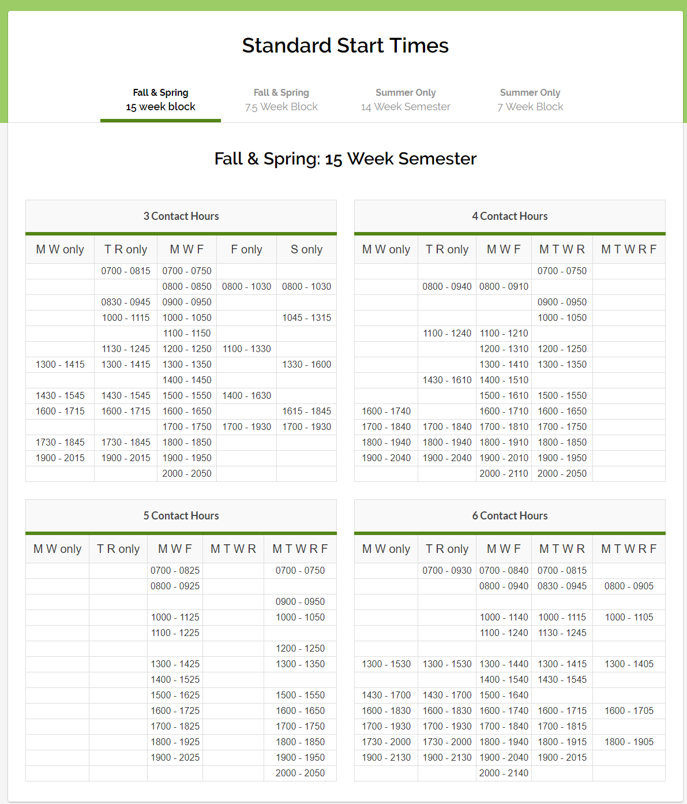
2. Academic Scheduling Revisions
2B - Standard Start Times
Description
Current standard start times create massive overlaps and inefficiencies felt by many stakeholders.
Next slide shows these times when seen on a weekly calendar.
https://www.uvu.edu/academicscheduling/standard_start_times/index.html

Slide 15
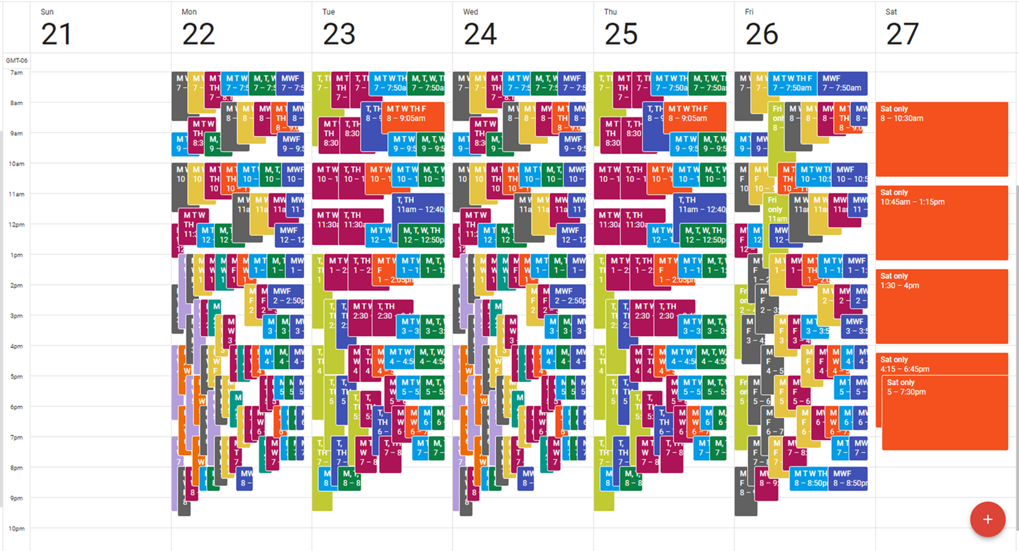
2. Academic Scheduling Revisions

Slide 16
2. Academic Scheduling Revisions
2C - Credit Hours and Contact Hours
Credit Hour
Contact Hour
Notes:
Tiff - You’ll notice these are not filled out. Please define a credit hour. Please define a contact hour.

Slide 17
2. Academic Scheduling Revisions
2D - Low-Enrolled Courses
Description
Academic scheduling and those informing academic scheduling need to consider registration times and deadlines in relation to "low-enrollment" courses, before cancelling those courses
keep in mind the late registration tendencies of students for particular courses--being more flexible for courses with historically late registering students (which tend to be the courses students most need to persist)
academic scheduling shouldn't be part of making course cancelling decisions.

Slide 18
3. Open Enrollment vs. Program Cap
Bottlenecked Programs

Slide 19
3 - Open Enrollment vs. Program Enrollment
Description
Bottlenecks exist in some high-demand programs because there are more students than there are resources to support them.
Do programs have to be open enrollment just because the institution is?
Next Steps
We recommend departments evaluate and recommend program capacity limits based on human and facility capital.
What are the pros and cons of this action?

Slide 20
Summary
There is no massive, one-time fix.
Change is incremental and continuous.
Many groups and professionals are focused on these things as we speak.
We are engaged in an exciting process!

