Slide 1
Fire extinguishers
101

Slide 2
What is fire?
Fire is the visible effect of the process of combustion – a special type of chemical reaction. It occurs between oxygen and some sort of fuel. The products from the chemical reaction are completely different from the starting material.

Slide 3
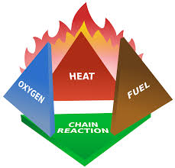
Theory of fire: THE FIRE TETRAHEDRON
Four elements must be present for fire to occur:
Fuel
Heat
Oxidizing agent (oxygen)
Chemical Chain Reaction
Take away any of these and the fire will be extinguished

Slide 4
Fire extinguishers
Fires are classified according to the type of fuel that is burning.
If you use the wrong type of extinguisher on the wrong class of fire, you might make matters worse
It is very important to understand the fuel classifications.

Slide 5
Fire classifications

Slide 6
Water extinguishers
Designed for class a fires only
Using water on a flammable liquid fire could cause the fire to spread
Using water on a electrical fire increases the risk of electrocution

Slide 7
CO2 extinguishers
Co2 fire extinguishers are designed for class b and c fires only
The pressure in a Co2 is so great, bits of dry ice may shoot out of the horn

Slide 8
Dry chemical extinguisher
Dry chemical extinguishers come in a variety of types.
You may see them labeled:
DC (for dry chemical)
ABC (can be used on class a, b, or c fires
Bc (can be used on class b and c fires

Slide 9
Class k extinguishers
Used on oils and greases
Agents use saponification to turn fats and oils into soapy foam that extinguishes the fire
Usually only found in commercial cooking operations
ONLY USE A CLASS K EXTINGUISHER AFTER THE HOOD SUPRESSION SYSTEM HAS ACTIVATED

Slide 10
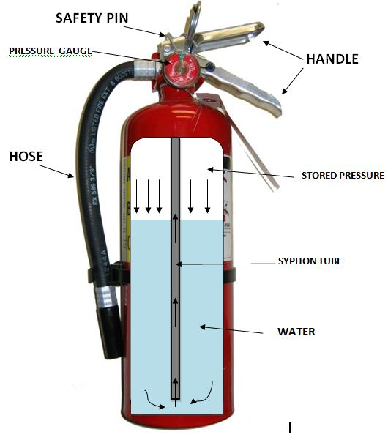
Anatomy of a extinguisher

Slide 11
Use of a extinguisher
Call 911 or activate nearest fire alarm
Verify the extinguisher is rated for the proper classification of fire
Pull the pin
Aim the extinguisher at the base of the fire
Squeeze the handle
Sweep side to side

Slide 12
Rules for fighting fires
Know what is burning. If you don’t know what’s burning you won’t know what kind of extinguisher to use
Even if you have an abc extinguisher, there may be something in the fire that may produce toxic fumes and/ explode.
Is the fire spreading rapidly beyond it’s point of origin? Is so evacuate immediately.

Slide 13
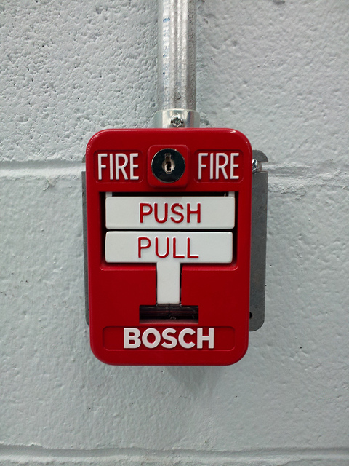
Reporting fires
Activate Building fire alarm system
Evacuate the building
Call 911

