Slide 1
GEAR UP 101
Helping your student prepare for college and career
Notes:
Welcome parents, family, and community members! This presentation is designed to give you the basics about college for your student: why it’s important, how much college actually costs, and what to do now to get ready for the future. You play an important role in your student’s life and we appreciate your support!

Slide 2
By the Numbers
1 Goal
2 Startling statistics
3 Reasons college is important
4 Types of higher education
5 Ways to pay for college
6 Career paths to explore
7 Things you can do now to help
Notes:
Today, we’ll cover the basics, by the numbers. There’s a lot more information out there but we’ve focused on the important stuff for now.

Slide 3
1 Goal
COLLEGE
It’s not a dream, it’s a plan.
As a parent or family member, you and your student can begin planning-for-the-future today.
Notes:
This is the motto of GEAR UP Utah which stands for Gaining Early Awareness and Readiness for Undergraduate Programs.
The GEAR UP program in Utah is funded by the U.S. Department of Education, run through Utah State University, and supports middle and high schools across the state to encourage students to pursue higher education and prepare them to succeed.
Explain what kinds of activities GEAR UP is doing at your school.

Slide 4
2 Startling Statistics
On average, 52% of Utah high school grads (cohorts 2007-2012) attended college in the first year after high school graduation. That rate increased to 63% by the end of the third year, 69% by the fifth, and 71% ten years after high school graduation.
60% of Utah female high school graduates attended college the first year after high school graduation, compared to only 44% of male high school grads.
However, the gap in college participation rates between males and females narrowed over time.
By 2020, 70% of the jobs in Utah will require some type of postsecondary education.
Sources: NCHEMS Information Center (2014); Georgetown Center on Education and the Workforce (2013)
Notes:
Given these statistics, it is imperative that you and your student understand the importance of a college education!

Slide 5
Utah College Facts
On average, 80 percent of Utah high school graduates attended a USHE institution, 11 percent attended a Utah private institution, 5 percent attended a public out-of-state institution, and 5 percent attended a private out-of-state institution.

Slide 6
3 Reasons to Go to College
There are LOTS of reasons to go to college, but these are some of the most important.
More money!
Greater job security
Career satisfaction

Slide 7
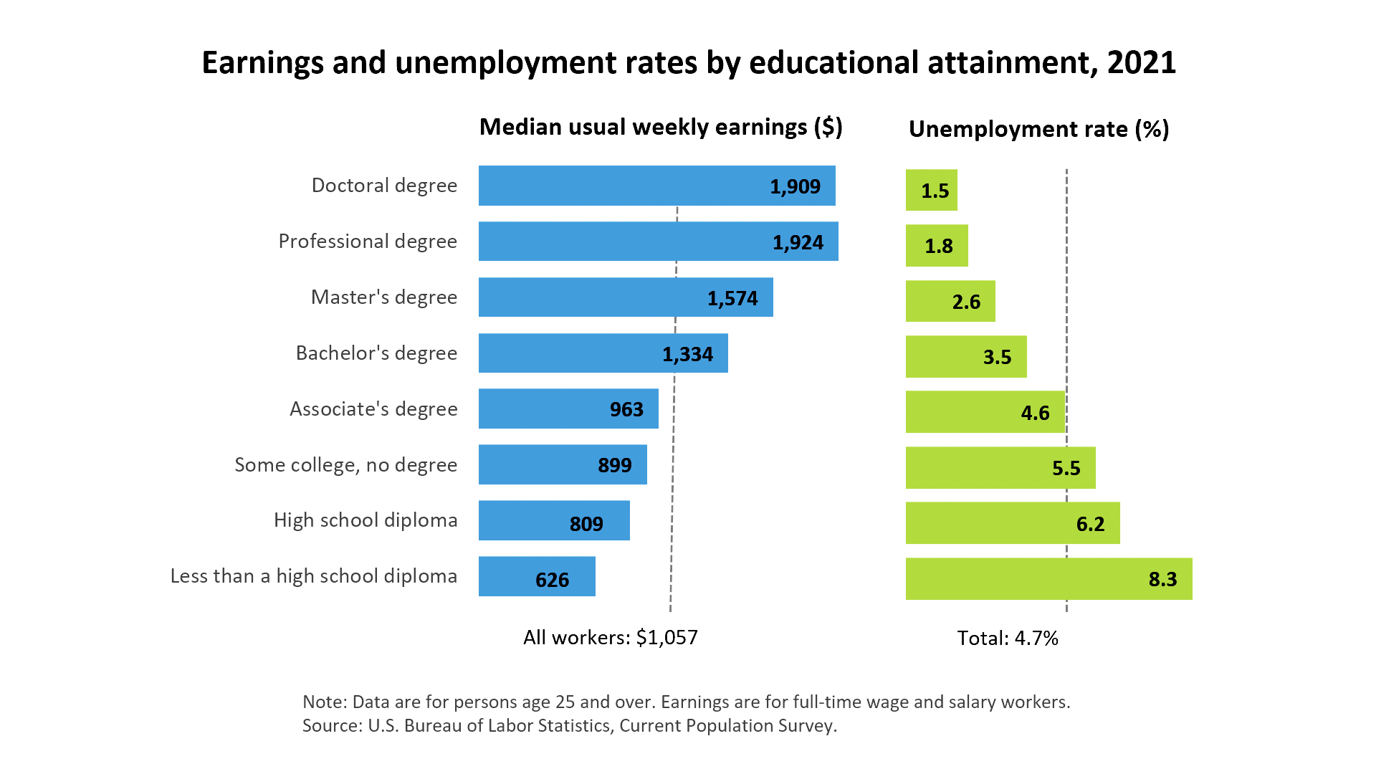
3 Reasons to Go to College
Source: U.S. Bureau of Labor Statistics (2021)
Notes:
College graduates with a BA or higher will earn $300,000 more over a lifetime than someone with a high school diploma.
The more education, the more likely you are to be employed.

Slide 8
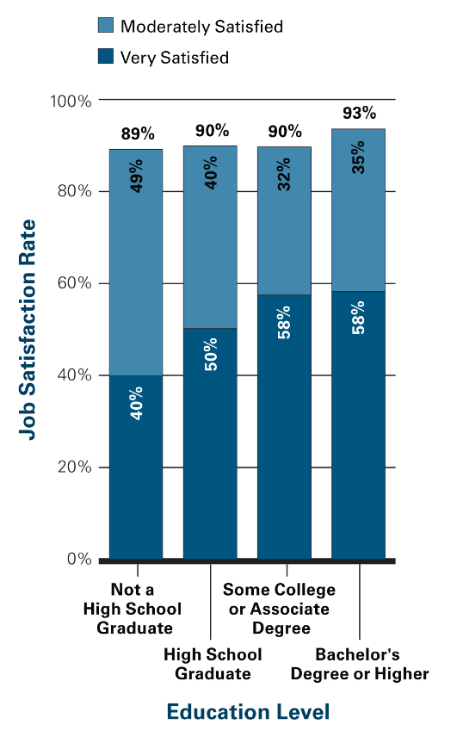
3 Reasons to Go to College
^{Source: College Board (2008)}
Notes:
Someone with more education will have more opportunities and choices in the jobs they do and work in a field where he/she has real interest and passion.

Slide 9
4 Types of Higher Education
Type | Degree | Years | Utah Examples
Technical or Vocational | Diploma or certificate | 1-2 | Mountainland Technical College, Davis Technical College, Provo College, Cosmetology schools
Community College | Associate’s Degree (may also have certificates) | 2 | Salt lake Community College, Westminster College
Public 4-Year | Bachelor’s Degree (often also have Graduate and Professional degrees) | 4 | Utah State University, University of Utah, Weber State, Utah Valley University, Southern Utah University and Utah Tech University
Private 4-Year | Bachelor’s Degree (occasionally Graduate and Professional degrees) | 4 | Brigham Young University
Notes:
Feel free to edit this to provide the names of schools that might be near your community.

Slide 10
5 Ways to Pay
There are multiple ways of paying for college.
College Savings Plans
Grants
Scholarships
Work-Study
Loans

Slide 11
5 Ways to Pay
College Savings Plans
Save this amount each week: | In 5 years with 5% interest, you’ll have: | In 5 years with 8% interest, you’ll have:
$5 | $1,475 | $1,595
$10 | $2,950 | $3,185
$20 | $5,895 | $6,370
$50 | $14,725 | $15,650
Notes:
By saving now, your student will have more money for college later.
There are several types of savings plans – the most common college savings plans are known as 529 plans which gain interest tax-free. Your student may also be eligible for an Individual Development Account which is a matched savings account that gives low-income students extra money for their education. Talk to local banks or credit unions about setting up an account. Other family members and your student can contribute, too!

Slide 12
5 Ways to Pay for Higher Education
Financial Aid
Merit-Based | What is it? | Pay back?
Scholarships | Given for good grades, community service, athletic ability or unique personal qualities. | No
Need-Based | What is it? | Pay back?
Grants | Money from the federal government or the college. | No
Work-Study | Part-time jobs, often on campus, to help pay for college. | No
Loans | Borrowed money to help pay for college. | Yes
Notes:
Students receive financial aid for college by filling out the Free Application for Federal Student Aid (FAFSA) There may be additional forms to complete for colleges and additional scholarships.

Slide 13
5 Ways to Pay for Higher Education
The cost of college includes tuition, fees, books, living expenses, and tuition.
Utah Institutions | Tuition & Fees | Other Costs not including Housing | Avg. Annual Total
2-Year Community Colleges | $2,128 | $4,864 | $19,518
4-Year Public | $9,085 | $15,209 | $25,015
4-Year Private | $33,810 | $13,455 | $47,265

Slide 14
5 Ways to Pay for Higher Education
The “sticker price” reflects the full cost, but most students won’t pay this.
Instead, focus on the net price – what you will actually pay after financial aid is included.
Notes:
Remember, this is the sticker price – most students won’t pay full price! Focus on the net price – all colleges have to have a net price calculator on their websites where you can get an estimate of how much you will actually pay.
Also, don’t be scared away by some private universities “sticker prices” – they often have more scholarships and grants to give away.

Slide 15
6 Career Paths to Explore
Careers can be grouped into six categories:
Agriculture, Food, and Natural Resource Systems
Arts, Information, and Communications
Business, Finance, and Management
Health Sciences
Human Resources, Education and Social Services
Industrial and Engineering Systems
Notes:
Help your student explore his/her interests, related careers, and the kind of education he or she will need.
Discuss resources available at your school, such as CIS, to explore careers.

Slide 16
6 Career Paths to Explore
Agriculture, Food, Natural Resources
Student interest: Nature, science
Career option: Hydrologist, Agricultural specialist
Environmental scientist
Education needed: Bachelor’s degree or higher

Slide 17
6 Career Paths to Explore
Arts, Communication, Information
Student interest: Art, drawing, or design
Career option: Graphic designer, Marketing Communications Manager
Education needed: Associate’s degree or higher

Slide 18
6 Career Paths to Explore
Business, Finance, Management
Student interest: Computers, math
Career option: Computer Information Systems Manager
Education needed: Bachelor’s degree or higher

Slide 19
6 Career Paths to Explore
Health Sciences
Student interest: Sports, animals, helping people
Career option: Dental hygienist
Education needed: Associate’s degree or higher

Slide 20
6 Career Paths to Explore
Human Resources, Education, Social Services
Student interest: Helping others, listening, persuading
Career option: Teacher, Social Worker
Education needed: Bachelors degree or Graduate degree

Slide 21
6 Career Paths to Explore
Industrial, Engineering Systems
Student interest: Solving problems, doing experiments
Career option: Aerospace engineering technician
Education needed: Associate’s degree or higher

Slide 22
7 Ways to Help Your Student
Talk to your student.
Ask questions and start conversations about homework, classes, high school, college, and careers.

Slide 23
7 Ways to Help Your Student
Set a routines
Encourage your students to attend all classes daily.
Set specific times for homework for students to do homework. Good grades are the most important factor in getting into college.

Slide 24
7 Ways to Help Your Student
Encourage your student to get involved.
Sports, music, community service, or school clubs are all good ways for your student to stay engaged and explore interests.

Slide 25
7 Ways to Help Your Student
Talk to the school.
Teachers, counselors, administrators and staff can help navigate the transition process to high school and preparing for college.

Slide 26
7 Ways to Help Your Student
Visit a college campus.
Join a school field trip or visit a community college or university with your student. Schools offer free tours with current college students.

Slide 27
7 Ways to Help Your Student
Talk to a bank.
Start a college savings plan that both you and your student can contribute to each month.

Slide 28
7 Ways to Help Your Student
Keep it up.
Continue learning with your student about the steps to get into college. There are resources available online, at school, and at colleges to help you through the entire process.

Slide 29
More Information
Helpful websites include:
uvu.edu/gearup/
Bigfuture.collegeboard.org
Ktsutah.org

Slide 30
More Information
For more information about college and career planning, call, e-mail or visit:
Name
Phone
E-mail

