Slide 1
College 101
Why go to college and what should you do to prepare?
Notes:
Welcome parents, family, and community members! This presentation is designed to tell you a little about GEAR UP at our school and what your student should be doing this year to get ready for college.

Slide 2
GEAR UP
COLLEGE
It’s not a dream, it’s a plan.
Notes:
This is the motto of GEAR UP which stands for Gaining Early Awareness and Readiness for Undergraduate Programs.
The GEAR UP program in Utah is funded by the U.S. Department of Education, run through Utah Valley University, and supports middle and high schools across the state to encourage students to pursue higher education and prepare them to succeed.
Explain what kinds of activities GEAR UP is doing at your school and how parents can be involved (attending workshops, chaperoning college visits, etc.)

Slide 3
Why go?
Notes:
Play “Why College?” video: https://youtu.be/-N6nru0nThg
Here’s a quick video by Oregon GEAR UP

Slide 4
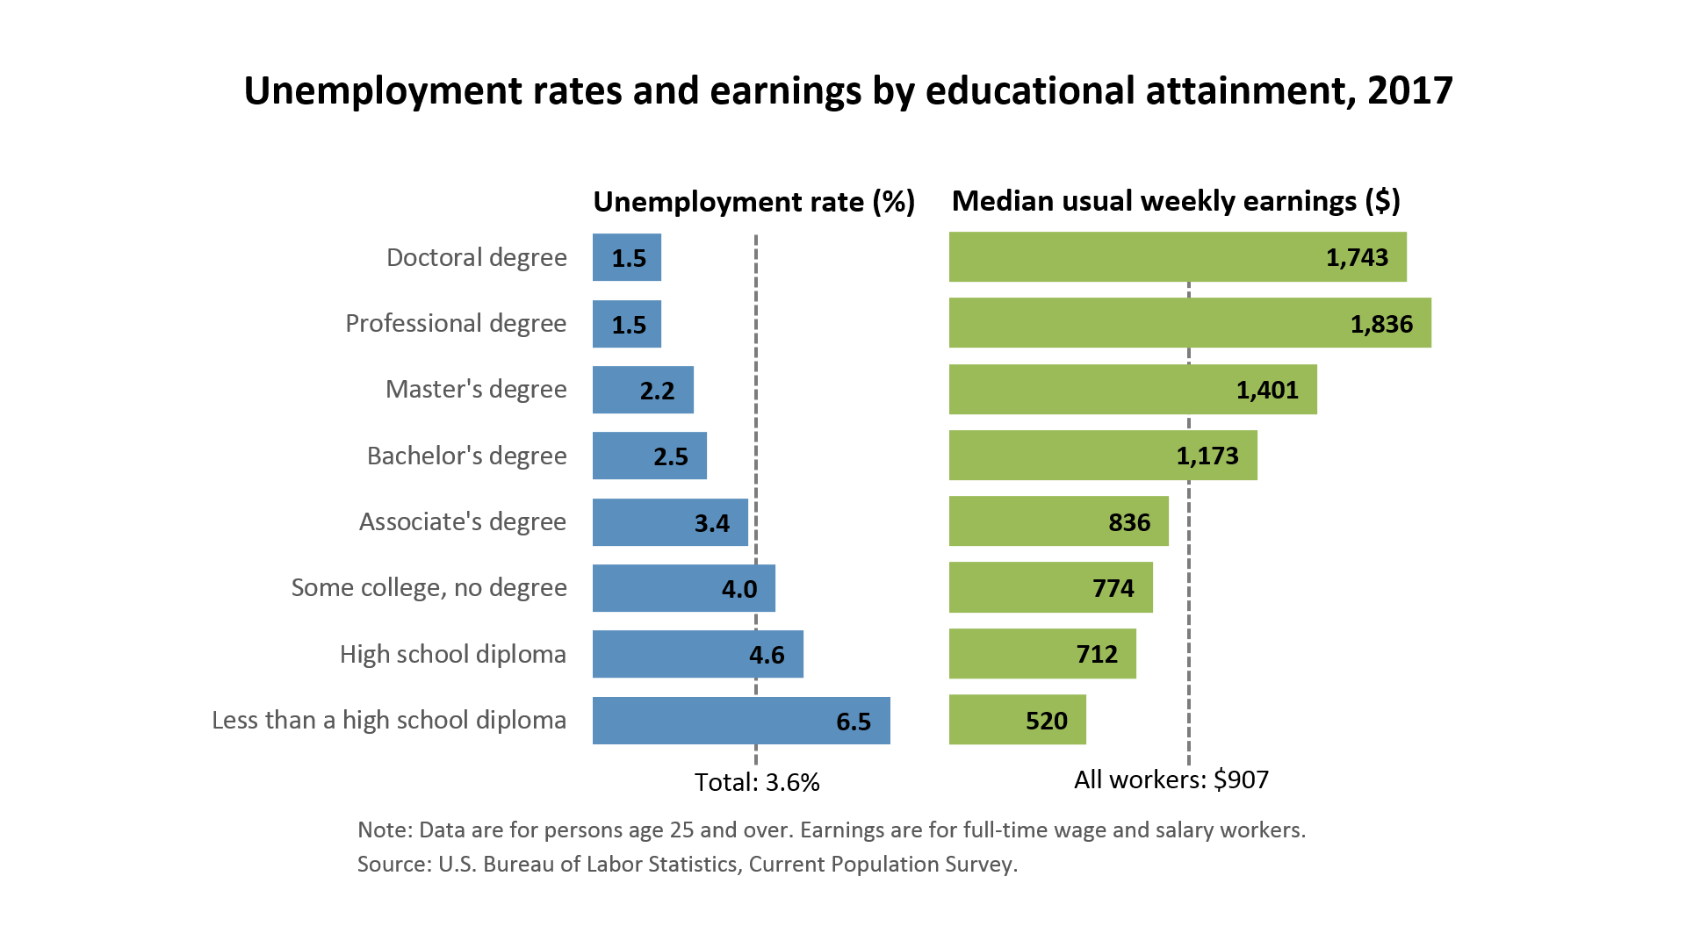
Why go?
Source: U.S. Bureau of Labor Statistics (2017)
Notes:
With a college degree you make more money, and have greater job security. Jobs that require a college degree are also more likely to include benefits such as dental insurance and retirement plans.

Slide 5
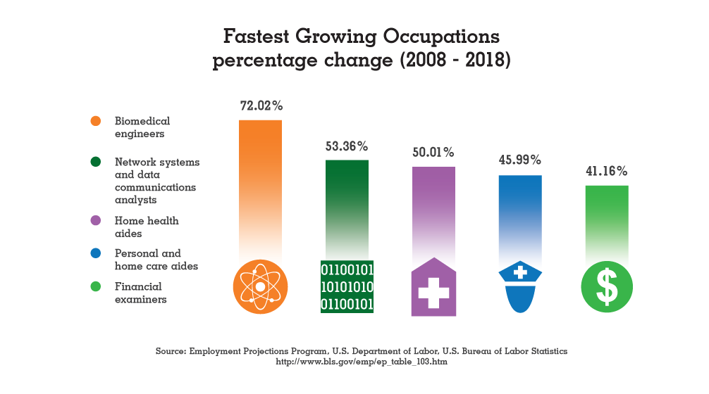
Why go?
Notes:
The fastest growing occupations will require a college degree. Individuals with a college degree report greater job satisfaction, too.

Slide 6
Why go?
With a college degree you are more likely to:
N
GIVE BLOOD
VOLUNTEER
VOTE
BE HEALTHY

Slide 7
Why go?
DISCOVER PASSIONS
NEW PEOPLE, PLACES & EXPERIENCES
LEARN & GROW
INDEPENDENCE
Notes:
College is also a host to many “intangibles”: the opportunity to discover passions and learn in-depth about a field of study, the chance to meet new people and try new experiences, and a supportive independence.

Slide 8
Get College Ready
WHAT STUDENTS CAN DO
& HOW PARENTS CAN HELP!
Information from College Preparation Checklist, via Federal Student Aid
Notes:
We want to go over what your student should be doing now to prepare for college – and how you can help them along the way.
This information and others can be found in the College Preparation Checklist from Federal Student Aid and a worksheet that we will pass out tonight.

Slide 9
EVERY student, EVERY year
Work hard
Get good grades
Ask for extra help
Take more rigorous classes
Notes:
There are many things that all students should be doing throughout their high school career.

Slide 10
EVERY student, EVERY year
Take the classes needed for college admission (not just graduation)

Slide 11
Requirements for 4-Year Schools
4 credits – English
3 credits – Math
3 credits – Science
3 credits – Social Studies
2 credits – Second language (depending on the degree you are seeking
15 credits with a C or better
Notes:
Start planning now with your counselor and student to make sure they are on track to be able to get into college. These 15 credits must be in college preparatory classes, with a C- or better. Note: these are the MINIMUM requirements.
Admission requirements to 4-year universities in Utah also include graduating from high school [which also requires showing proficiency in Essential Skills of Reading (beginning 2012), Writing (beginning 2013) and Applied Math (beginning 2014)], taking the SAT or ACT, and a satisfactory GPA in all coursework.

Slide 12
EVERY student, EVERY year
Get involved! Volunteer, play sports, have a job, or be in a club
Notes:
Colleges and universities like to see well-rounded students who are involved in their schools and communities. In addition, extracurricular activities or part-time jobs are good ways for students to explore interests and possible careers.

Slide 13
EVERY student, EVERY year
Visit colleges and consider the right fit
Notes:
Your school will be offering visits to college campuses for students to gain exposure to majors, admission requirements and much more. Students should take advantage of these, as well as opportunities when colleges visit the high school or nearby community and think about where they might want to go to school.

Slide 14
EVERY student, EVERY year
Savings Accounts, Scholarships, FAFSA4Caster
Notes:
It’s never too late – or early – to start a college savings account. Talk to a bank or credit union to set up an account.
[If your school offers Individual Development Accounts for students, offer information about this option.]
There are plenty of scholarships to apply for that are open to anyone in high school, or sometimes younger. Start searching for scholarships to apply to now – or in the future.
Fill out the FAFSA4Caster (we’ll talk about the FAFSA more in future workshops) to have an idea what type of financial aid your student will be eligible for.

Slide 15
EVERY parent, EVERY year
Talk to your student about college.
Talk to teachers and school staff.
Notes:
One of the best things you can do is to simply talk to your student about their plans for after high school and be supportive of their college and professional goals. Let them know that you EXPECT them to continue their education, not IF but WHEN.
In addition, be in touch with the school and teachers through Open Houses, Parent-Teacher conferences, or other chances to get involved, like chaperoning college campus visits with GEAR UP.

Slide 16
9th Grade
School work is #1!
Notes:
The freshman year is an important transition year that will set the tone for the rest of high school. Make sure that your student is not overwhelmed with extracurricular activities, sports, or social obligations that makes academics suffer. Additional tutoring or support may be available for students – no matter what, teachers what to see your student succeed!

Slide 17
10th Grade
PSAT 10 for practice or ASPIRE
Notes:
10th grade students should continue to take courses that are required for college admission, get good grades, stay involved in school and community, and add to their college payment plan through scholarships and/or savings.
In addition, students should consider taking the PSAT 10 (Preliminary SAT) held in October or the ACT ASPIRE test. These are excellent practice for the SAT or ACT.
http://www.collegeboard.com/student/testing/psat/reg.html
http://www.act.org/planstudent/

Slide 18
11th Grade
MORE TESTS!
PSAT • SAT* or ACT* • SAT Subject Exams*
Advanced Placement Exams*
*fee waivers available
Notes:
The PSAT (when taken in 11th grade) is used in determining National Merit Scholarships by the federal government.
Most universities require students to take the SAT or ACT, and scholarships are often based on these scores. Taking them starting junior year will allow students to take them more than once if they wish.
SAT Subject Exams are a chance to show proficiency in a specific subject such as Writing, Math, or a Foreign Language. Doing well on these tests might help with admission into more selective schools, as well as scholarships.
If your school offers advanced placement (AP) classes, students should take the exams in order to receive college credit in the future.

Slide 19
11th Grade
Narrow the college search & apply for scholarships!
Notes:
Students should use their junior year to narrow their college choices that may include a “safety” school (one that they are sure to get in to) and a “reach” (one that is more selective and may not be guaranteed admission). Students should attend college fairs and campus visits.
Many scholarships open for seniors as early as the summer after junior year – students should have possible essays ready along with scholarships they want to apply for in the coming year.

Slide 20
12th Grade
LAST CHANCE FOR TESTS!
ACT or SAT • SAT Subject Exams
Advanced Placement Exams
Notes:
Be sure to take the SAT or ACT if students will be applying to a 4-year college or university. Register well in advance and consider doing a free prep program to get a better score (available online or with books in the College Counseling office or library).
SAT Subject Exams are a chance to show proficiency in a specific subject such as Writing, Math, or a Foreign Language. Doing well on these tests might help with admission into more selective schools, as well as scholarships.
If your school offers advanced placement (AP) classes, students should take the exams in order to receive college credit in the future.

Slide 21
12th Grade
COLLEGE APPLICATIONS
Visit colleges
Final list with deadlines
Apply
Notes:
By senior year, students should have a plan on where they want to apply to college, visiting them if at all possible to make sure it’s a good fit. They should have a list of when application deadlines occur and start compiling the necessary information (letters of recommendation, essays, transcripts, etc.) to be ready to apply by the fall or winter (some deadlines might be rolling, and be through the spring.
Finally, students will have to officially accept a college admission offer, in part looking at the financial aid package that the school will award. Which brings us to…

Slide 22
12th Grade
Continue saving
Scholarships
FAFSA – January 1st
Notes:
PAYING FOR COLLEGE.
The senior year is the MOST IMPORTANT year when getting money to pay for college. We will be putting on workshops for families to learn more about these in detail throughout the year, but keep these in mind as the school year begins!
Hopefully the student has a college savings account, and is continuing to put money in it.
Scholarships, scholarships, scholarships! There are so many scholarships available. In general, students can use similar essay questions and letters of recommendation for many scholarship applications which makes it easy to apply for lots of scholarships! Remember – this is FREE MONEY.
And most importantly, parents should help students fill out the Free Application for Federal Student Aid (FAFSA) as close to January1 as possible. This will allow your student to be eligible for federal financial aid, including grants and loans, some of which is first-come, first-serve. We will go over this in detail in the future, and even have a night where you can work on it with additional help.

Slide 23
More Information
Helpful websites include:
ktsutah.org
bigfuture.collegeboard.org

Slide 24
More Information
For more information about college and career planning, call, e-mail or visit:
Name
Phone
E-mail

