Slide 1


College 102
types of colleges and the right “fit”

Slide 2
GEAR UP
COLLEGE
It’s not a dream, it’s a plan.
Notes:
This is the motto of Oregon GEAR UP which stands for Gaining Early Awareness and Readiness for Undergraduate Programs.
The GEAR UP program in Oregon is funded by the U.S. Department of Education, run through Oregon State University, and supports middle and high schools across the state to encourage students to pursue higher education and prepare them to succeed.
Explain what kinds of activities GEAR UP is doing at your school and how parents can be involved (attending workshops, chaperoning college visits, etc.)

Slide 3
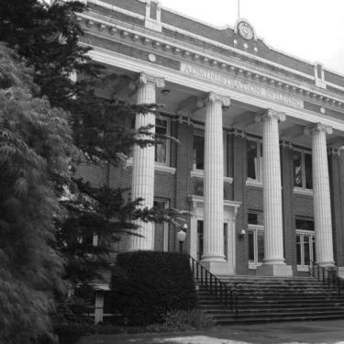
Types of Colleges
There are many different kinds of colleges.
Admission requirements, degrees and programs offered, and the student experience will all vary from school to school.
Notes:
The first thing to know is that there are many different types of colleges in the United States. While some offer the same degrees, the college admissions requirements and student experience can be very different.

Slide 4
Types of Colleges
Community Colleges: Also known as junior colleges. They offer two-year degrees, certificates and career retraining programs. Many students opt to transfer from a community college to a four-year school.
Example: Salt Lake Community College, Snow College and USU - Eastern

Slide 5
Types of Colleges
Four Year Public Schools: Colleges operated by the state. They offer four year degrees and many schools also have graduate, PhD, and professional programs.
Examples: Utah State University, University of Utah, Utah Valley University, Southern Utah University

Slide 6
Types of Colleges
Four Year Private Schools: Colleges operated independently, not-for-profit. They offer four-year degrees and some schools also have graduate, PhD, and professional programs.
Examples: Brigham Young University, Westminster College and Ensign College.

Slide 7
Types of Colleges
For Profit Colleges: These colleges are for profit, where the others are non-profit organizations. You can earn either a two or four year degree from these schools. Some of these schools operate entirely online.
Examples: Provo College and University of Phoenix

Slide 8
Pros and Cons
Community Colleges:
The least expensive school
Small class sizes
Transfer programs to 4 year schools
Most flexible class schedules
Commuter and older students
Larger campuses with many programs

Slide 9
Pros and Cons
Four Year Public Colleges:
The least expensive four year school
Accepts community college transfer students
Offers dorm living and study abroad programs
Accessible admissions requirements

Slide 10
Pros and Cons
Private Colleges:
Smaller campuses
Lower student teacher ratio
More rigorous admission requirements
More prestigious schools (sometimes)
Higher tuition
May have more financial aid to give out

Slide 11
Types of Colleges
For Profit Colleges:
Expensive schools
Online options
Intensive programs
Same degree as junior colleges and state schools
Less personal attention
Not necessarily accredited

Slide 12

What is accreditation?
Accreditation is a voluntary, independent review of a college that determines whether the school is providing students with a uniform quality education.
State and most private schools are accredited, many for profit schools are not.
Notes:
Accreditation matters because some financial aid and scholarships cannot be used to pay for unaccredited schools.
It also will matter if you are trying to transfer credits from one school to another. They may not be accepted.

Slide 13
Degree Options
Certificate: a vocational or technical program that usually takes less than a year to complete like welding or medical assisting
Associate’s Degree: two year degree that you earn from a community college. You can transfer these credits to a 4-year school, too.
Bachelor’s Degree: four year degree in a specific subject area like math or psychology

Slide 14
Choosing a College
WHAT’S IMPORTANT |  | WHAT’S NOT
Size | Location | Boyfriend or girlfriend is going
Distance from home | Available majors | Best friend is going
Housing options | Campus atmosphere | Good sports teams (for non-athletes)
Diversity of students | Extracurricular activities | School colors
Notes:
There are over 4,000 colleges and universities in the U.S. and close to 50 in Oregon. It can be difficult to decide which one is the right “fit”.
One of the best ways to figure out the right “fit” is to spend time researching and visiting college campuses – either virtually (peruse college websites, social media, and review sites) or as part of a campus field trip. Colleges offer free tours to prospective students so stop by if you’re on vacation nearby or attending a sports match or event at a university or community college.

Slide 15
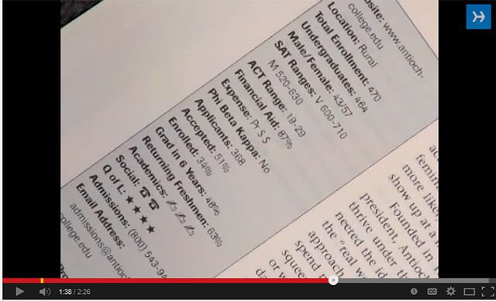

Choosing a College
Notes:
A humorous take on choosing a college and finding the right fit. Watch till 2:27

Slide 16
College Myth Busters
Notes:
There are a lot of myths surrounding college. You may have heard some and you might even believe some. Keep these facts in mind while starting your college search.

Slide 17
College Myth Busters
Myth: Community college is the same thing as high school.
Fact: Not true! You are working on a degree, you are in charge of your classes, you are going to college. This is a great way to save money or raise your GPA.

Slide 18
College Myth Busters
Myth: Private schools are way too expensive for me.
Fact: While they are expensive, private schools also have the most scholarship money to give away. Sometimes it can be cheaper than attending a state school.

Slide 19
College Myth Busters
Myth: High school graduation requirements and college admission requirements are the same.
Fact: Don’t be fooled! They are not the same. The admission requirements between state and private schools can be different too. Do your homework.

Slide 20
College Myth Busters
Myth: Grades and my SAT and/or ACT scores are the only things that matter.
Fact: Nope, a college wants to know about your academic and service experiences. While your scores, grades, and course rigor matter the most, schools will also want to know about your leadership and service.

Slide 21
College Myth Busters
Myth: It is best to go to a private school.
Fact: Not necessarily true. You need to go to the best college for you. That might be starting at a community college and transferring. Private schools aren’t always the best option.

Slide 22
College Myth Busters
Myth: The best time to visit colleges is after you have been admitted.
Fact: If possible, you and your student should visit before she applies and again after she has been admitted. If you can visit only once, make it before your student applies.
Notes:
Many students have fallen for this myth only to find that none of the colleges to which they were admitted "felt" right when they visited.
And if it’s not possible to visit at all, that’s ok too! Explore online forums like unigo.com to learn more about the campus from the student perspective.

Slide 23
College Myth Busters
Myth: It’s better to get good grades than take challenging courses.
Fact: False! Colleges look at the rigor of classes in addition to your grades. In addition, it’s good preparation for college!
Notes:
A challenging college preparatory program or some advanced placement courses will help you get into more selective colleges.

Slide 24
College Myth Busters
Myth: The standardized tests (ACT, PSAT, SAT) are more important than grades.
Fact: Performance in high school is a better predictor of college success than the standardized tests. Colleges know that. That doesn’t mean that most colleges won't look at your student’s test scores.

Slide 25
College Myth Busters
Myth: I have to know what I want to major in when I start college.
Fact: College is a time to explore! Most students end up changing their minds about their majors and career choices at least once.
Notes:
College is a time to explore. Except in a few specific cases, your student can choose a major in her sophomore year and still complete the degree in four years. A surprising number of students discover the field for them while taking a course they didn't expect to like. Your student shouldn’t let well-meaning friends pressure her into deciding on a major field or a career at this time. She can take her time.

Slide 26
College Myth Busters
Myth: It’s difficult to transfer colleges.
Fact: Many students choose to start college at a 2-year institution and then transfer to a 4-year college. Other students might realize that the college they’re attending isn’t the best fit and want to try a new school. Either way, colleges will help your student with the transfer process.
Notes:
In Oregon, many of the public universities have agreements with the community colleges, so it’s easy to transfer credits. In addition, most schools have a special orientation session just for transfer students so your student can get support and make friends.

Slide 27
College Myth Busters
Myth: If I haven't heard of a college or university, it can't be very good.
Fact: You may not have heard of many of the nation's colleges – there are over 4,000 of them! Judge a college on its own merits. Don't let name recognition determine a good or bad college.
Notes:
Athletics on television is how most colleges get to be known, but many colleges do not get that kind of exposure. Some of the nation's finest colleges don't play big-time athletics.

Slide 28
College Myth Busters
Myth: I can slack off my senior year, because colleges don’t look at those grades.
Fact: False, colleges DO look at your grades from senior year – even after they may have admitted you. Also, keeping up good grades is important for scholarships applications.

Slide 29
More Information
Helpful websites include:
ktsutah.org
bigfuture.collegeboard.org

Slide 30
More Information
For more information about college and career planning, call, e-mail or visit:
Name
Phone
E-mail

