Slide 1

Brexit: The European Perspective
Franz Kolb, Director
International Trade and Diplomacy
Governor’s Office of Economic Development
State of Utah
Honorary Consul for the Republic of Austria

Slide 2
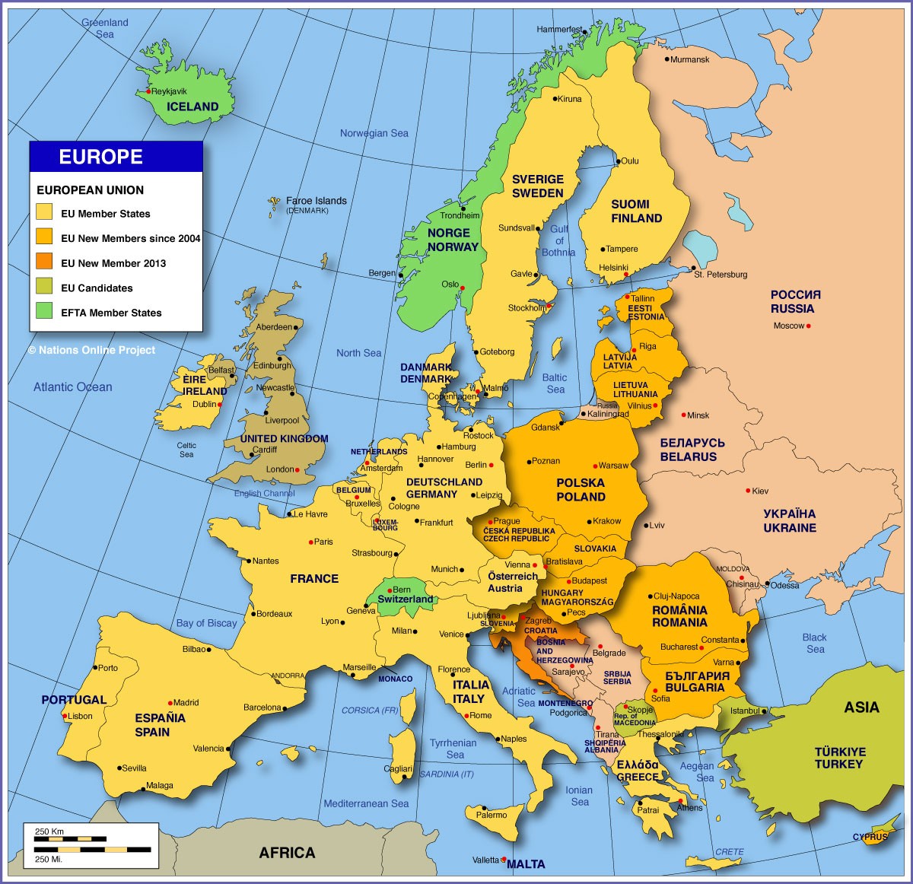
Map of Some European Countries

Slide 3
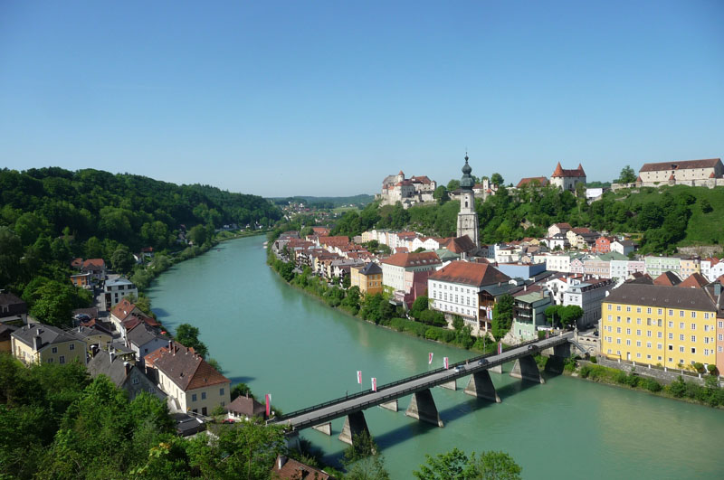
Austria-German Border
Ach an der Salzach - Burghausen

Slide 4
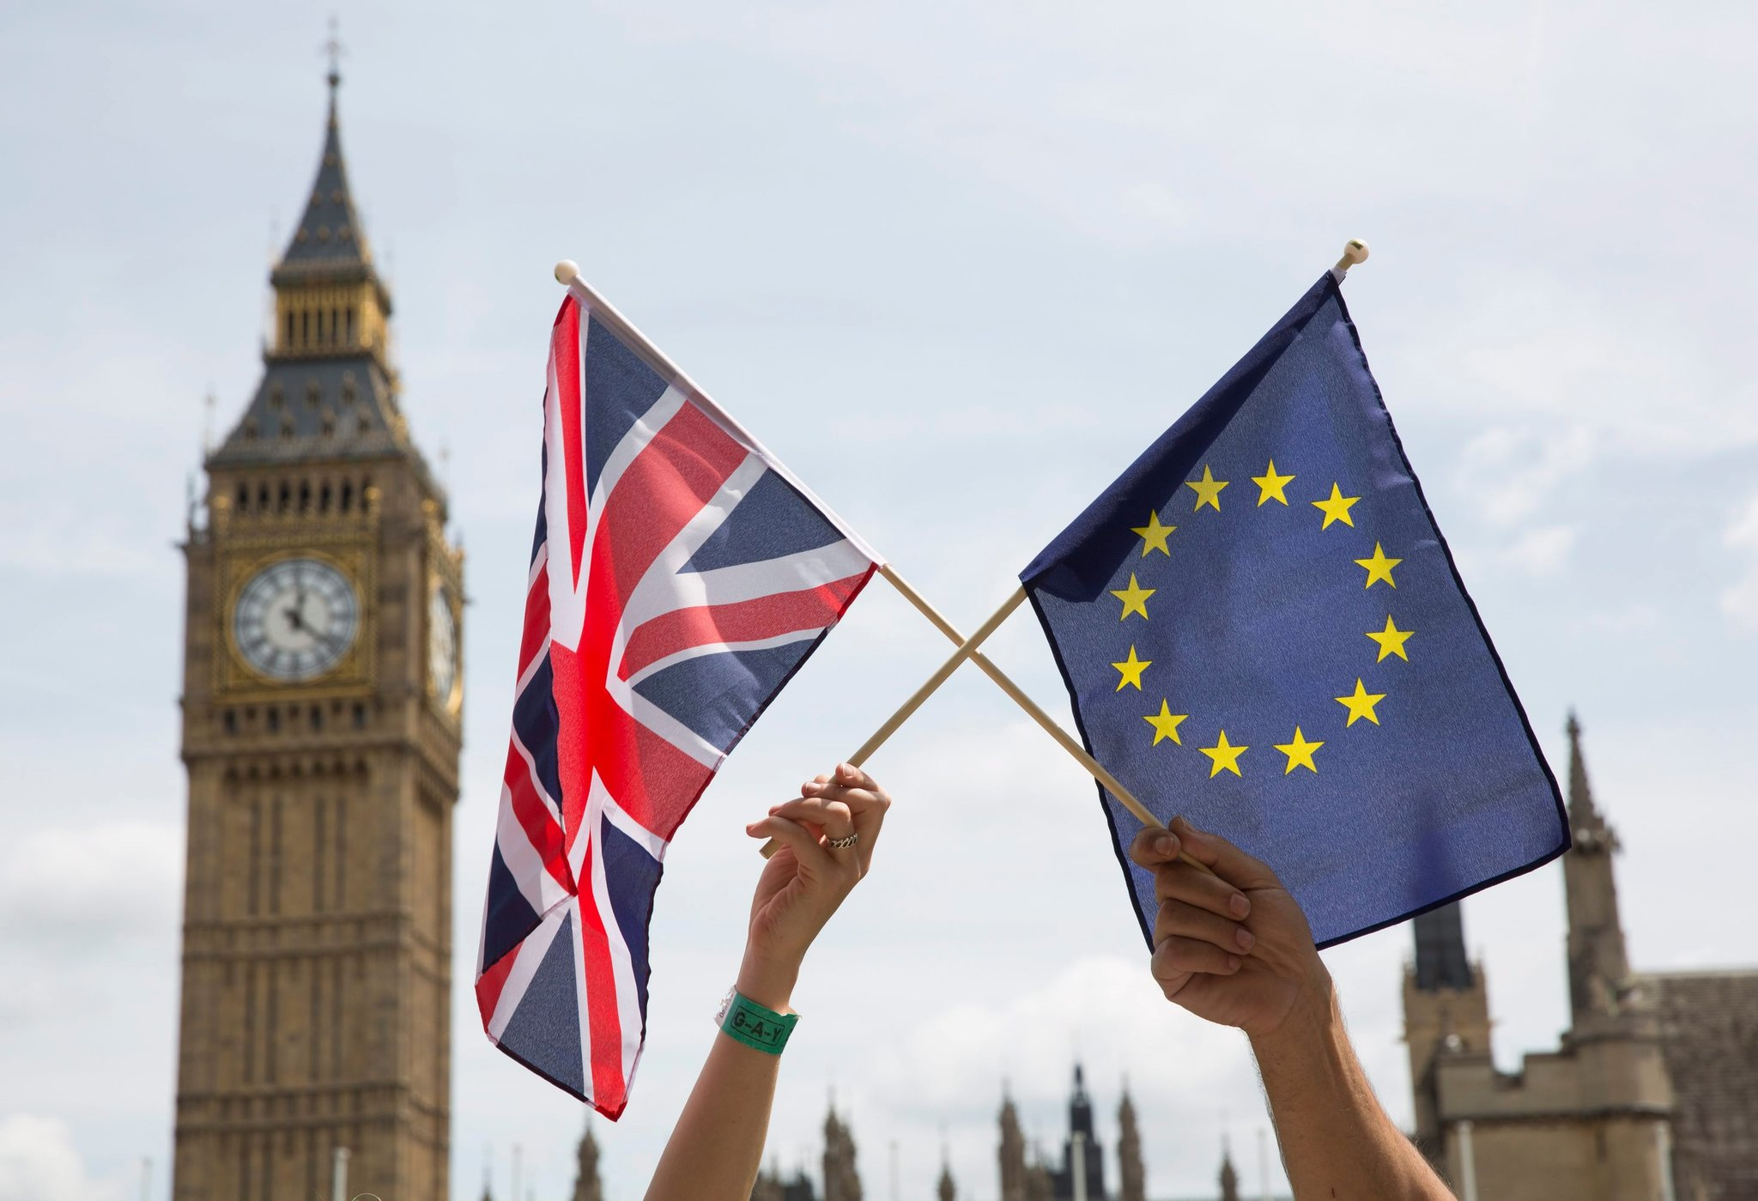
A portmanteau of the words “Britain” and “exit,” it is the nickname for a British exit of the European Union.
“Should the United Kingdom remain a member of the European Union or leave the European Union?”

Slide 5
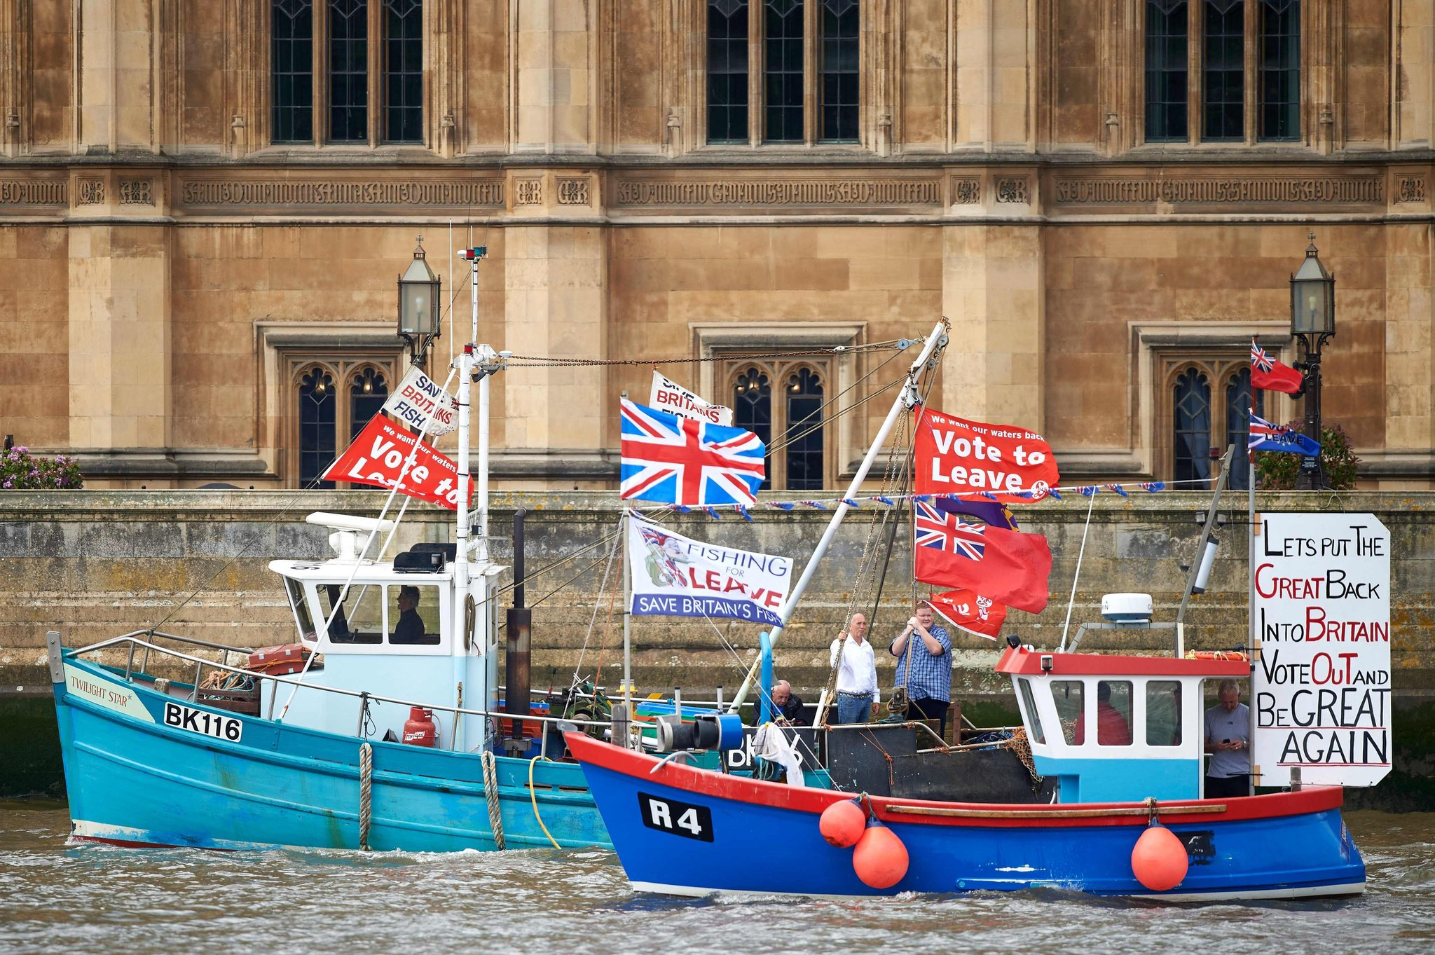
Pro-Brexit advocates have framed leaving the European Union as necessary to protect, or perhaps restore, the country’s identity: its culture, independence and place in the world.
‘Remain” supporters typically argue that staying in the union is better for the British economy and that concerns about migration and other issues are not important enough to outweigh the economic consequences of leaving.

Slide 6
Some History….
In 1957, France, West Germany, Belgium, Italy, Luxembourg and the Netherlands signed the Treaty of Paris, which established the European Economic Community (EEC)
The UK finally made it into the club in 1973, but just two years later was on the verge of backing out again.
Tensions between the EEC and the UK exploded in 1984, when the Conservative Prime Minister Margaret Thatcher talked tough in order to reduce British payments to the EEC budget. Though at the time the UK was the third-poorest nation in the Community, it was paying a lot more into the budget than other nations due to its relative lack of farms.
The Maastricht Treaty, which took effect in 1993, created the Brussels-based European Union (EU), of which the EEC, renamed simply the European Community (EC) was the main component.
Labour Prime Minister Tony Blair, who won a landslide victory in 1997, was strongly pro-European Union, and worked to rebuild ties with the rest of Europe while in office.

Slide 7
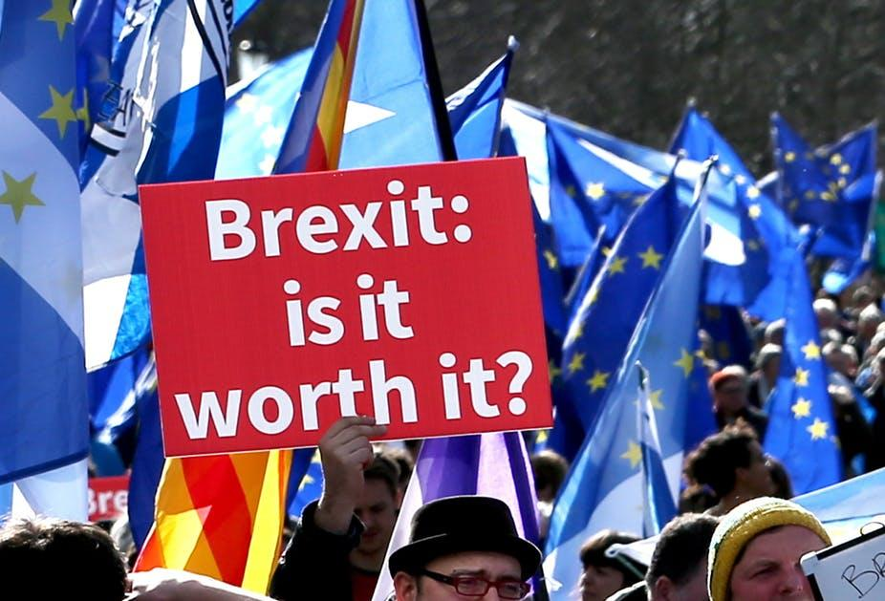
In 2007, after plans for an official EU constitution collapsed, the member nations finished negotiating the controversial Lisbon Treaty, which gave Brussels broader powers.
In the interests of protecting Britain’s financial sector, David Cameron became the first UK prime minister to veto a EU treaty in 2011. In early 2013, he gave a much-anticipated speech in which he outlined the challenges facing Europe and promised to renegotiate membership in the EU.

Slide 8
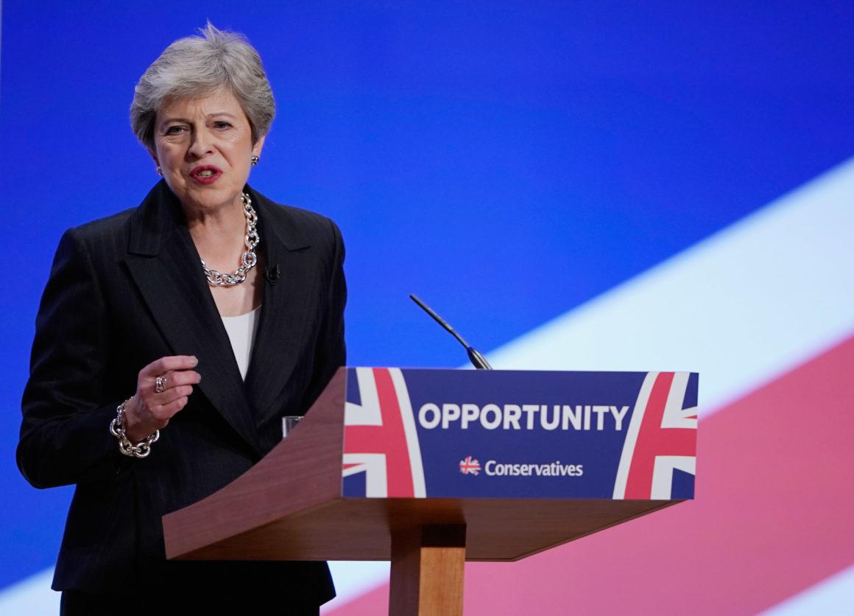
In October 2016, Prime Minister Theresa May, who had assumed office following David Cameron’s resignation, announced her intention to invoke Article 50 of the Treaty on European Union, formally giving notice of Britain’s intent to leave the EU. On March 29, 2017, the order, signed by May a day earlier, was delivered to the Council of the European Union, officially starting the two-year countdown to Britain’s EU departure, now tentatively set for March 2019.

Slide 9
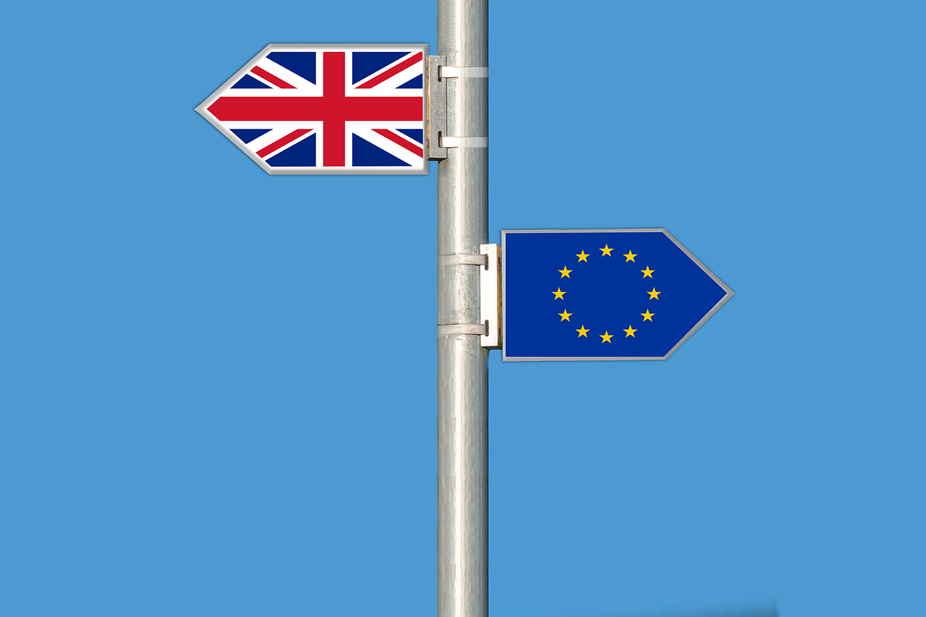
What is Hard Brexit?
Favoured by ardent Brexiteers, a hard Brexit arrangement would likely see the UK give up full access to the single market and full access of the customs union along with the EU.
The arrangement would prioritize giving Britain full control over its borders, making new trade deals and applying laws within its own territory.
Initially, this would mean the UK would likely fall back on World Trade Organisation (WTO) rules for trade with its former EU partners.

Slide 10
What is Soft Brexit?
This approach would leave the UK's relationship with the EU as close as possible to the existing arrangements, and is preferred by many Remainers.
The UK would no longer be a member of the EU and would not have a seat on the European Council. It would lose its MEPs and its European Commissioner. But, it would keep unfettered access to the European single market.
Goods and services would be traded with the remaining EU states on a tariff-free basis and financial firms would keep their "passporting" rights to sell services and operate branches in the EU. Britain would remain within the EU's customs union, meaning that exports would not be subject to border checks.
It is likely that a "soft Brexit" deal would insist on Britain observing the "four freedoms", meaning continued free access for European nationals to work and settle in the UK.

Slide 11
What will happen to Britain if it leaves…?
Without access to the union’s open markets, Britain would probably lose trade and investment. And while the influx of migrant workers has created anxiety over British culture and identity, losing that labor force could lead to lower productivity, slower economic growth and decreased job opportunities.
A Brexit could also quickly spawn, a “Scexit.” Nicola Sturgeon, the first minister of Scotland, has said that if Britain votes to leave the European Union, she will hold a new referendum in which Scots could vote to exit Britain — and then rejoin the union as an independent nation.
Britain makes up about a sixth of the European Union’s economy. A Brexit, Mr. Klaas said, “would be akin to California and Florida being lopped off the U.S. economy.”
The implications for the European project itself are unclear, but that uncertainty may be the greatest threat to the union, which has helped bring Europe 70 years of peace and is already under growing strain.

Slide 12
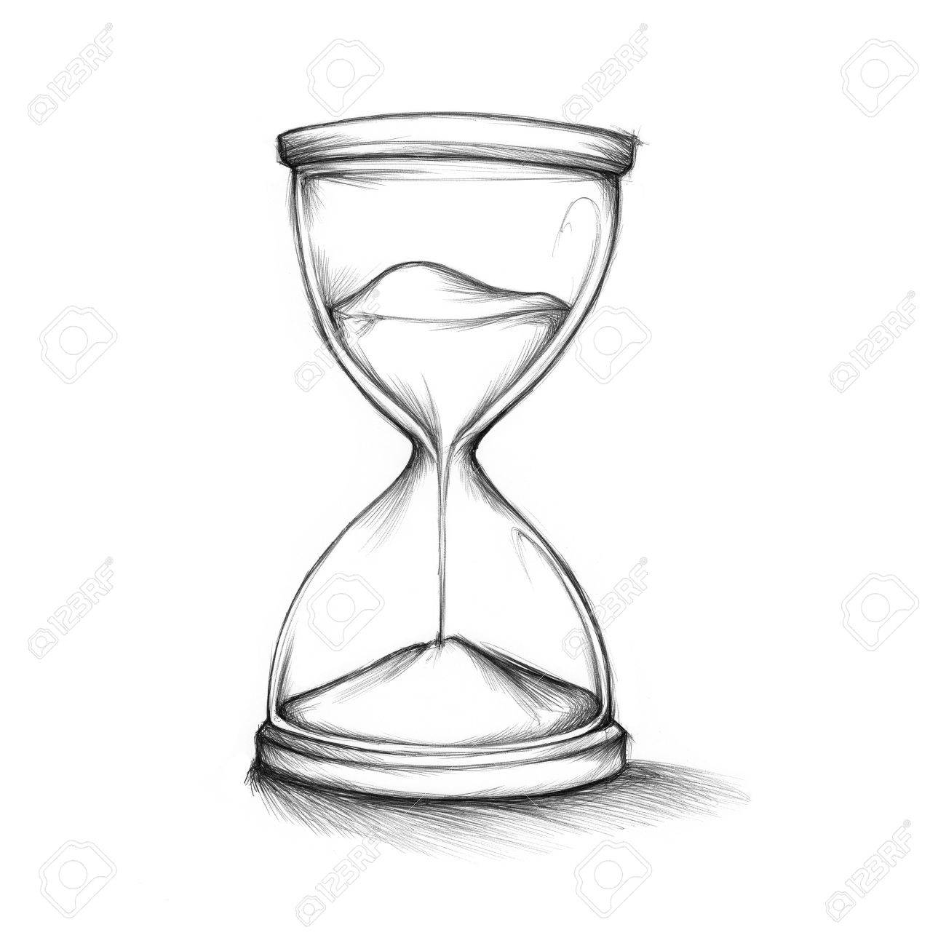
Why is Brexit taking so long?
Voted in 2016...why the wait?
None of the major players has ever left the European Nation before.
Single market
The UK might have to pay more to sell to or buy from other EU countries.
The deal has to be agreed by 27 national parliaments across Europe.
The date Uk is meant to leave is March 29th 2019.
However, there are plans for a 21-month transition period after that.
During which time the UK will still be governed by EU laws.
A trade deal between Canada and the EU took 7 years to agree.

Slide 13
Question: Brexit, for or against?

Slide 14
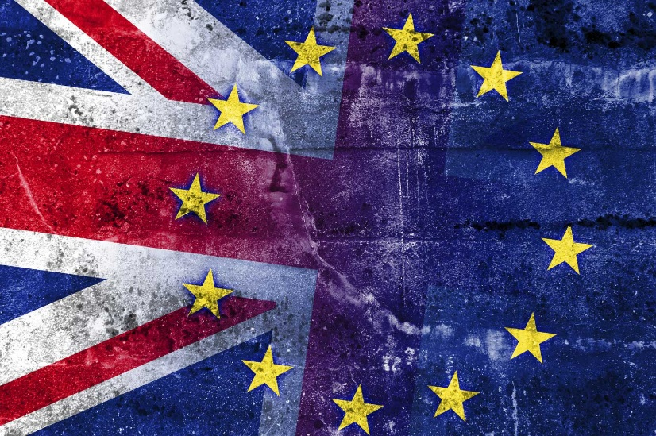
When people ask…
“I am pro-Brexit…and pro-EU.”

Slide 15
Flexibility
States rights versus federal oversight – or in European terms, Multi-Tier;
    Core members (defense, fiscal or welfare policy)
    “Multi-tier” Europe would find a place for non-members as well. The continent consists of 48 countries and 750m people, not just the 28 countries and 510m people in the union, still less the 19 and 340m in the euro.
    Beyond that a multi-tier Europe should accommodate widely differing countries. That means a changed mindset more than changed treaties: in the language of Eurocrats, accepting a menu that is à la carte, not prix fixe.
    Countries like Norway or Switzerland may wish to be closely bound to the European single market. Others such as Britain may not be ready to accept the single market’s rules, but still wish to trade as freely as possible with the EU. They might seek a bigger role in other areas such as defence and security. And places like Turkey, the western Balkans, Ukraine and Georgia might prefer a similar associated status instead of today’s unsatisfactory situation, where they are told they are eligible to be full members but know they will never be allowed to join.

