Slide 1
The Office of General Counsel: IT 3350 Cyber Law

Slide 3
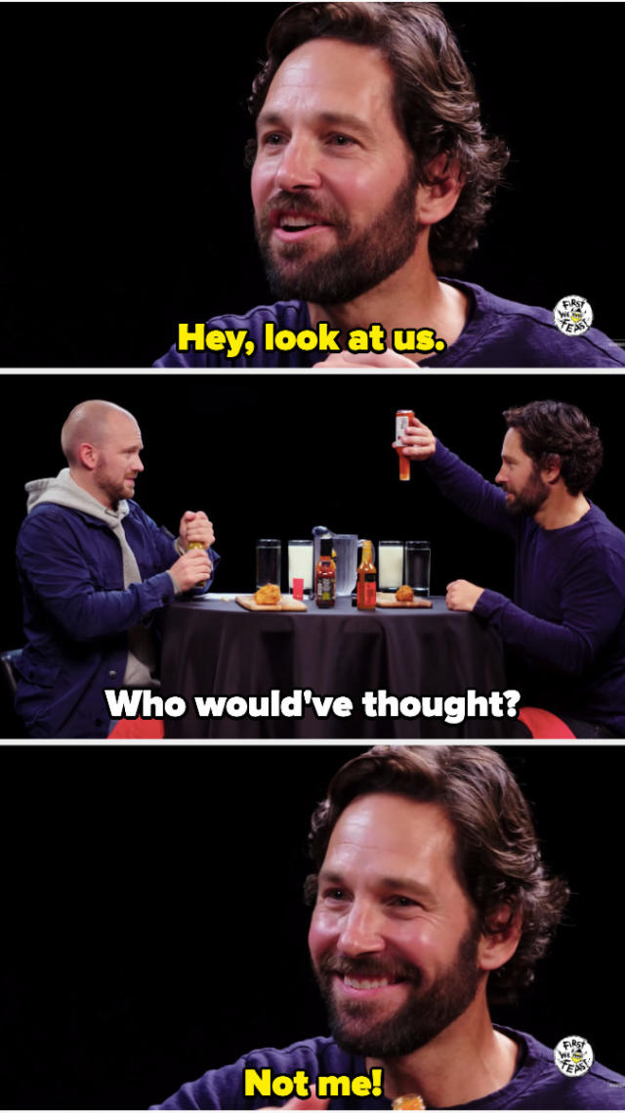
Conversation Starters
Let’s chat about. . .
The Team
The Goals
The Budget
The Metrics
The Results

Slide 4
“Tell me about the people on the team?”

Slide 5
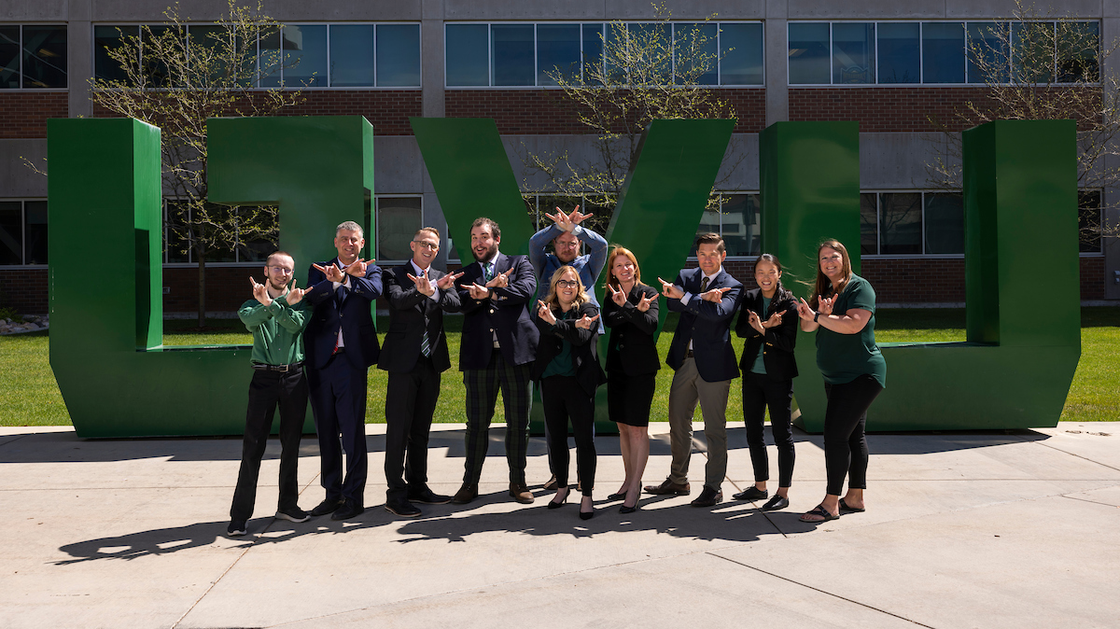

Slide 6
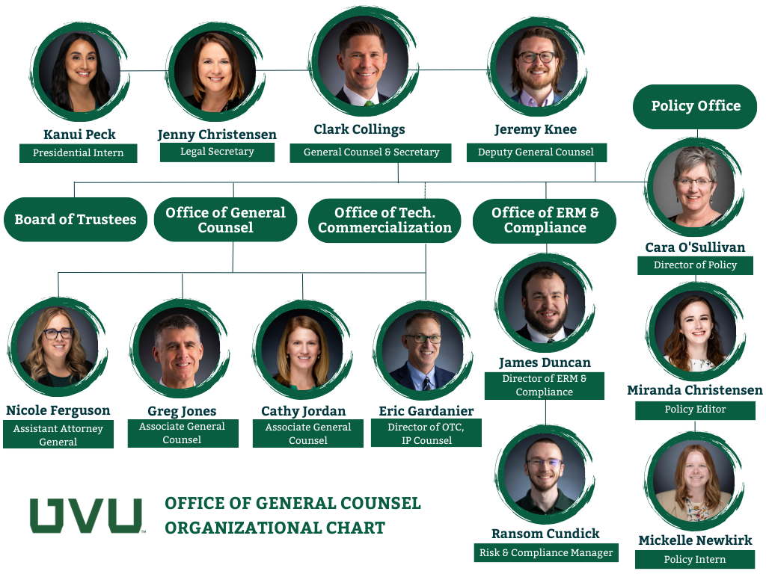

Slide 8
“What’s OGC up to this year?”

Slide 9
COLLABORATE
Policy Office - The Policy Office will (1) ensure that policies are accessible to the campus community, (2) steward the policy development process so that it is efficient and transparent, and (3) foster collaboration by engaging key stakeholders from all parts of the university community to forge policies that support the educational process.
INFORM
Office of ERM - Develop and maintain a fully-established Enterprise Risk Management (ERM) program, where ERM capabilities and practices are well integrated into strategic planning and performance management activities and risk appetites are clearly articulated.
EMPOWER
OGC - Empower university leaders to make student-focused, risk-informed, ethical, and legally compliant decisions by providing timely, practical, and expert legal services.

Slide 10
Include:
Provide Accessible, Flexible, and Affordable Education in an Environment that is Inclusive for All.
Engage:
Strengthen Student Learning and Societal Impact Through Collaboration with Community and Industry.
Achieve:
Enhance Student Success Through Improved Recruitment, Retention, and Completion.

Slide 11
FY24 Priorities
Include
Draft updated anti-discrimination policies
Engage
Support and facilitate the Vineyard buildout
Achieve
Continue to deliver timely, relevant trainings
Facilitate faculty and student innovation
Operational Effectiveness
ERM dashboard
Policy dashboard
Contract template updates

Slide 12
“It looks like OGC has a lot of moolah. What’s up with that?”

Slide 14
“So what did you do with all that money, and how do you measure success?”

Slide 15
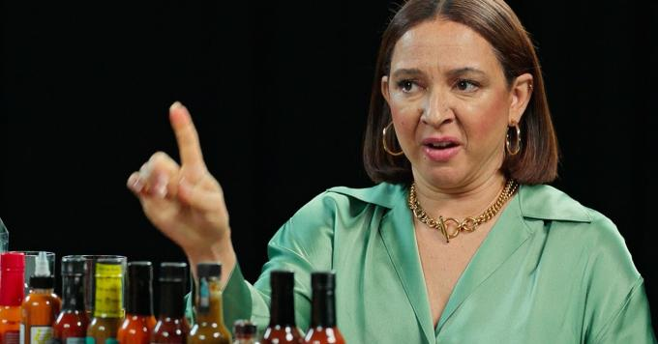

Slide 16
Metrics
Execute strategic initiatives (trainings, tabletops, etc.)
Deliver digestible, actionable collateral to university decision-makers (checklists, rubrics, templates, etc.)
Client Satisfaction Surveys - maintain quality interactions (trainings, committee participation, regular 1 on 1s)
Number of annual risk assessments targeted to risks prioritized by UVU Cabinet
Number of contracts reviewed
Number of GRAMA requests reviewed
ER and Title IX cases supported
Policy activity (revisions, new, deletions, and non-sub changes)

Slide 17
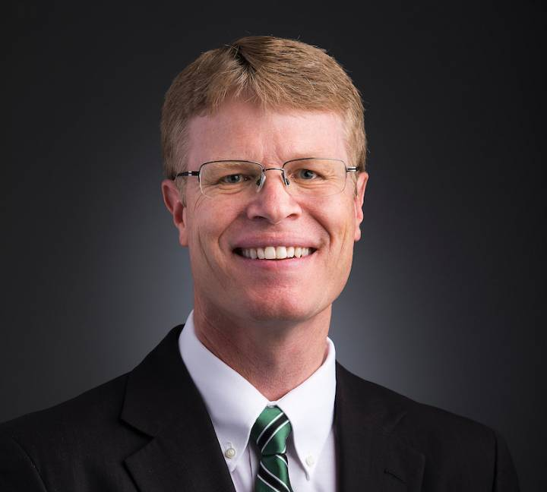
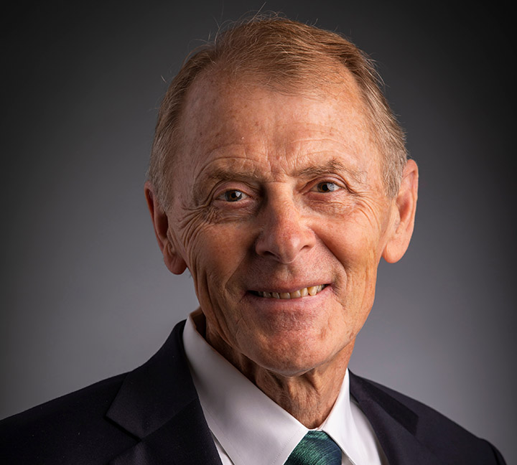
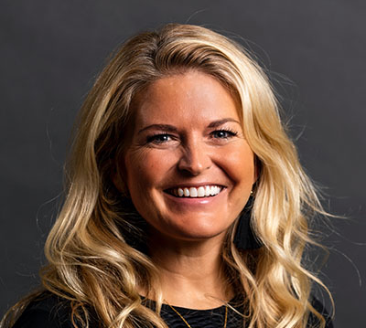
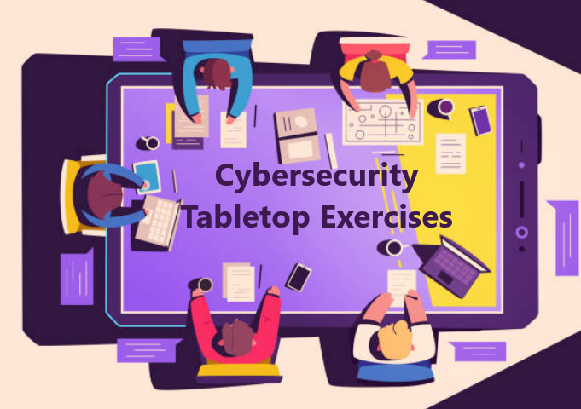
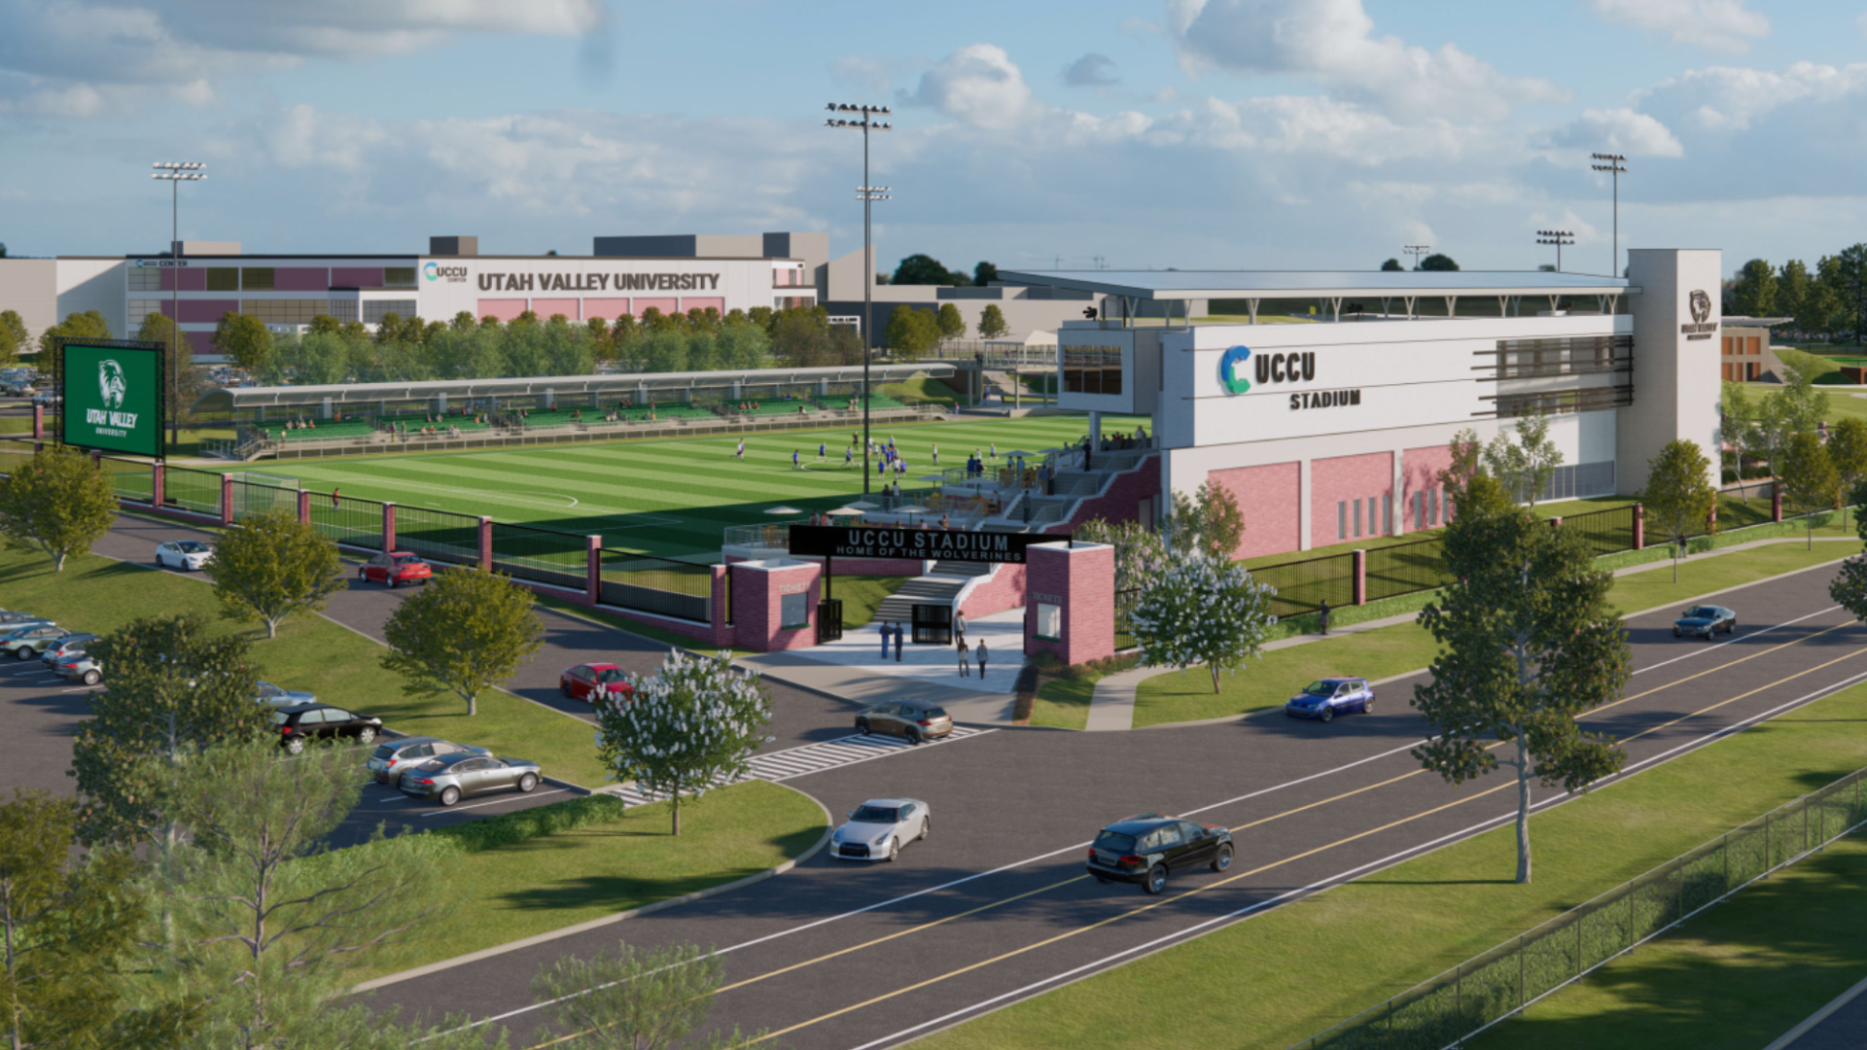
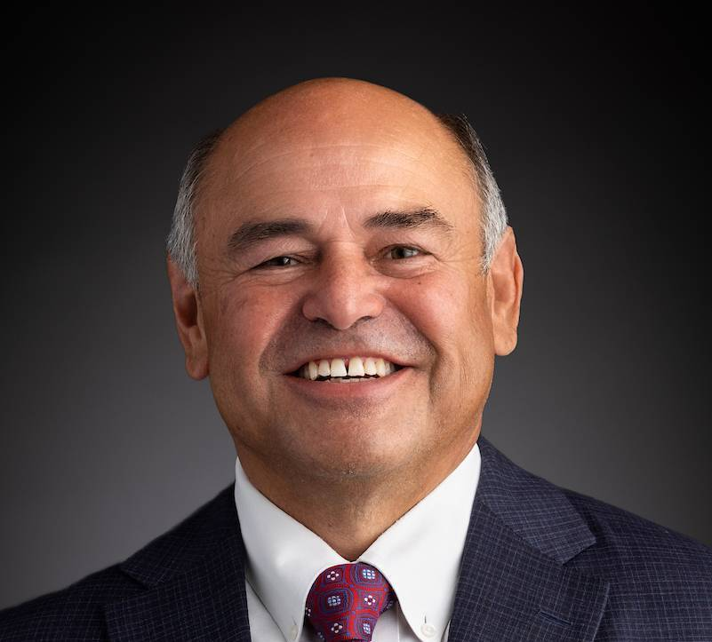
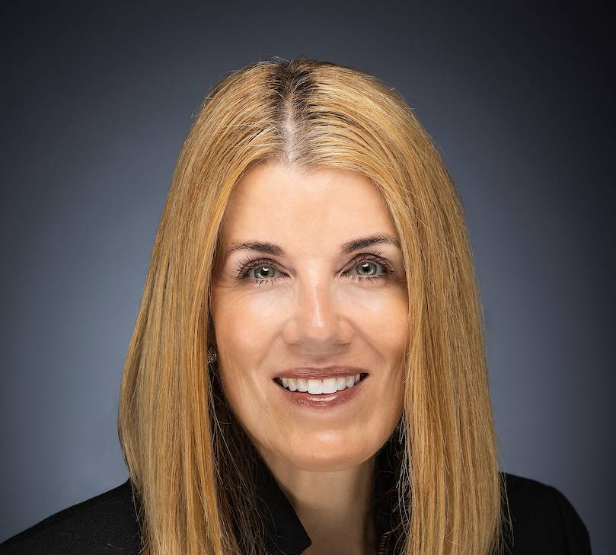
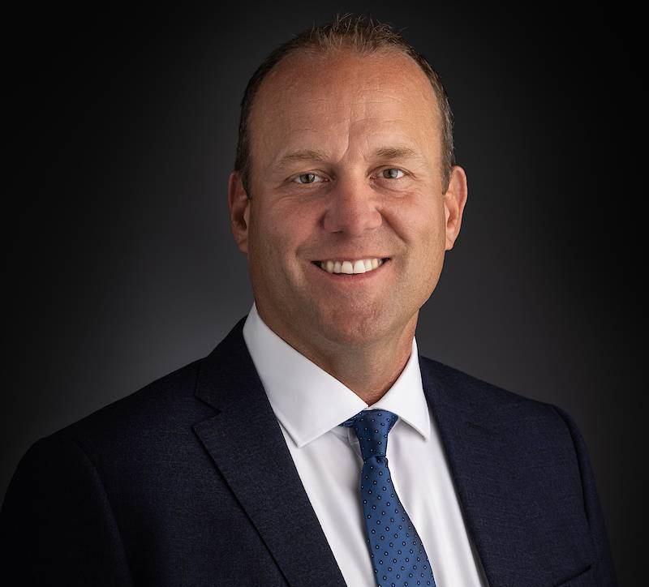
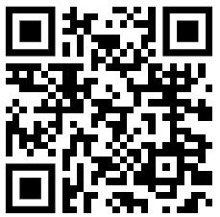

Slide 18
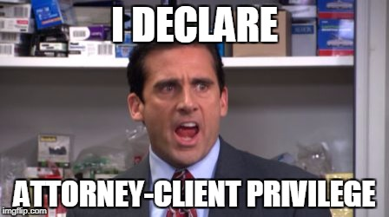
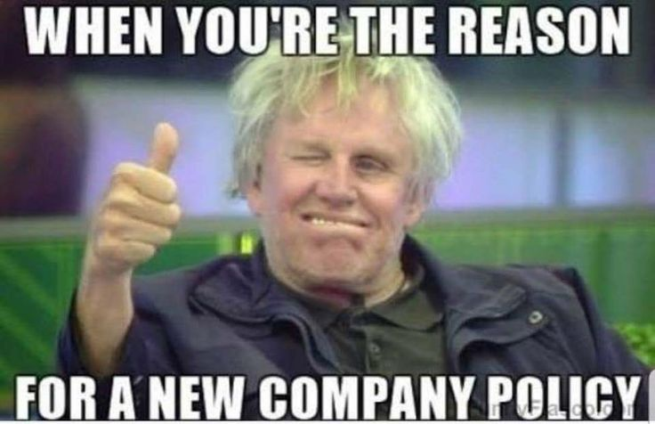

Slide 19
60 Policies Processed
3 issued patents, 2 filed patent applications, and 2 registered trademarks
500+ Contracts Reviewed
Approximately $1mil saved in legal fees
100+ Training Hours Delivered
20 GRAMA Requests Supported

Slide 20
“Wait. Tell me that all again.”

Slide 21
Conversation Enders
We chatted about. . .
The Team = Strong
The Goals = Aligned
The Budget = Weird & Adequate
The Metrics = Quantitative & Qualitative
The Results = Extensive

Slide 22
Questions?
OGC Stewardship Conversation

