Slide 1
Creating Engaged Readers In Your Classroom
Seven Salient Reading Motivational Strategies In Action
Notes:
Diane- Introduce ourselves--Teachers from Springside Elementary…. 4th Grade. Introduce the grant-- In 2017, we applied for and received a grant from UVU, Read-a-Difference Fellowship. The article Inspiring Students to Value Reading was the basis for our learning.

Slide 2
The Seven Salient Strategies
Inspiring Students to Value Reading: Seven Salient Principles of Motivation
Ann C. Sharp, Lorilynn Brandt, and Douglas S. Gardner
Choice
Collaboration
Challenge
Control
Technology
Authenticity
Proximate Reward
Notes:
Diane- The article was compiled/authored by three UVU Educators, Ann Sharp, Lorilynn Brandt, and Doug Gardner and presents 7 noticeable and important reading motivational strategies which get children excited and motivated to read. Our presentation is based upon the 7 Salient Strategies introduced in the article and our experiences with our students as we implemented the strategies.

Slide 3
Choice

Slide 4
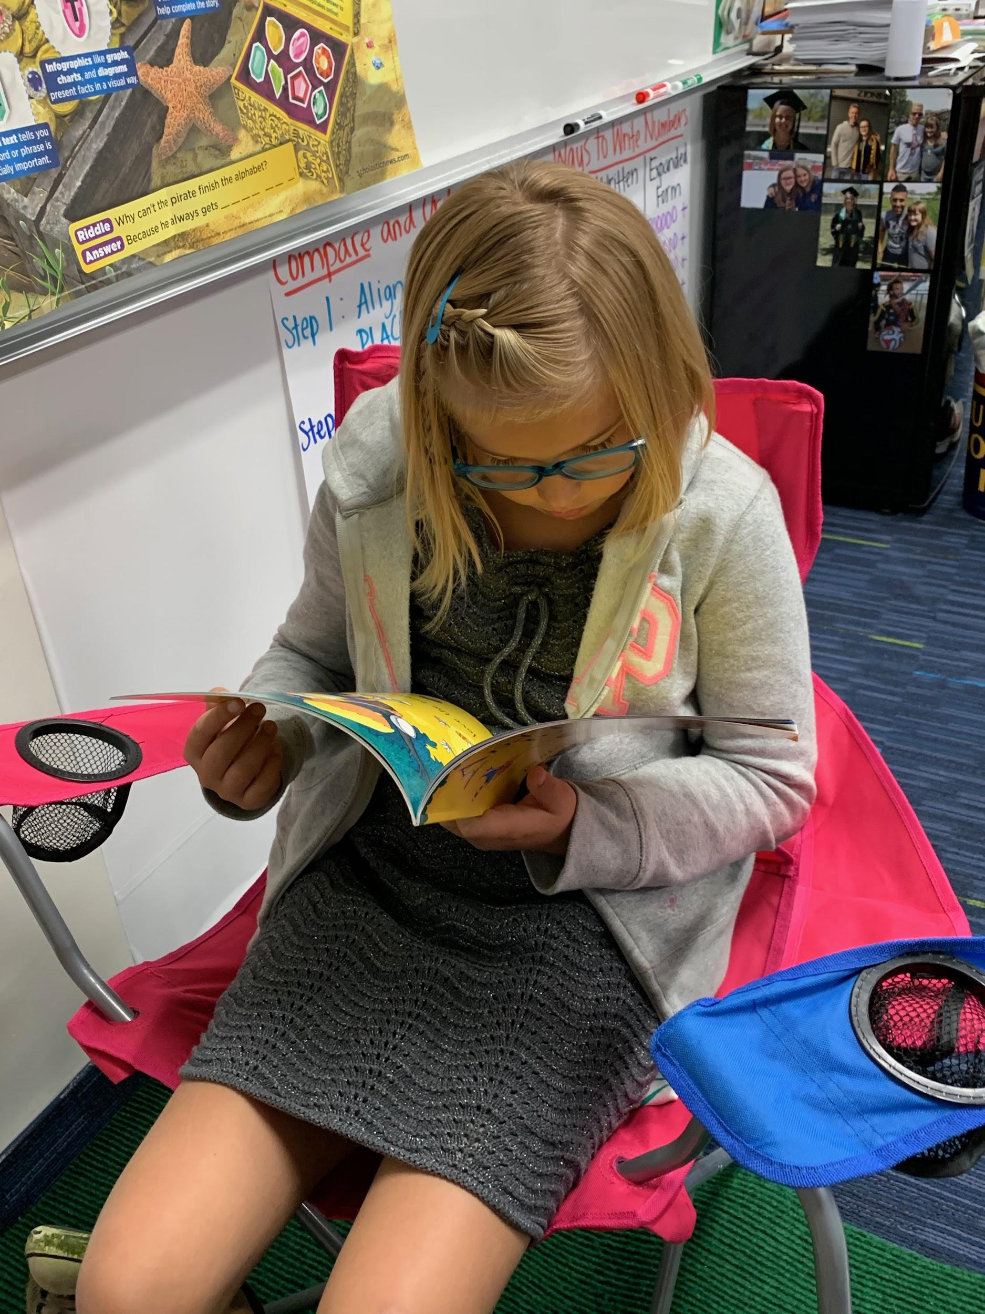
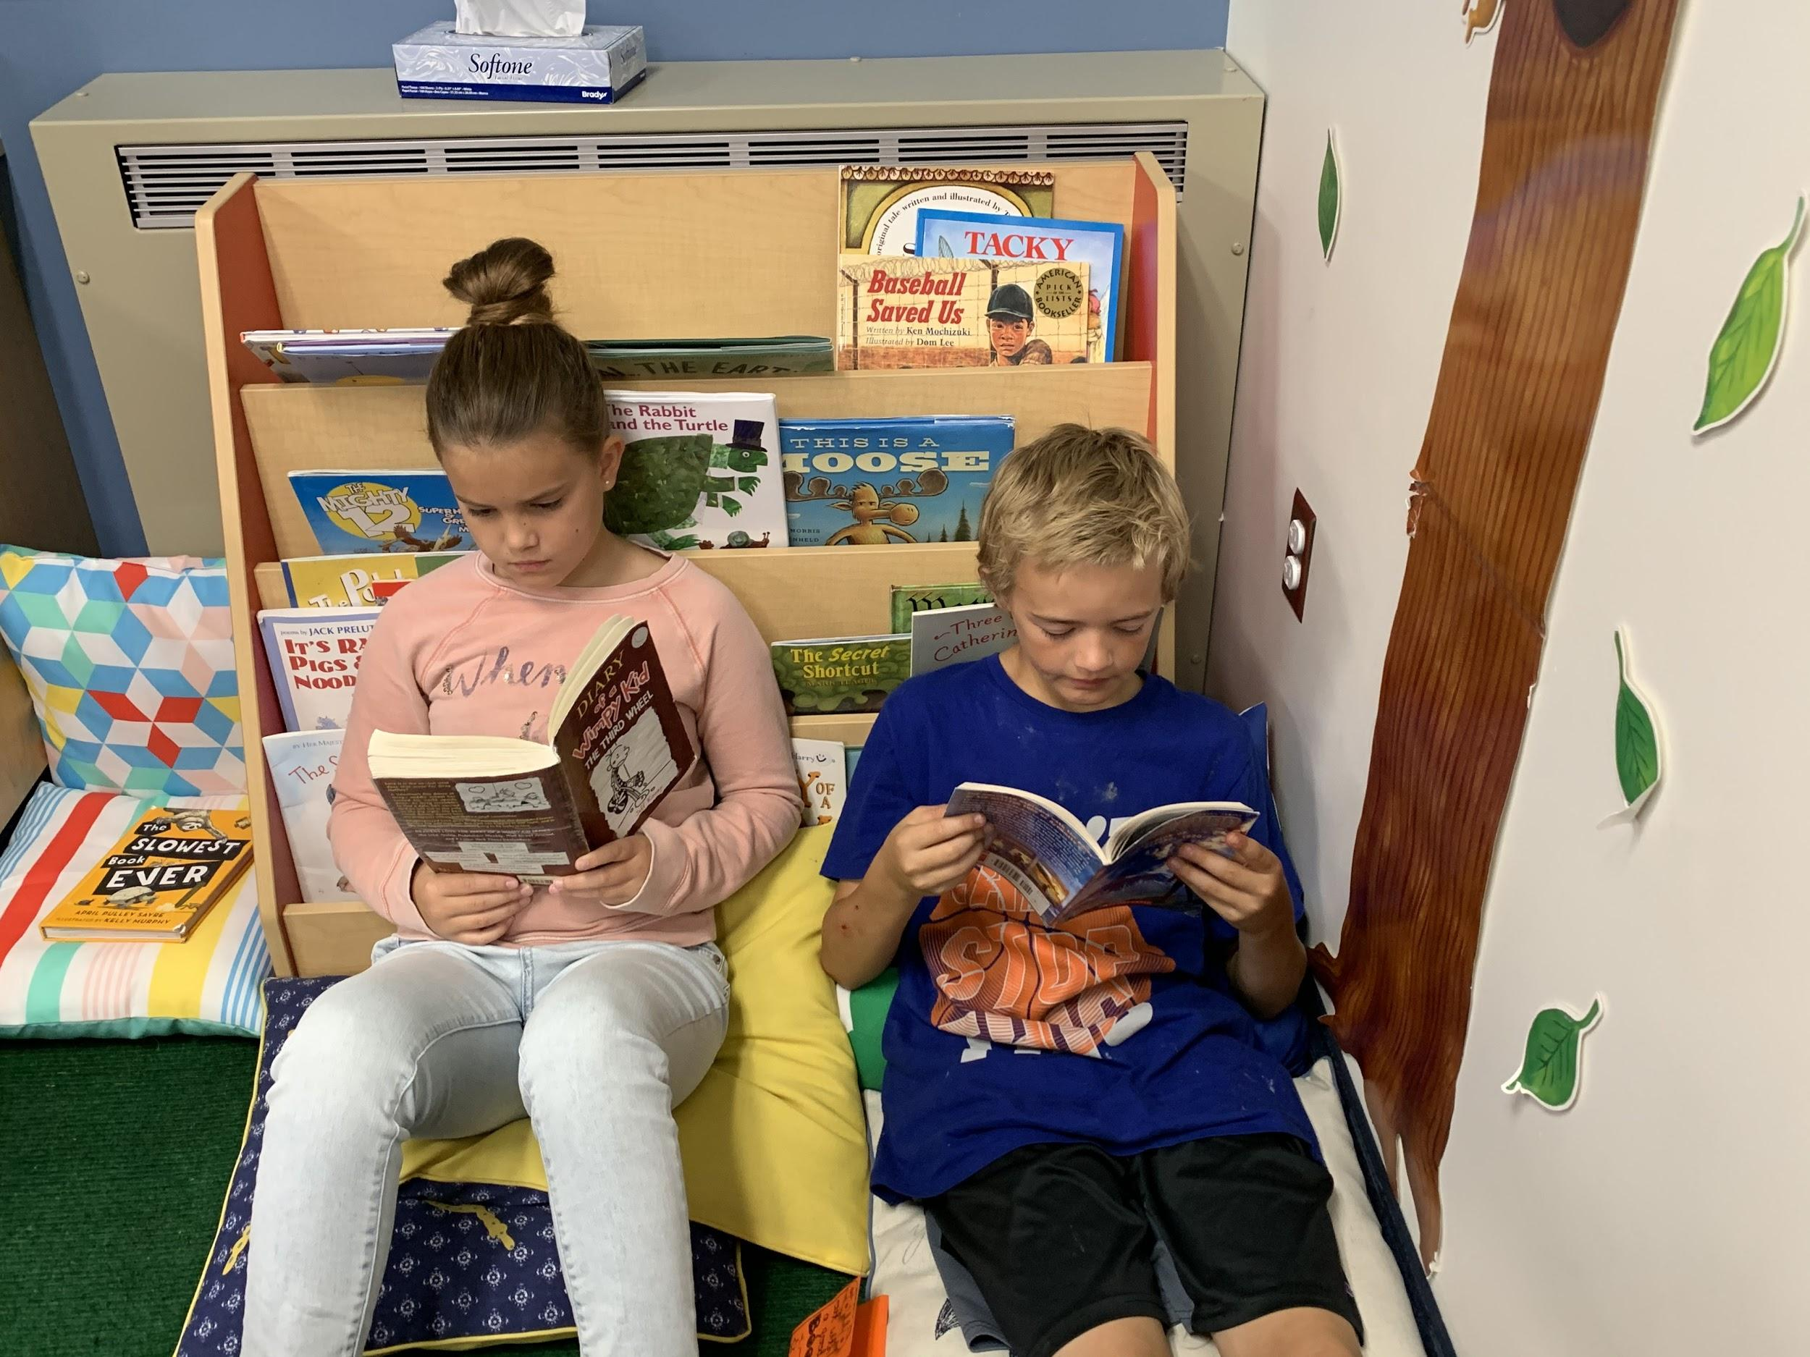
Choice-Book Choice
Notes:
Teri - Giving students a choice in what they are going to read each day

Slide 5
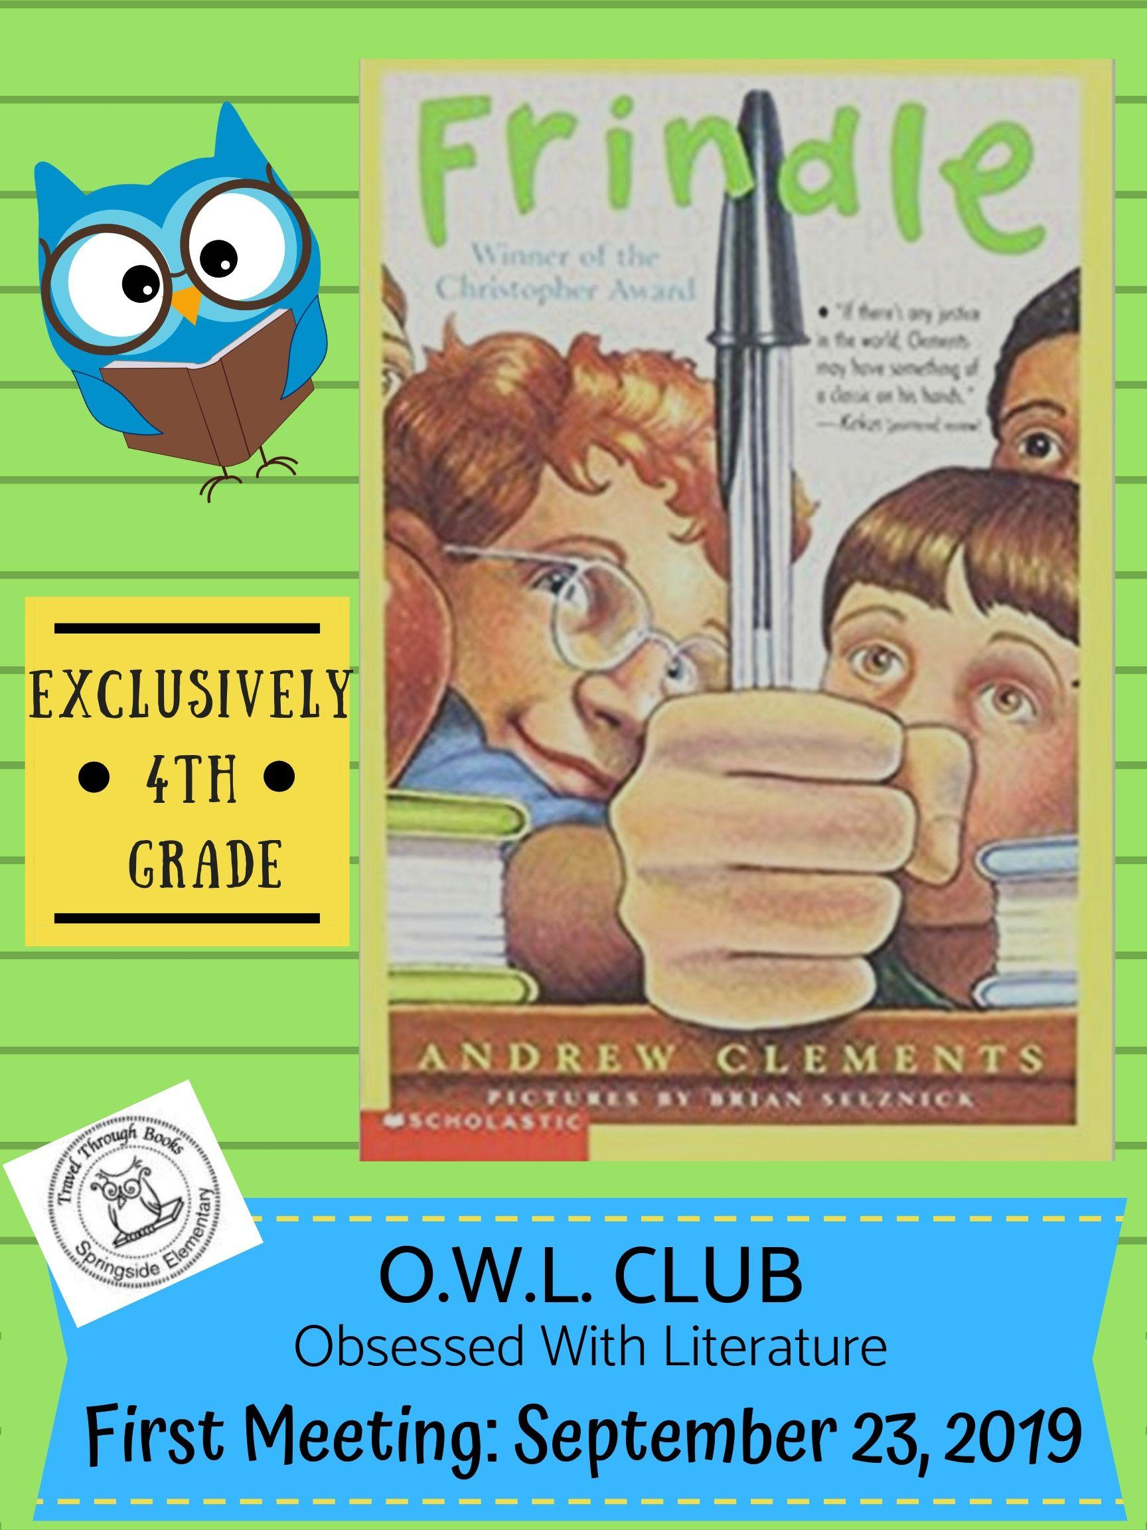







Choice-OWL Book Clubs
Notes:
Ashley - Describe what OWL stands for “Obsessed with Literature”

Slide 6
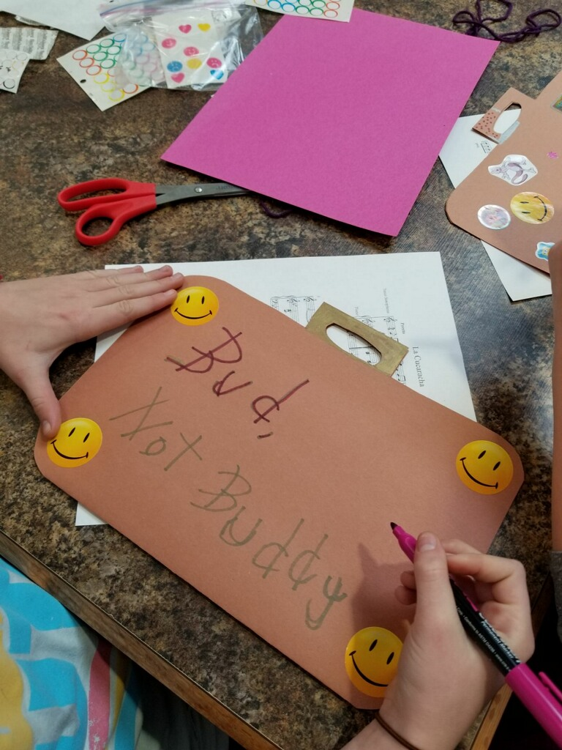
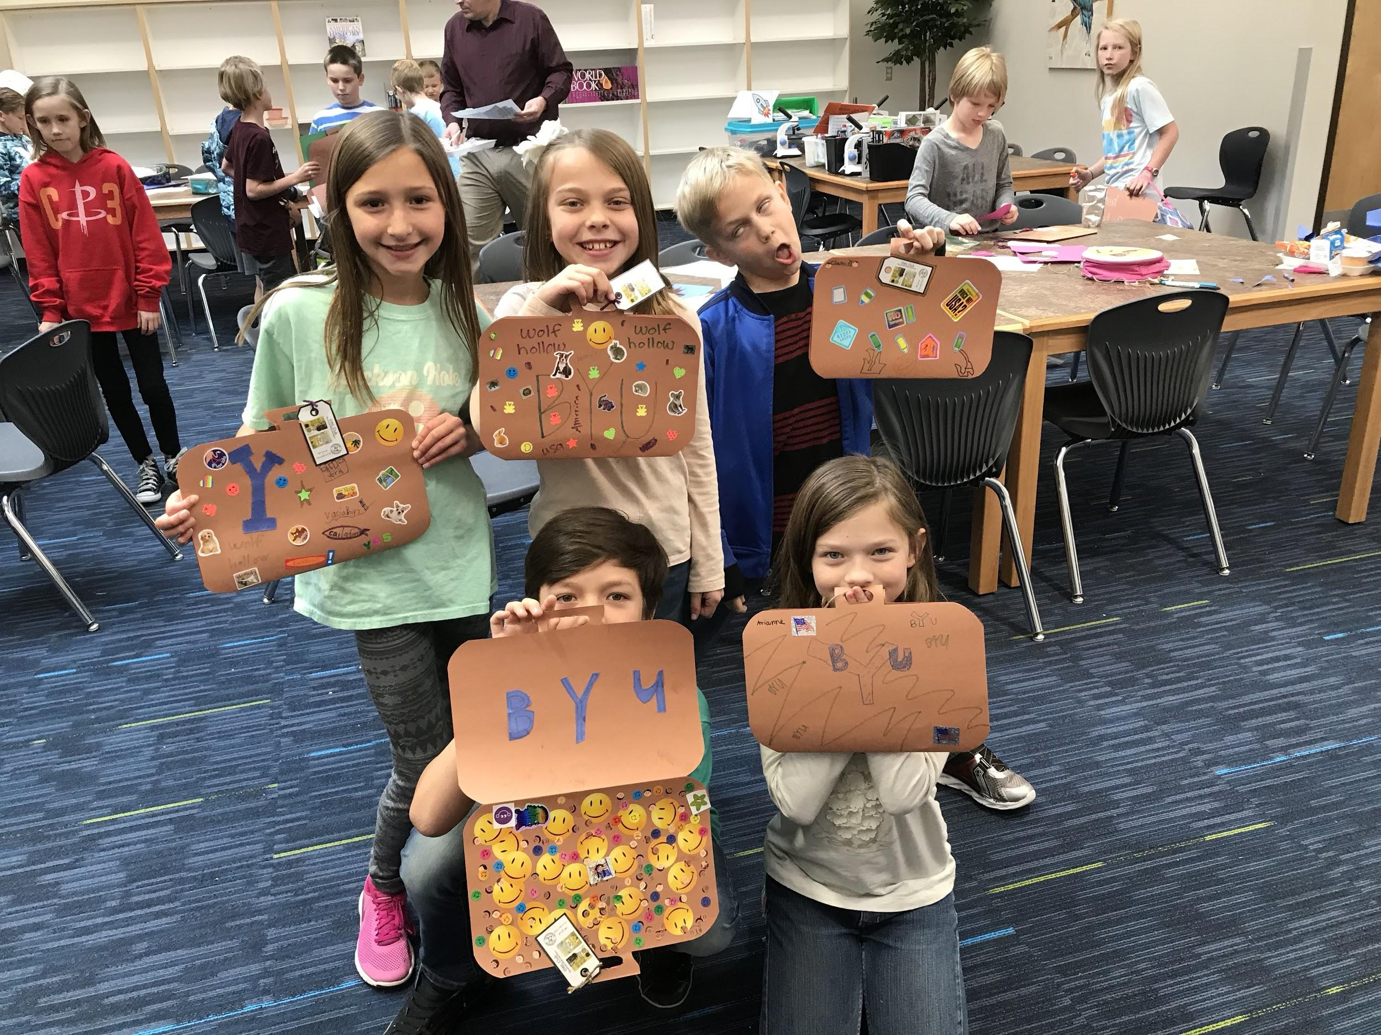
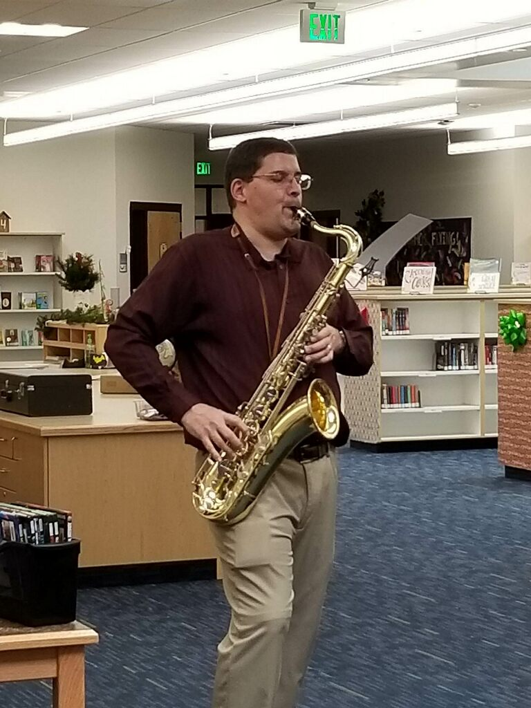
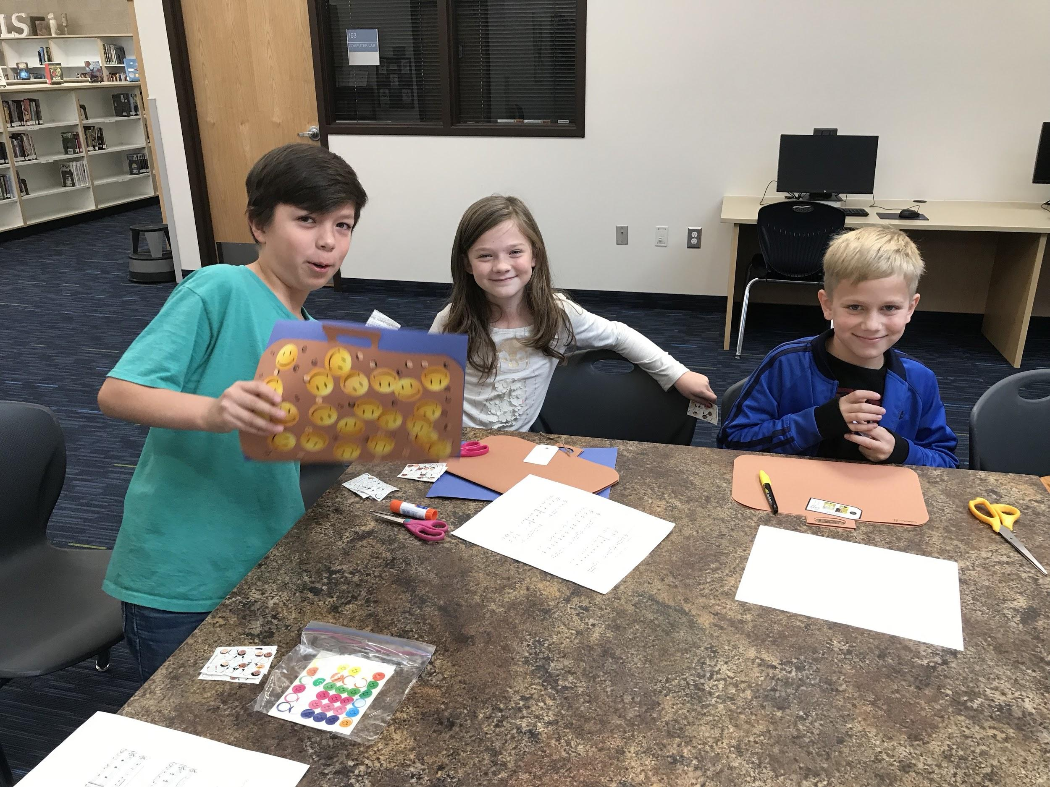
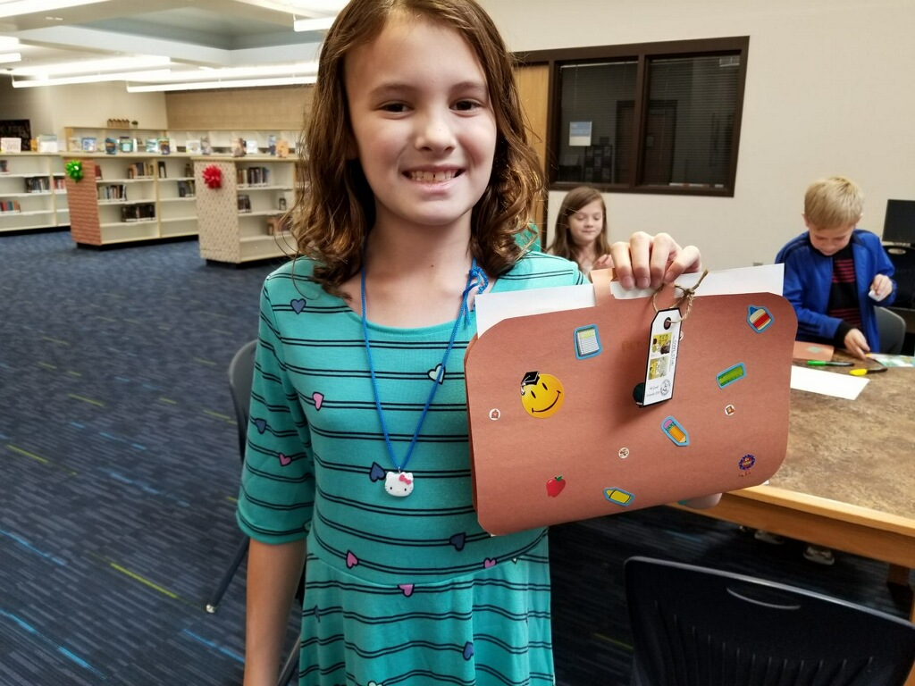

Notes:
Ashley

Slide 7
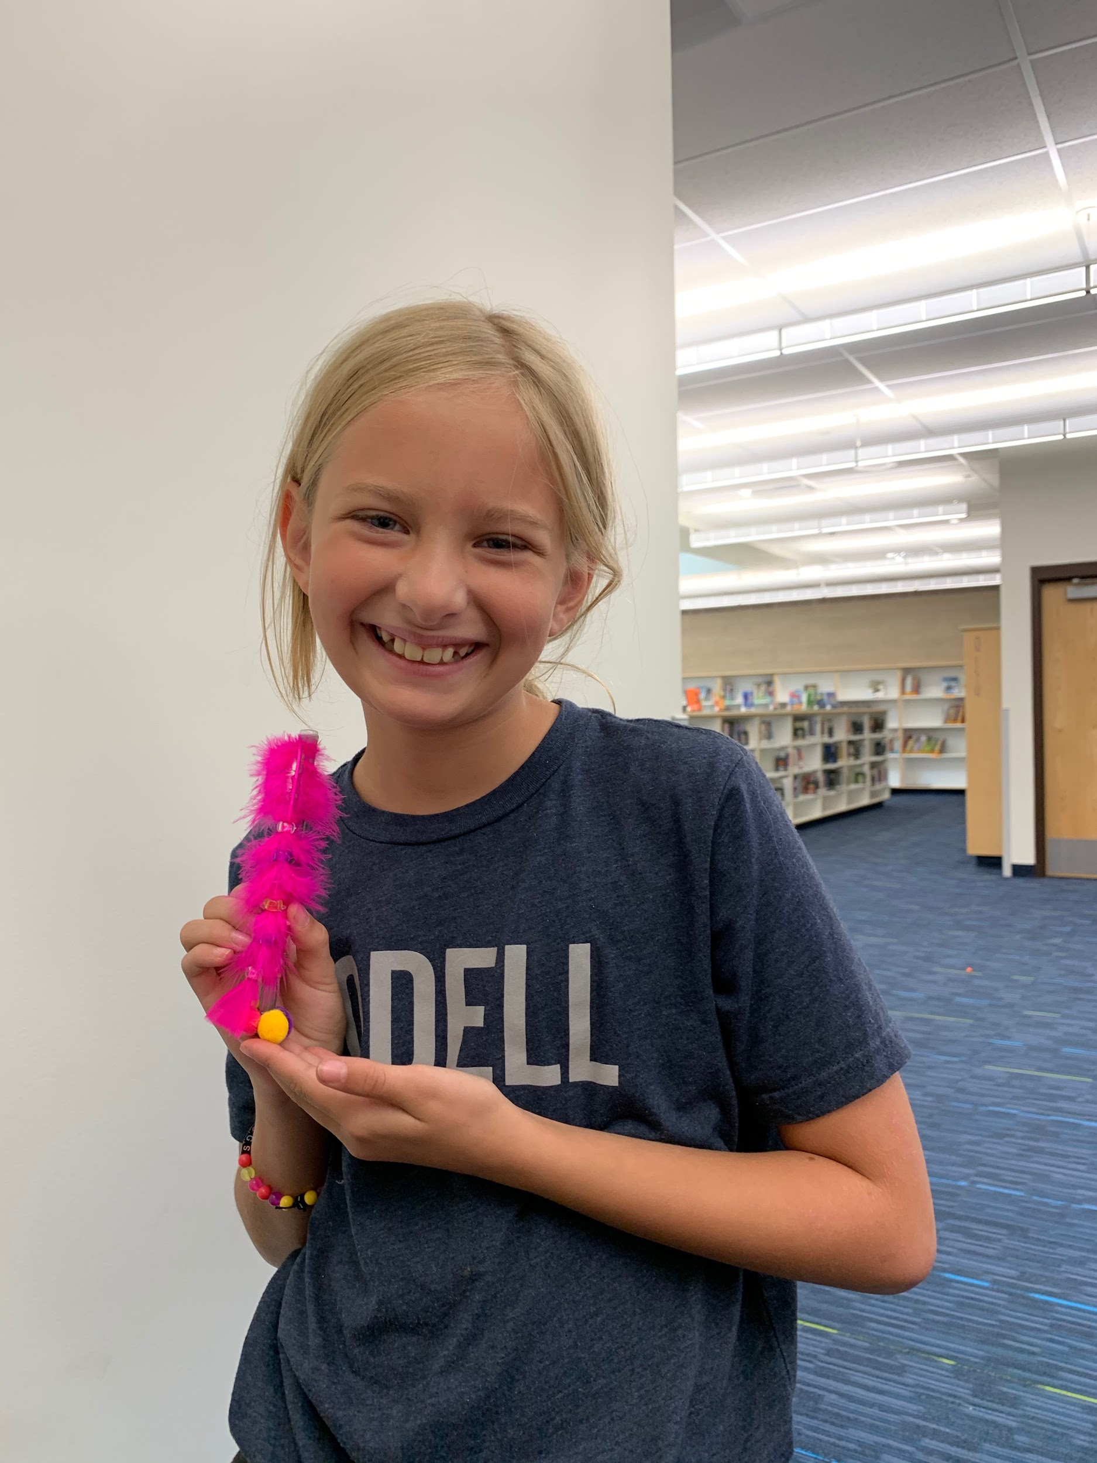
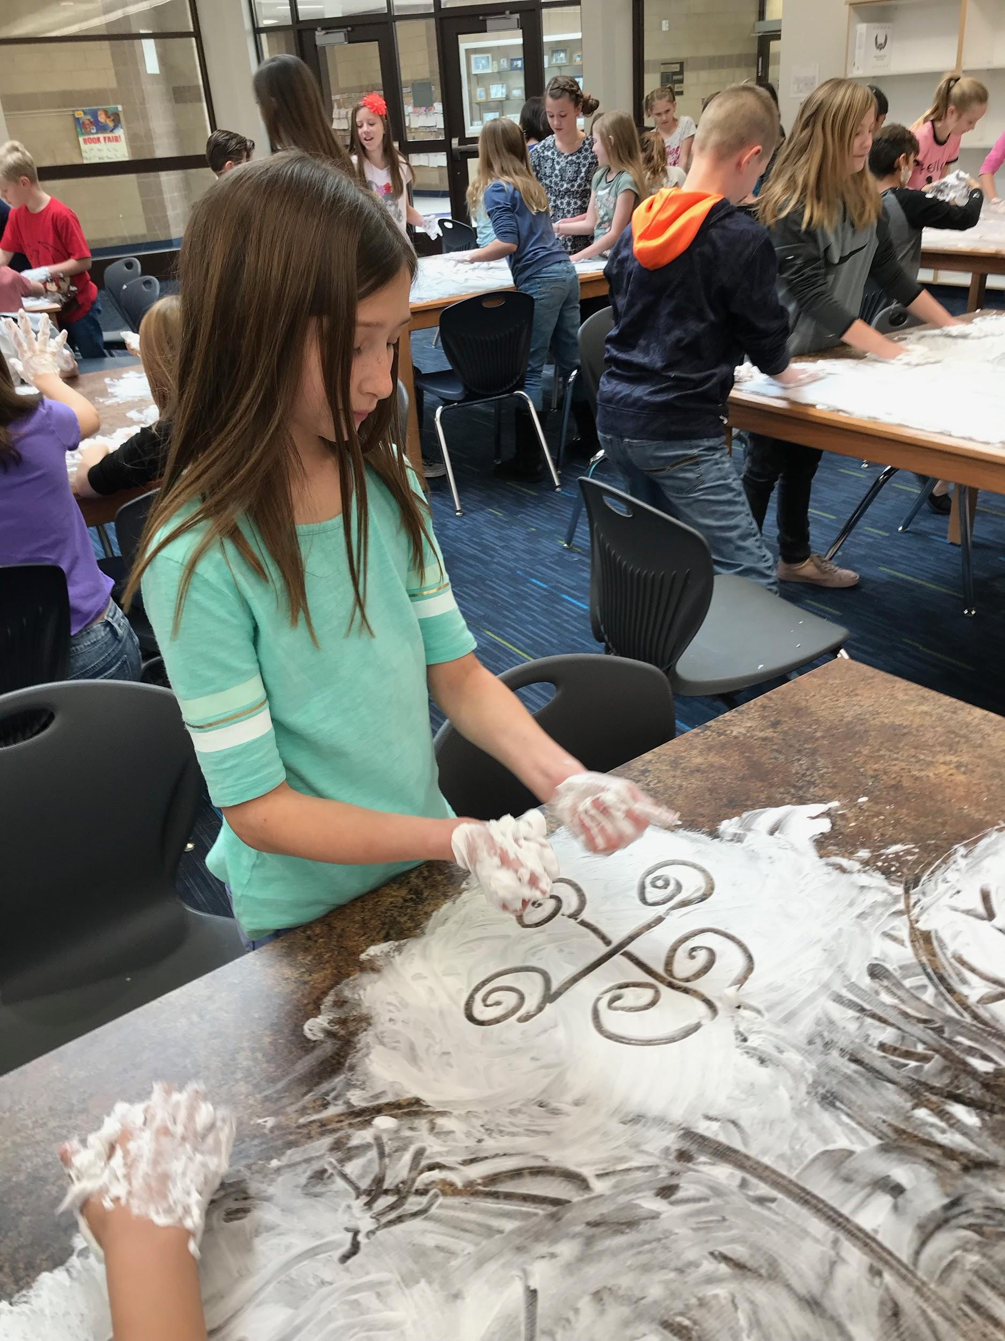
Notes:
Ashley

Slide 8
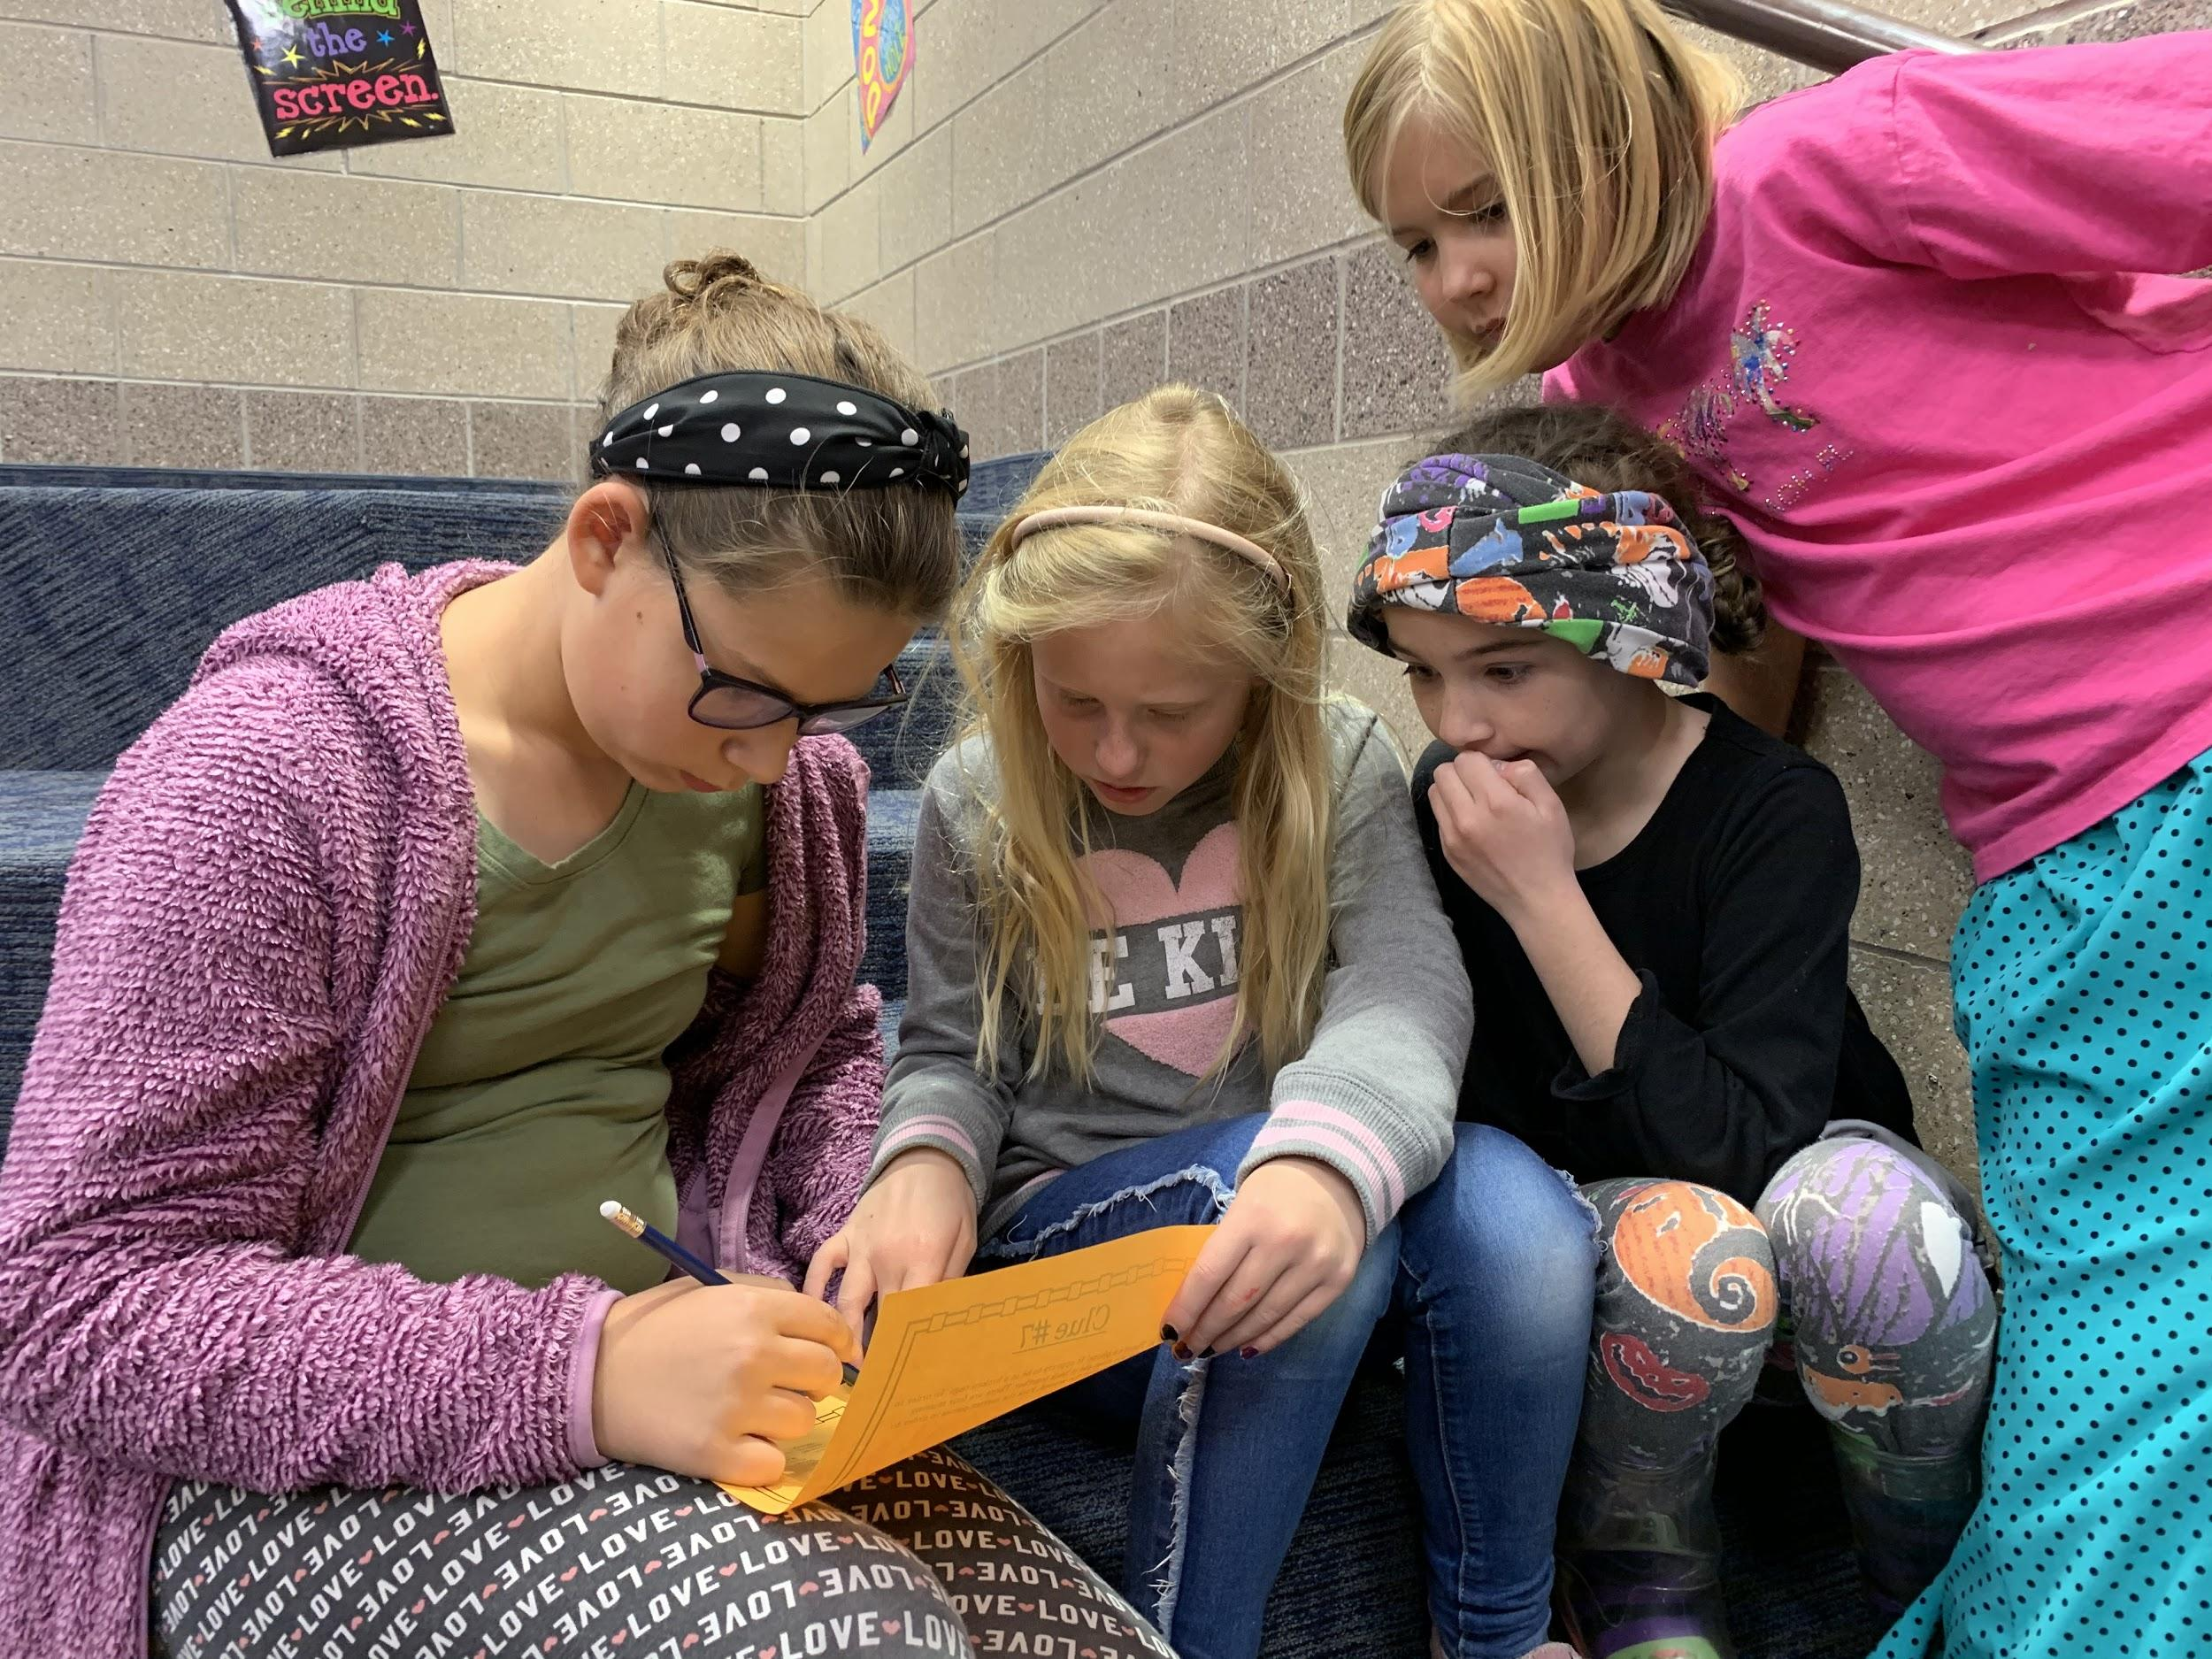
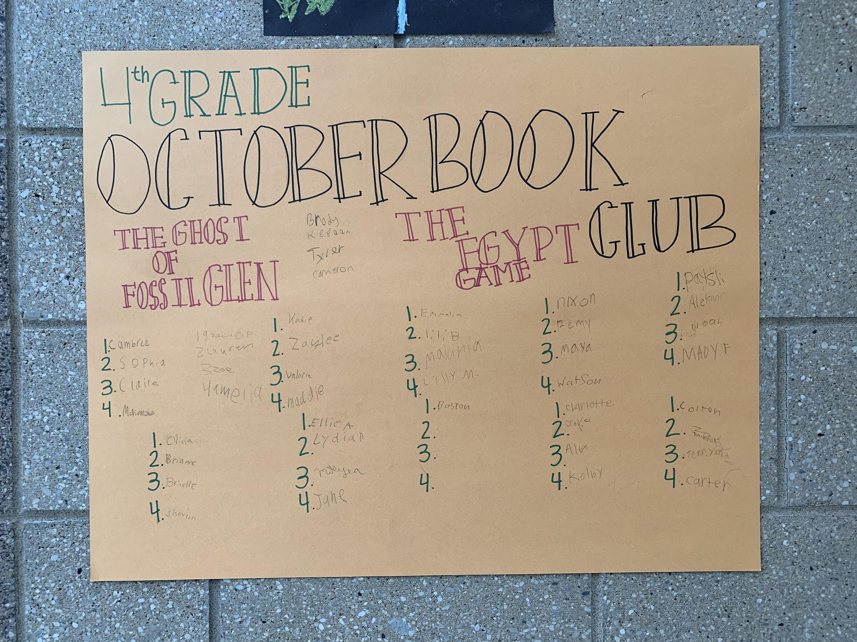
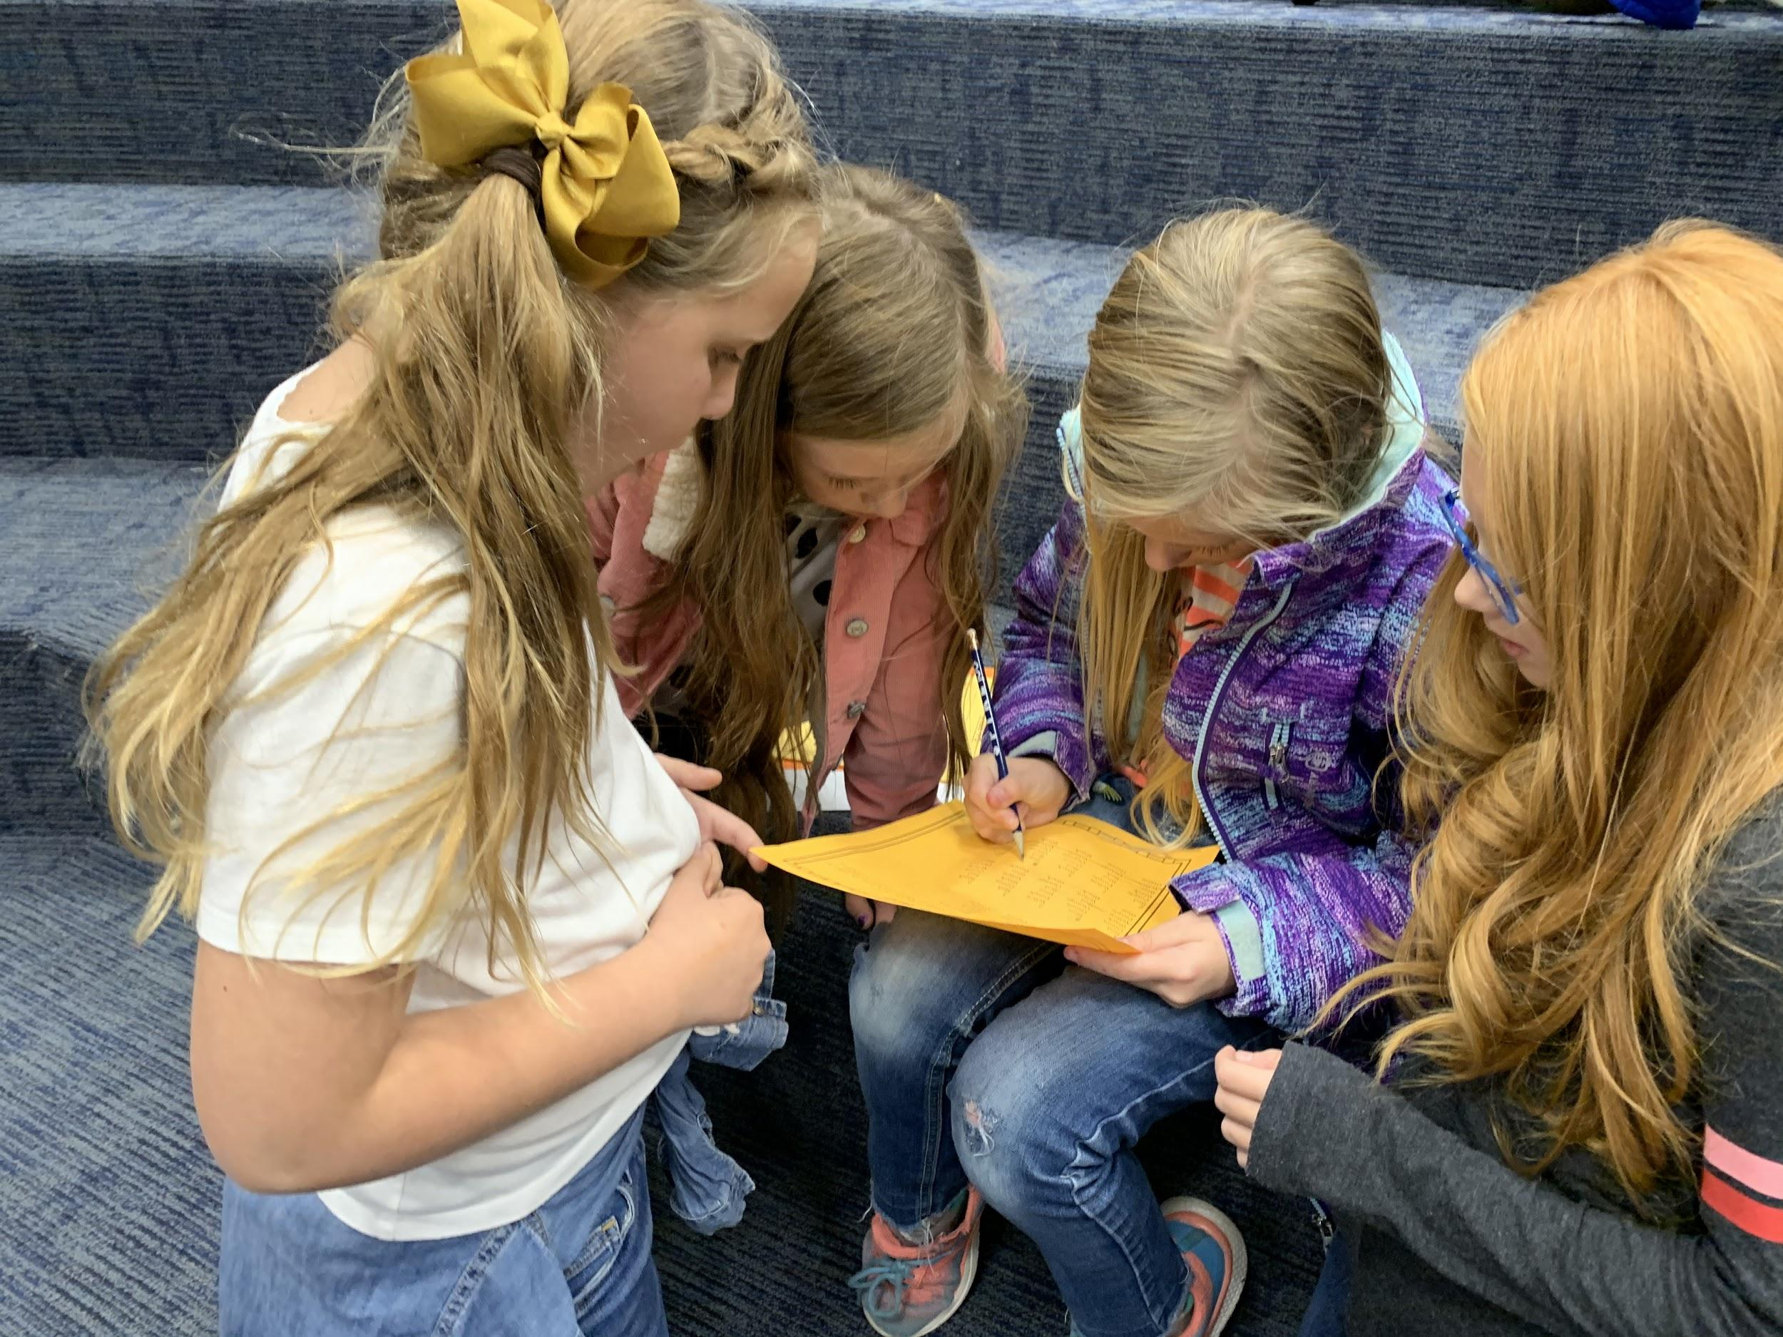
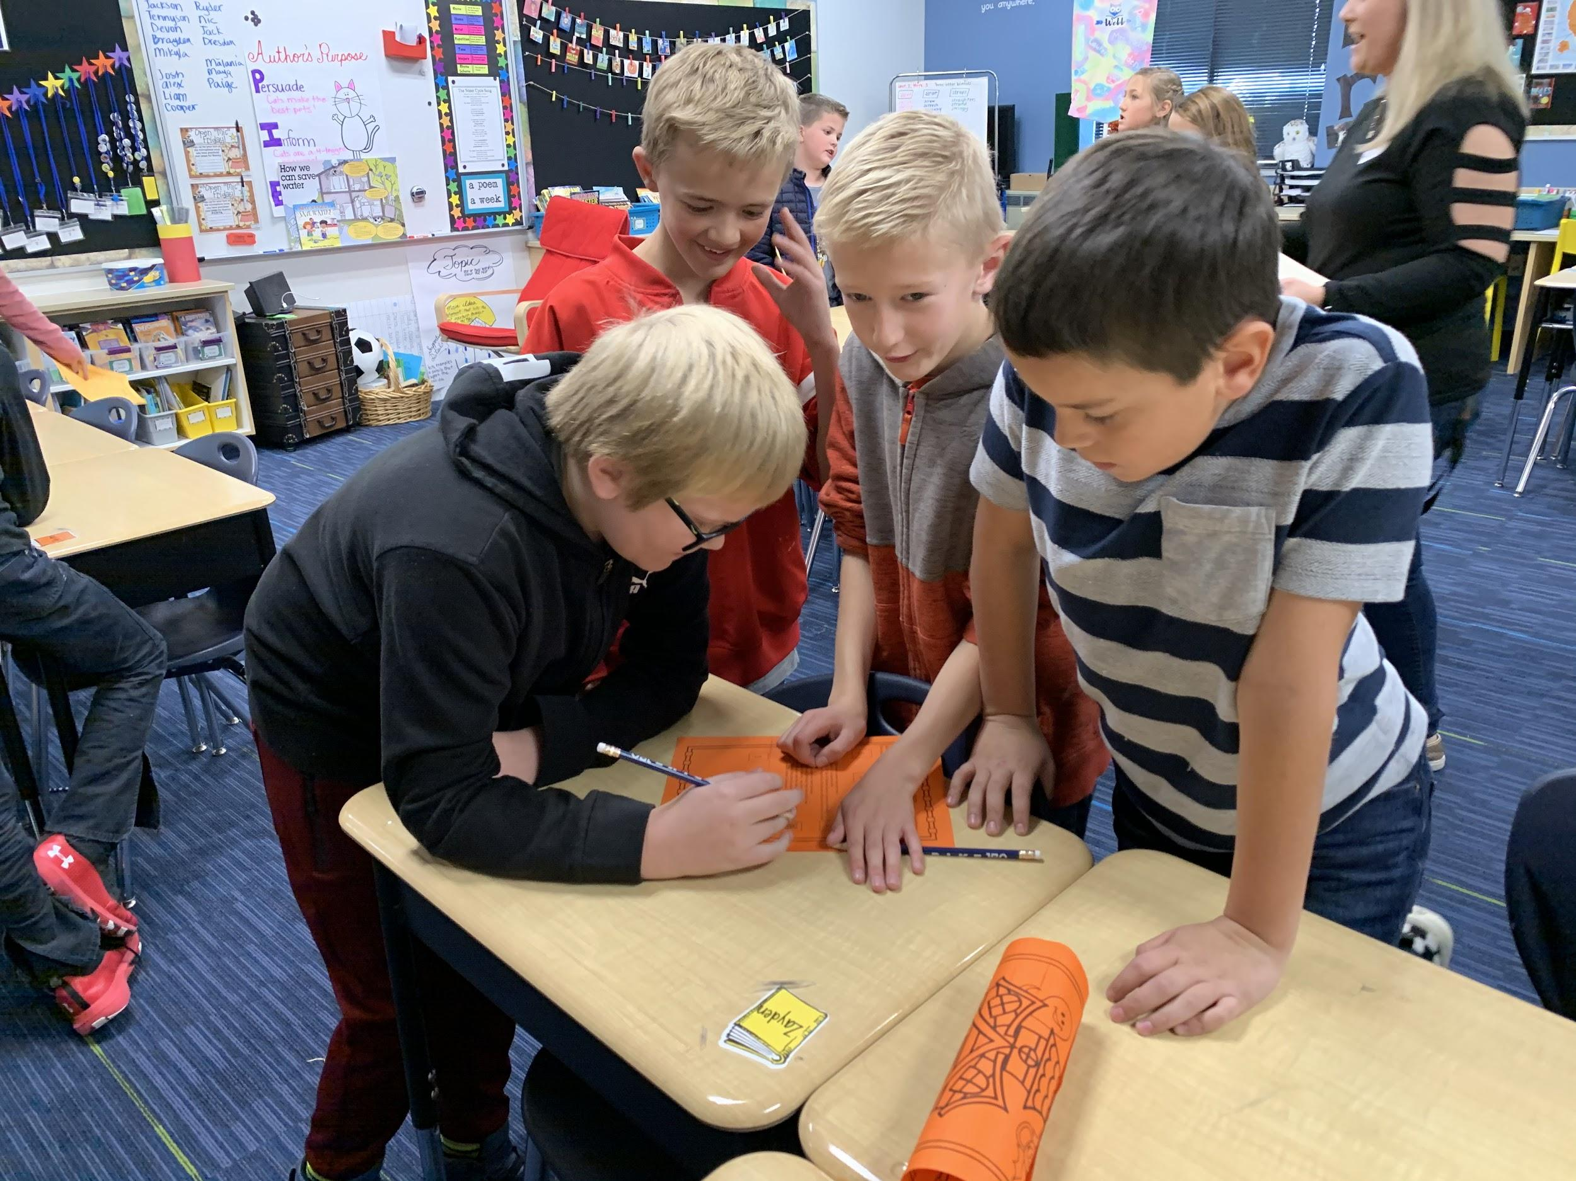

Slide 9
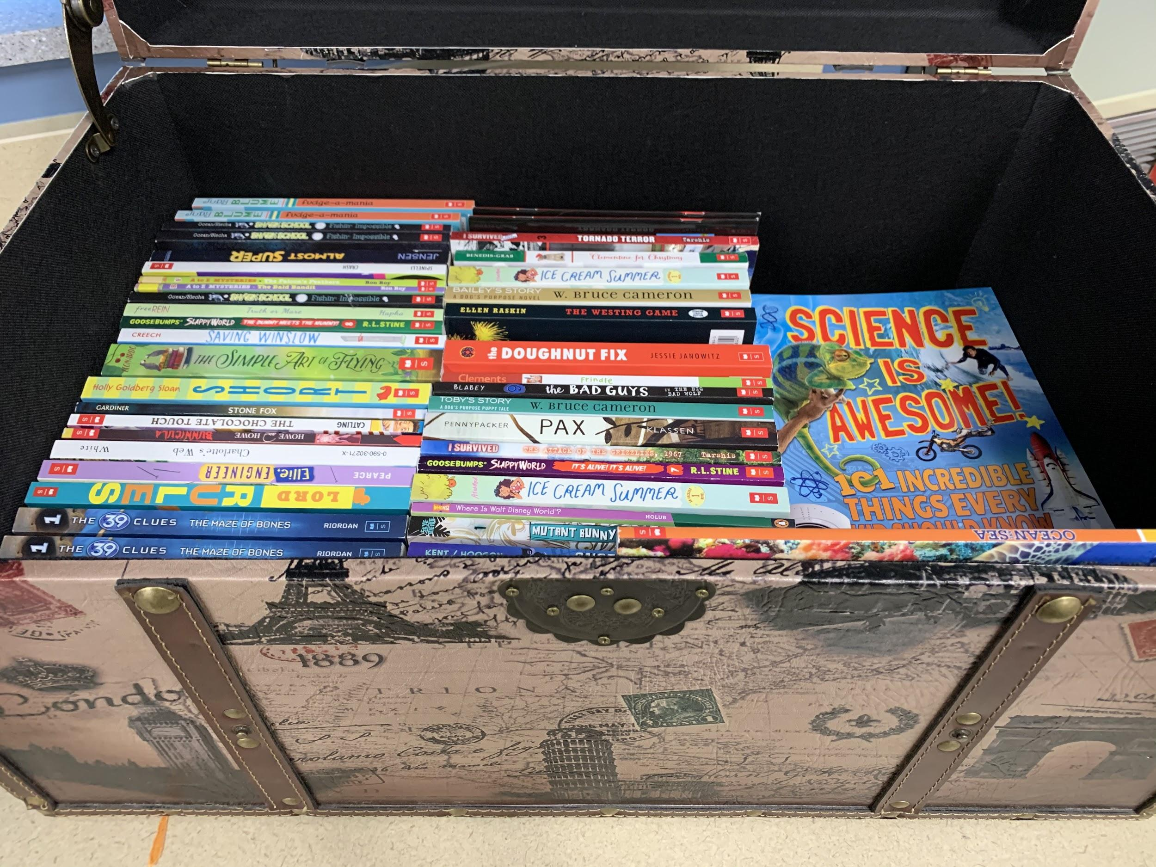
Choice-Birthday Books
Notes:
Teri

Slide 10
Collaboration

Slide 11
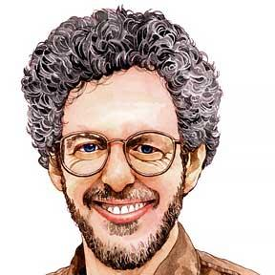



Collaboration-Reader’s Theater
Dr. Chase Young RT Scripts (http://www.thebestclass.org/rtscripts.html/)
Aaron Shepard’s RT Page (http://www.aaronshep.com/rt/)
Benchmark Education Readers’ Theater (multi-leveled scripts)
Notes:
Gary--

Slide 12
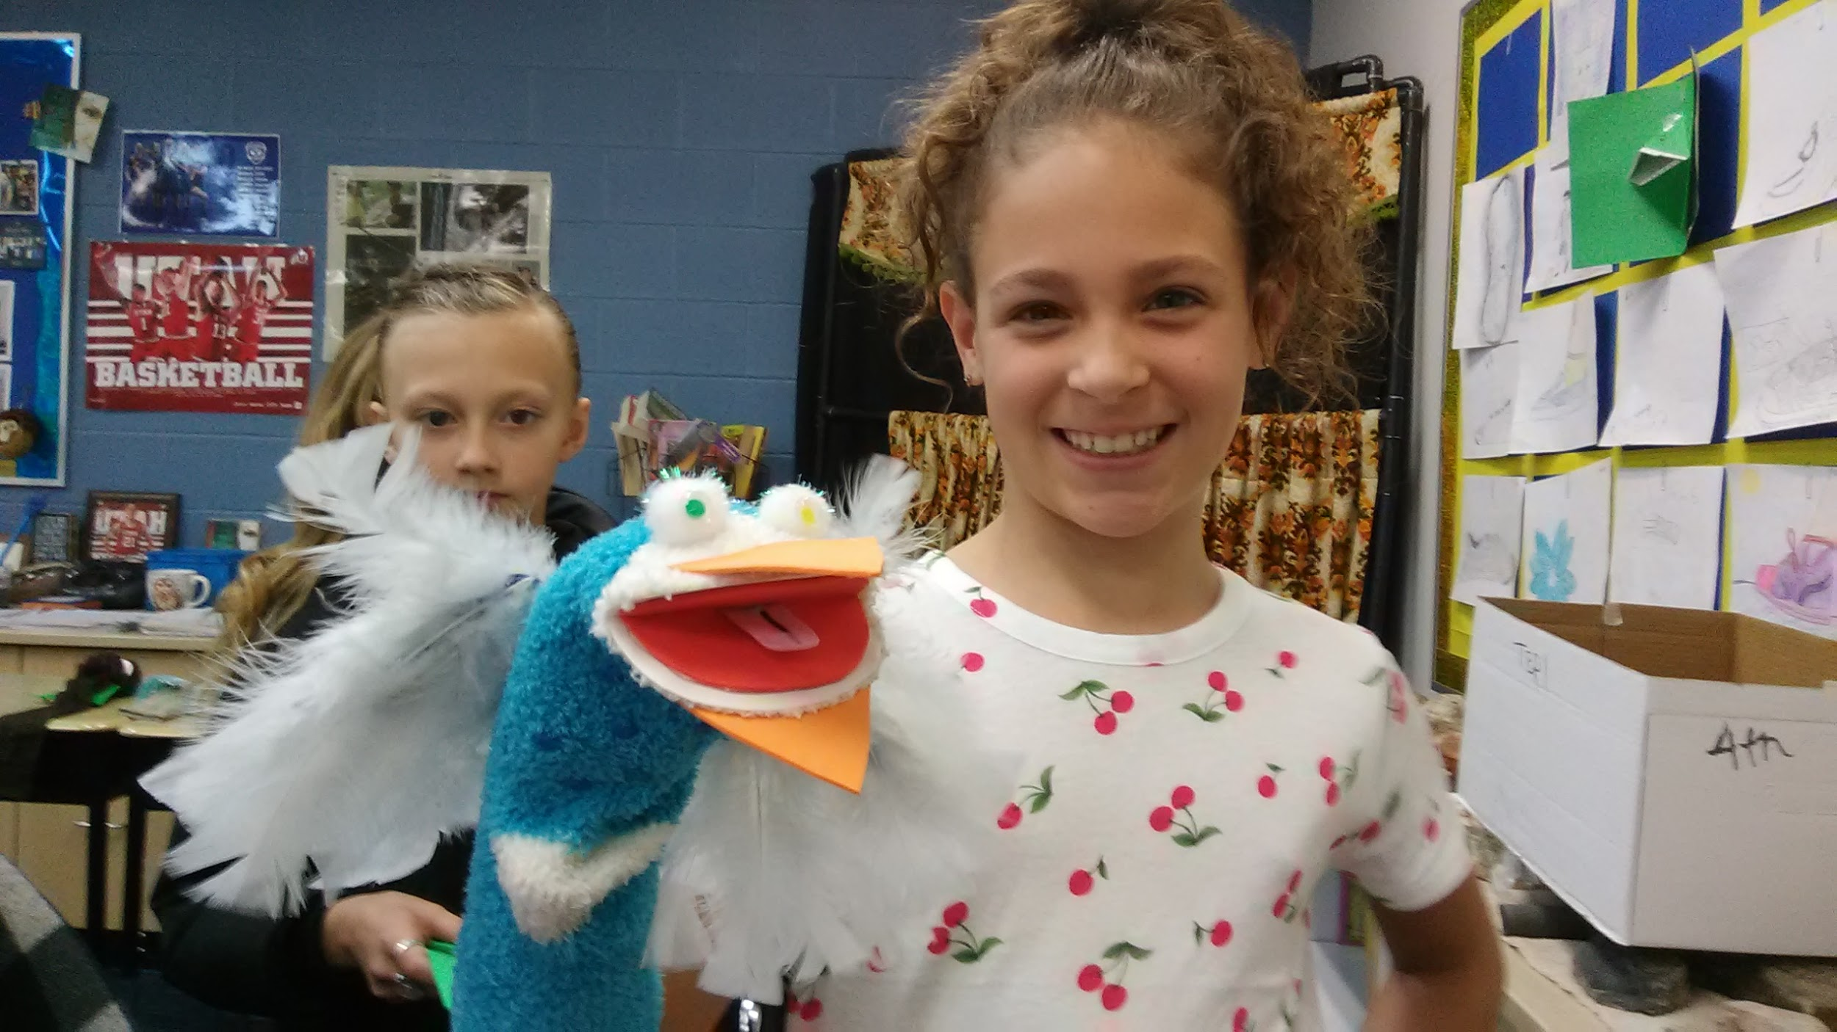
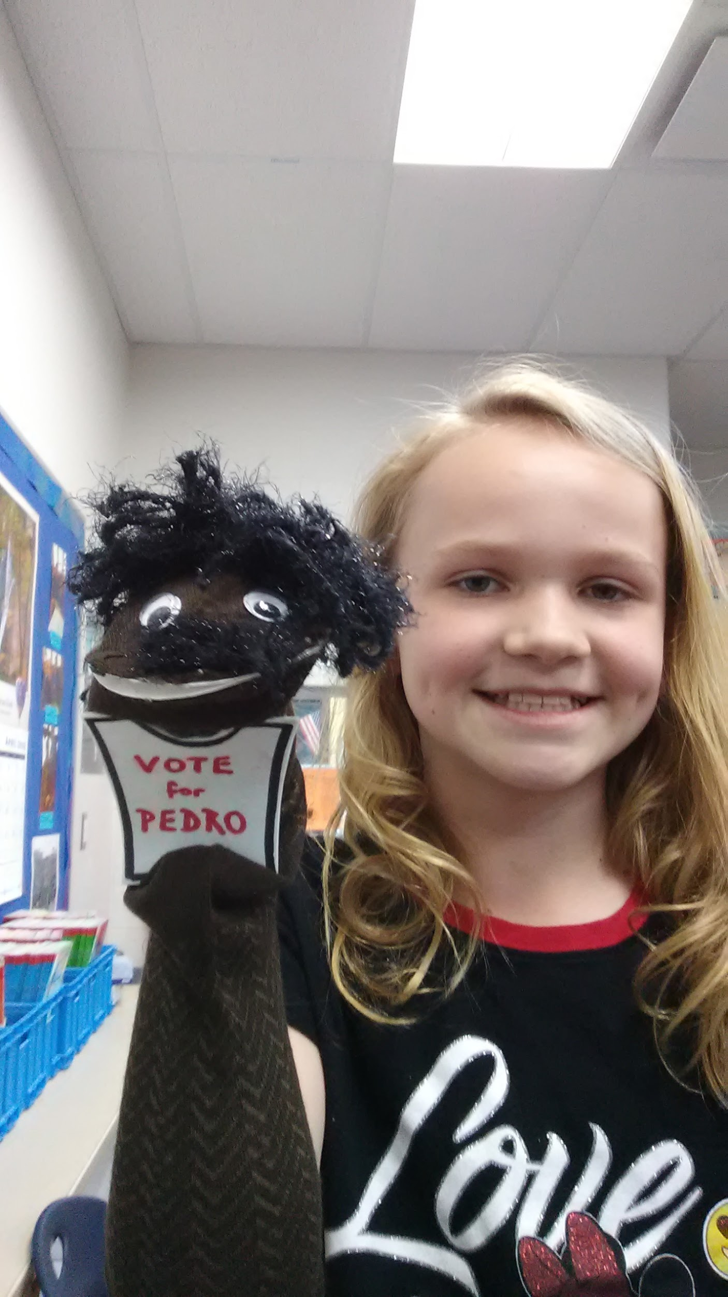
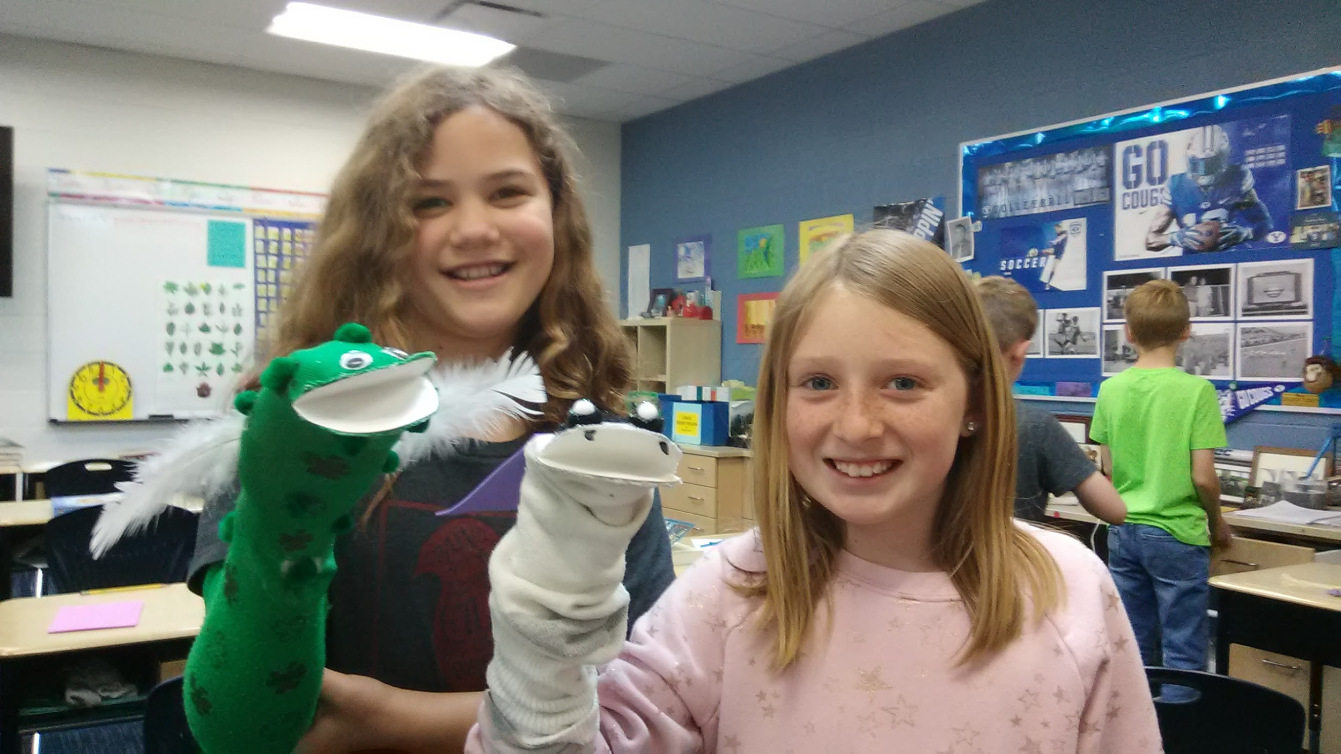
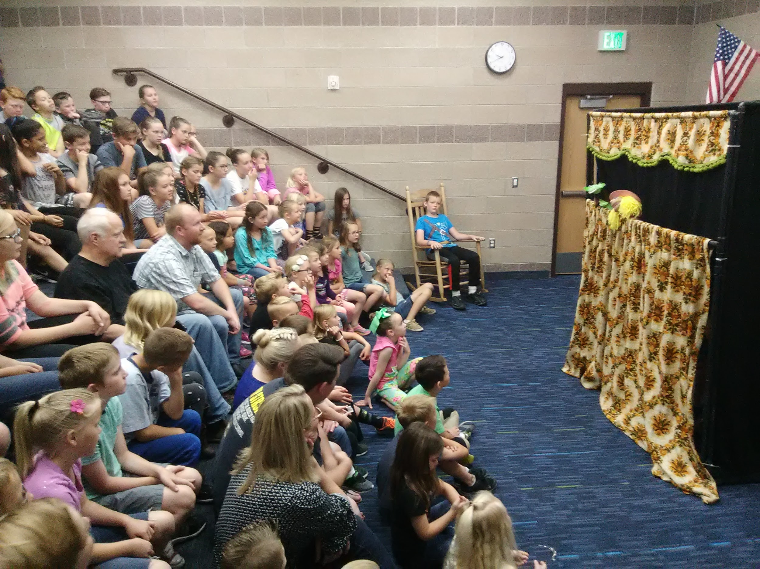
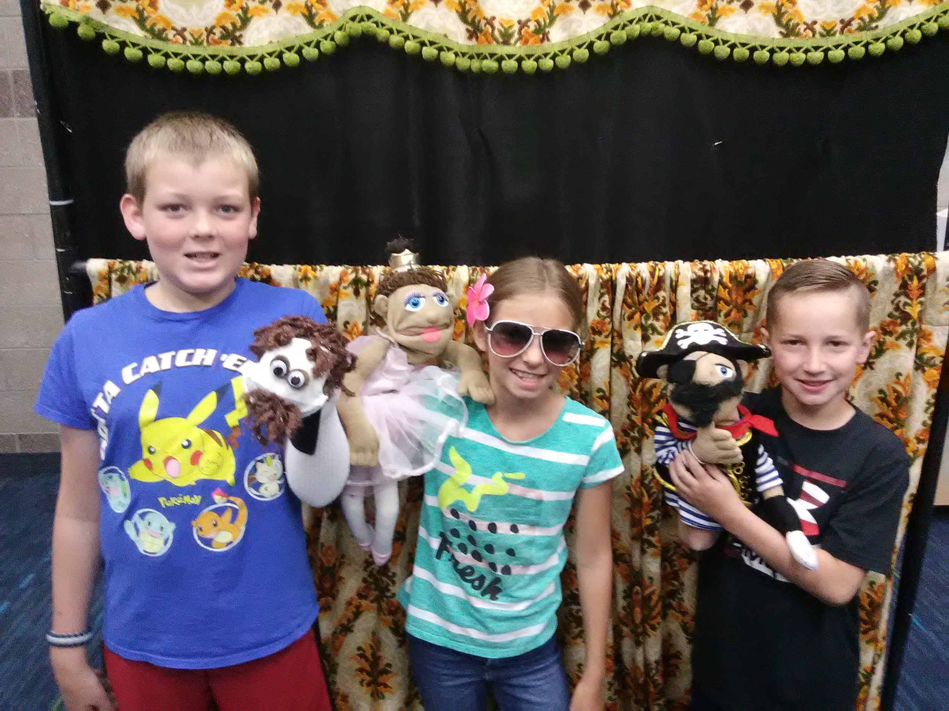
Collaboration-Puppet Shows
Notes:
Gary—
Room mother: ”You let your students’ creativity come out!”
Repeated readings from their puppet show scripts, helps develop children’s expression in reading.
Super fun!

Slide 13
Control

Slide 14
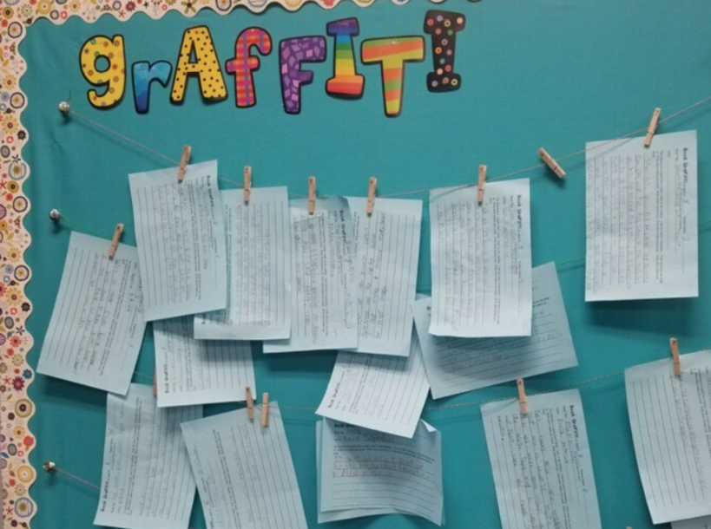
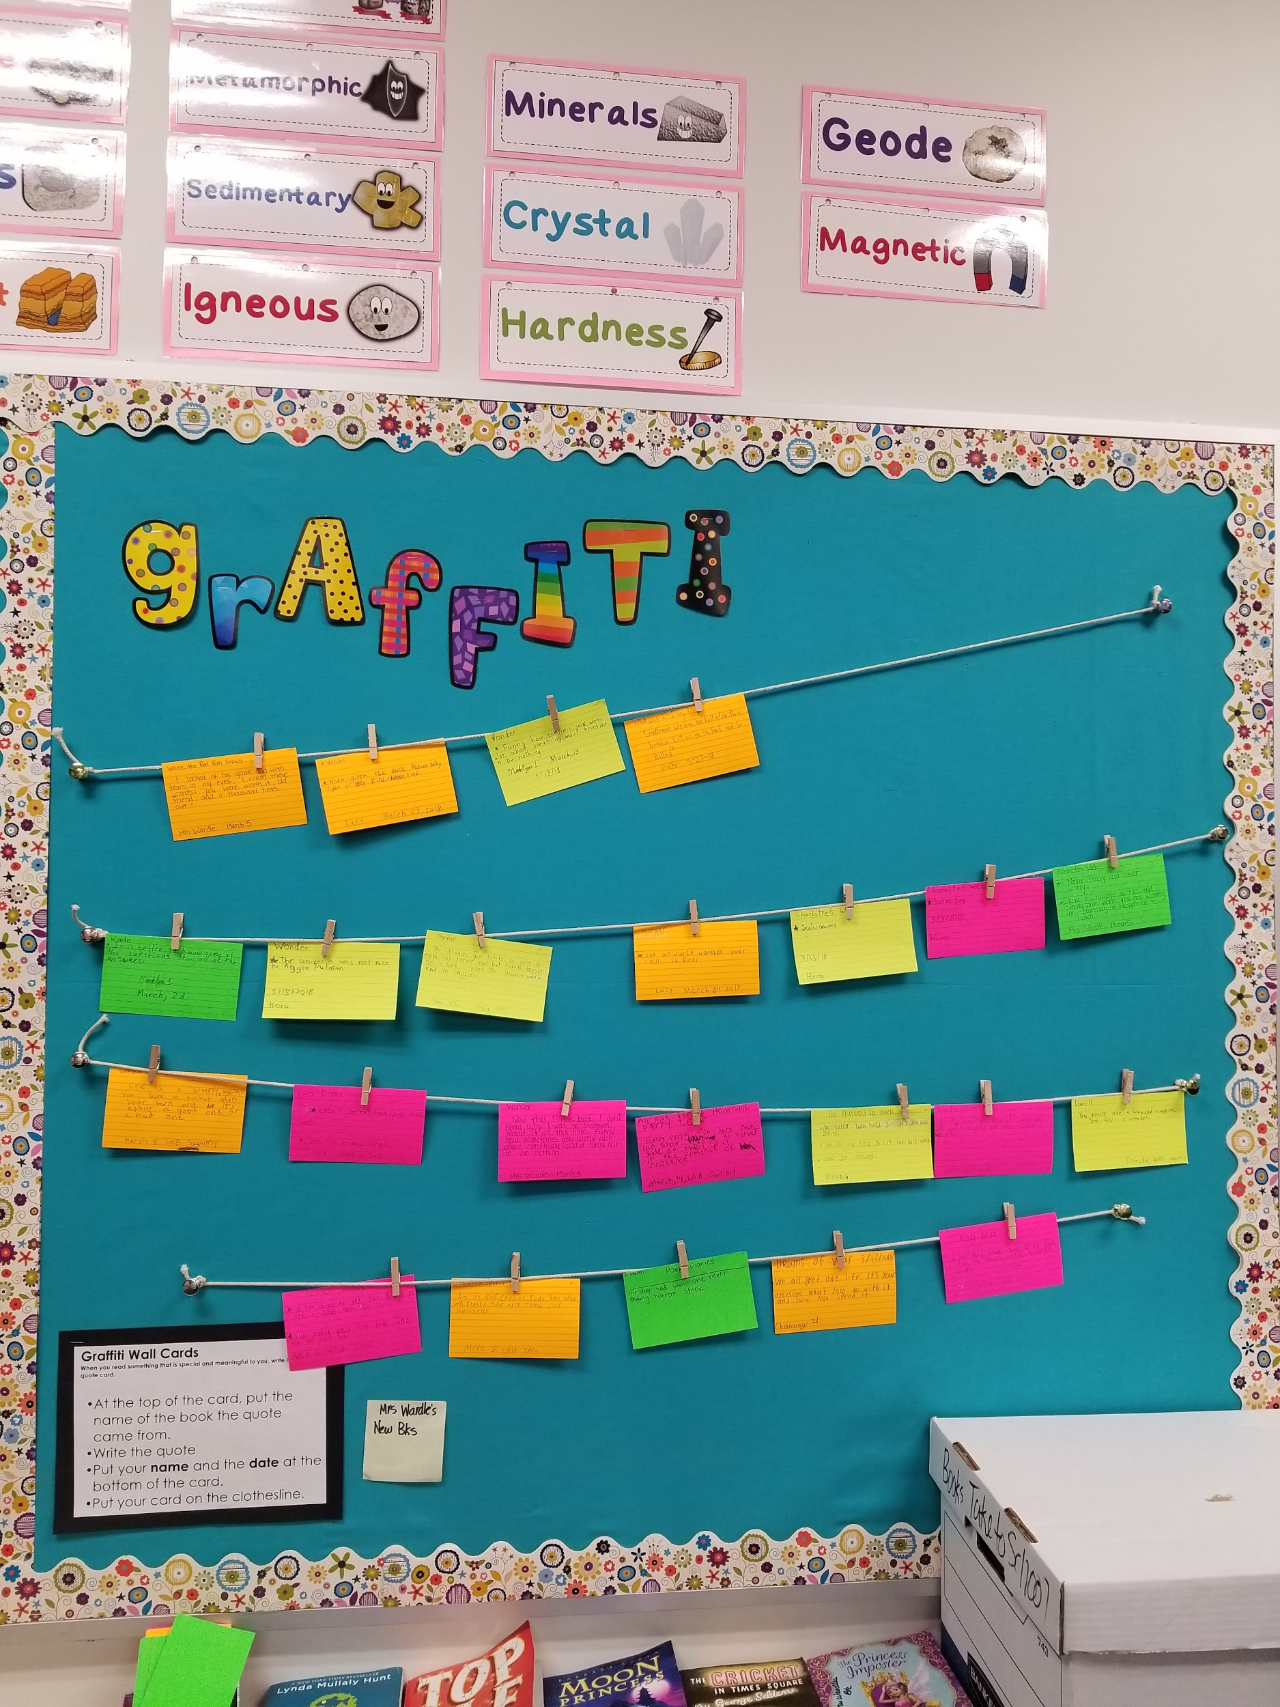

Control-Graffiti Wall
Notes:
Diane-Book Graffiti
The students will write down an “aha” quote from a book that they are reading on a weekly basis. The quote will be written on a card sent home each week in the students Monday folder—due back to school each Friday. The student will place their quote on a bulletin board. Each day, a few students will be given the opportunity to read their quote and share why it was an “aha” quote to them and explain any special meaning that the quote may have to them.

Slide 15
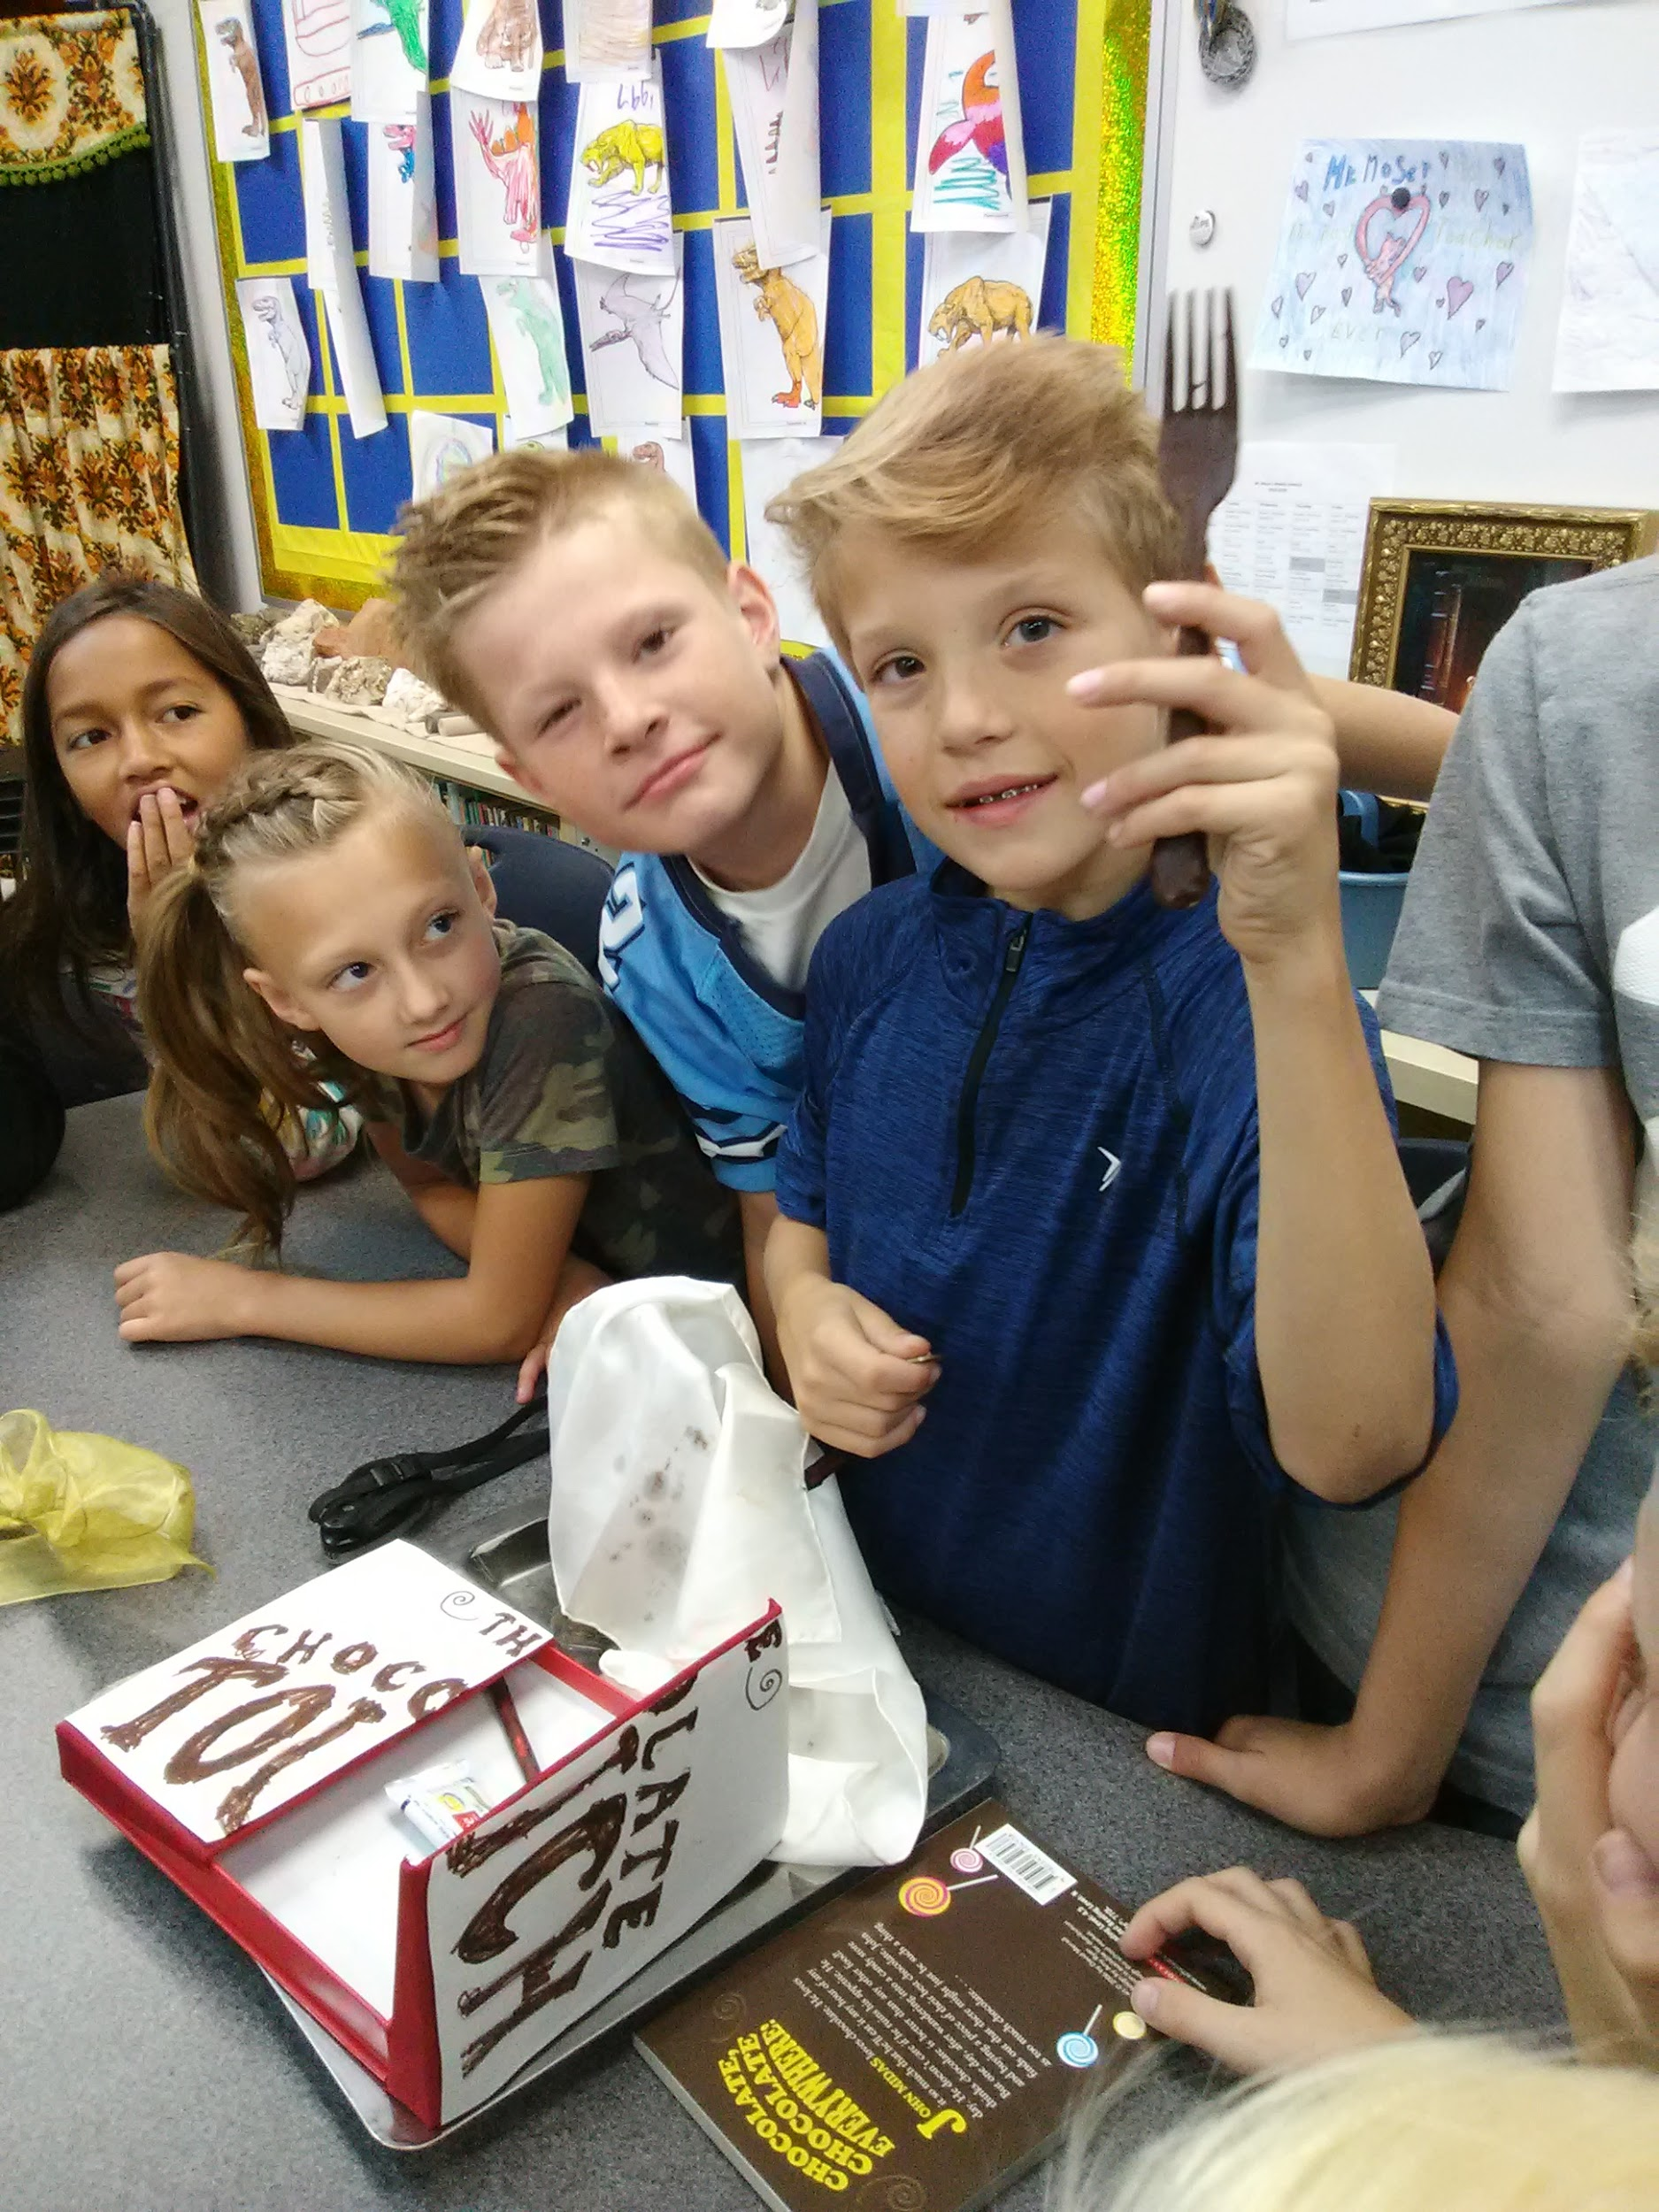
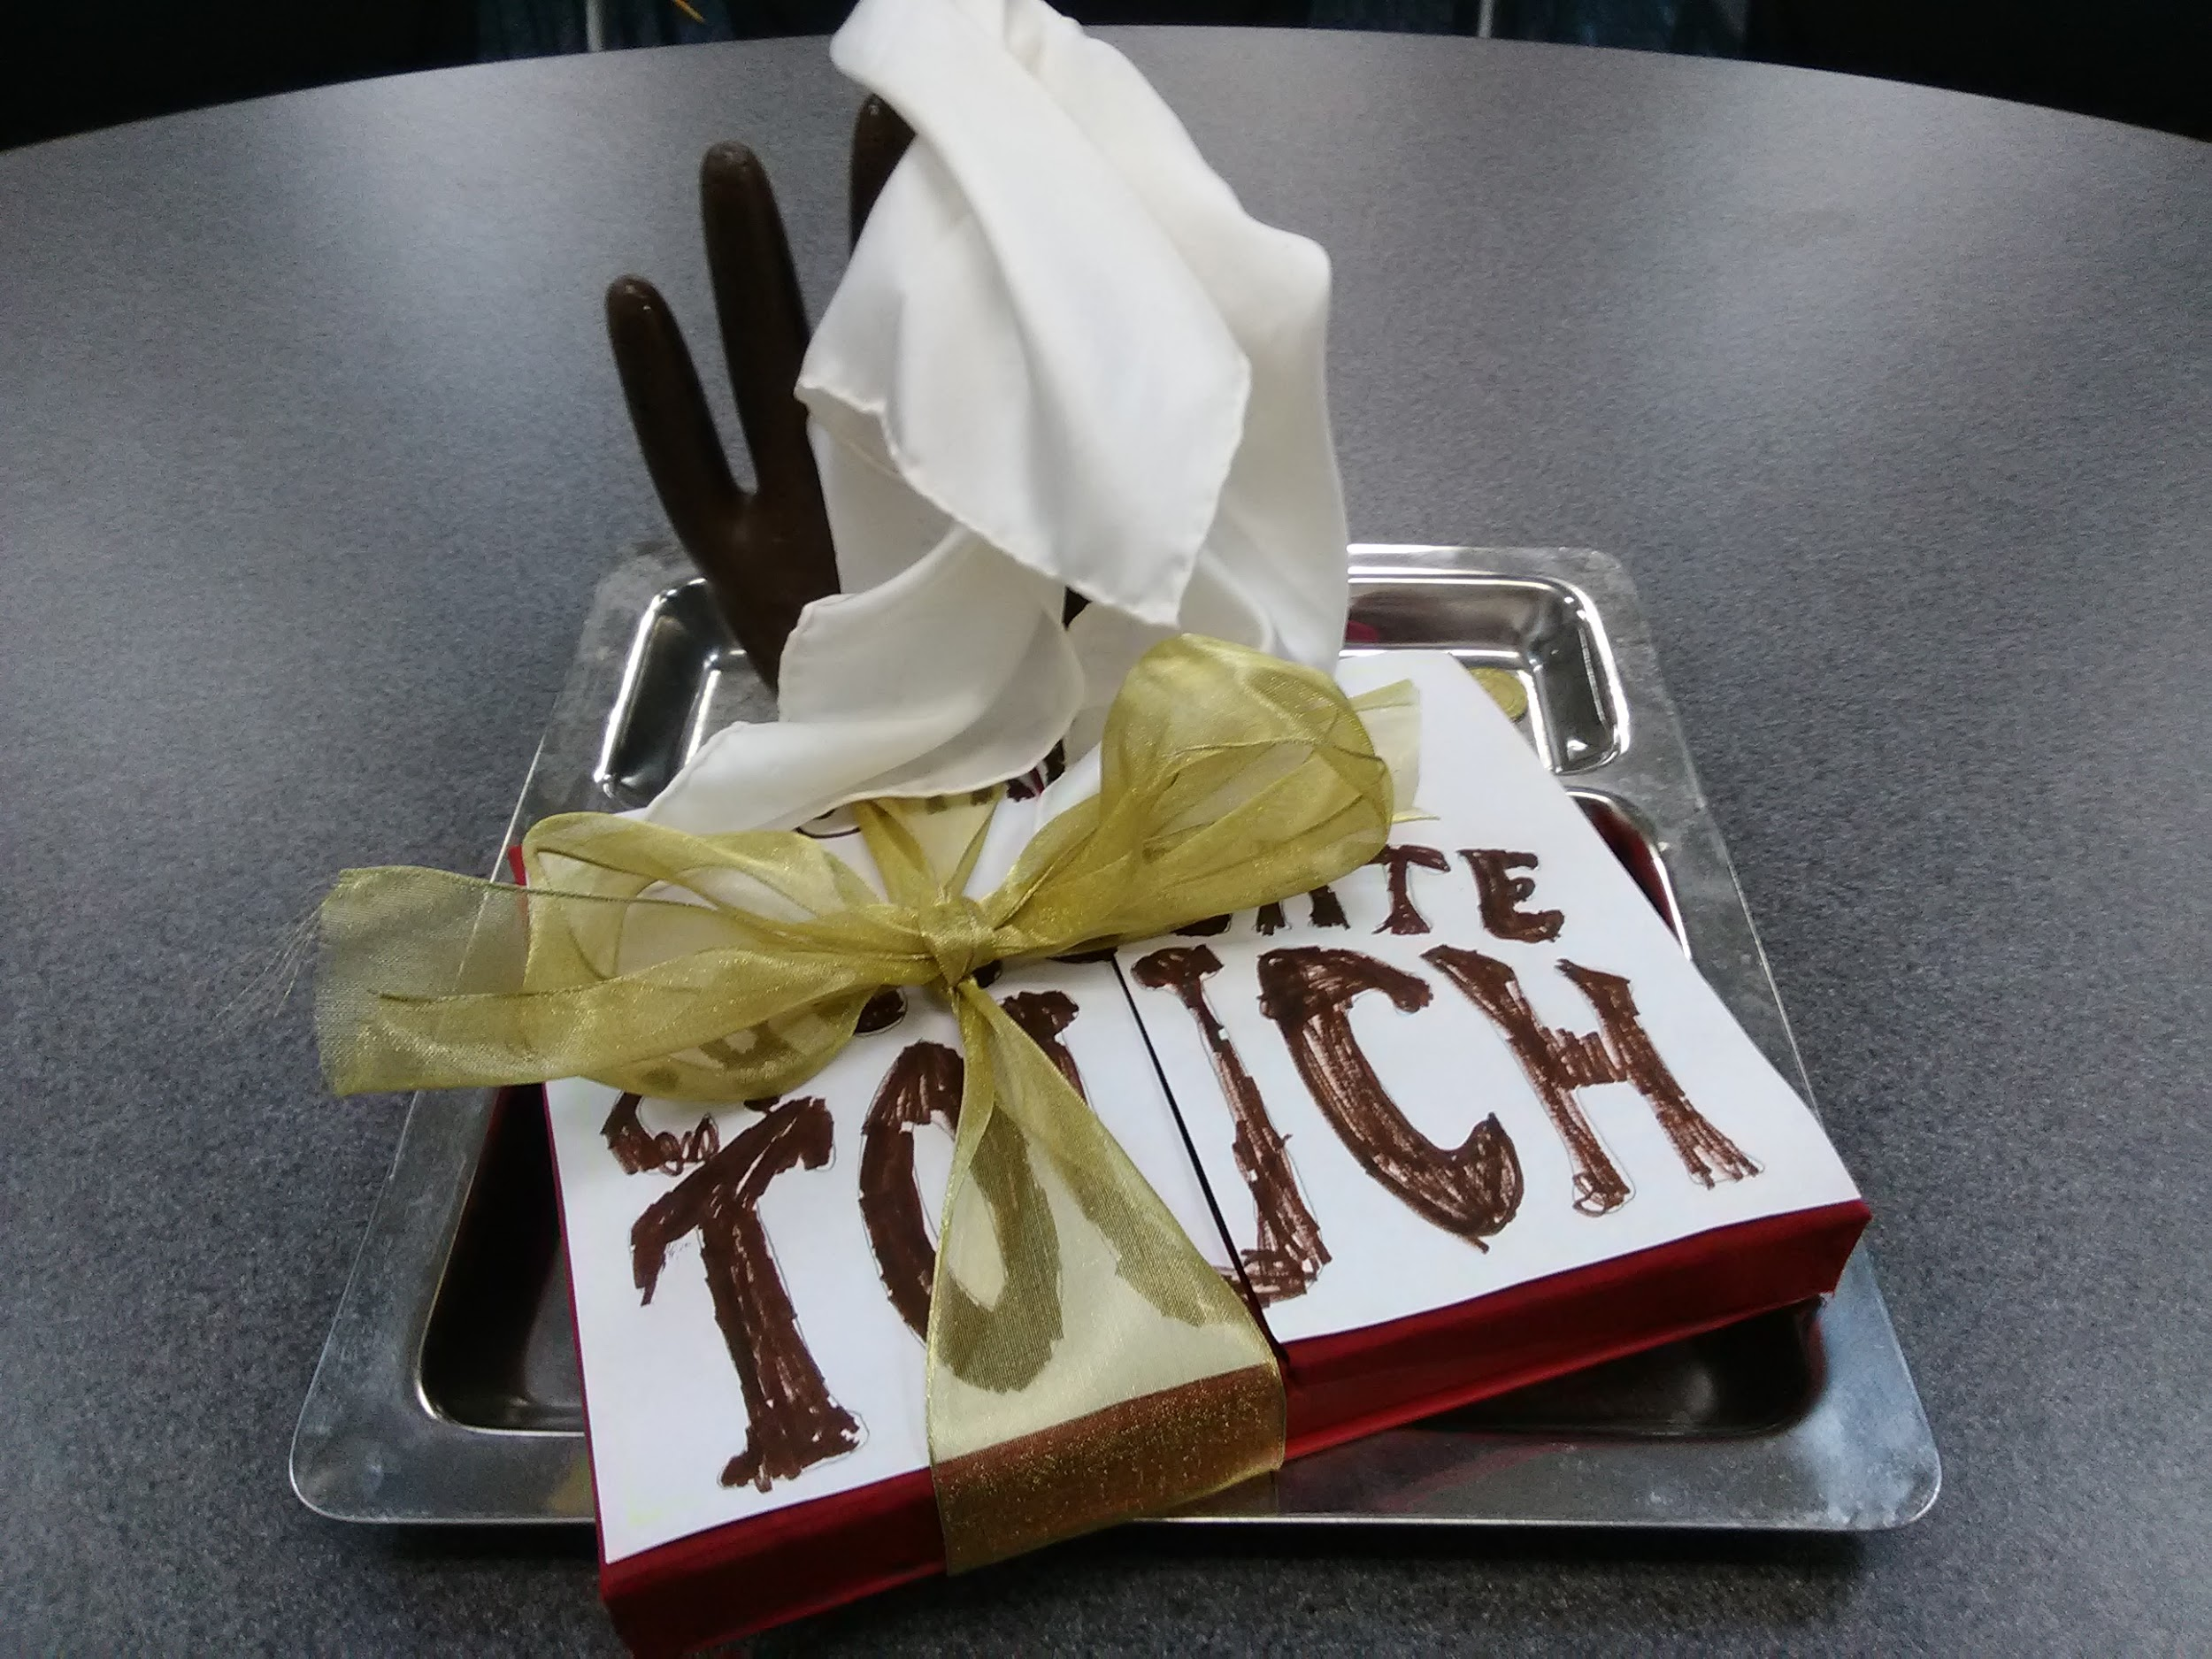
Control-Open Ended
Book Projects
Notes:
Gary -
*Literature response article placed on the back table (Brad Wilcox’s literacy class)
(e.g. dioramas, PowerPoint presentations, Google Slides, game boards, story cubes, mobiles, origami, iMovie, Chatterpix, science demonstrations, posters, et cetera)

Slide 16
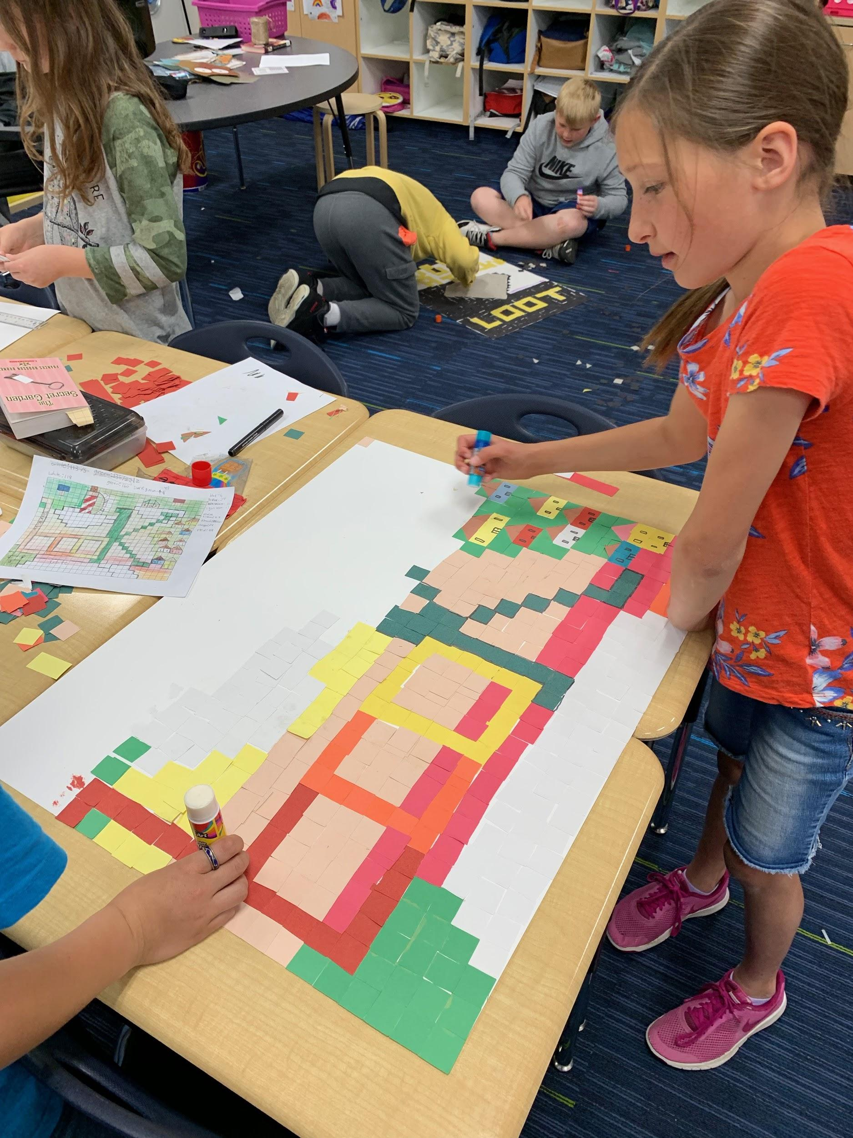
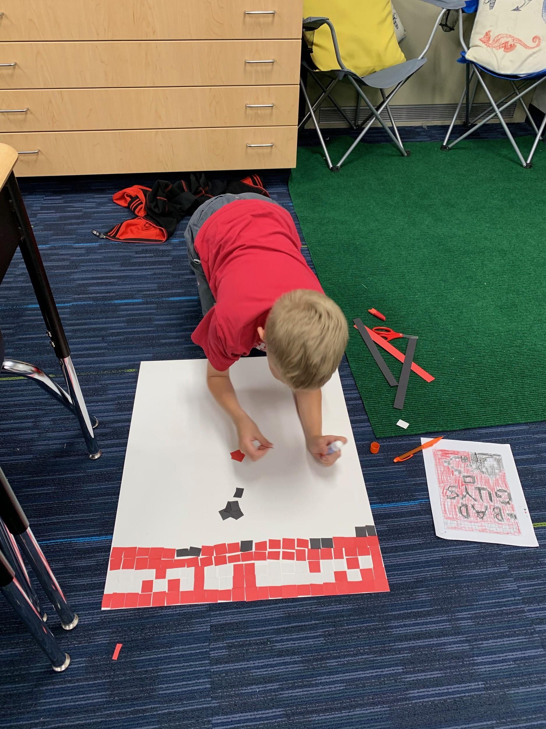
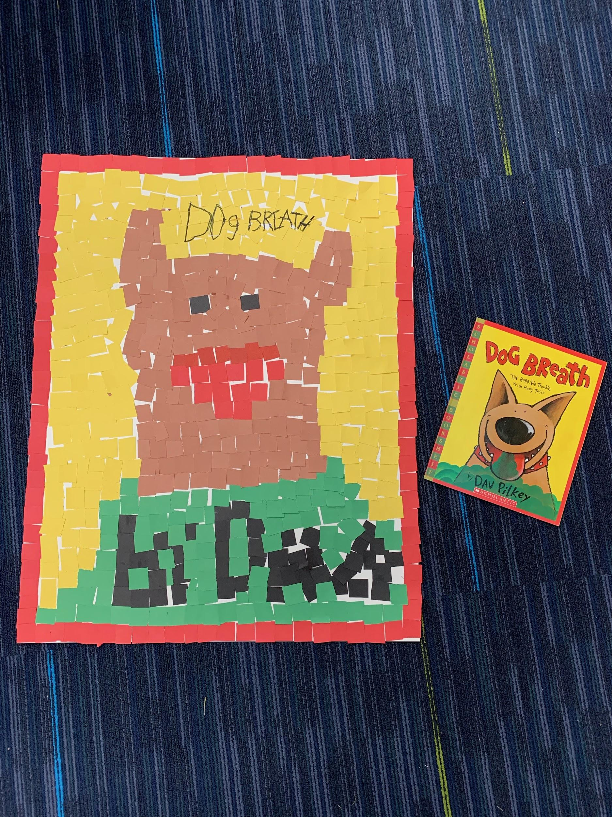
Choice-Book Projects
Notes:
Ashley

Slide 17
Technology

Slide 18
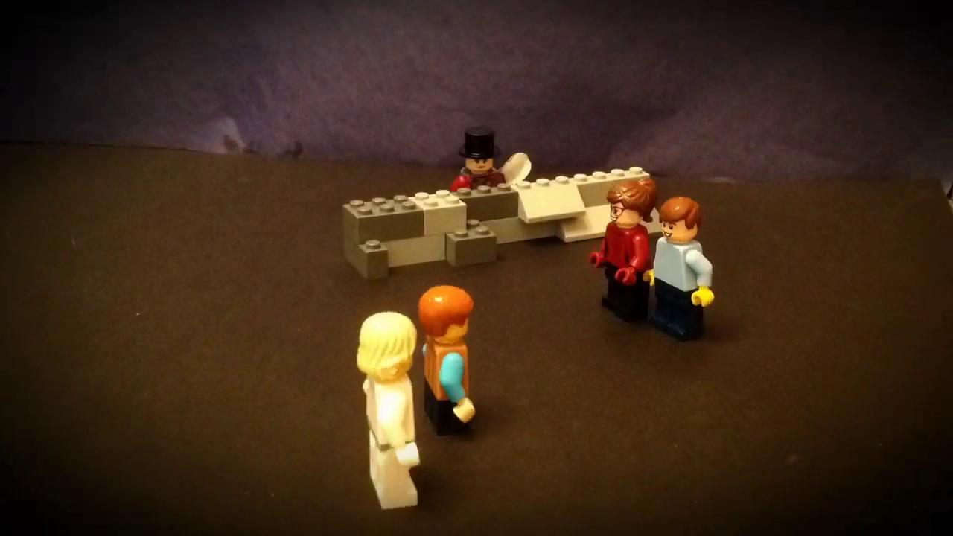
Technology--Stop Motion with iMovie
Notes:
Gary
Chatterpix and iMovie
Movie Trailers with iMovie
PowerPoint Presentations or Google Slides

Slide 19
Challenge

Slide 20
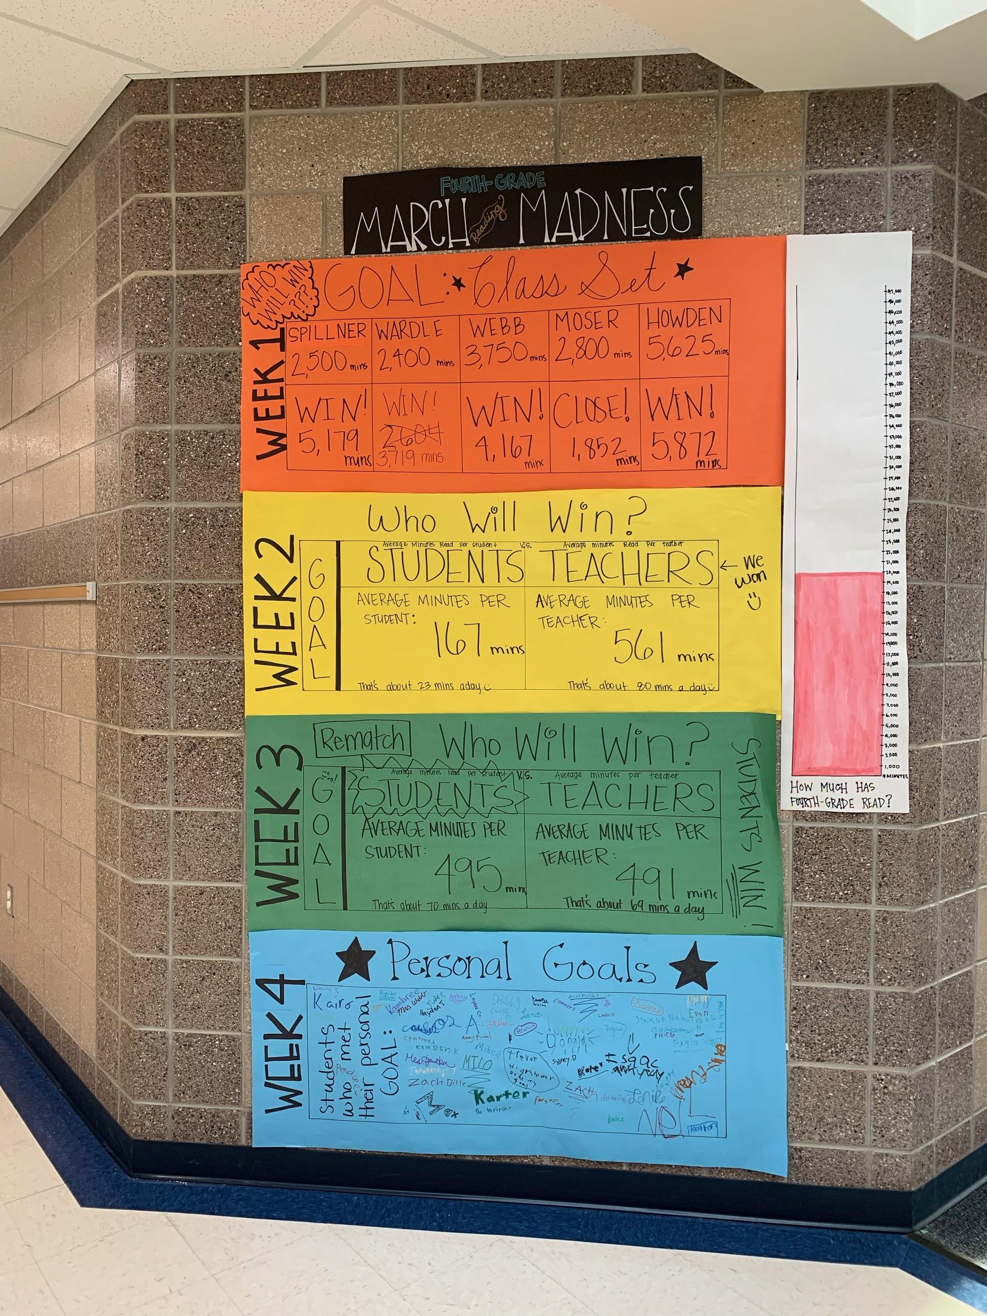


Challenge-
March Reading Madness
Notes:
Ashley

Slide 21
Proximate Rewards

Slide 22
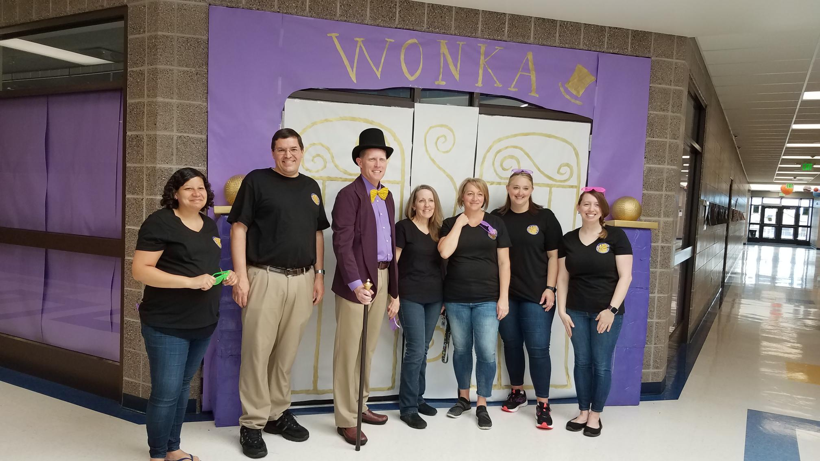
Proximate Reward - Charlie and the Chocolate Factory Event
Notes:
Ashley

Slide 23
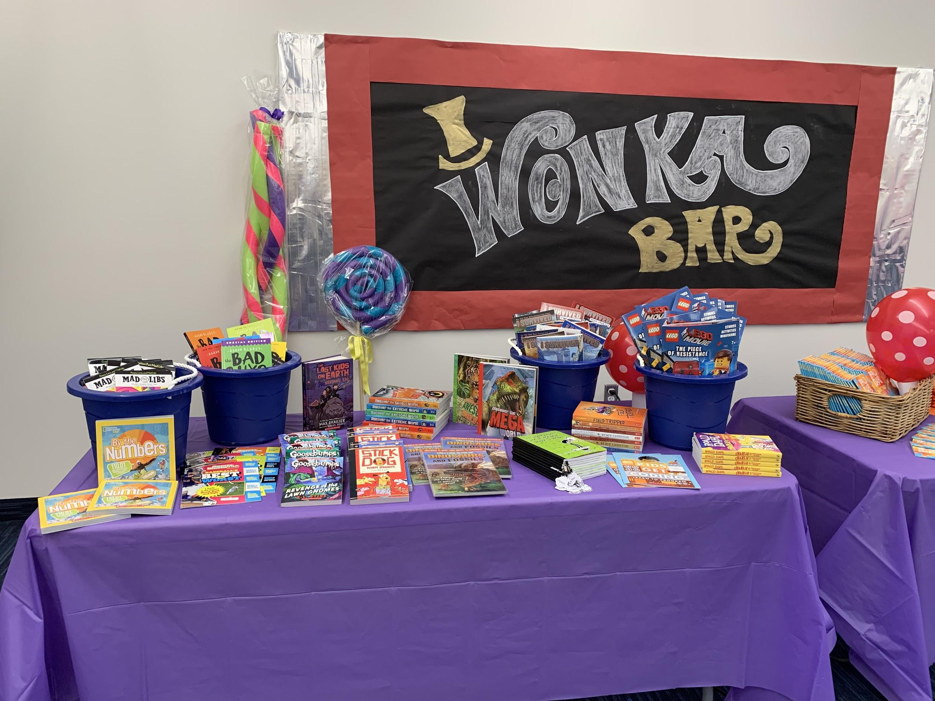
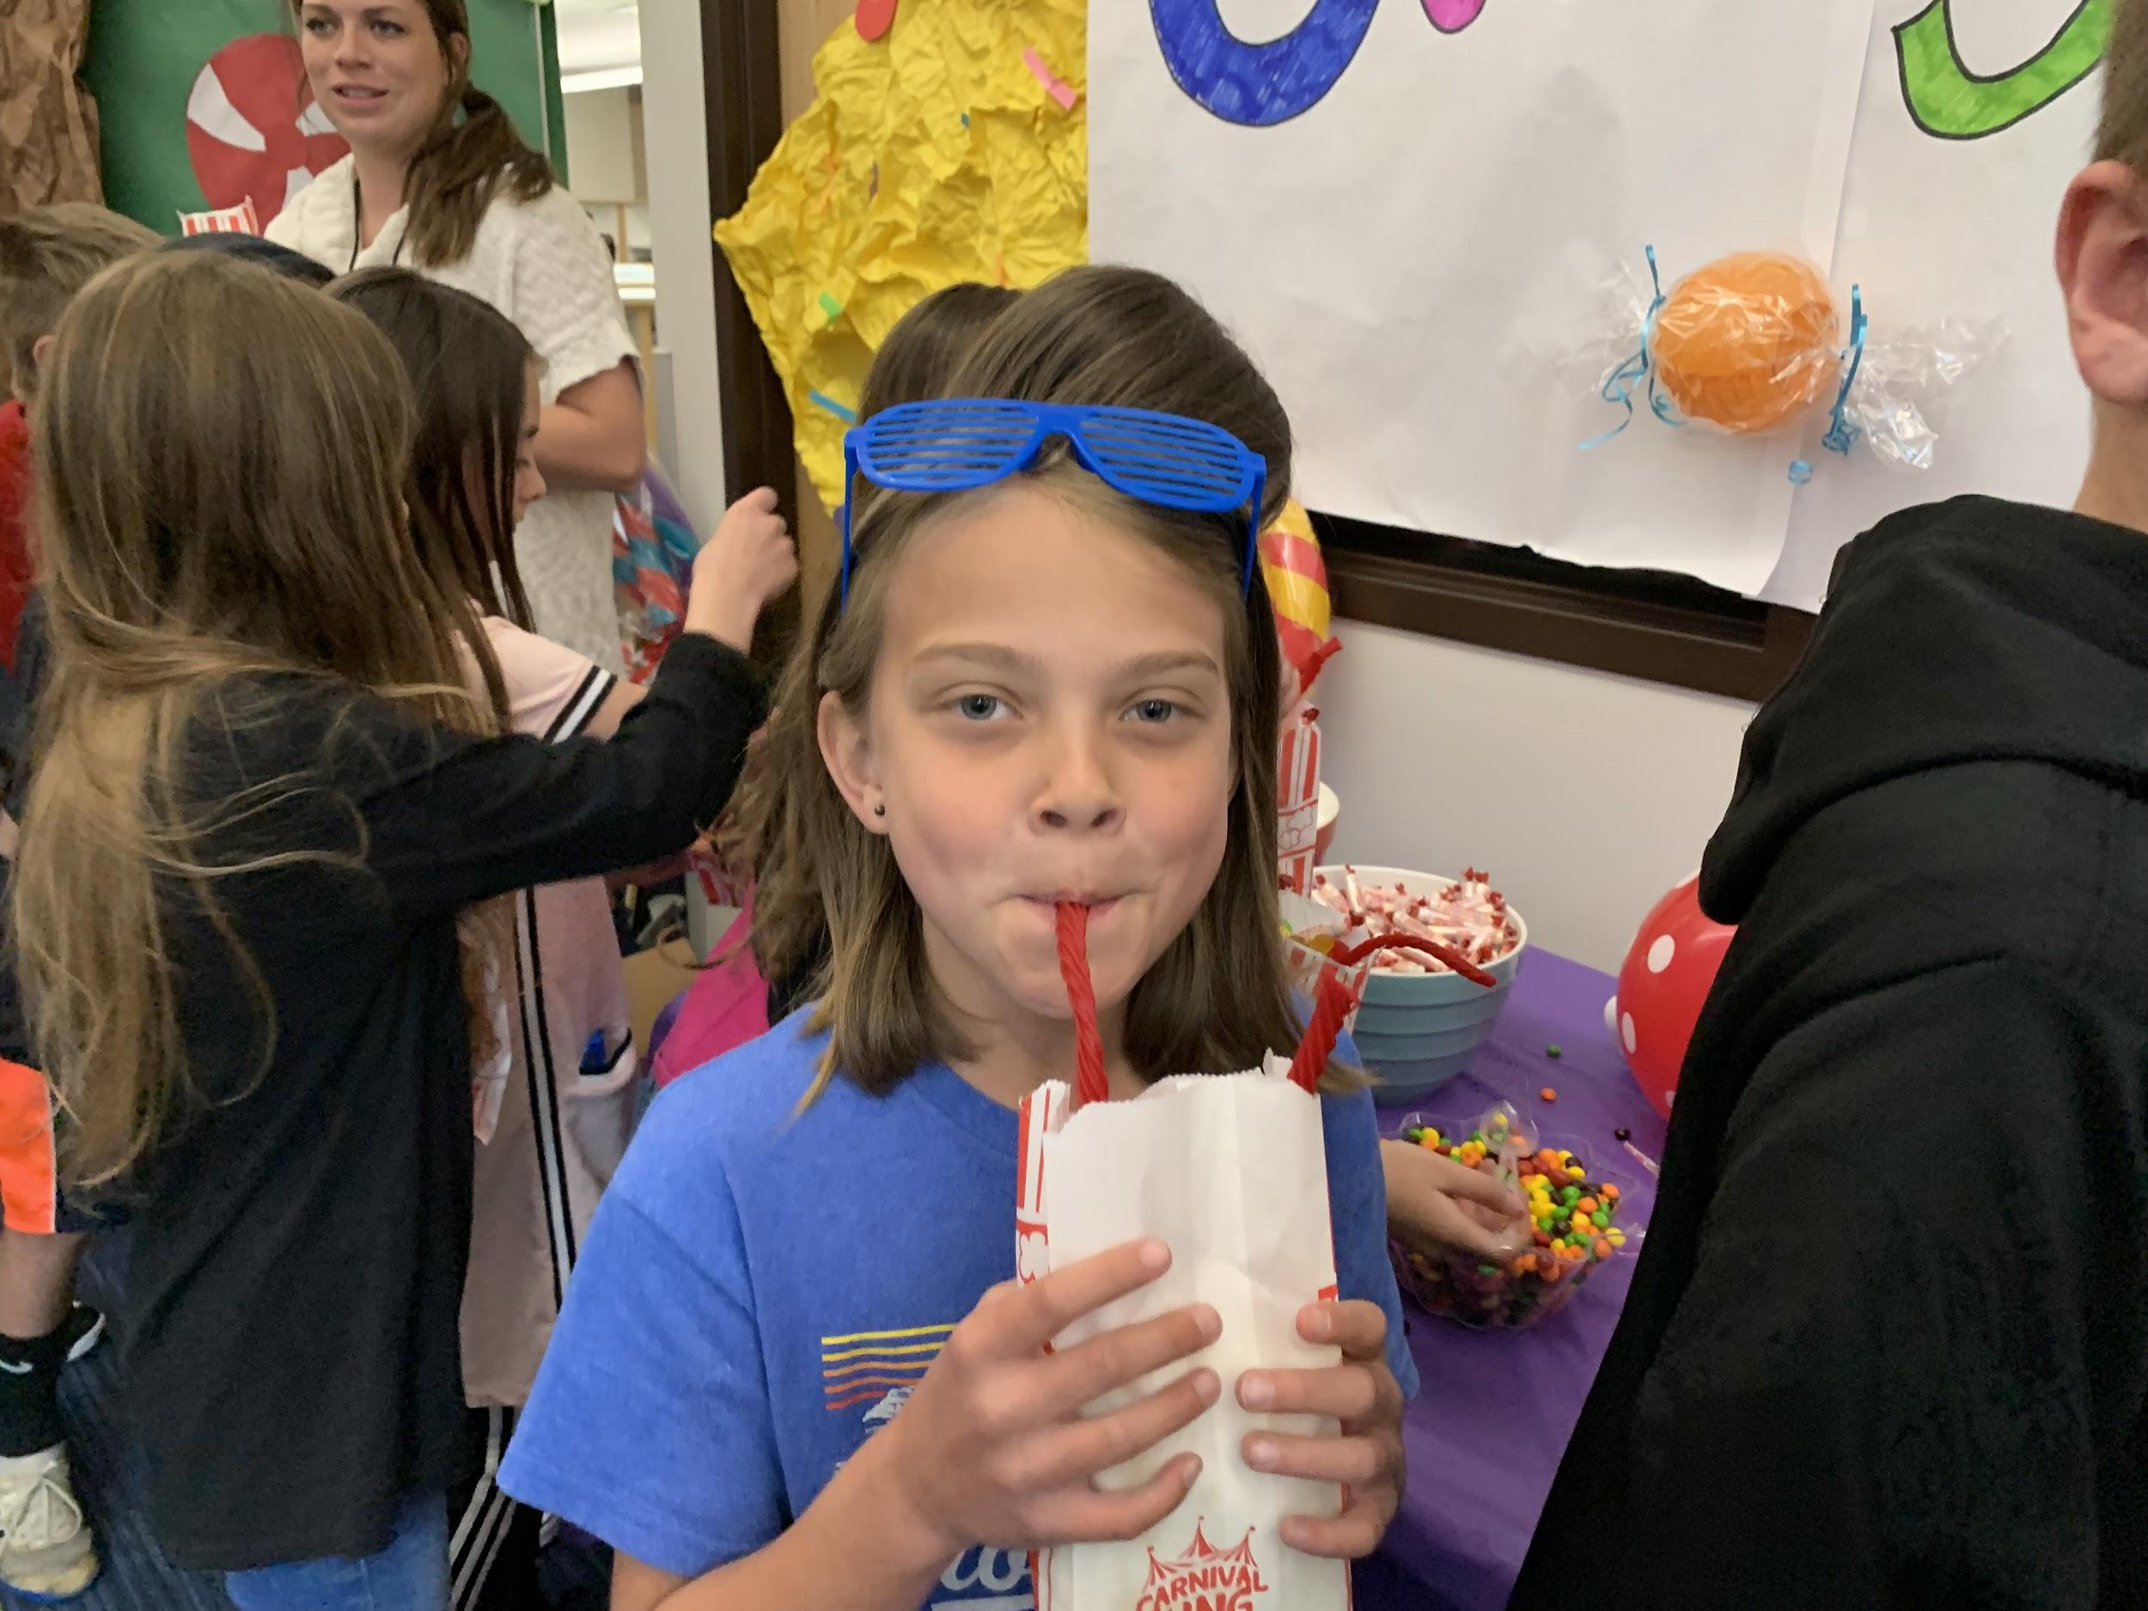
Proximate Reward - Charlie and the Chocolate Factory Event
Notes:
Ashley

Slide 24
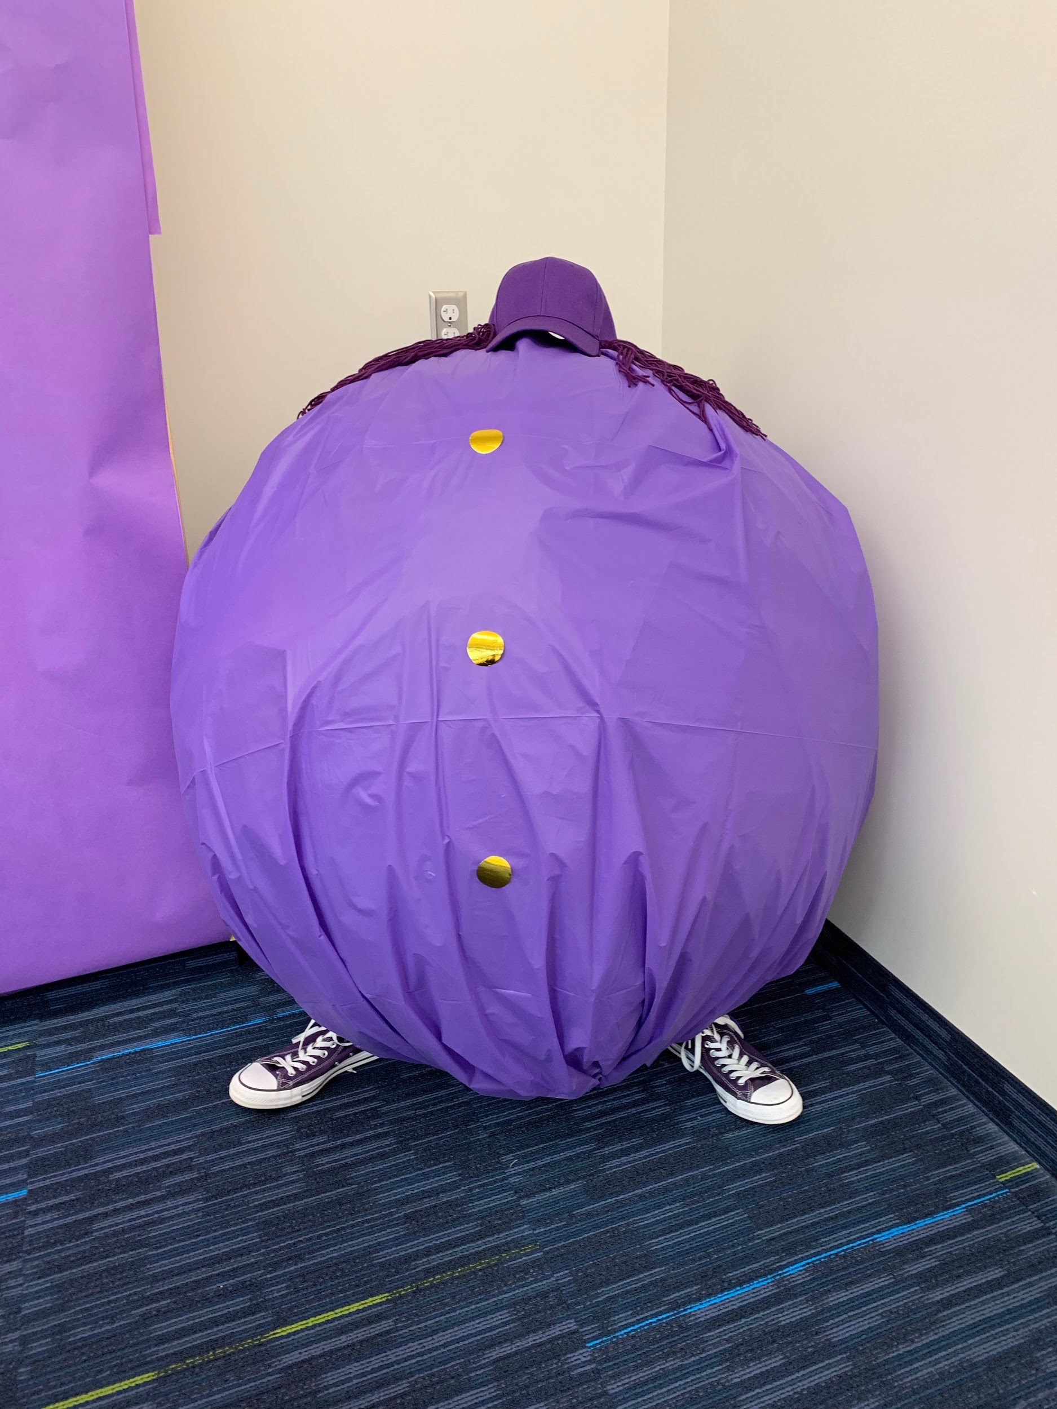
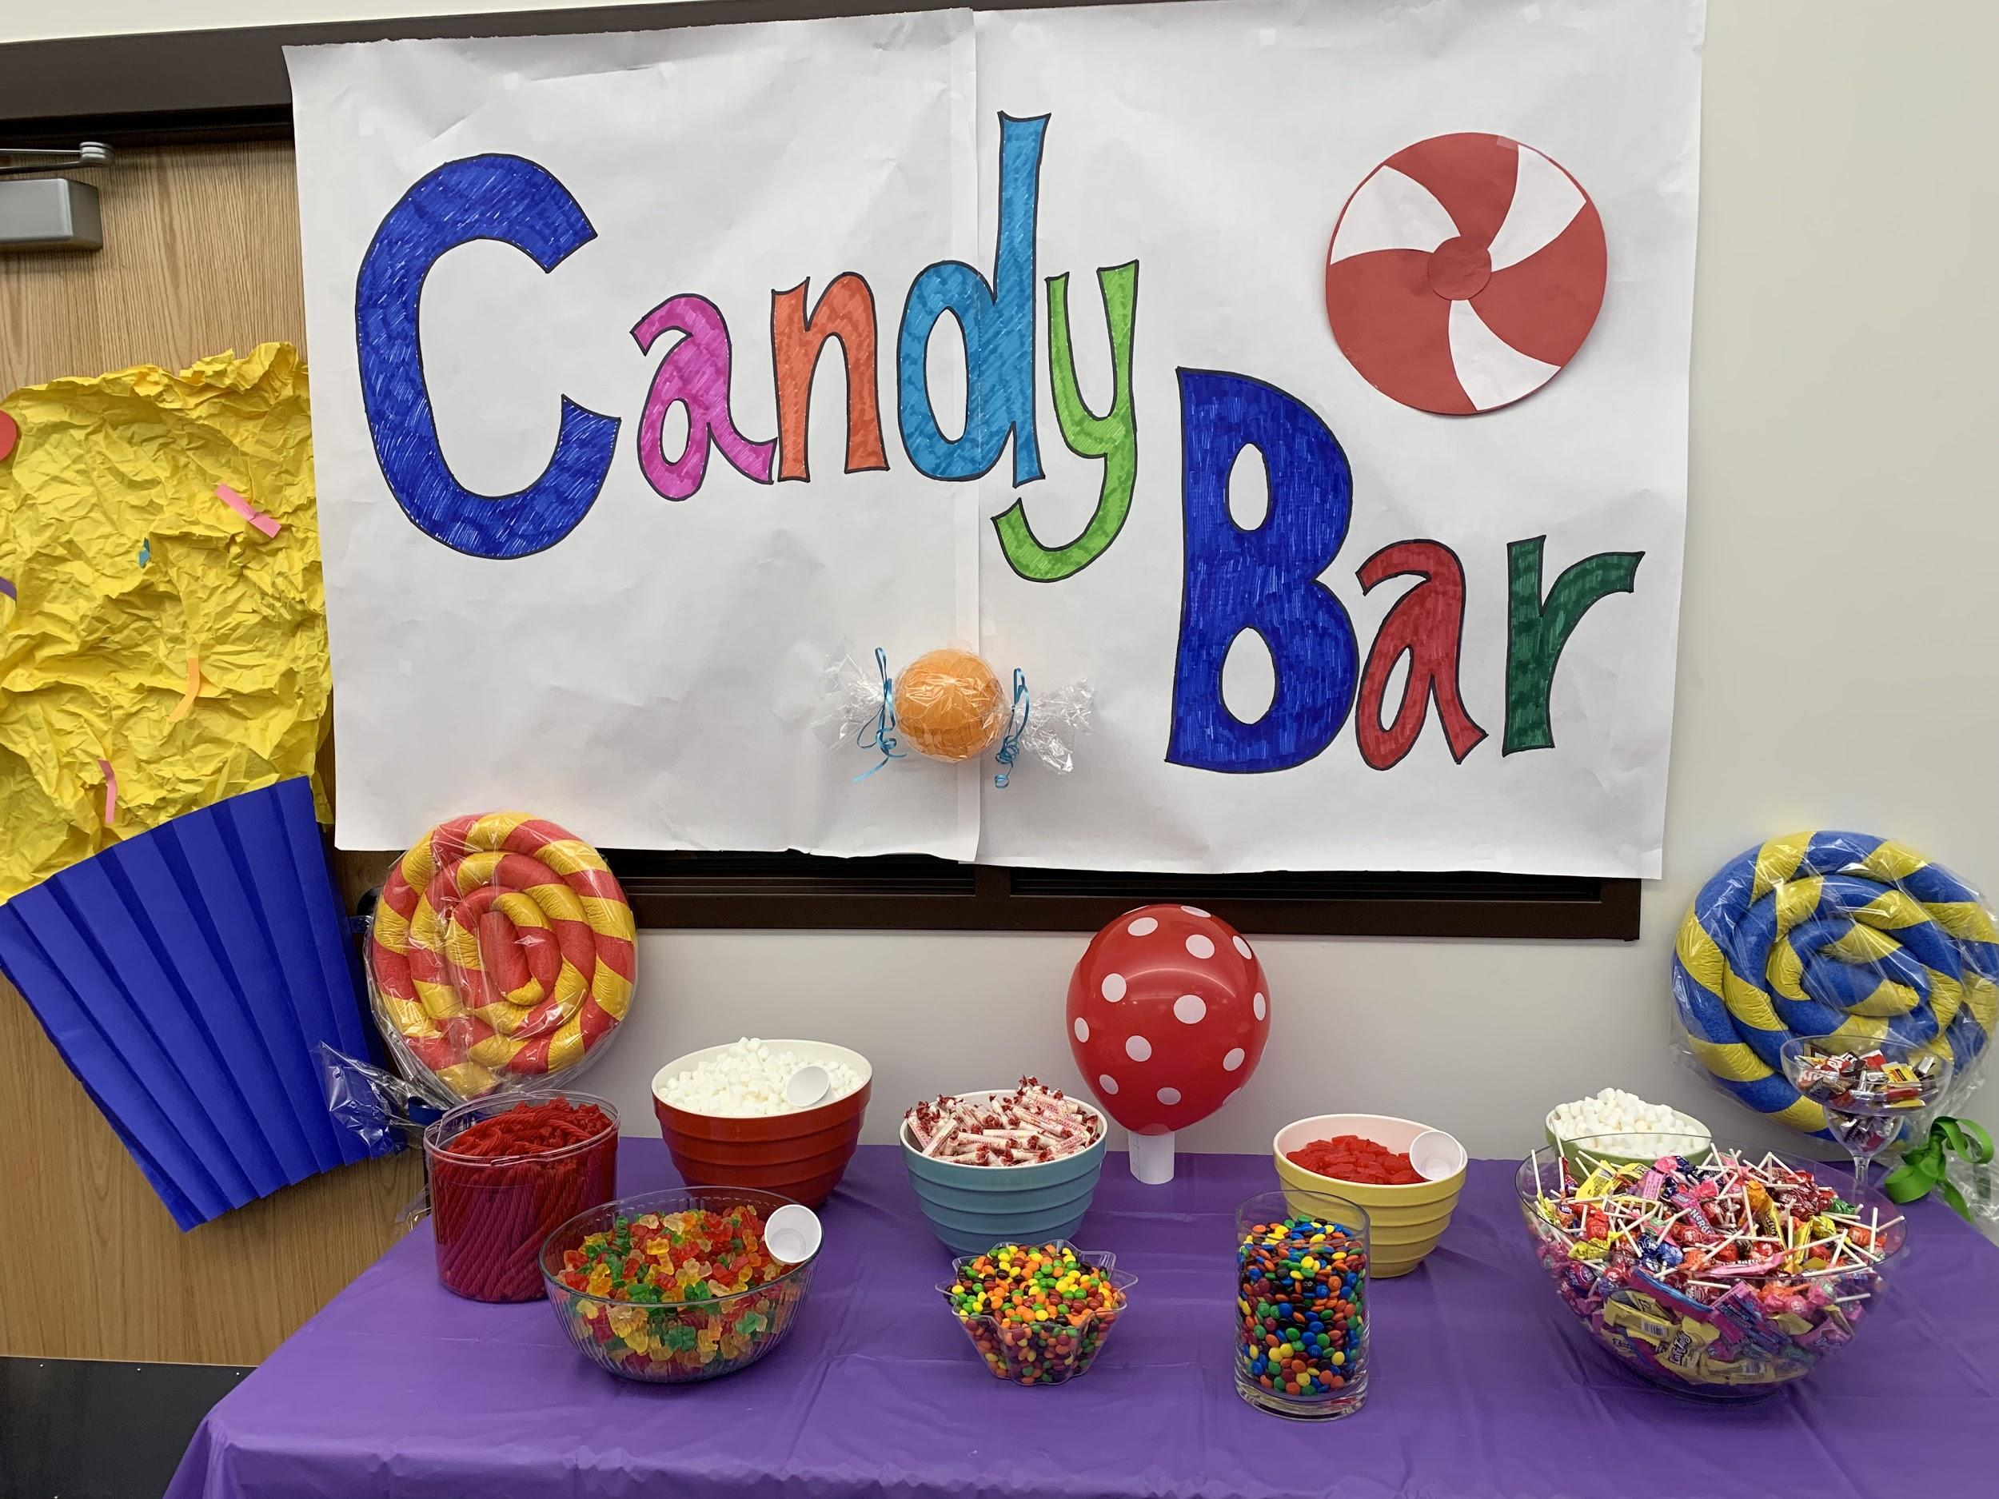
Proximate Reward - Charlie and the Chocolate Factory Event
Notes:
Ashley

Slide 25
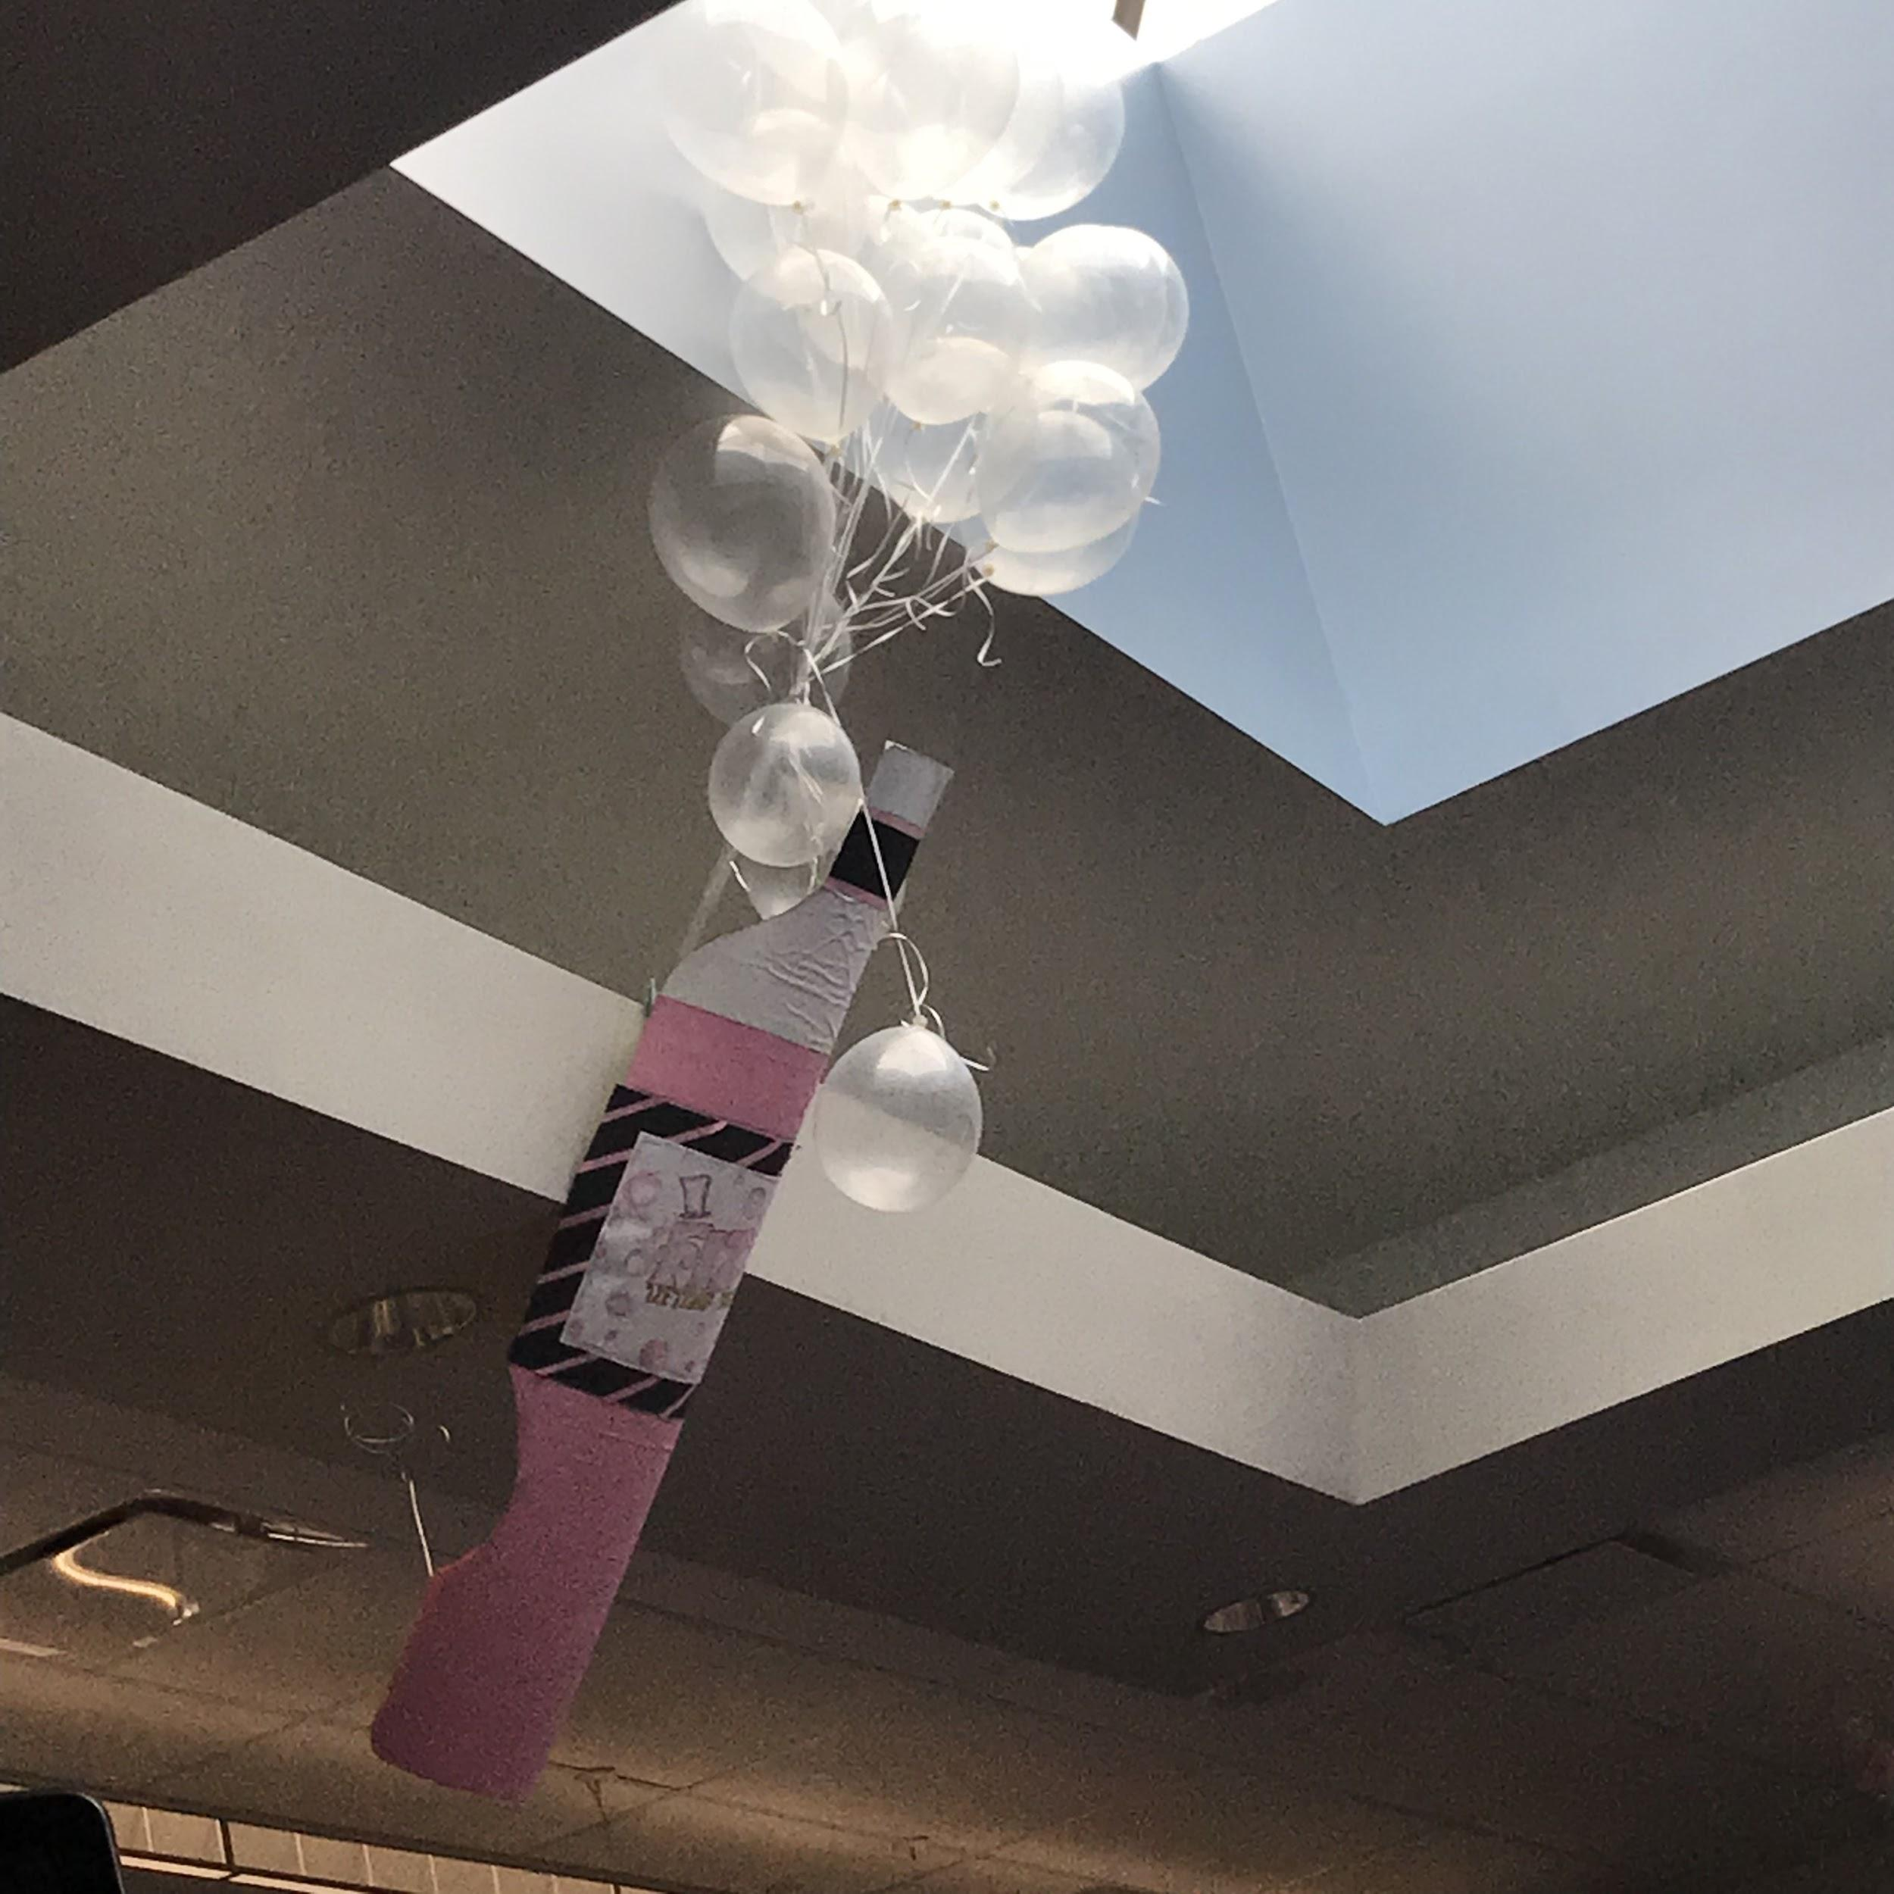
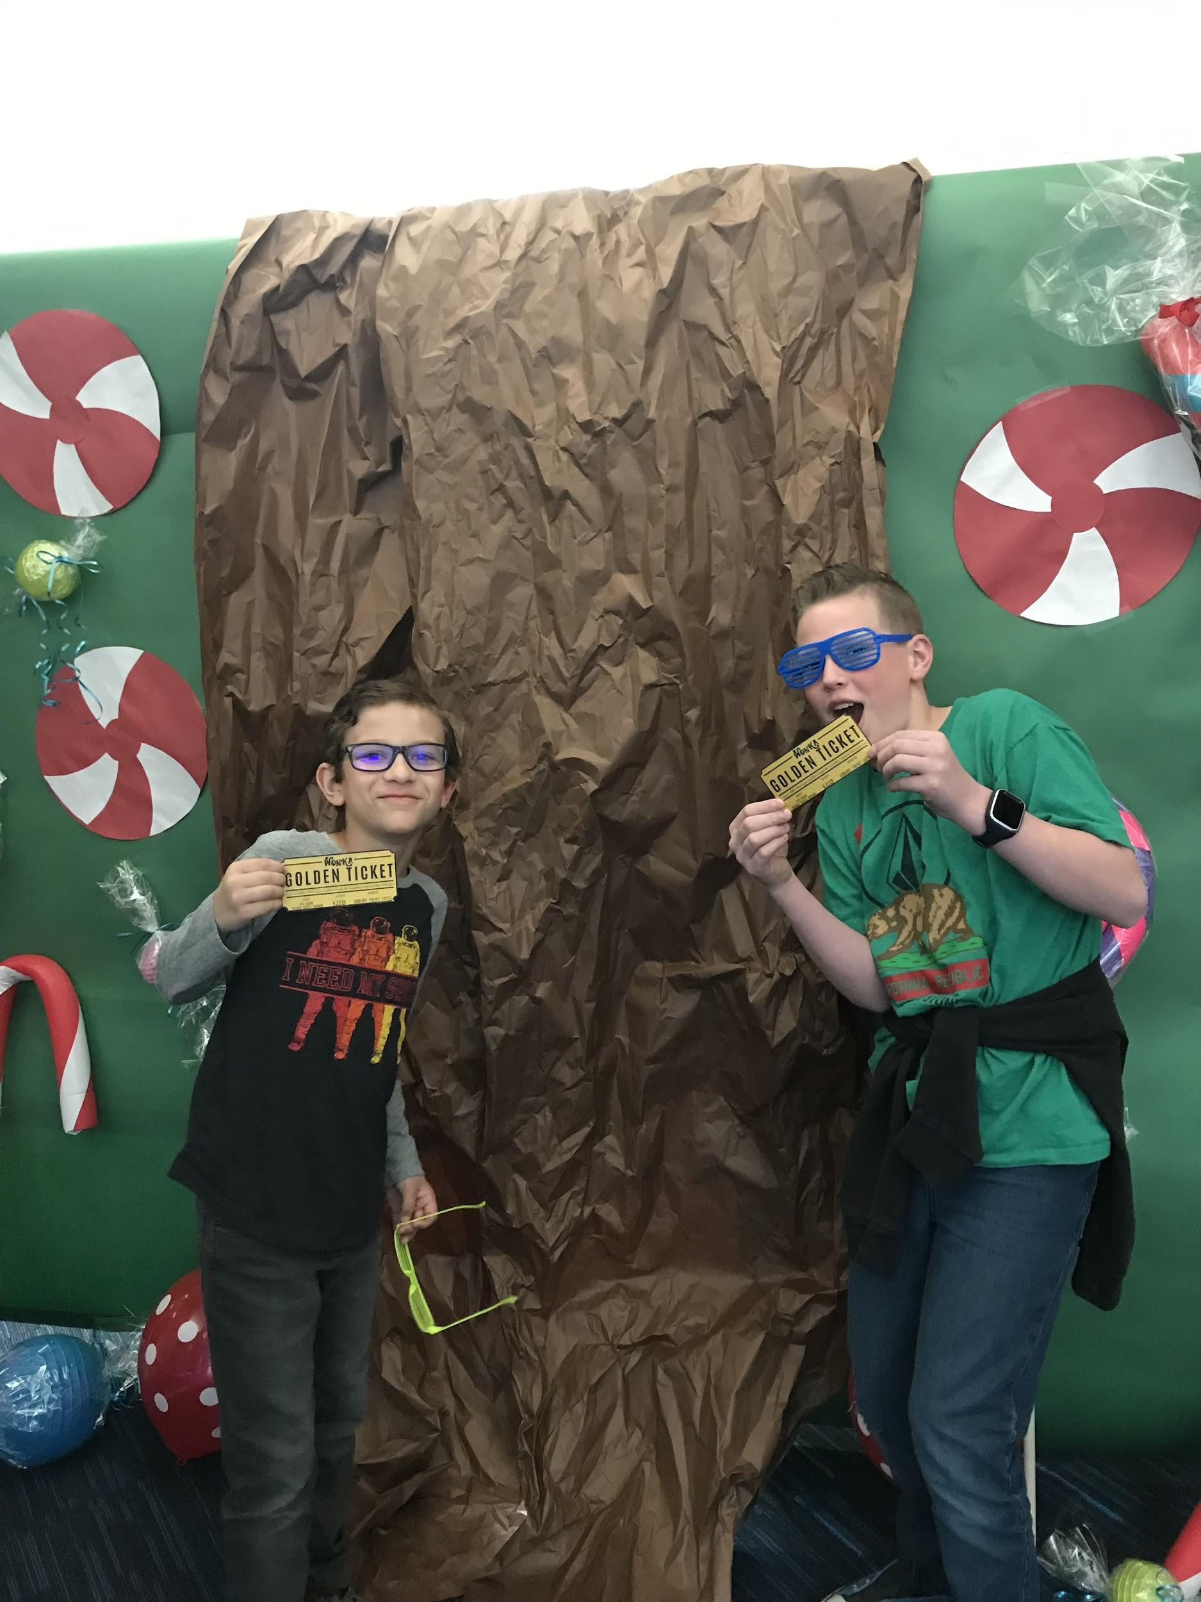
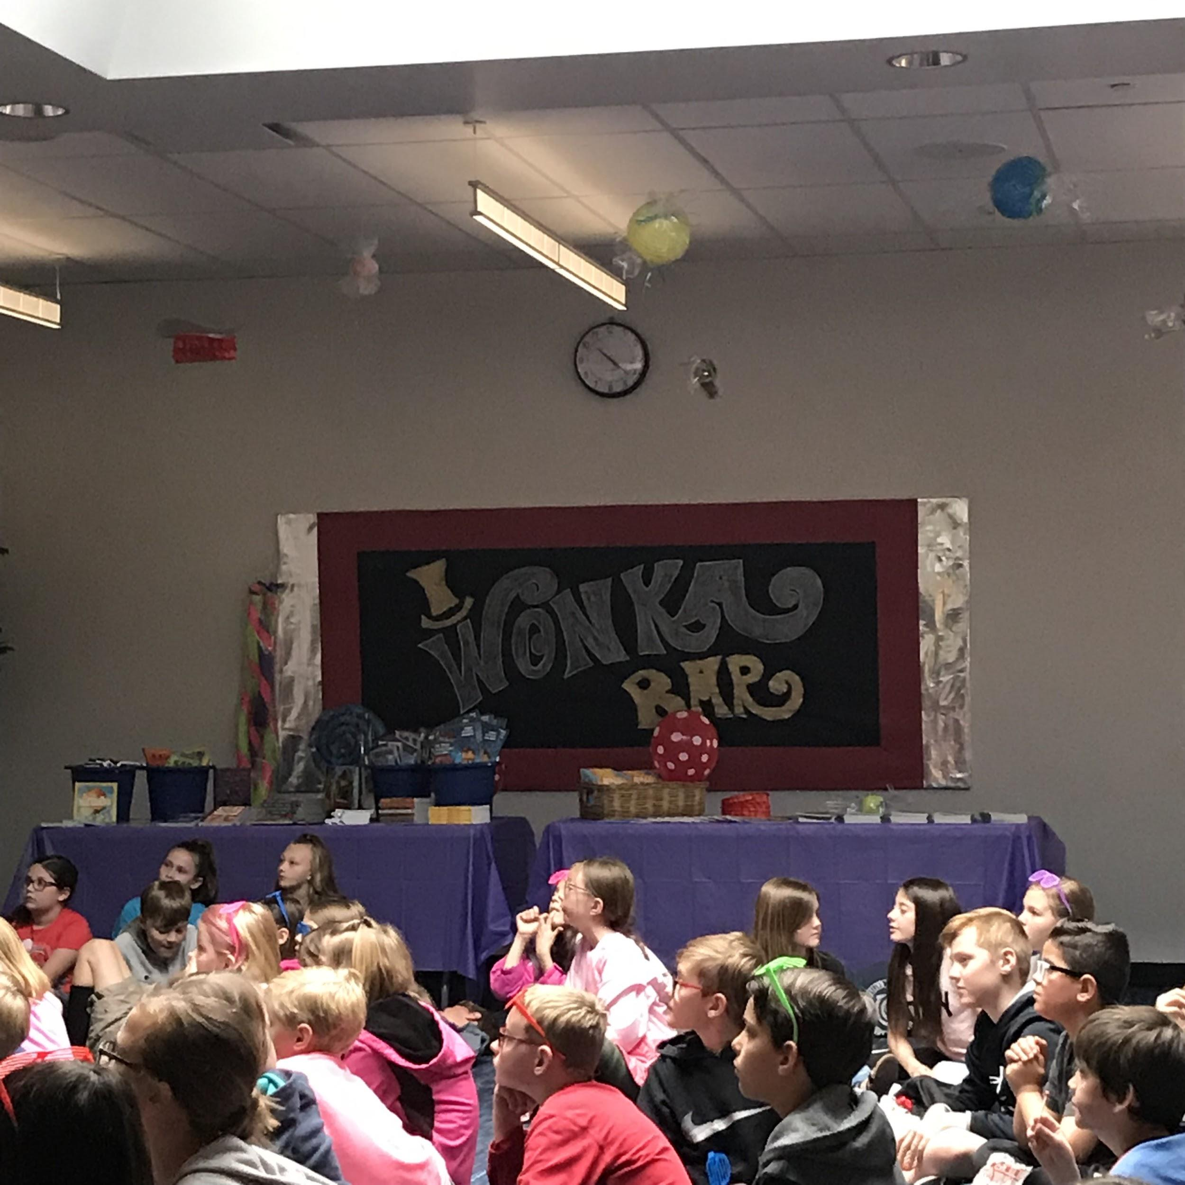
Proximate Reward - Charlie and the Chocolate Factory Event
Notes:
Ashley

Slide 26
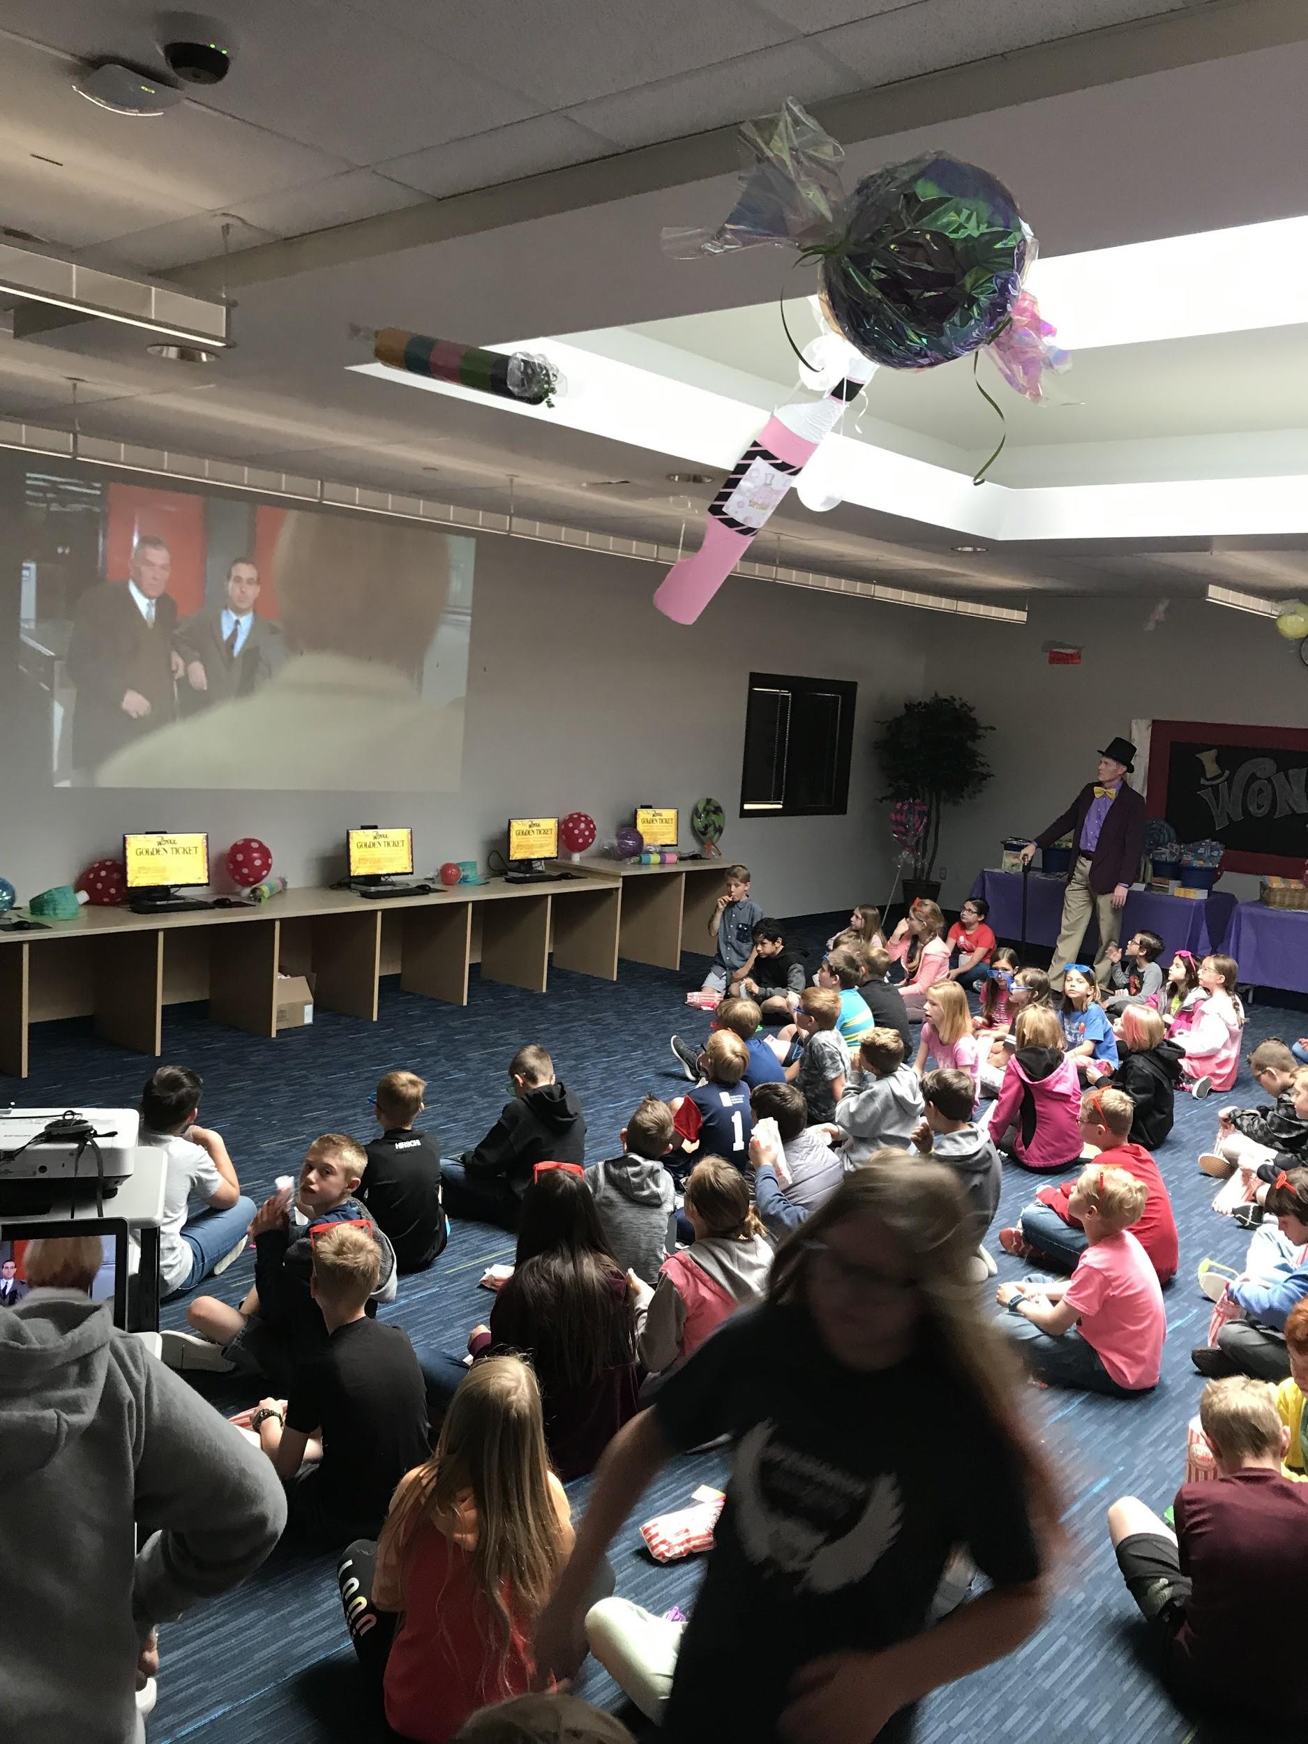
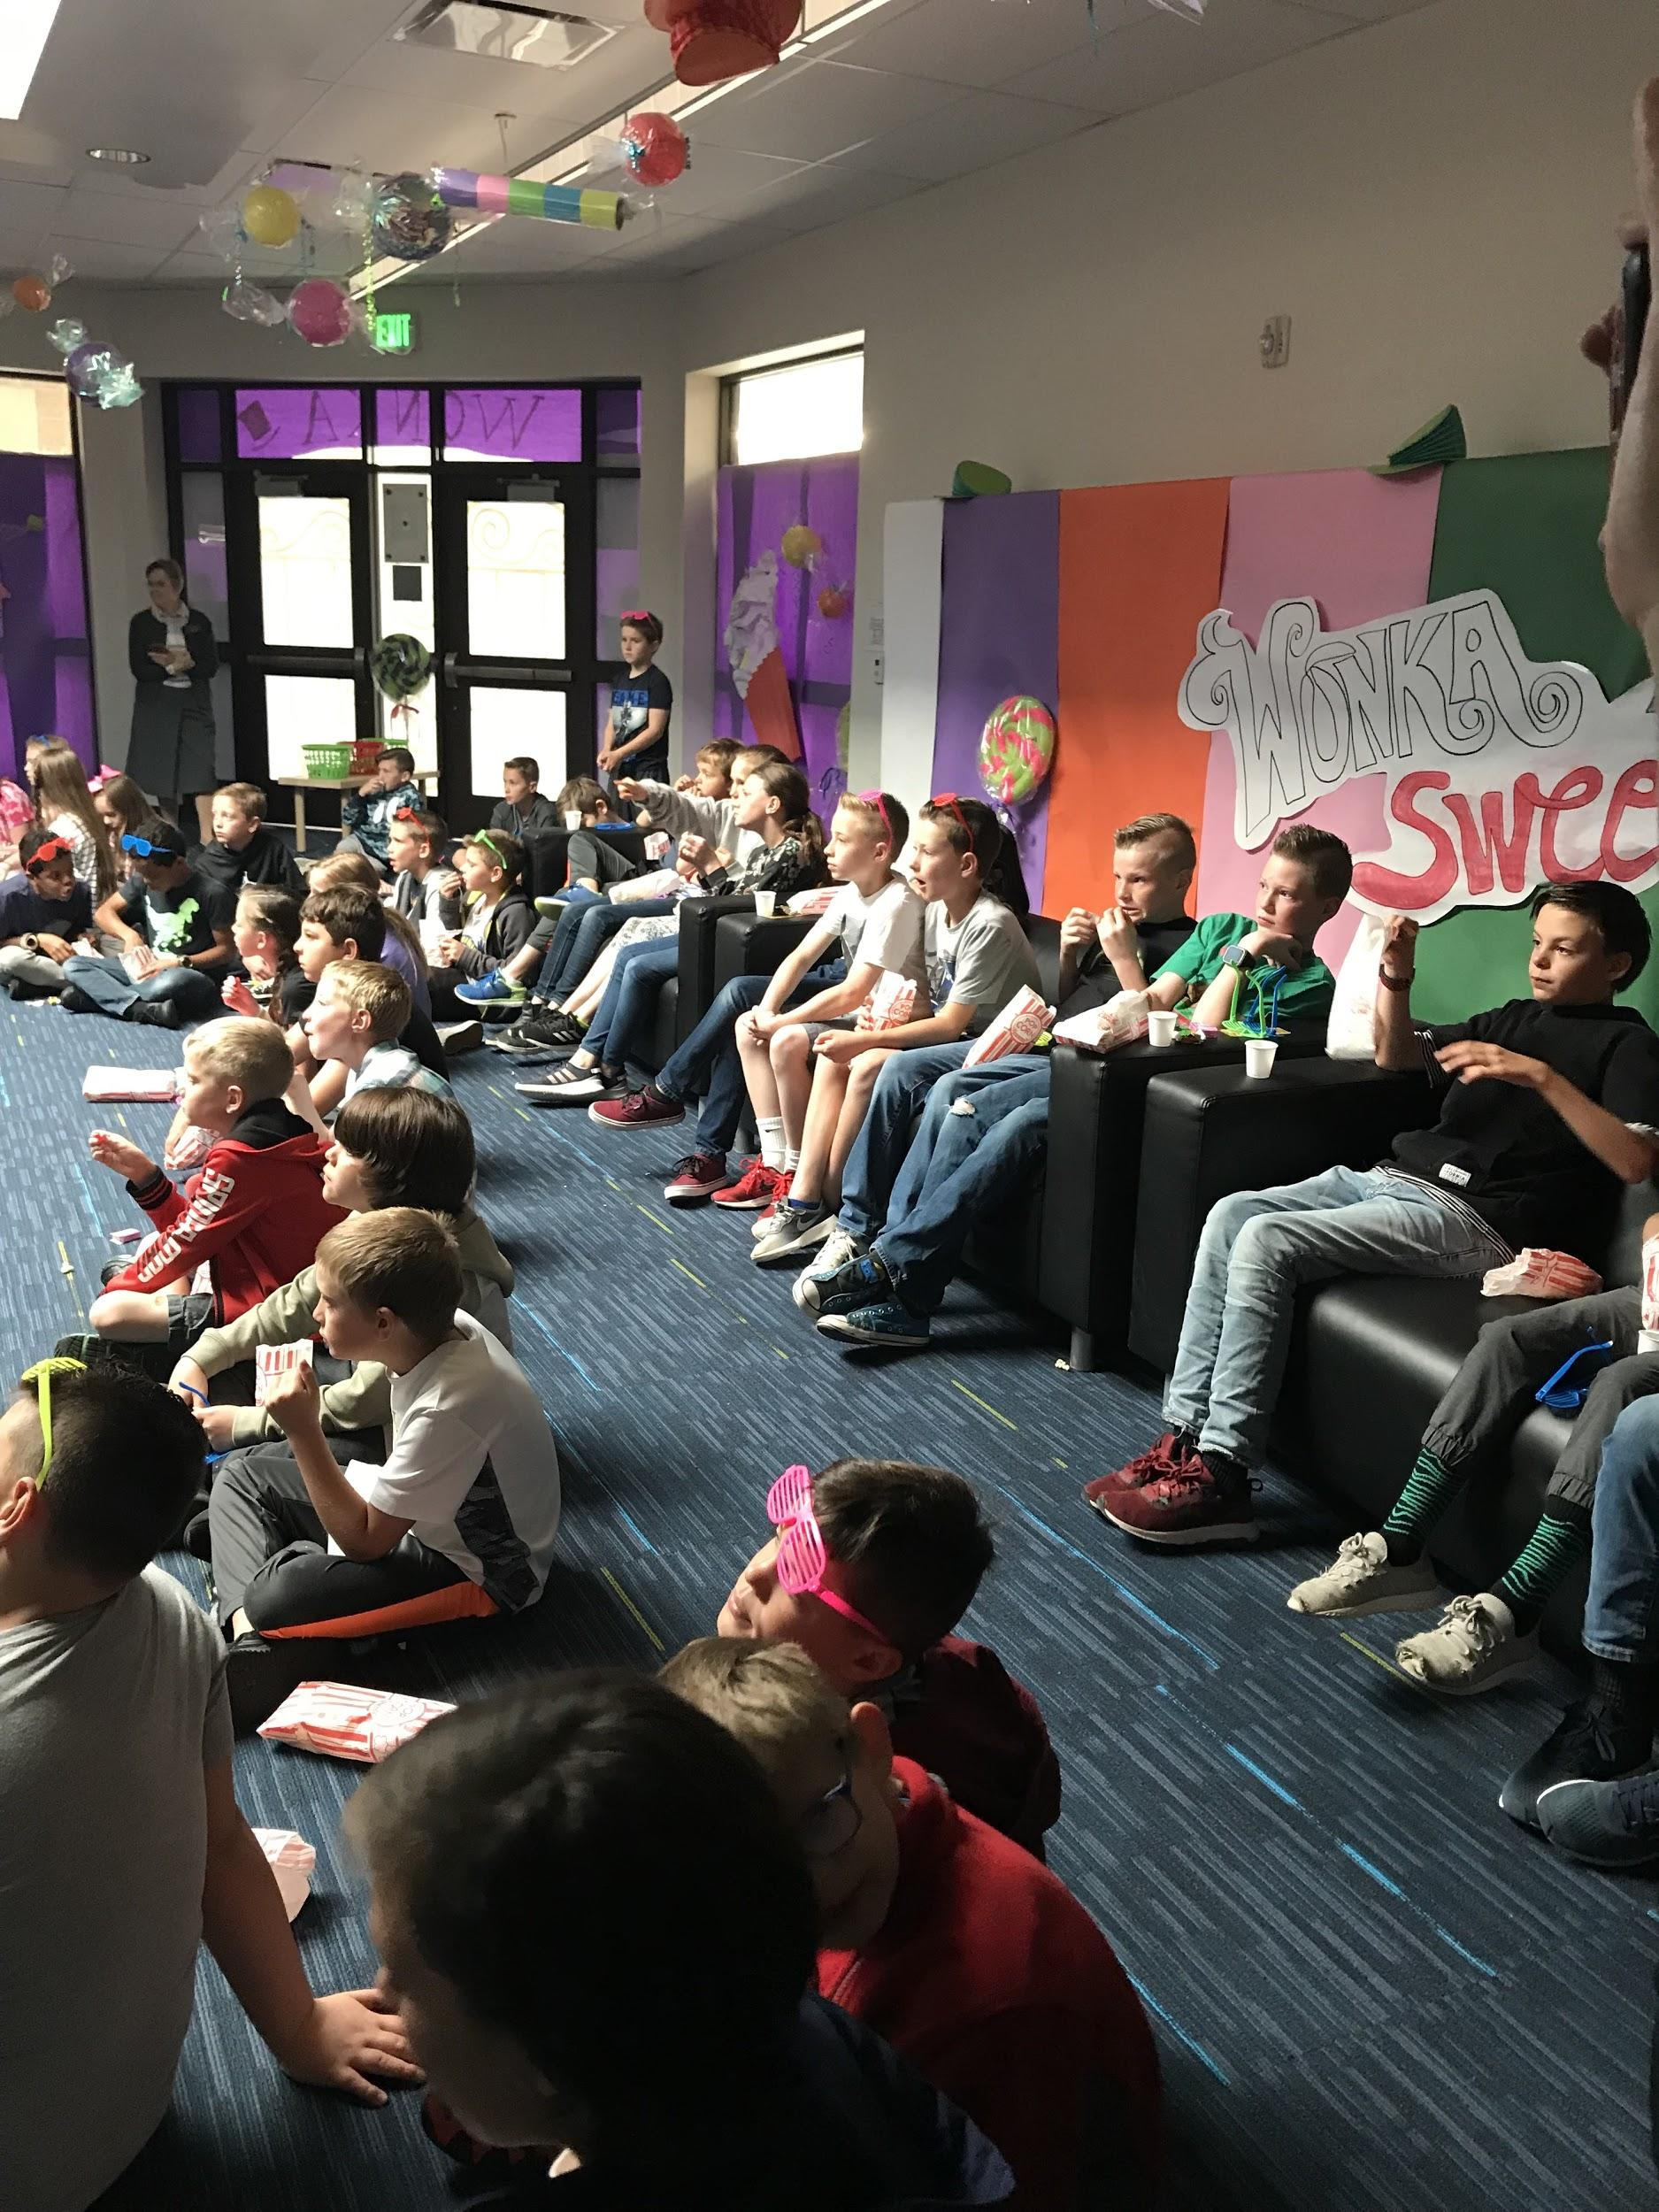
Proximate Reward - Charlie and the Chocolate Factory Event
Notes:
Ashley

Slide 27
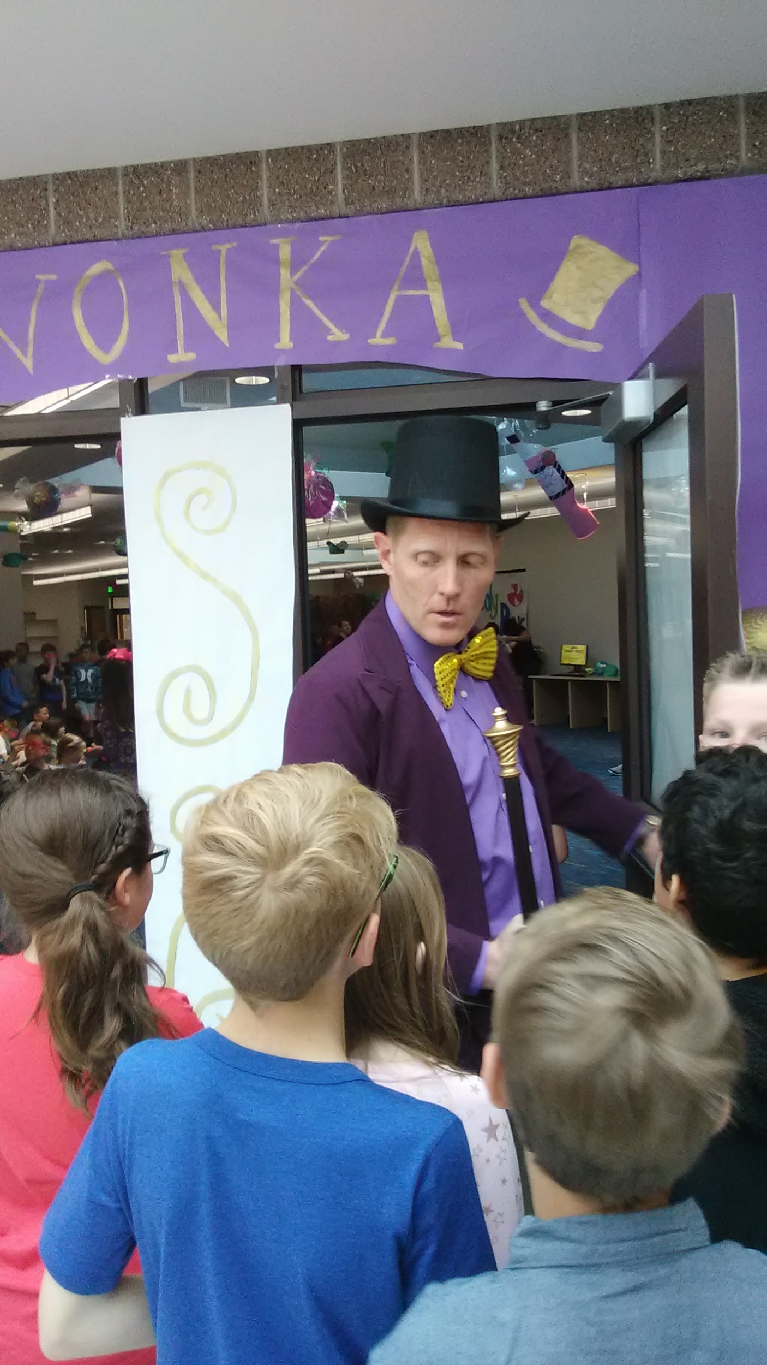
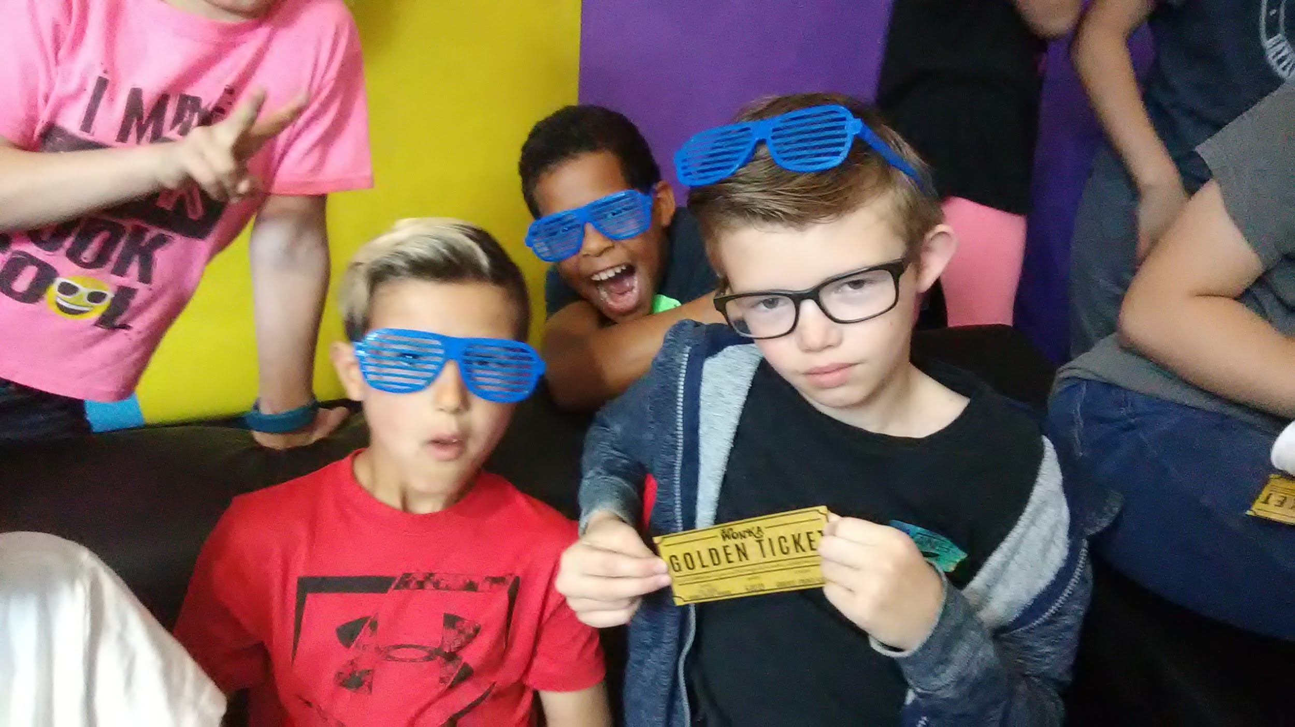
Proximate Reward - Charlie and the Chocolate Factory Event
Notes:
Ashley

Slide 28
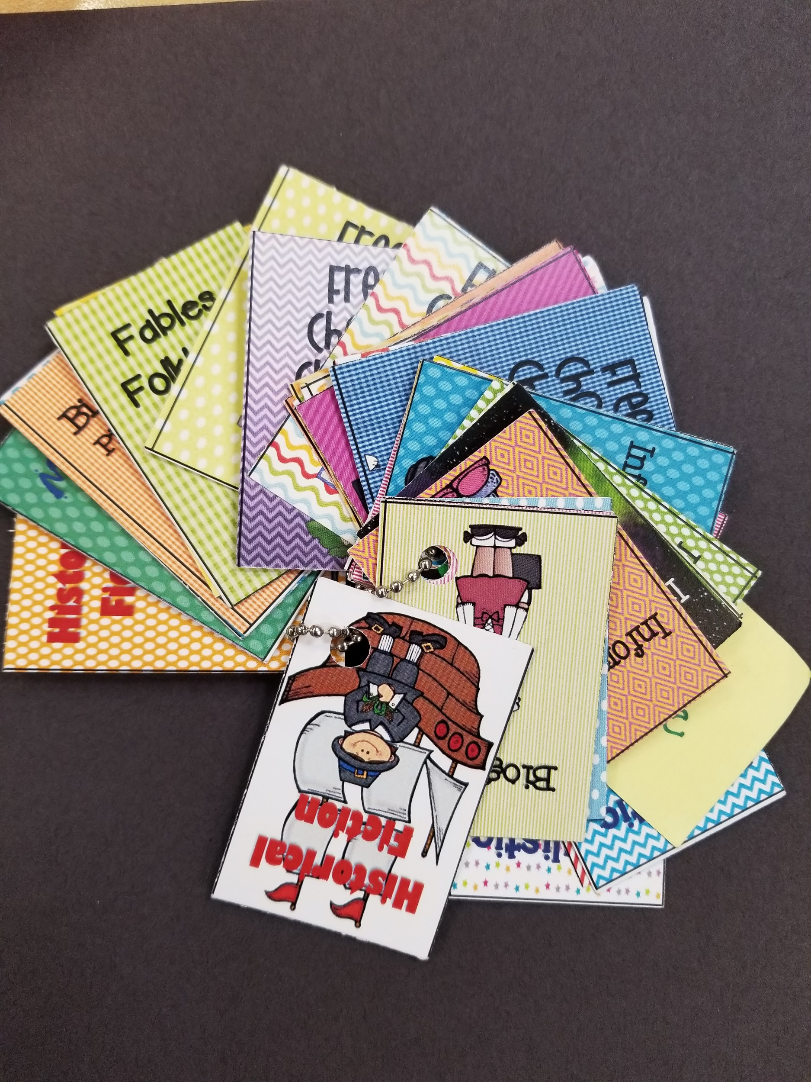
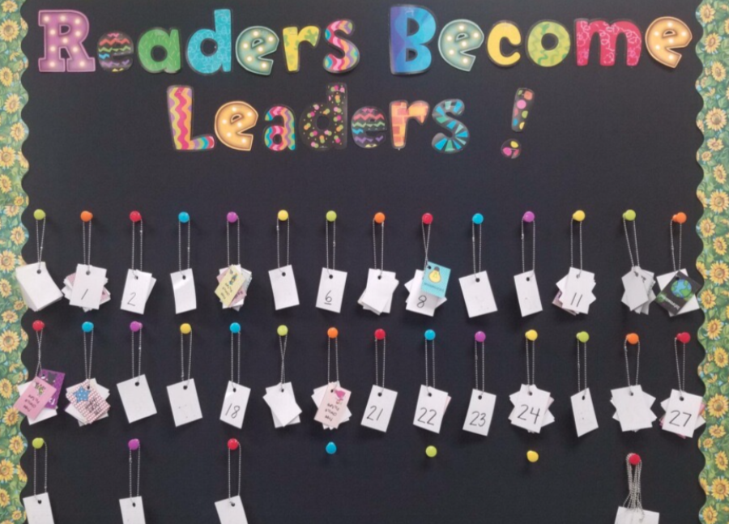
Proximate Rewards-Genre Book Tags
Realistic Fiction
Fantasy
Fables
Informational
Poetry
Mystery
Notes:
Diane - When students finish a book they will be awarded the matching Reading Genre Tag. The Students tags will be displayed on a bulletin board (on a chain) to show off their growing reading habits as they ventured into new and different genres to earn more tags. In the process of doing this, they will discovere new genres that they enjoyed and they will be reading MORE! The goal is to read at least 25-30 books from the different genres across the 180 days of the school year. Fairy Tale, Historical Fiction, Informational, Fables, Folklore and Legends, Poetry, Mystery, Biography, Fantasy, Picture Books, Science Fiction, Informational, Realistic Fiction., Free Choice Chapter, Free Choice Picture. (Some categories will be limited to encourage exploration of other genres. A cardstock sheet will be kept in a Monday folder and then sent home each week. The parents will need to sign off that their child completed the book. Cards will be awarded each Monday that the student will add to their chains. A student will choose whether to do a book or two in a week, or take a couple of weeks to complete a book. (This is similar to a reading passport, however, the books read will be recorded on a cardstock and rather than “stamps” a card will be awarded from the students to put on their chains.

Slide 29
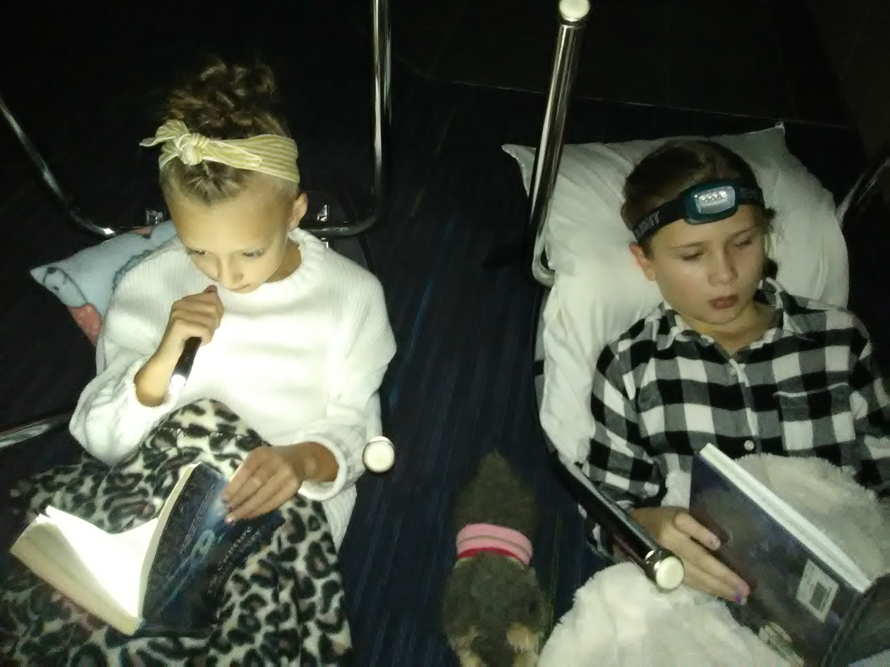
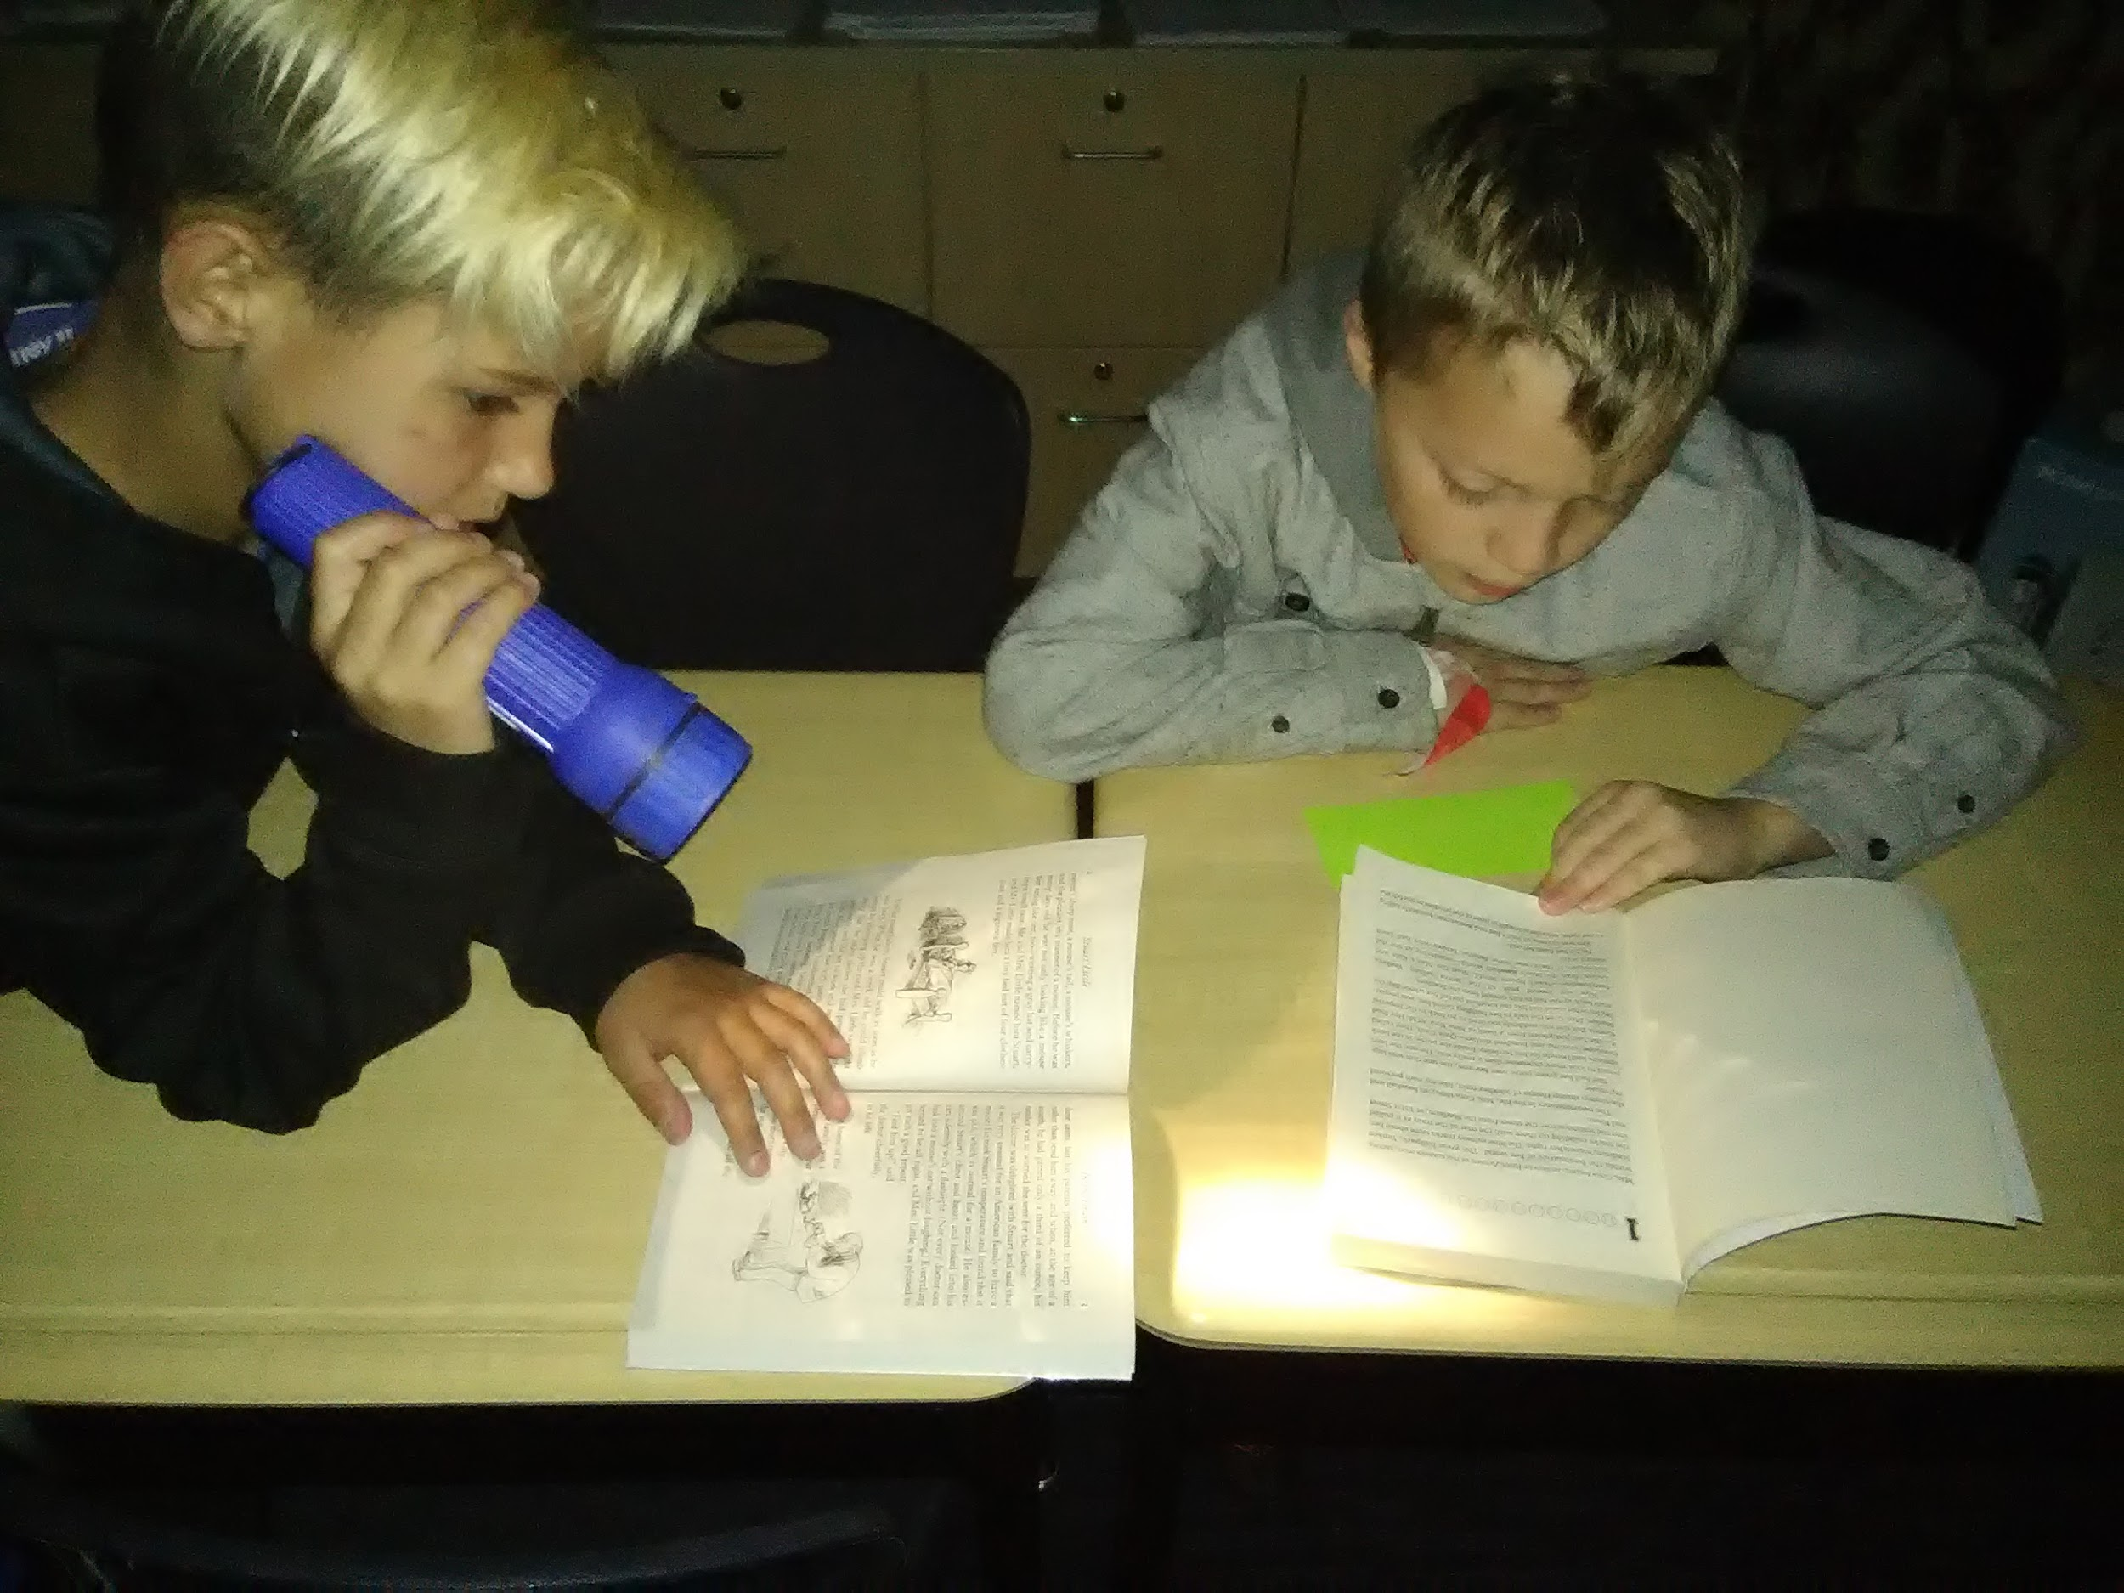
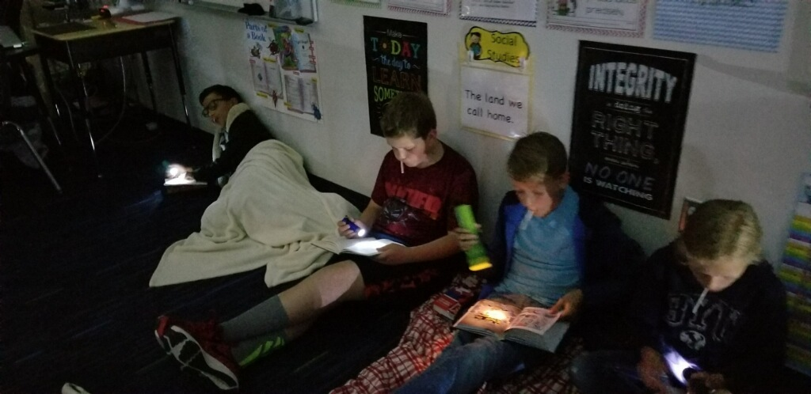
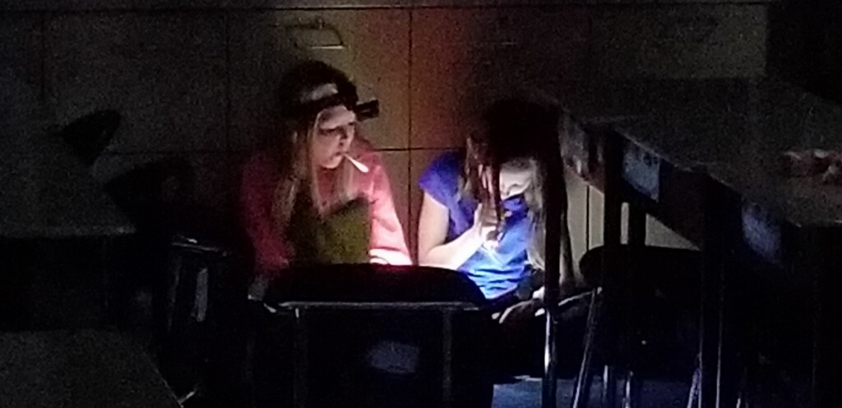
Proximate Rewards-Flashlight Friday
Notes:
Teri

Slide 30
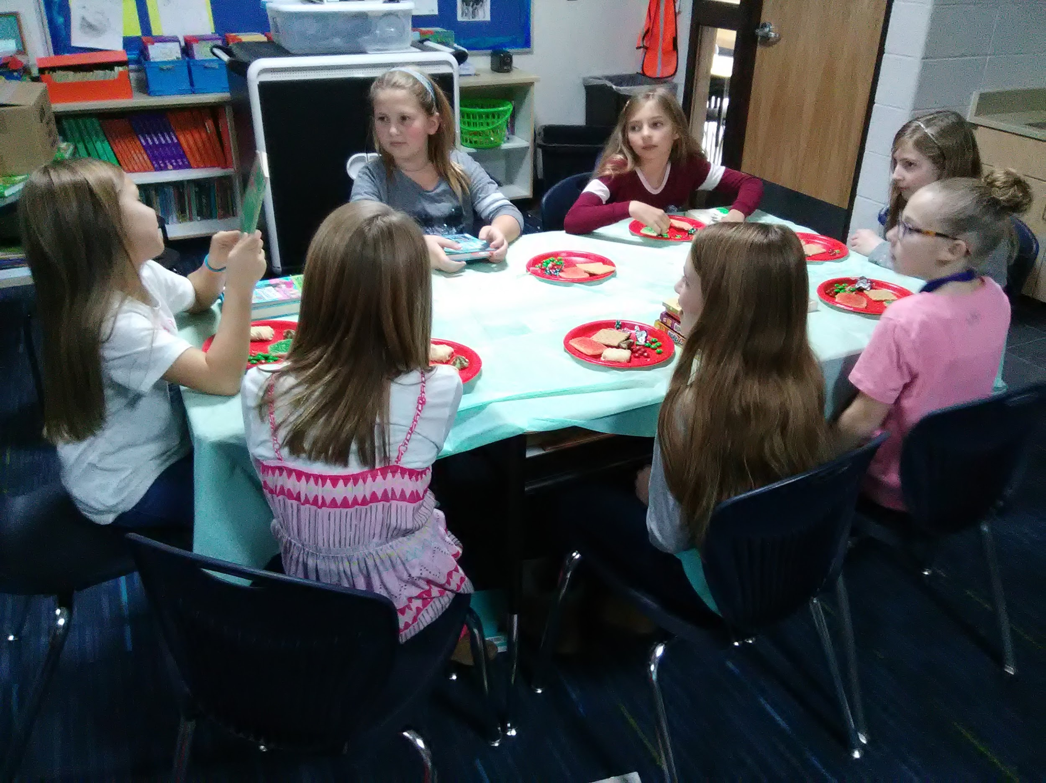
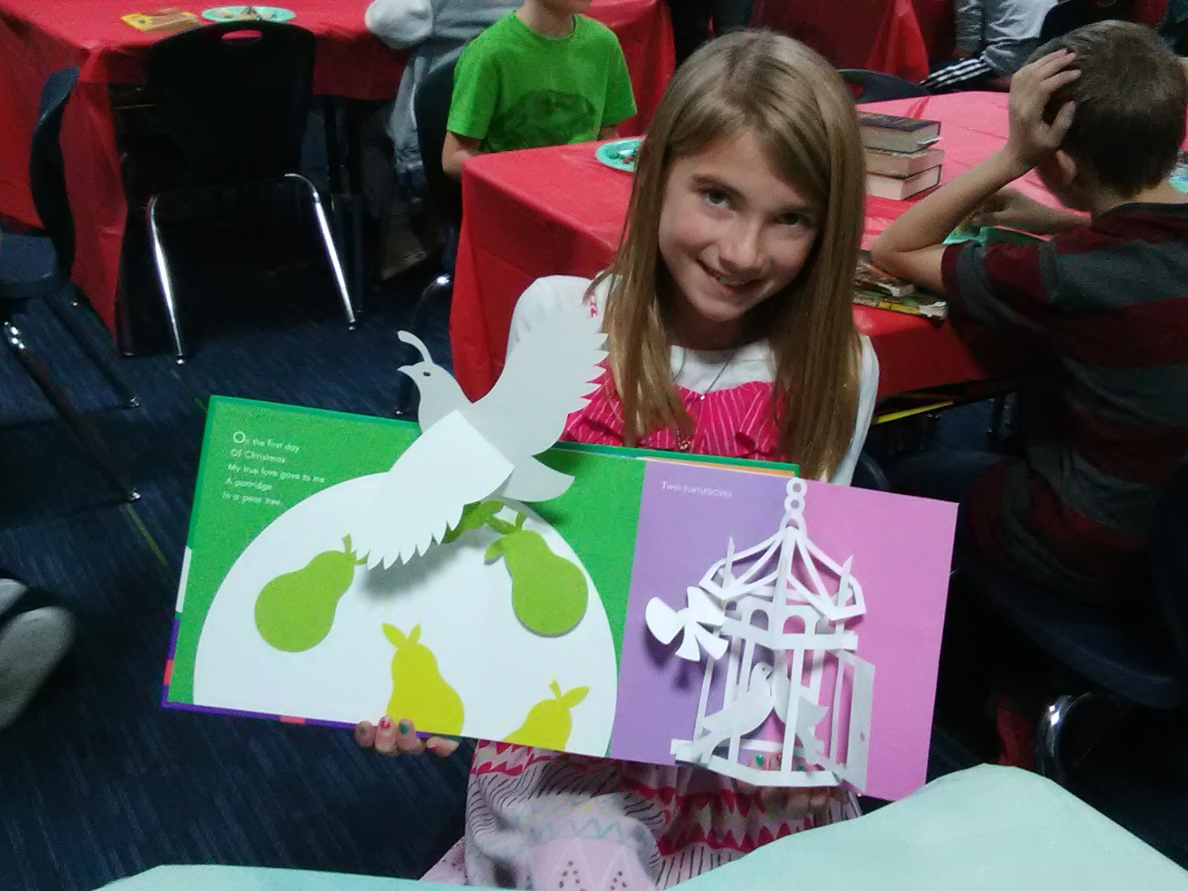
Proximate Rewards--Dining Room Share
Notes:
Gary--Nancie Atwell, Dining Room Table Discussion . . . with treats!

Slide 31
Authenticy

Slide 32


Authenticity-#picturebookfriday
Notes:
Teri

Slide 33



Authenticity-#picturebookfriday
Notes:
Teri

Slide 34


Authenticity-1st Grade Reading Buddies
Notes:
Teri

Slide 35


Authenticity-Teacher Read Aloud
Notes:
Diane

Slide 36


Authenticity-Teacher Read Aloud
Notes:
Teri

Slide 37

Authenticity-Picture Wall
Notes:
Ashley

Slide 38

Notes:
Perfect!

Slide 39

Springside Elementary School--Saratoga Springs
4th Grade Team:
Diane Wardle
Ashley Howden
Teri Webb
Gary Moser

