Slide 1
martin luther king jr and andrei sakharov
SIMILARITIES AND DIFFERENCES IN THE US AND RUSSIAN CIVIL RIGHTS MOVEMENTS.
MATTHEW JOSEPH
JANUARY 2012
Notes:
There is also a museum in Nizhny Novgorod where he was exiled to, as well as archives at Harvard University in Massachusetts and an Andrei Sakharov Foundation USA.

Slide 2
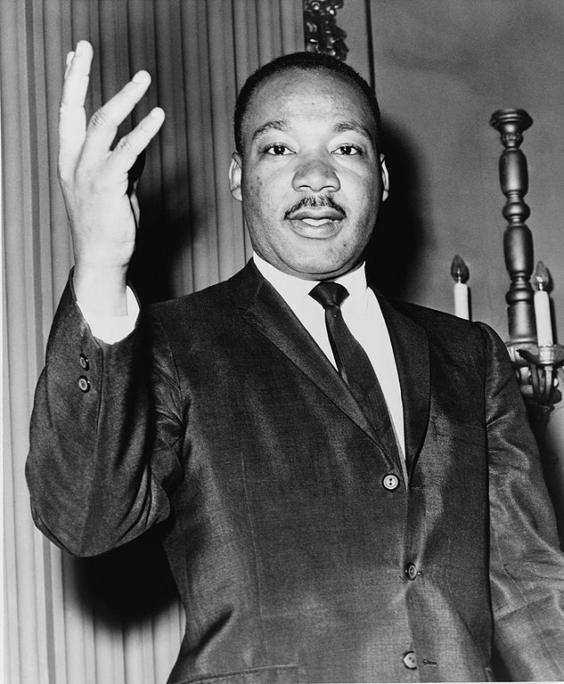
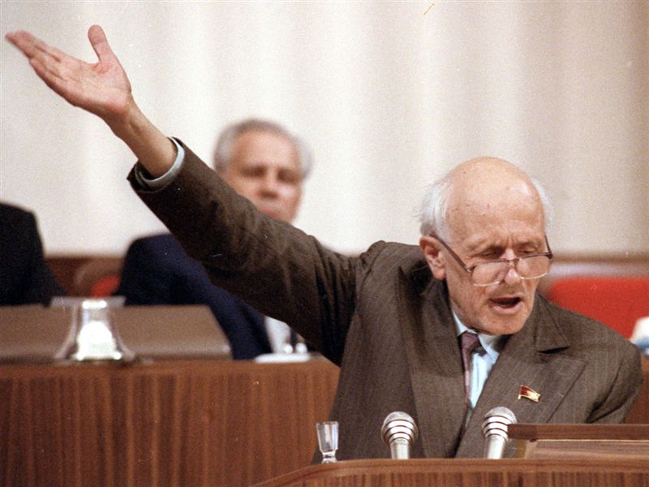

Slide 3
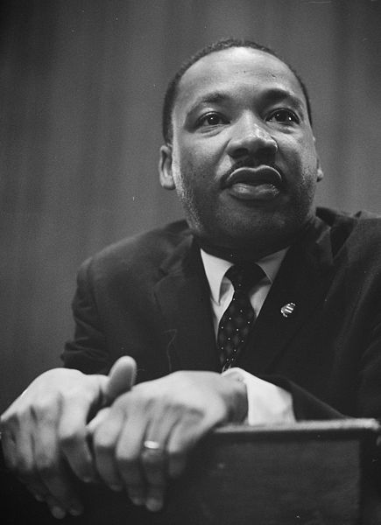
MARTIN LUTHER KING JR.: CIVIL RIGHTS ACTIVIST
One of the most prominent American Civil Rights activists.
Undoubtedly changed the course of history.
Led non-violent demonstrations.
Felt a part of the struggle.

Slide 4
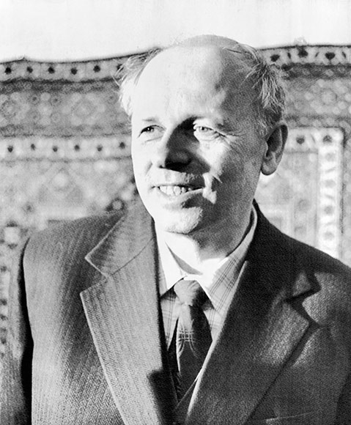
ANDREI SAKHAROV: PHYSICIST AND DISIDENT
Renowned Soviet physicist, father of the Thermo-nuclear bomb.
Prominent figure in Soviet Elite Society
Awards: Hero of Socialist Labor, Stalin, Lenin, Nobel Peace Prize.
Famous quote, “где наша совесть?”
Moscow Helsinki Group, Elena Bonner.
Notes:
1. Comes from a family of physicists. Father wrote the textbook on physics that was used throughout all of the USSR in schools. Worked with team to develop first soviet atomic bomb.
2. had luxurious apartment, large private “Дача”, access to Elite stores and services, private driver.
3. Three time recipient of “Hero of Socialist Labor” award, as well as the “Stalin” and “Lenin” prizes, and later received the “Nobel Peace Prize”.

Slide 5
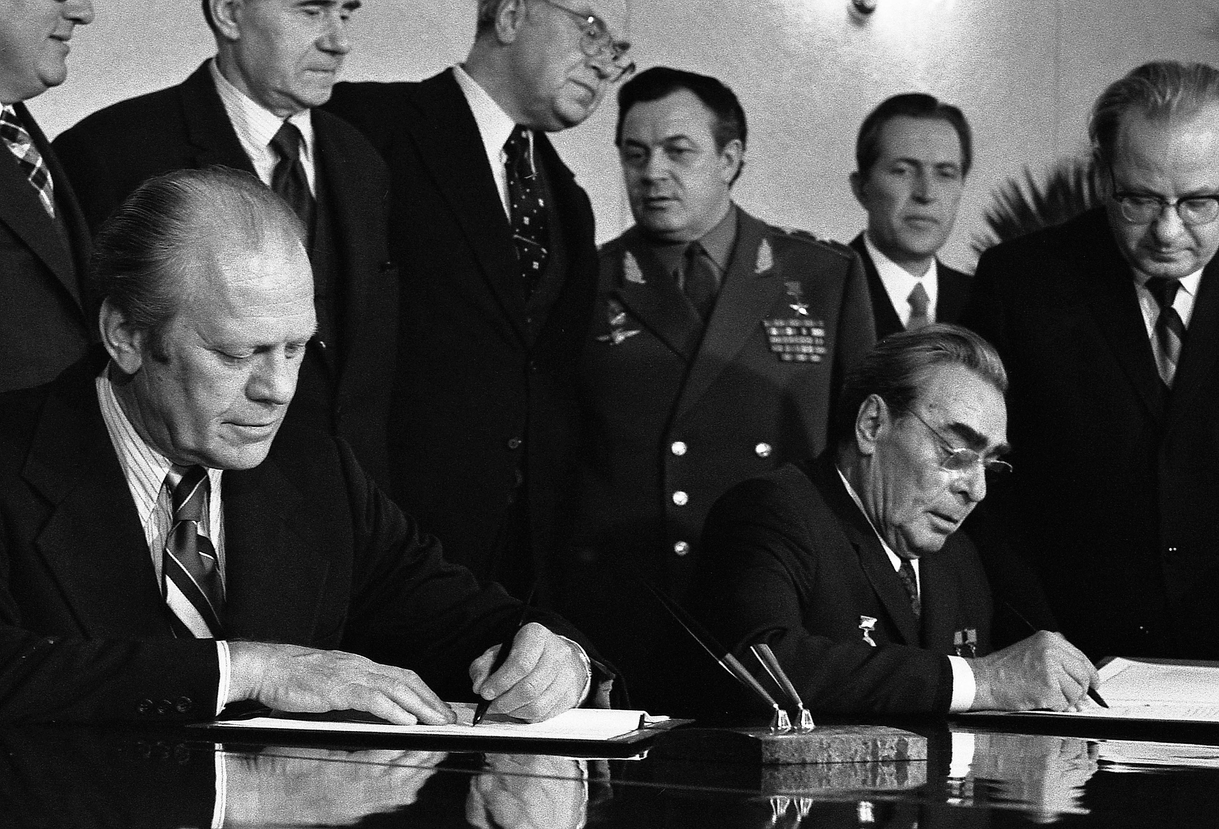
Helsinki Accords
Signed by 35 states, including the USSR, in 1975.
Article VII: Respect for human rights and fundamental freedoms, including the freedom of thought, conscience, religion or belief.
Possible influence from Civil Rights movement in the US.

Slide 6
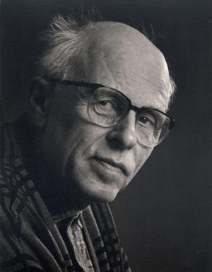
ANDREI SAKHAROV: PHYSICIST AND DISIDENT
Sakharov's motto "Peace, Progress, Human Rights," the title of his Nobel Lecture of 1975.
Forfeit elite status to fight for civil liberties, such as:
Protection from governmental threat
Freedom of movement
Acknowledgement of charges
Letters from Crimean Tartars
Notes:
1. Had access to almost every secret facility, VERY high status, had bodyguards and was protected, not allowed to do things that could danger his life. After successful test of thermo-nuclear warhead, started to campaign for peaceful use of nuclear technology and warned the Soviet leadership of nuclear fall out. Was close friends with Aleksandr Solzhenitsyn, who convinced him to take a more active part in human rights in the Soviet Union. Seemed to have a more prestige among the Soviet leaders, so was not punished as quickly or as severe as others that he was associated with.
1.B - Reading Yale’s book on the KGB documents, in a letter Sakharov talked about how during WWII and after, they were convinced that what they were doing was for the benefit of the people and the mother land. That the people they worked with who were dying from radiation poisoning were justified sacrifices for the advancement of science. However, when he saw the true power of what he had helped to create in the test of the thermo-nuclear warhead, the detonation force of which has still to this day not been matched, he started to see the danger that could come from this power being placed in the wrong hands. The story goes that during the banquet party afterward, Sakharov made a toast to the successful detonation of the device, and hoped that they would never have to use it but that the technology would be used for peaceful means. In response to his toast, the head military authority at the banquet told him that he had done his service to the motherland, and that he did not need to worry about how or when it would be used because this is not his decision, but the motherlands.
2. Strong advocate for the freedom of conscience, and often received requests for assistance from minorities such as the Crimean Tartars, very strong opponent of death penalty.
3. Participant of the Moscow Helsinki Group where he met his wife, Elena Bonner. Group was inaugurated on May 12, 1976 in Sakharov’s apartment, and consisted of many prominent scientists and generals.
4. Exiled to Nizhny Novgorod after publishing article in western media about the dangers of nuclear weapons, “Reflections on Progress, Peaceful Coexistence, and Intellectual Freedom”. While living there, they were constantly under the watch of the KGB, in fact the archives at Harvard consist mostly of documents written by different agents to the central committee. On multiple occassions Elena Bonner complained to the local adminstration for the region as well as letters to the Moscow, demanding that they were being treated in an inhumane way, and that they should be allowed access to a home telephone line and mail box. Often were denied telegrams and letters from own children who had escaped to the US. Sakharov gave an interview in his apartment in Nizhny Novgorod.

Slide 7
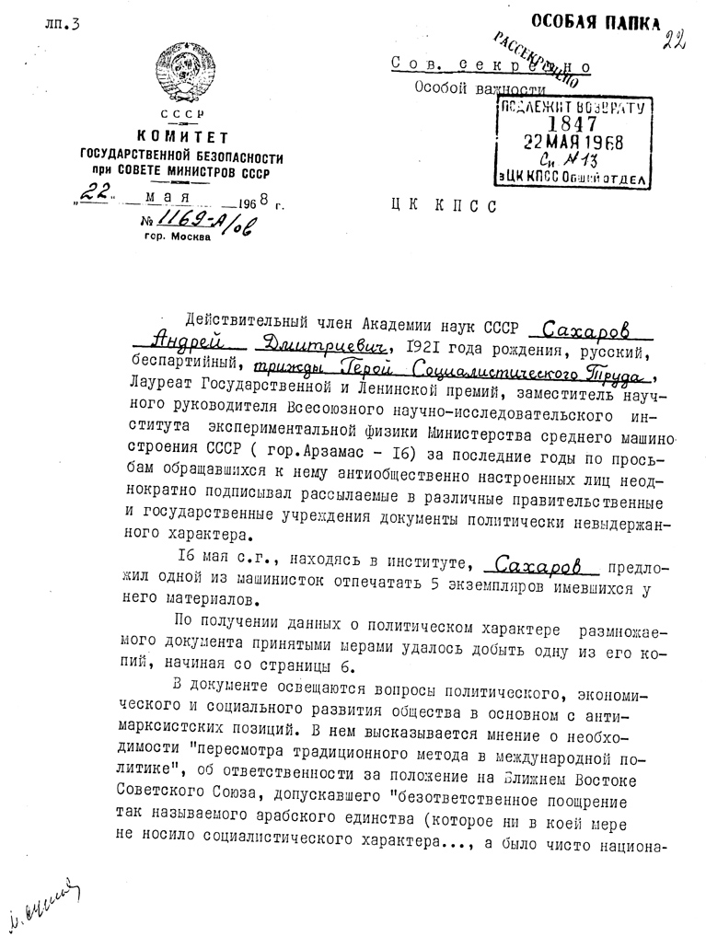
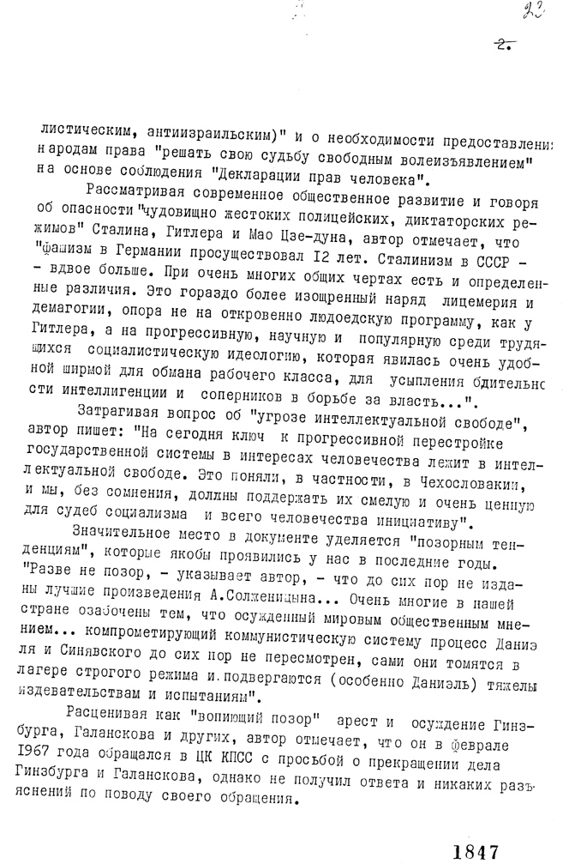
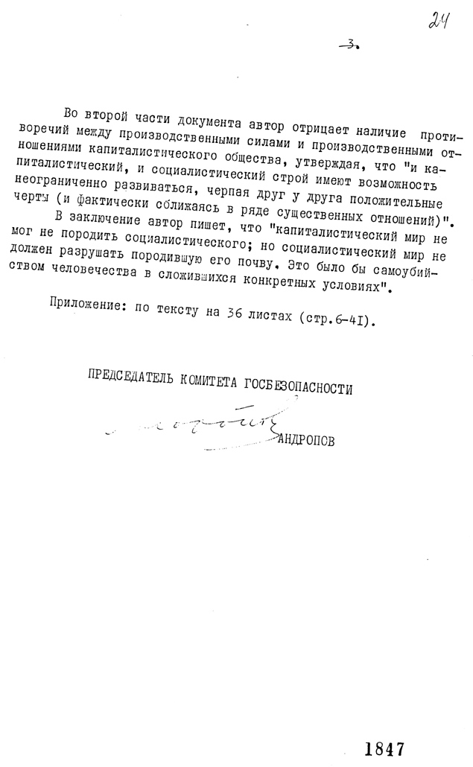
ARCHIVES
Sakharov’s archives contain many documents that still need to be searched for possible influence from Martin Luther King Jr.
Notes:
Pic - http://www.yale.edu/annals/sakharov/documents_frames/Sakharov_001.htm

Slide 8
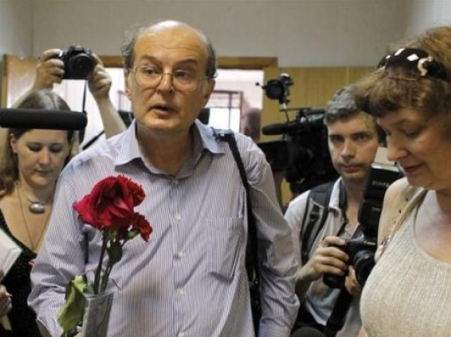
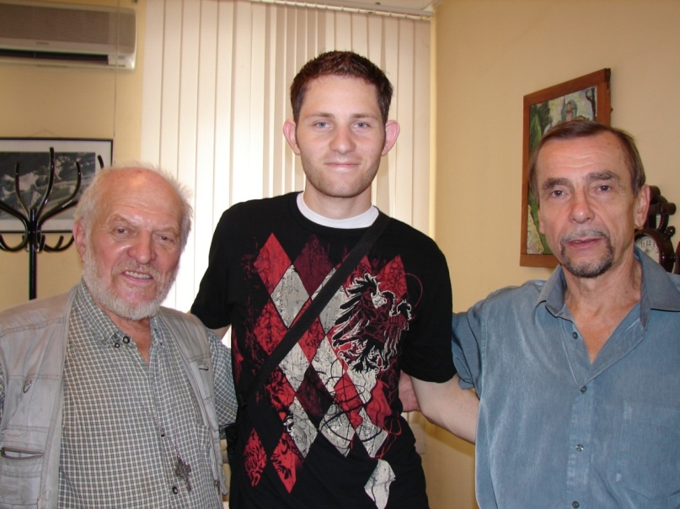
LEADING MODERN RUSSIAN HUMAN RIGHTS ACTIVISTS
Father Gleb Yakunin and Lev Ponomaryov
Bela Koval

