Slide 1
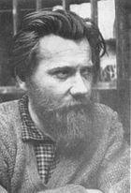
Andrei Sinyavsky and the Human Rights Movement in the Soviet Union
Richard Portwood
January 17, 2011

Slide 2
“Historians now have no difficulty in pinpointing the birth of the modern soviet dissident movement. It began in February 1966 with the trail of Andrei Sinyavsky and Yuli Daniel...little did they realize at the time that they were starting a movement that would help end communist rule.” (95) -Fred Coleman The Decline and Fall of the Soviet Empire: forty years that shook the world, from Stalin to Yeltsin

Slide 3
Writers had a unique ability to mobilize the public in the Soviet Union
Samizdat
Inspired by Pasternak - Doctor Zhivago
Followed by KGB, arrested for publishing his writings abroad under the pseudonym, Abram Tertz
“Public” trial - charged under Article 70 of the Soviet Criminal Code
Not guilty plea enabled Sinyavsk & Daniel to present their own defense

Slide 4
Proceedings of the trial were published - western media followed closely
Sentenced to 7 years of hard labor in the Gulag
Publicity and reaction from the scientific and cultural elite – “more people, more publicity”
Marked the beginning of confrontations between the nascent human-rights movement and Soviet authorities

Slide 5
Moscow, December 10

Slide 11
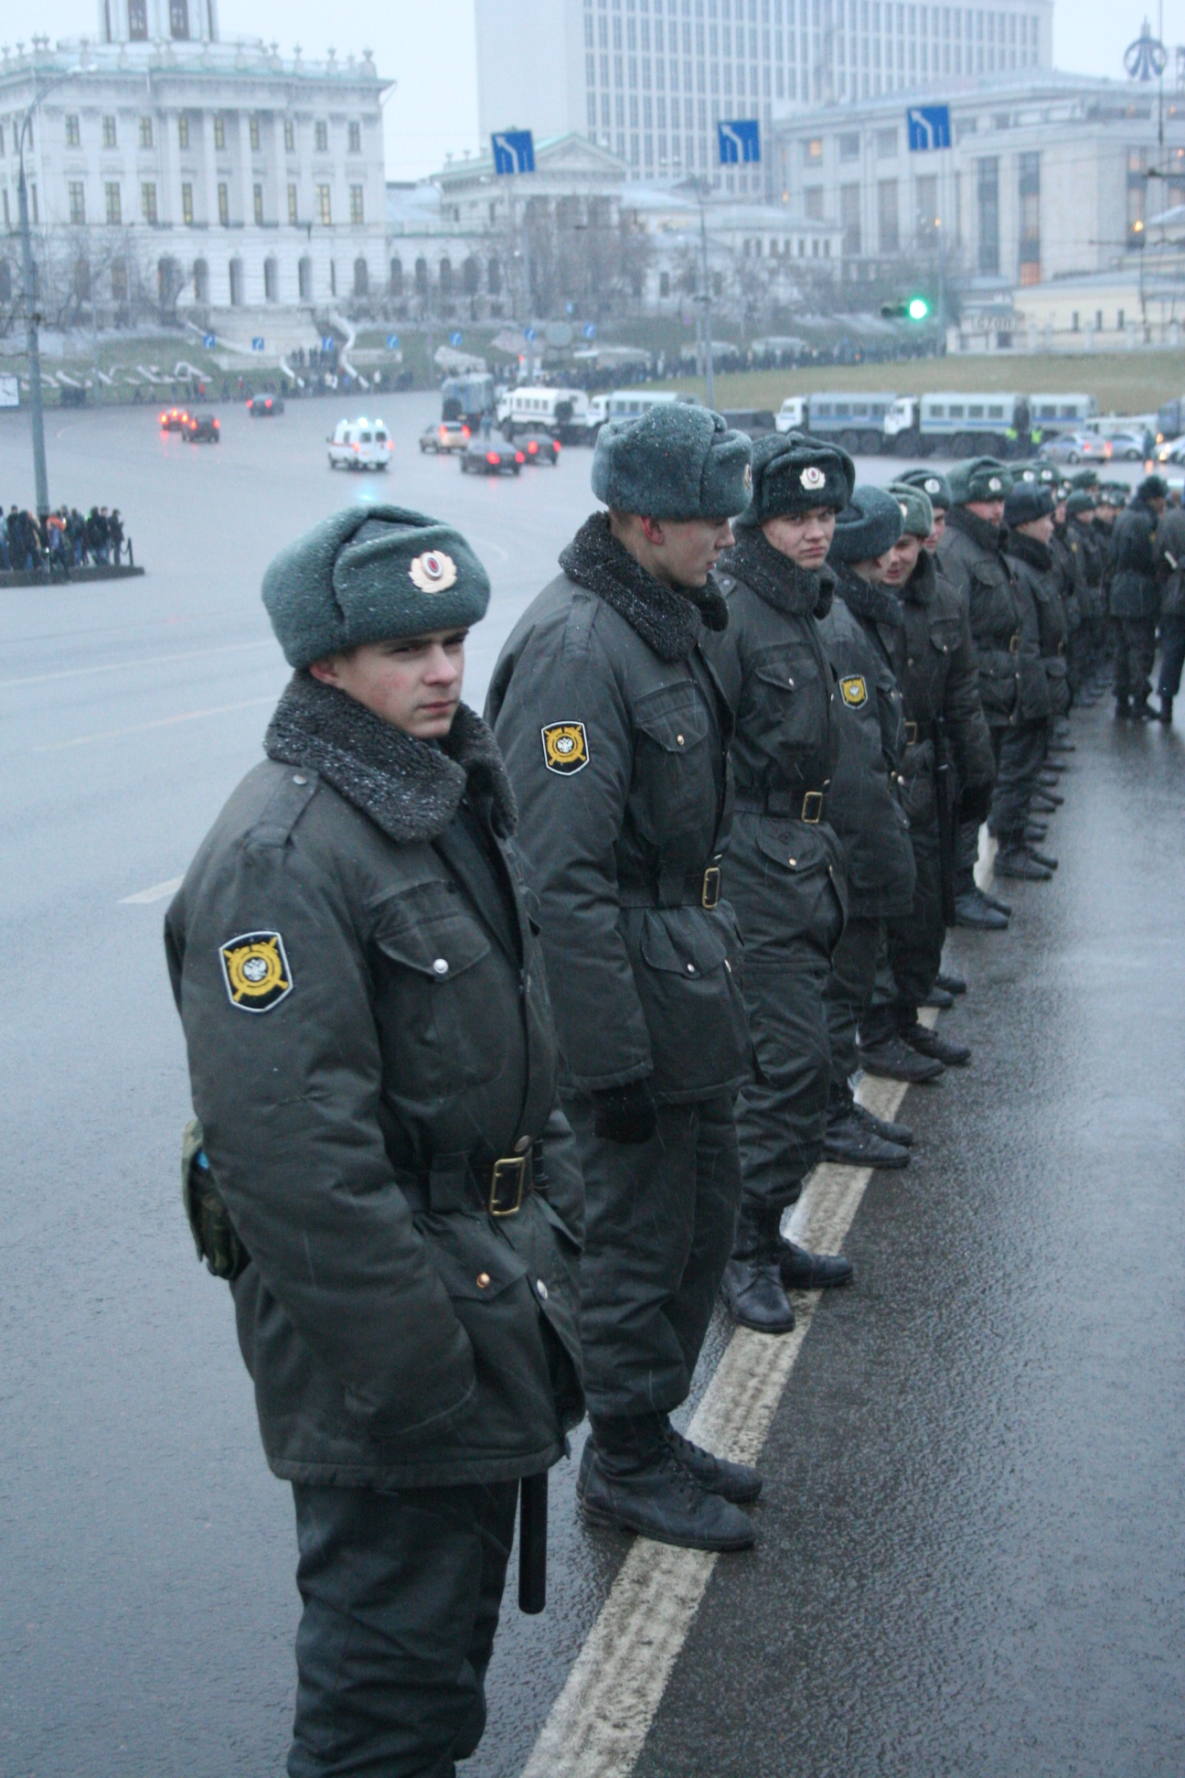

Slide 12
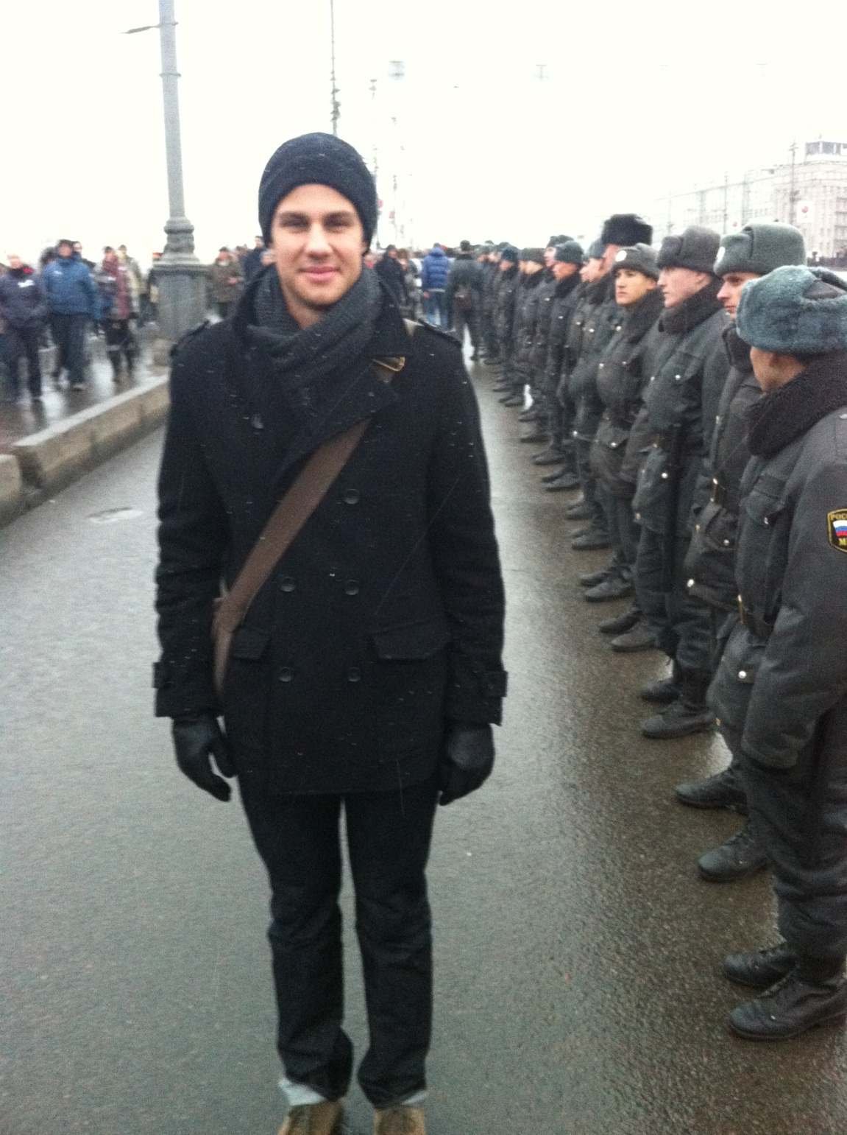
Richard in Moscow

