Slide 1
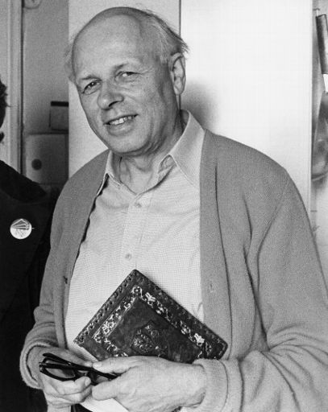
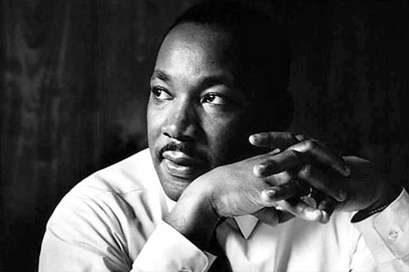
MLK and Andrei Sakharov
“Dr. Martin Luther King possessed a remarkable clarity of vision and purpose. He complemented these attributes with a sound, empathic understanding of the history of human oppression.”

Slide 2
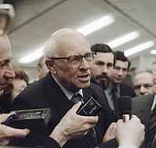
"PEACE, PROGRESS AND HUMAN RIGHTS"
Andrei Dmitrievich Sakharov
May 21, 1921 – December 14, 19
Soviet nuclear physicist, dissident and human rights activist.
Sakharov was an advocate of civil liberties and civil reforms in the Soviet Union. He was awarded the Nobel Peace Prize in 1975.

Slide 3
As a nuclear physicist Andrei Sakharov participated in the Soviet atomic bomb project. Sakharov played a key role in the development of the first megaton-range Soviet hydrogen bomb using a design known as "Sakharov's Third Idea".
From the late 1950s Sakharov had become concerned about the moral and political implications of his work.
In 1968 he wrote an essay, "Reflections on Progress, Peaceful Coexistence, and Intellectual Freedom", where the anti-ballistic missile defense is featured as a major threat of world nuclear war.

Slide 4
Sakharov was banned from all military-related research and returned to study fundamental theoretical physics. In 1970 he, along with others , was one of the founders of the Committee on Human Rights in the USSR and came under increasing pressure from the government.
In 1974 the Soviet media campaign targeted both Andrei Sakharov and others.
Due to his political activism , Andrei Sakharov was internally exiled in 1980 until 1986

Slide 5
He helped to initiate the first independent legal political organizations and became prominent in the Soviet Union's growing political opposition. In March 1989, Sakharov was elected to the new parliament, and co-led the democratic opposition.
Andrei Sakharov Archives and Human Rights Center
The Archive contains thousand of documents pertaining to Sakharov's life and activities, as well as materials on the history of the human rights movement in the USSR.

Slide 6
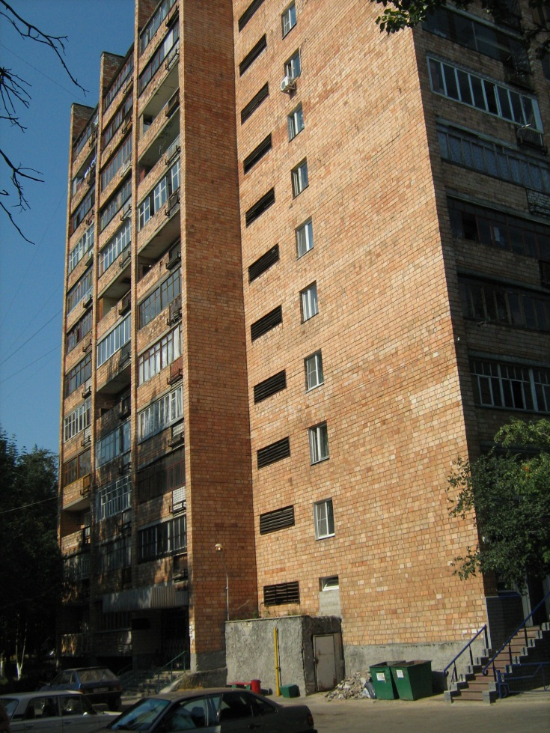
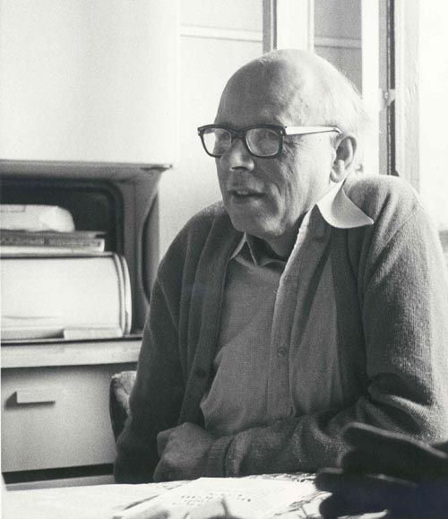
“What connection or influence did Martin Luther King Jr. have on the human rights activities in the former Soviet Union?”
I will be interning at with Andrei Sakharov Foundation in Moscow and at the museum of Sakharov in Nizhniy Novgorod.
I will conduct research on mutual influences and connections between civil rights movements in the U.S. and human rights activities in the former U.S.S.R.

Slide 7

Shane Davis
Shane Davis is a Full time student at UVU with a 3.4 GPA majoring in Peace and Justice studies and Accounting.
He also works full time as middle management for Teleperformance USA.
Shane Spent two years in Ukraine as a missionary for the Church of Jesus Christ of latter day Saints, where he learned to speak Russian.
He currently is the Academic Chairman for the Rho-Phi Chapter of the Kappa Sigma Fraternity.

Slide 8
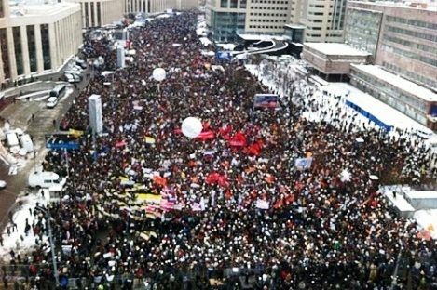
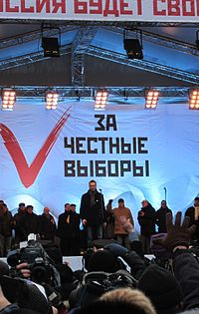
With this new movement promoting free, honest, and open elections in Russia, this subject is crucial to understanding it’s beginnings with Andrei Sakharov and others in the former USSR.

Slide 9
The second basic thesis is that intellectual freedom is essential to human society — freedom to obtain and distribute information, freedom for open-minded and unfearing debate and freedom from pressure by officialdom and prejudices. Such a trinity of freedom of thought is the only guarantee against an infection of people by mass myths, which, in the hands of treacherous hypocrites and demagogues, can be transformed into bloody dictatorship. Freedom of thought is the only guarantee of the feasibility of a scientific democratic approach to politics, economics and culture.“
- Andrei Sakharov

